Slide 1
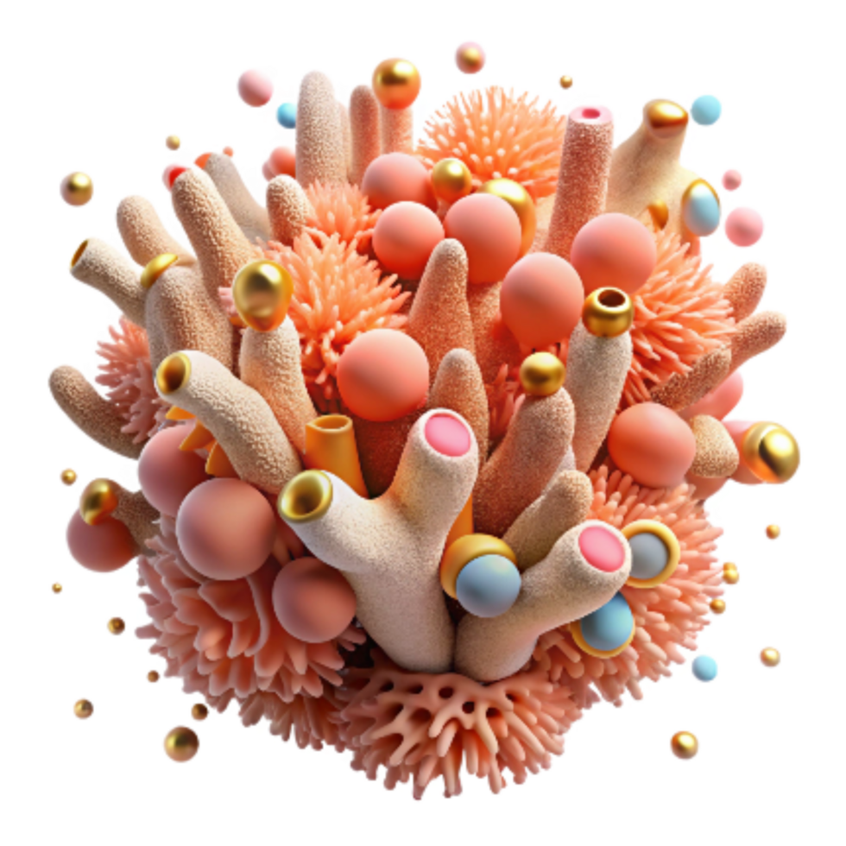
The Vibrant World of Coral Reef Animals
- Coral reefs occupy less than 0.1% of the ocean floor but host over 25% of all marine life.
- This incredible concentration of species is often referred to as the 'rainforests of the sea'.
- Reefs are found primarily in warm, shallow, clear tropical waters where sunlight can penetrate.

Slide 2
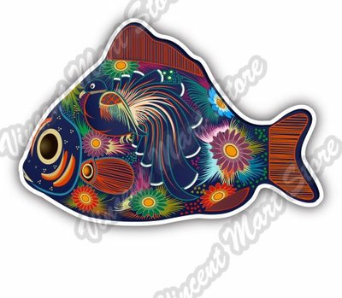
Reef Fish Diversity: Masters of Camouflage
- Fish constitute the largest group of vertebrates found on coral reefs, exhibiting extreme specialization.
- Parrotfish are vital herbivores, using fused beak-like teeth to scrape algae off corals, producing sand as a byproduct.
- Clownfish demonstrate mutualistic symbiosis by living unharmed within the stinging tentacles of sea anemones, providing the anemone with cleaning and ventilation.

Slide 3
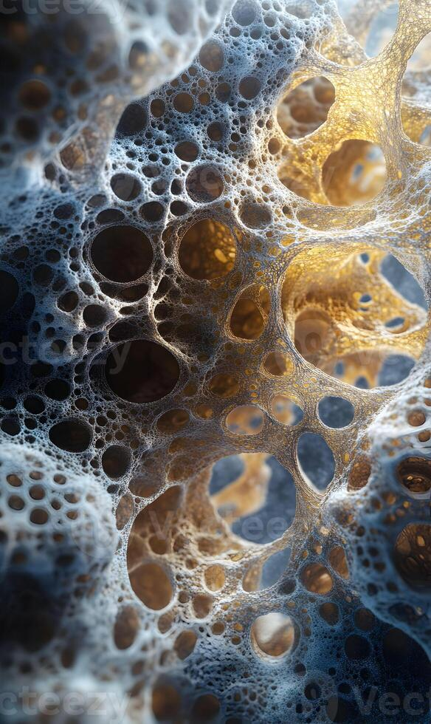
Cnidarians: The Architects of the Reef
- Corals themselves are animals—tiny polyps related to jellyfish and anemones, classified in the phylum Cnidaria.
- Hard, or stony, corals secrete calcium carbonate skeletons, which accumulate over time to build the massive reef structure.
- Coral polyps rely heavily on symbiotic algae called zooxanthellae for energy (photosynthesis), which also gives them their vibrant color.

Slide 4
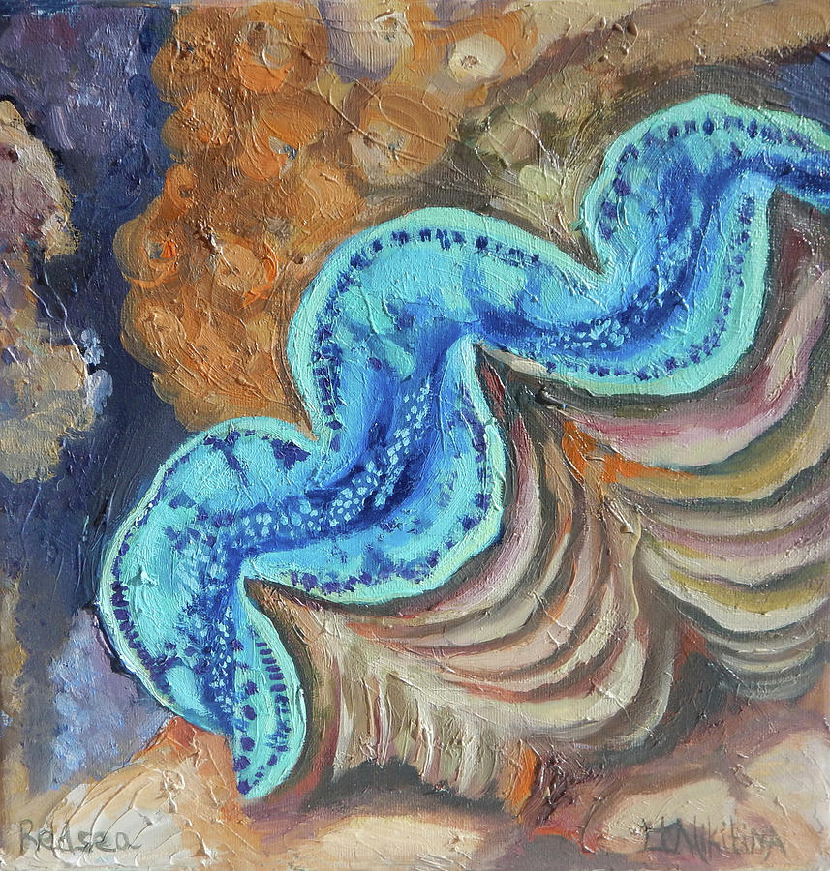
Mollusks and Echinoderms
- Mollusks, such as Giant Clams (Tridacna gigas), are the largest bivalves and act as crucial filter feeders within the ecosystem.
- Nudibranchs (sea slugs) are shell-less gastropods known for their bright, warning coloration (aposematism) and complex defense mechanisms.
- Echinoderms, including sea stars and sea cucumbers, play important roles; for example, some sea stars, like the Crown-of-Thorns, are natural coral predators when populations boom.

Slide 5

Crustaceans: The Clean-up Crew and Symbiotes
- Cleaner shrimp and certain crabs engage in cleaning symbiosis, removing parasites and dead tissue from fish and larger invertebrates.
- Mantis shrimp possess one of the fastest and most powerful strikes in the animal kingdom, used to smash mollusk shells or spear prey.
- Burrowing crustaceans, like pistol shrimp, create shelter by digging into the sand and rubble, often sharing burrows with gobies for protection.

Slide 6

Threats and the Need for Conservation
- Coral reef animals face existential threats from ocean acidification, which makes it harder for organisms to build their calcium carbonate skeletons.
- Rising sea temperatures cause coral bleaching, expelling the vital zooxanthellae and leading to mass die-offs.
- Conservation efforts, including establishing Marine Protected Areas (MPAs) and reducing global carbon emissions, are critical to preserving this biodiversity hotspot.

