Slide 1
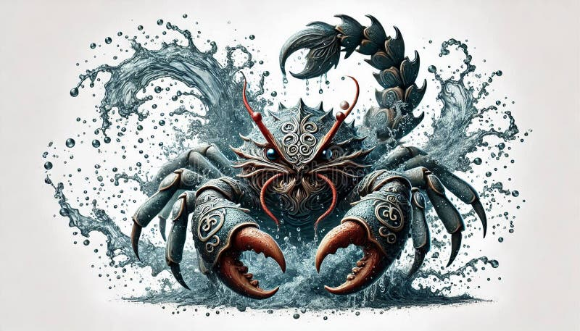
Introduction to Crabzilla
- Crabzilla is a mythical giant crab said to inhabit the ocean depths.
- It is often depicted as a massive creature, much larger than any known crab species.
- This presentation explores the lore, characteristics, and cultural significance of Crabzilla.

Slide 2
Mythical Origins
- The legend of Crabzilla originates from various coastal folklore.
- Many cultures have tales of giant sea creatures, with Crabzilla being one of the most famous.
- These stories often serve as cautionary tales about the dangers of the sea.

Slide 3

Physical Characteristics
- Crabzilla is described as having enormous claws capable of crushing ships.
- Its shell is said to be armored and covered in barnacles and seaweed.
- The creature's size is often exaggerated, with some tales claiming it can reach lengths of over 50 feet.

Slide 4
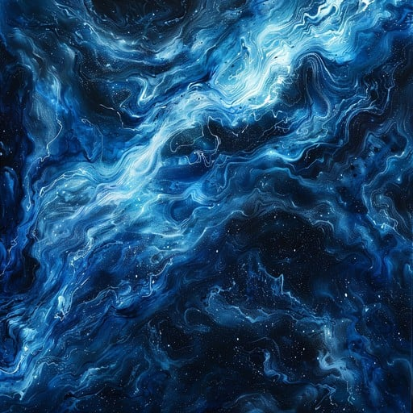
Habitat and Behavior
- Crabzilla is believed to dwell in the deep ocean, often near coral reefs.
- It is depicted as a solitary predator, hunting smaller marine animals.
- Some stories suggest it can create whirlpools to trap prey.

Slide 5

Cultural Impact
- Crabzilla has inspired various forms of media, including films and books.
- It is often featured in horror and adventure genres, symbolizing the unknown dangers of the sea.
- Artists have created numerous interpretations of Crabzilla, showcasing its mythical nature.

Slide 6

Conclusion
- Crabzilla remains a fascinating subject in marine mythology.
- Its legend highlights humanity's fear and fascination with the ocean's depths.
- As ocean exploration continues, the line between myth and reality may blur.

