Slide 1
Introduction
- The Eye of Cthulhu is one of the first bosses in Terraria.
- Understanding its mechanics is crucial for a successful fight.
- This presentation covers equipment, arena style, and attack dodging strategies.

Slide 2

Recommended Equipment
- Use a full set of Silver Armor for balanced defense and offense.
- Equip a strong weapon like the Starfury or the Night's Edge.
- Stock up on healing potions and buff potions like Ironskin and Swiftness.

Slide 3
Arena Setup
- Build an arena using wooden platforms to allow for easy movement.
- Place campfires and heart lanterns for health regeneration.
- Ensure the arena is wide enough to dodge attacks but not too large to lose track of the boss.

Slide 4
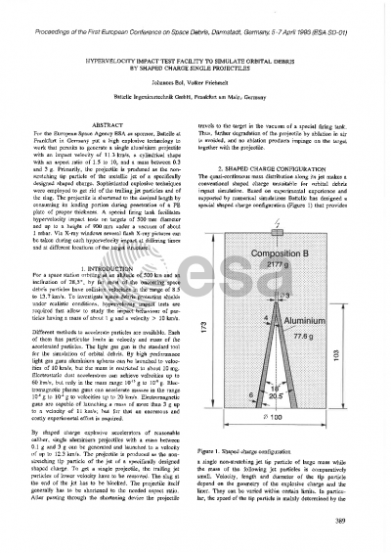
Understanding Attacks
- The Eye of Cthulhu has two phases: the first is more straightforward, while the second is aggressive.
- It will charge at the player and shoot projectiles that can deal significant damage.
- Learn the attack patterns to anticipate movements.

Slide 5

Dodging Strategies
- Always keep moving to avoid projectiles and the charge attack.
- Jump over the Eye when it charges to avoid damage.
- Use the platforms to your advantage, jumping to avoid ground attacks.

Slide 6
Phase Two Strategies
- In phase two, the Eye becomes faster and more aggressive.
- Maintain your distance and focus on dodging while dealing damage.
- Use the terrain to create distance when it charges.

Slide 7
Conclusion
- Be well-prepared with the right equipment and arena.
- Understand the attack patterns and practice dodging.
- With patience and strategy, you can defeat the Eye of Cthulhu!

