Slide 1

Introduction to Minecraft
- Minecraft is a sandbox game that allows players to build and explore virtual worlds.
- The objective is to survive and thrive in this blocky environment.
- This presentation will guide you through the steps to beat Minecraft.

Slide 2
Understanding the Game Mechanics
- Players have health and hunger bars that must be managed.
- Crafting is essential for creating tools, weapons, and shelter.
- Resources are gathered from the environment to aid survival.

Slide 3
Starting Your Journey
- Upon starting, players spawn in a random location.
- The first step is to gather basic resources like wood and stone.
- Craft a crafting table to unlock more crafting options.

Slide 4
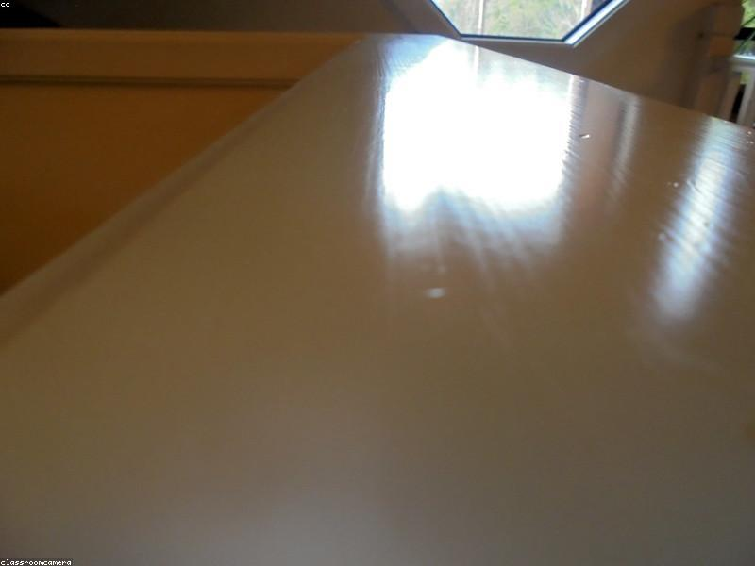
Building Your First Shelter
- Construct a simple shelter to protect against night-time mobs.
- Use gathered resources like wood and dirt to create walls and a roof.
- Ensure there is a light source to prevent hostile mobs from spawning.

Slide 5
Crafting Essential Tools
- Start with wooden tools and upgrade to stone tools for better efficiency.
- Essential tools include pickaxes, axes, and swords.
- Learn crafting recipes to maximize resource usage.

Slide 6
Exploring the World
- Explore different biomes to find unique resources and structures.
- Caves provide valuable ores but also pose dangers.
- Villages can offer trades and shelter.

Slide 7
Mining for Resources
- Digging underground is crucial for finding ores like iron, gold, and diamonds.
- Use the branch mining technique for efficient resource gathering.
- Always carry torches to light up dark areas.

Slide 8
Farming for Sustainability
- Establish a farm for a sustainable food source.
- Grow crops like wheat, carrots, and potatoes.
- Breed animals for meat, leather, and other resources.

Slide 9
The Nether Dimension
- Build a Nether portal to access the Nether dimension.
- Gather resources like Nether wart and blaze rods for potion making.
- Be prepared for hostile mobs like ghasts and blazes.

Slide 10
Enchanting and Potions
- Create an enchanting table to enhance your gear.
- Use experience points to enchant weapons and armor.
- Brew potions for various effects to aid in combat and exploration.

Slide 11
The End Dimension
- Locate and activate the End portal to access the End dimension.
- Prepare for the battle against the Ender Dragon.
- Bring strong gear, potions, and food for the fight.

Slide 12
Defeating the Ender Dragon
- Destroy the Ender Crystals to prevent the dragon from healing.
- Use bows and arrows or melee attacks to defeat the dragon.
- Collect the dragon egg as a trophy after the victory.

Slide 13

Post-Game Activities
- After defeating the Ender Dragon, players can continue to explore.
- Build elaborate structures and engage in creative projects.
- Join multiplayer servers for additional challenges and experiences.

Slide 14
Tips and Tricks
- Always carry a bed to set spawn points.
- Use shields to block attacks from mobs.
- Keep inventory organized for quick access to items.

Slide 15
Conclusion
- Beating Minecraft is just the beginning of endless possibilities.
- Use the skills learned to explore, create, and enjoy the game.
- Remember, the journey is as important as the destination.

