Slide 1
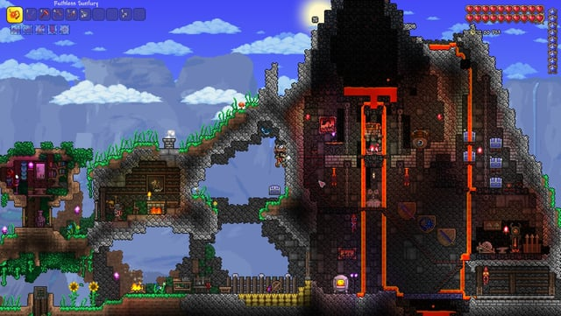
Introduction to Terraria
- Terraria is a sandbox adventure game...
- Players explore, build, and fight...
- The goal is to defeat bosses and progress through the game.

Slide 2

Starting Your Adventure
- Create your character and choose a world...
- Gather basic resources like wood and stone...
- Build a shelter to survive the first night.

Slide 3
Early Game Essentials
- Craft basic tools and weapons...
- Explore caves for ores and treasures...
- Set up a base with NPCs for trading.

Slide 4
Defeating the Eye of Cthulhu
- Prepare by crafting better weapons and armor...
- Summon the Eye at night using a Suspicious Looking Eye...
- Focus on dodging its attacks while dealing damage.

Slide 5

Progressing to Hardmode
- Defeat the Wall of Flesh to enter Hardmode...
- New enemies and biomes will appear...
- Upgrade your gear using Hardmode ores.

Slide 6
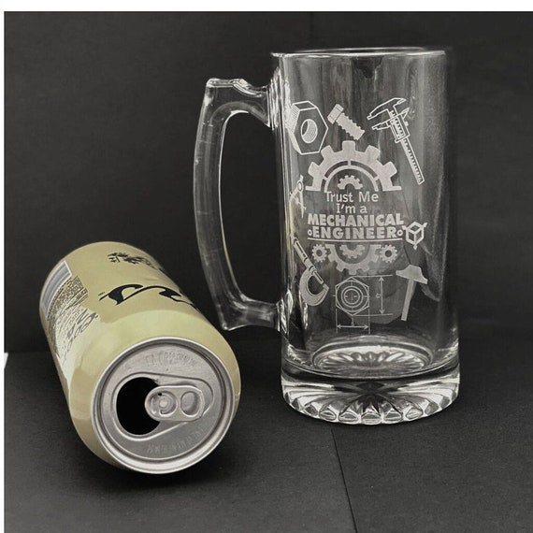
Defeating the Mechanical Bosses
- Summon and defeat the three Mechanical Bosses...
- Focus on crafting stronger weapons and potions...
- Use arena setups for easier fights.

Slide 7
Exploring the Underworld
- Venture into the Underworld for Hellstone...
- Craft powerful items and weapons...
- Prepare for the final bosses.

Slide 8
The Plantera Fight
- Locate and defeat Plantera in the Jungle...
- Use the right gear and potions for the fight...
- Plan your strategy to avoid its attacks.

Slide 9
The Golem and Cultists
- Defeat the Golem in the Lihzahrd Temple...
- Prepare for the Lunatic Cultist fight...
- Collect powerful items from these bosses.

Slide 10
The Moon Lord Encounter
- Summon the Moon Lord after defeating the Cultists...
- Use the best gear and potions available...
- Focus on dodging and attacking its eyes.

Slide 11
Post-Moon Lord Content
- Explore new biomes and defeat post-Moon Lord bosses...
- Craft the best gear and items...
- Enjoy the sandbox elements of the game.

Slide 12
Tips and Tricks
- Always be prepared with potions and gear...
- Explore and experiment with building...
- Join multiplayer for a more fun experience.

Slide 13
Conclusion
- Beating Terraria is about exploration and creativity...
- Enjoy the journey and the challenges...
- Keep playing to discover new content and updates.

