Slide 1
Introduction to Geometry Dash Level Creation
- Geometry Dash is a rhythm-based platformer game.
- Players can create their own levels using various tools.
- This presentation will guide you on making levels inspired by Israel Circles.

Slide 2

Understanding the Basics
- Familiarize yourself with the Geometry Dash level editor.
- Learn about the different game mechanics and objects available.
- Practice using the editor to get comfortable with controls.

Slide 3
Planning Your Level
- Start by sketching your level layout on paper.
- Decide on the theme and style of your level.
- Consider the difficulty and pacing of your level.

Slide 4

Choosing the Right Music
- Select a song that fits the mood of your level.
- Ensure the song has a clear rhythm to match gameplay.
- Use the music to enhance the player's experience.

Slide 5
Creating the First Section
- Begin designing the first section of your level.
- Introduce basic obstacles to familiarize players.
- Keep the design simple to ease players into the level.

Slide 6
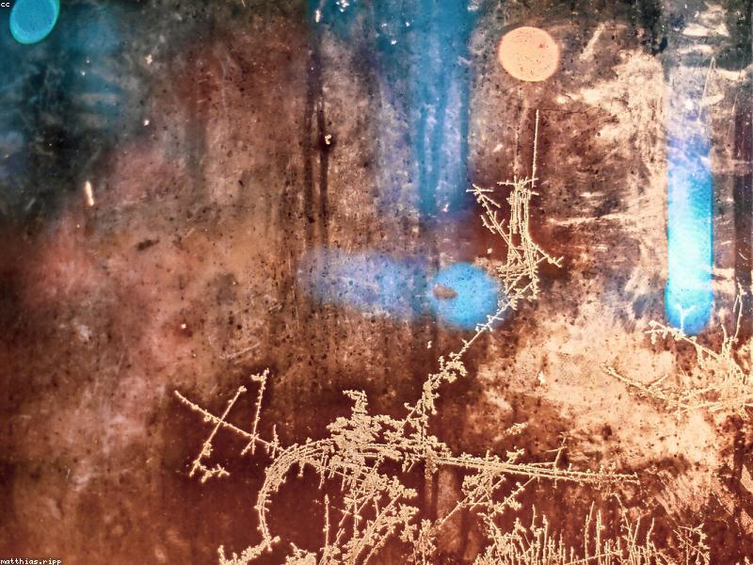
Adding Visual Elements
- Use background decorations to enhance visual appeal.
- Choose colors that match the theme of your level.
- Experiment with different visual styles to find what works.

Slide 7

Incorporating Unique Obstacles
- Introduce unique obstacles inspired by Israel Circles.
- Use moving platforms, spikes, and other creative elements.
- Ensure obstacles are challenging but fair for players.

Slide 8
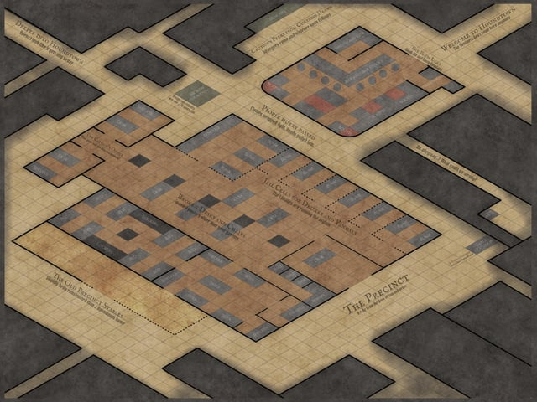
Testing Your Level
- Playtest your level multiple times to identify issues.
- Ask friends for feedback on difficulty and design.
- Make adjustments based on testing results.

Slide 9
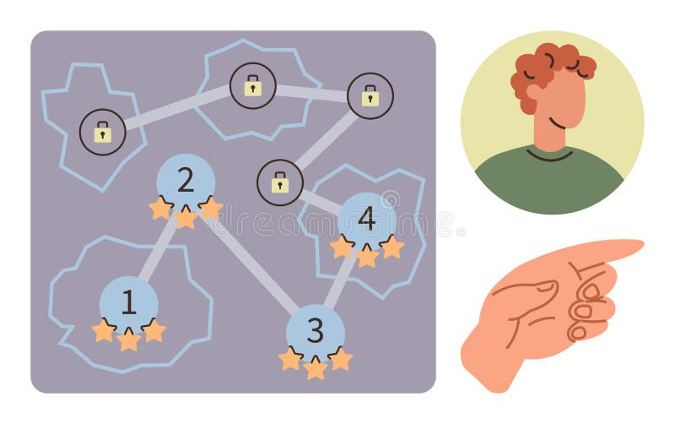
Adding Checkpoints
- Incorporate checkpoints to make the level more forgiving.
- Place checkpoints at strategic points in the level.
- Ensure players can easily reach them during gameplay.

Slide 10
Finalizing the Design
- Review your level for any final adjustments.
- Polish visuals and gameplay mechanics for a smooth experience.
- Ensure the level flows well from start to finish.

Slide 11
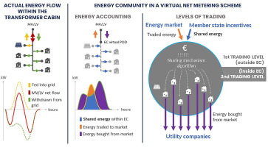
Sharing Your Level
- Publish your level for others to play and enjoy.
- Share your level on social media and Geometry Dash forums.
- Engage with the community for feedback and improvement.

Slide 12
Learning from Others
- Play levels created by others for inspiration.
- Analyze what makes their levels enjoyable or challenging.
- Incorporate successful elements into your own designs.

Slide 13
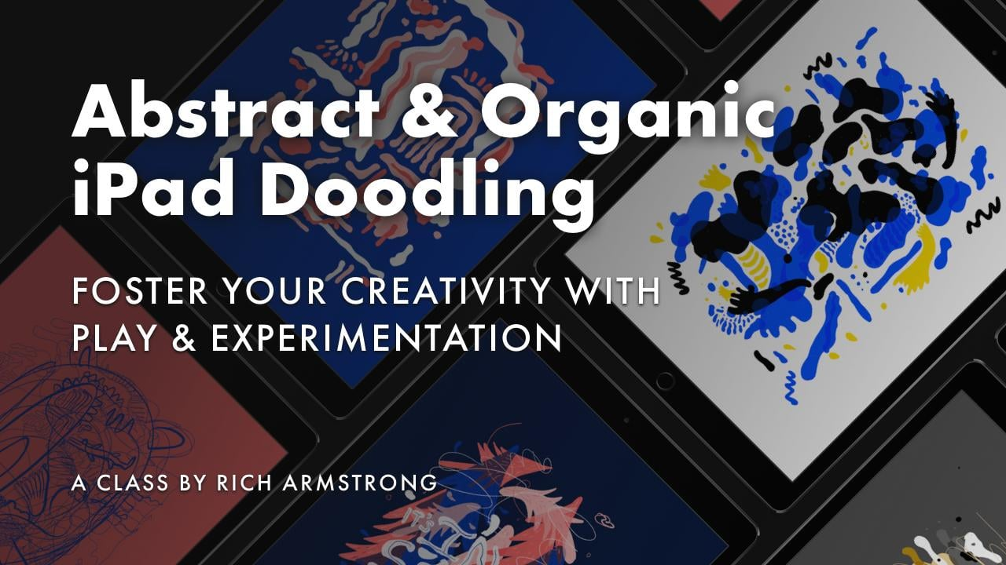
Experimenting with Styles
- Don't be afraid to experiment with different styles.
- Try combining elements from various levels you admire.
- Develop your unique style as a level creator.

Slide 14

Keeping Up with Updates
- Stay informed about updates to Geometry Dash.
- New features can enhance your level creation process.
- Adapt your levels to utilize new game mechanics.

Slide 15
Engaging with the Community
- Join forums and groups dedicated to Geometry Dash.
- Share your experiences and learn from other creators.
- Collaborate with others to improve your skills.

Slide 16
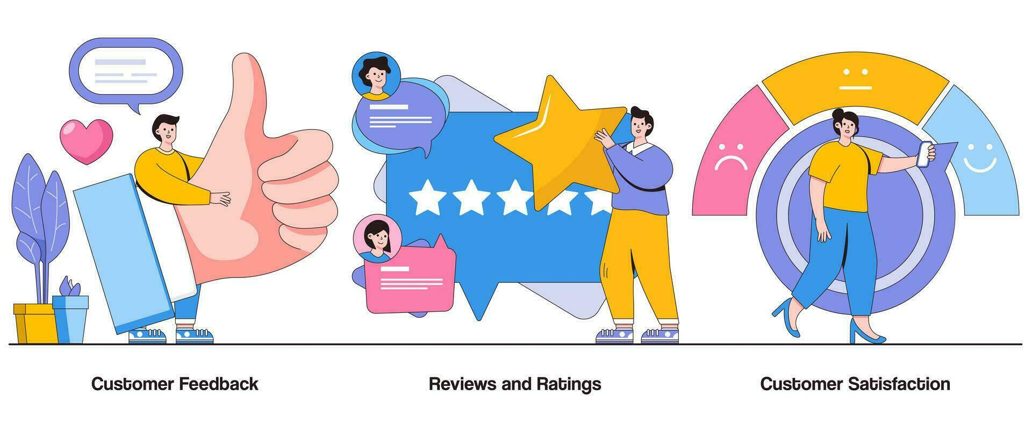
Analyzing Player Feedback
- Pay attention to player feedback on your levels.
- Use constructive criticism to improve future designs.
- Adapt your levels based on player experiences.

Slide 17
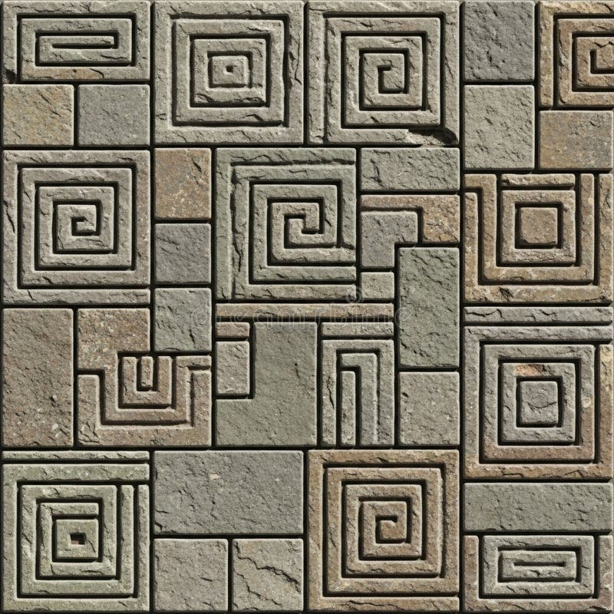
Creating a Series of Levels
- Consider creating a series of levels with a common theme.
- Develop a storyline or progression through your levels.
- Keep players engaged with consistent quality and design.

Slide 18

Staying Motivated
- Keep your passion for level creation alive.
- Set goals for yourself to stay motivated.
- Celebrate your achievements and progress.

Slide 19

Resources for Level Creation
- Utilize online tutorials and resources for tips.
- Join communities that focus on level creation.
- Share your knowledge and learn from others.

Slide 20
Conclusion
- Creating Geometry Dash levels can be a rewarding experience.
- With practice and creativity, you can develop unique levels.
- Enjoy the process and have fun sharing your creations!

