Slide 1
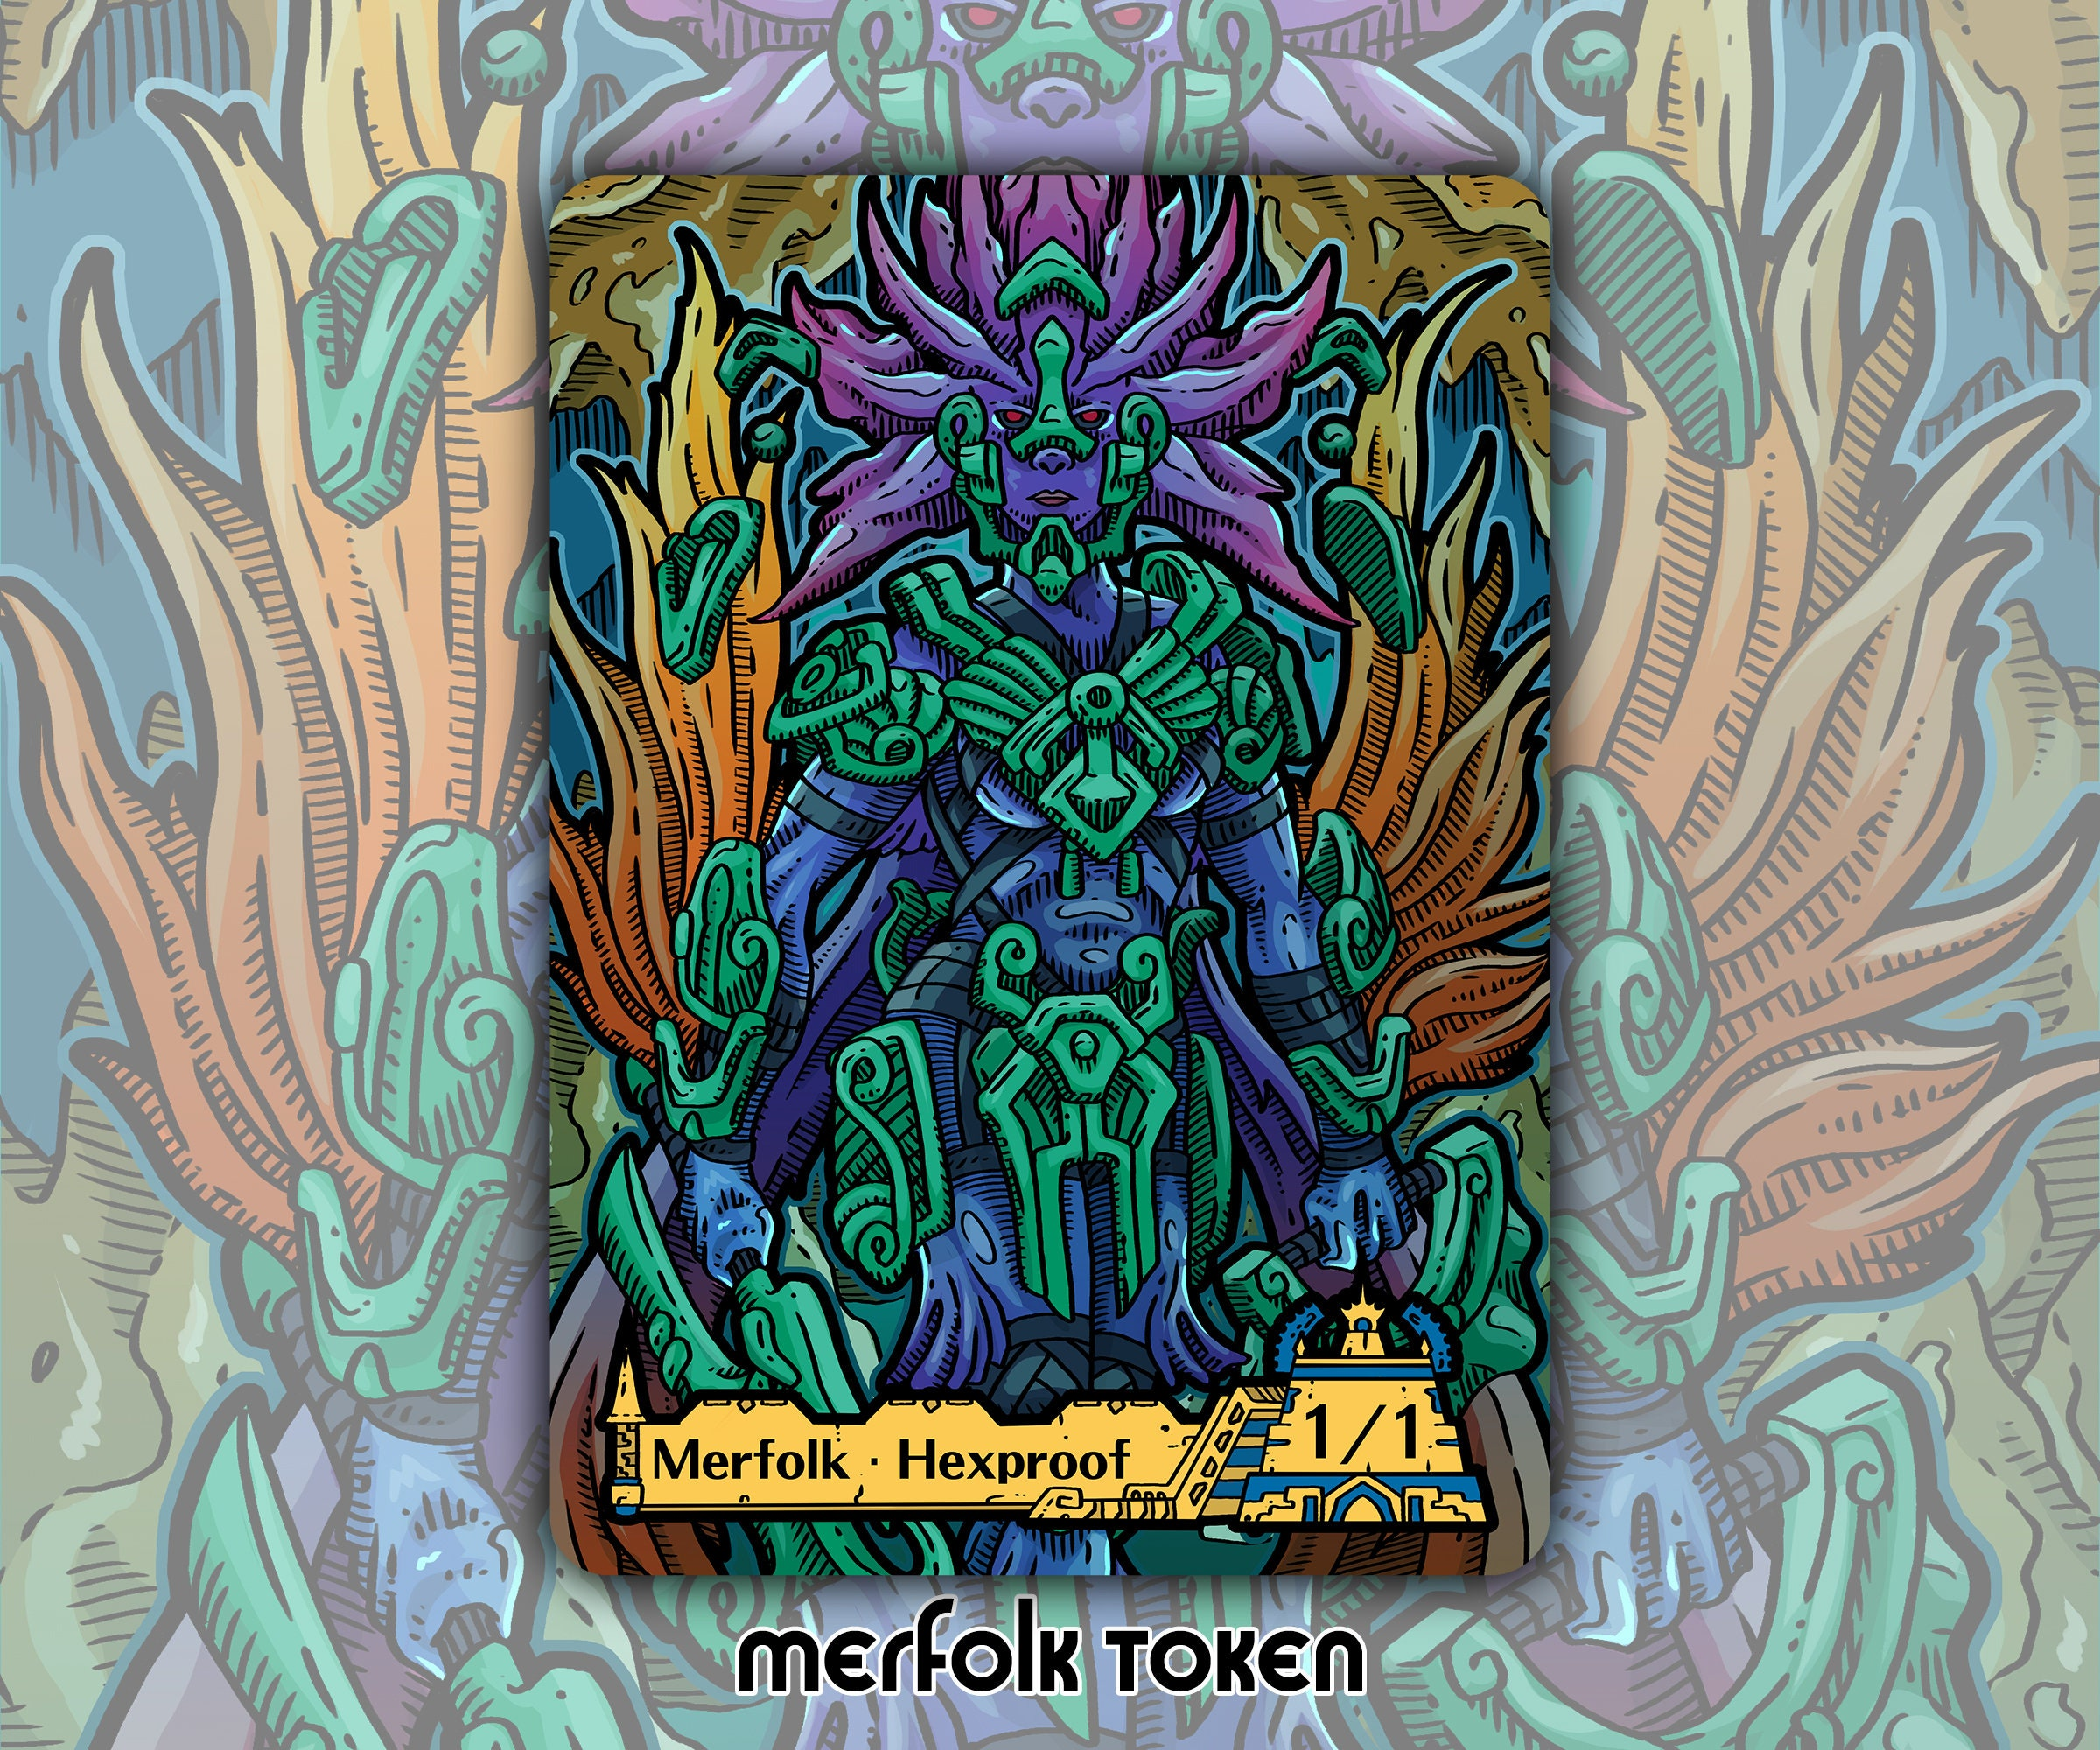
Introduction
- The Moonlord is the final boss in Terraria, requiring optimal gear to defeat.
- This presentation covers the best gear needed to conquer this challenge.
- We will discuss accessories, class, armor, weapons, mount, and hook.

Slide 2
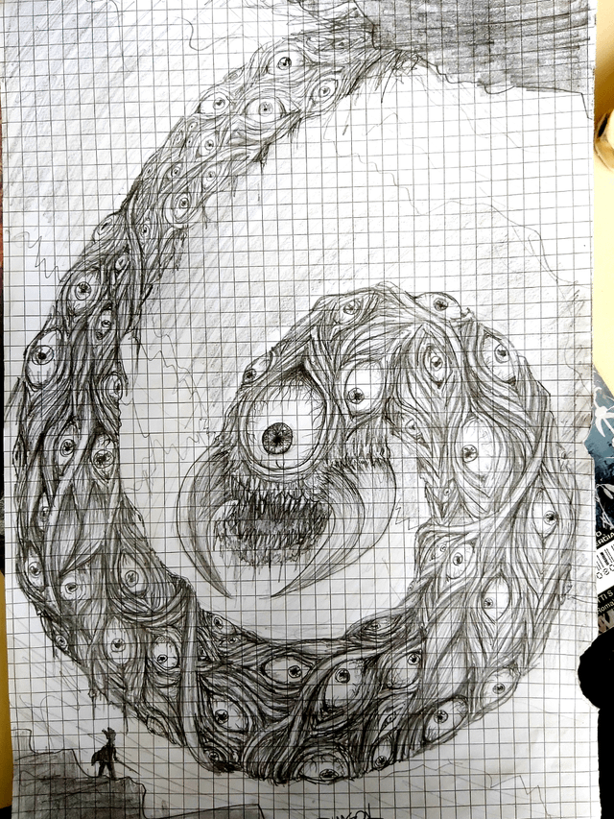
Class Selection
- The best class to defeat the Moonlord is the Ranger class.
- Rangers utilize ranged weapons and can deal high damage from a distance.
- Key strategies involve mobility and avoiding damage while maximizing DPS.

Slide 3
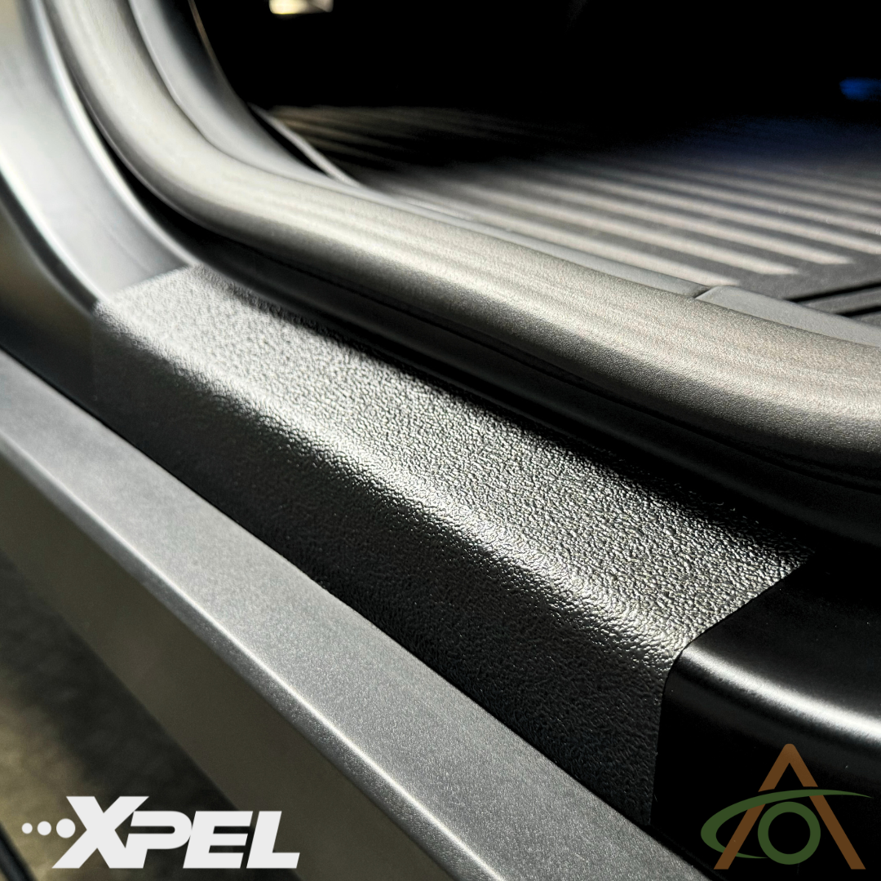
Armor
- The best armor set for defeating the Moonlord is the Vortex Armor.
- Provides significant ranged damage bonuses and increased mobility.
- The set bonus grants a powerful effect that enhances ranged attacks.

Slide 4

Weapons
- Recommended weapons include:
- The Phantasm: A powerful bow that fires multiple arrows.
- The S.D.M.G.: A high-damage gun with rapid fire.
- The Celebration: A rocket launcher that deals massive damage.
- Each weapon complements the Ranger class effectively.

Slide 5
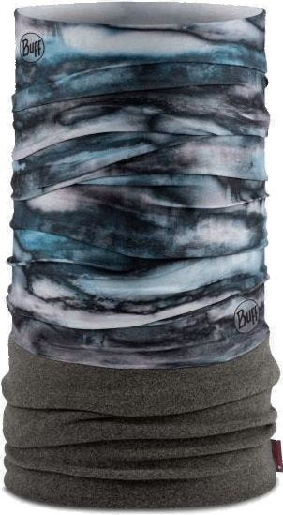
Accessories
- Essential accessories include:
- Celestial Shell: Increases damage and health regeneration.
- Ankh Shield: Provides immunity to knockback and various debuffs.
- Ranger Emblem: Boosts ranged damage significantly.
- Destroyer Emblem: Increases critical strike chance.
- Wings: For mobility and evasion during the fight.
- Charm of Myths: Enhances health regeneration.

Slide 6

Mount
- The best mount for the Moonlord fight is the UFO mount.
- Provides excellent mobility and allows for quick repositioning.
- The ability to fly helps avoid attacks and stay out of harm's way.

Slide 7
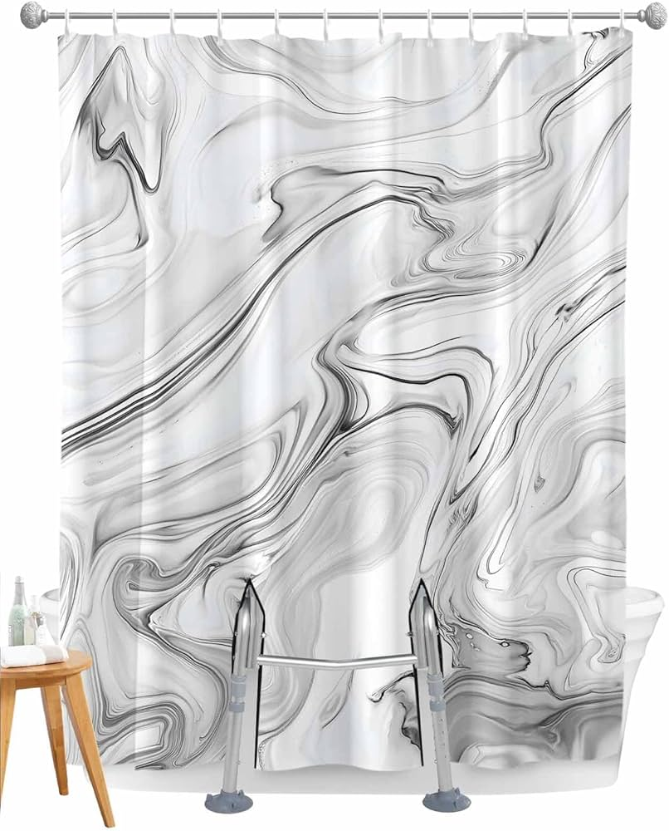
Hook
- The best hook to use is the Lunar Hook.
- Allows for quick movement and can attach to multiple surfaces.
- Enhances mobility during the battle, making it easier to dodge attacks.

Slide 8
Conclusion
- Equipping the right gear is crucial for defeating the Moonlord.
- Focus on maximizing damage output while maintaining mobility.
- With the right strategy and gear, victory is within reach!

