Slide 1
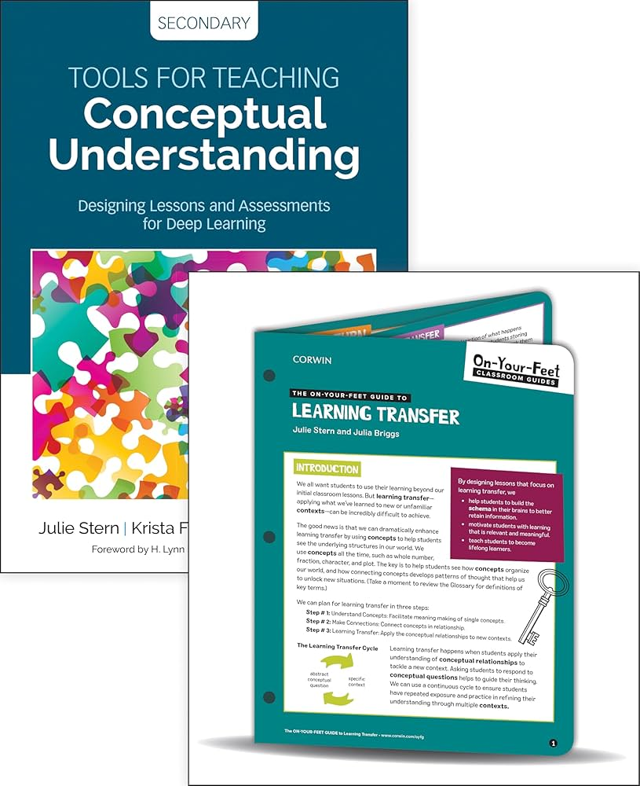
Introduction to the Strict Female Teacher
- A strict female teacher is often characterized by her disciplined approach to education.
- She sets high expectations for her students and maintains a structured environment.
- Her teaching style can significantly impact student learning and behavior.

Slide 2

Characteristics of a Strict Teacher
- Strict female teachers are known for their clear rules and guidelines.
- They enforce classroom management techniques to maintain order.
- Their authoritative presence can foster respect among students.

Slide 3
Teaching Style
- A strict teacher often relies on structured lessons and detailed assignments.
- She may prioritize assessments to evaluate student understanding.
- Her teaching style can include direct instruction and minimal leniency.

Slide 4

Impact on Students
- Students may respond positively to the discipline and structure provided.
- A strict teacher can motivate students to achieve their best.
- However, some students may feel intimidated or anxious in her presence.

Slide 5

Balancing Strictness with Support
- While being strict, it’s important for the teacher to show support and understanding.
- Building rapport with students can enhance their learning experience.
- A balance between discipline and encouragement can lead to a positive classroom environment.

