Slide 1

Introduction to Sun Conures
- Sun Conures are small, vibrant parrots native to South America.
- Known for their bright yellow and orange plumage.
- They are social birds that thrive in flocks.

Slide 2

Habitat and Distribution
- Sun Conures are primarily found in the northeastern regions of South America.
- They inhabit tropical forests, savannas, and woodlands.
- Their natural habitat provides ample food and shelter.

Slide 3
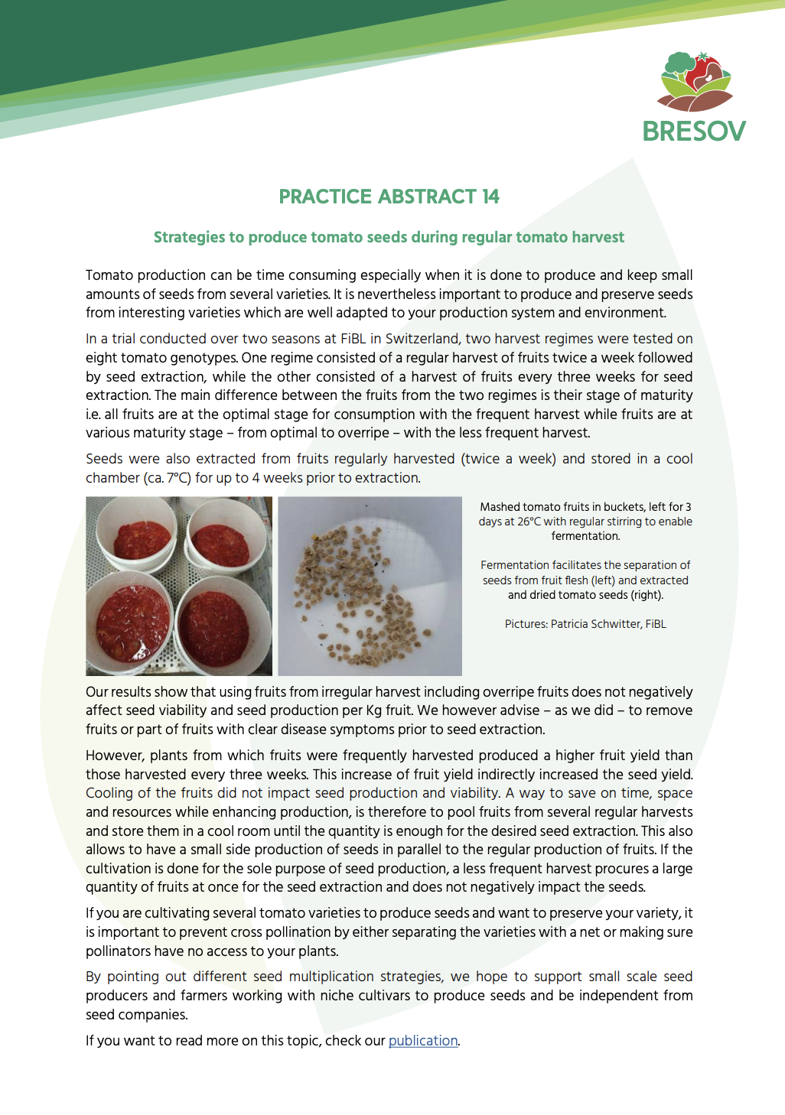
Diet
- Sun Conures are primarily herbivorous, feeding on seeds, fruits, and nuts.
- They enjoy a varied diet that includes berries and leafy greens.
- Proper nutrition is essential for their health and vibrant colors.

Slide 4

Behavior and Socialization
- Sun Conures are known for their playful and affectionate nature.
- They require social interaction and mental stimulation.
- Bonding with their owners is crucial for their well-being.

Slide 5

Care and Maintenance
- Providing a spacious cage with toys is important for their happiness.
- Regular vet check-ups are necessary to monitor their health.
- A balanced diet and social interaction are key to their care.

