Slide 1
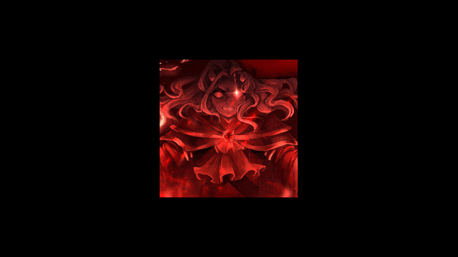
Introduction to Supreme Calamitas
- Supreme Calamitas is a notable character in the gaming world.
- Known for its challenging gameplay and unique design.
- Represents a significant challenge for players.

Slide 2

Background and Lore
- Supreme Calamitas is often associated with themes of chaos and destruction.
- The character has a rich backstory that enhances the gaming experience.
- Players must understand the lore to effectively engage with the character.

Slide 3

Gameplay Mechanics
- Features unique abilities that set it apart from other characters.
- Requires strategic planning and skill to defeat.
- Engages players through challenging encounters.

Slide 4
Strategies for Defeating Supreme Calamitas
- Players should focus on understanding attack patterns.
- Utilizing specific weapons and items can increase chances of success.
- Teamwork and coordination are crucial in multiplayer settings.

Slide 5

Community and Impact
- Supreme Calamitas has a dedicated fanbase and community.
- Players often share strategies and tips online.
- The character has influenced game design and player engagement.

