Slide 1
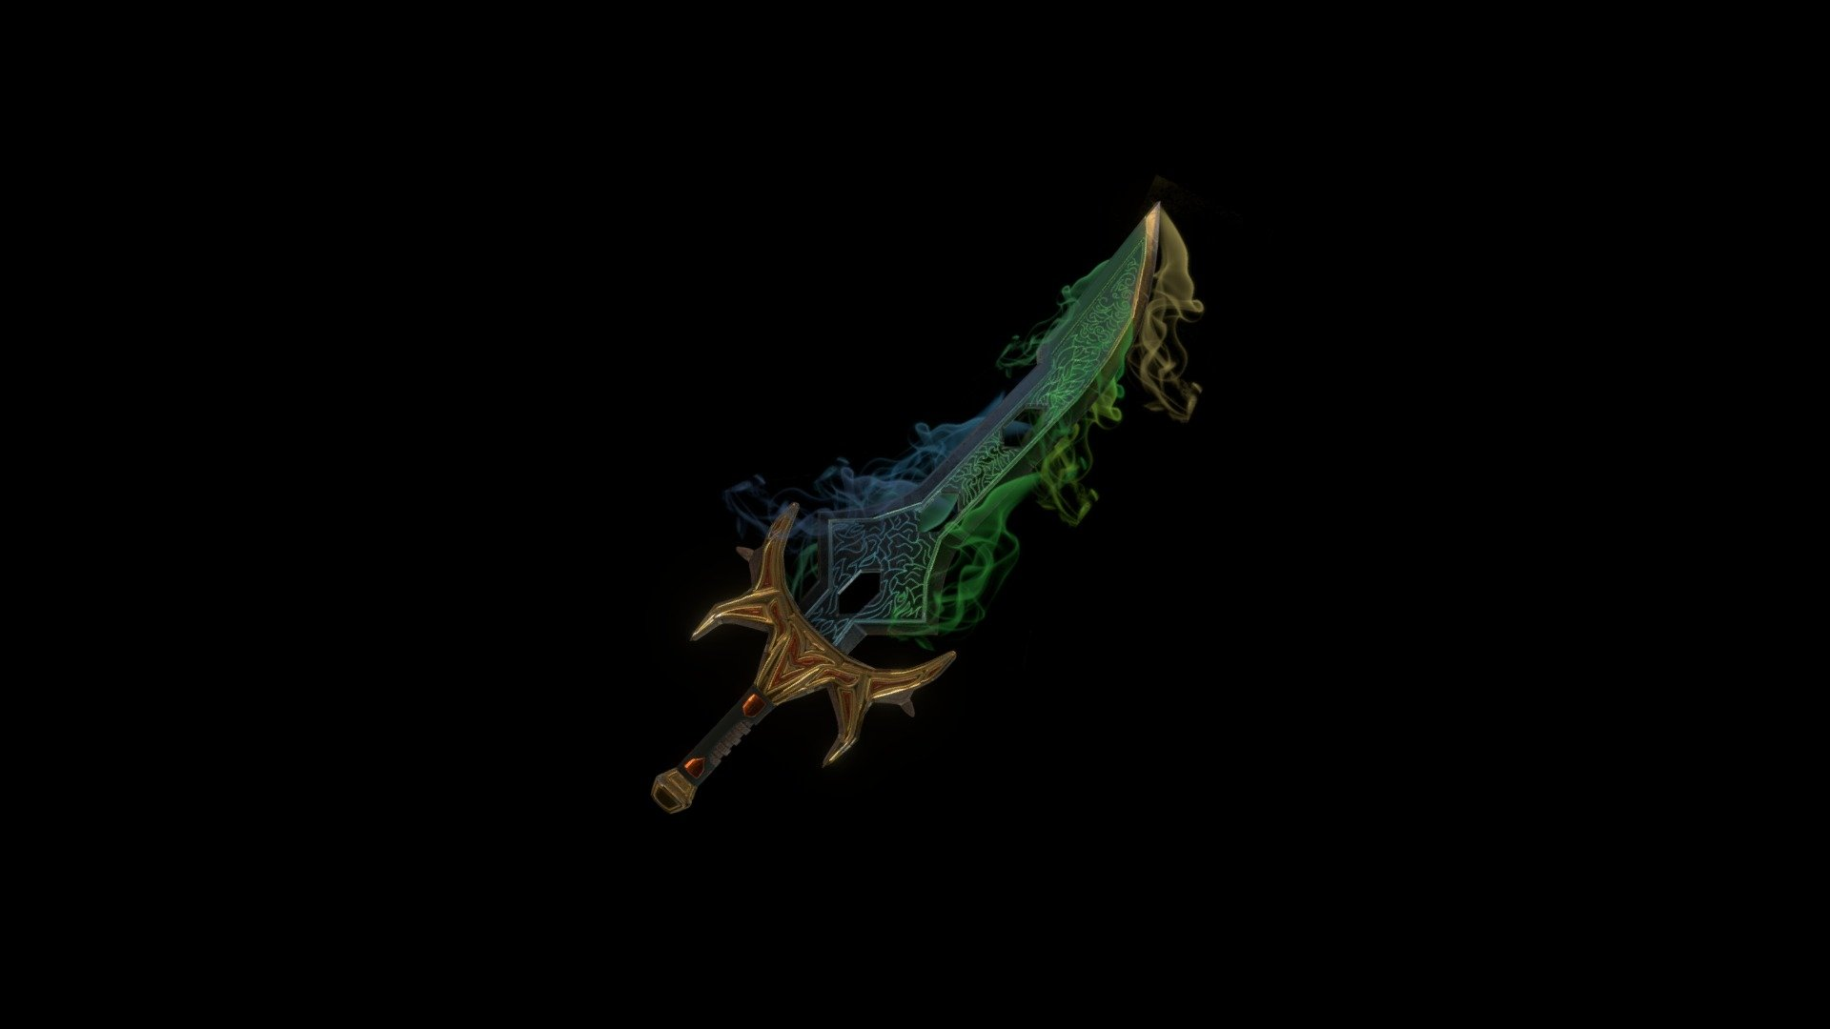
Introduction to the Terrablade
- The Terrablade is one of the most powerful swords in Terraria.
- It is known for its high damage and unique projectile attack.
- Crafting the Terrablade requires specific materials and preparation.

Slide 2

Required Materials
- To craft the Terrablade, you need:
- 1 True Excalibur
- 1 True Night's Edge
- 1 Broken Hero Sword
- Each of these items has its own crafting requirements.

Slide 3

Crafting True Excalibur
- True Excalibur is crafted using:
- 1 Excalibur
- 12 Hallowed Bars
- Excalibur can be obtained from the Hardmode Dungeon.

Slide 4
Crafting True Night's Edge
- True Night's Edge is crafted using:
- 1 Night's Edge
- 12 Hallowed Bars
- Night's Edge is made by combining several swords in the game.

Slide 5
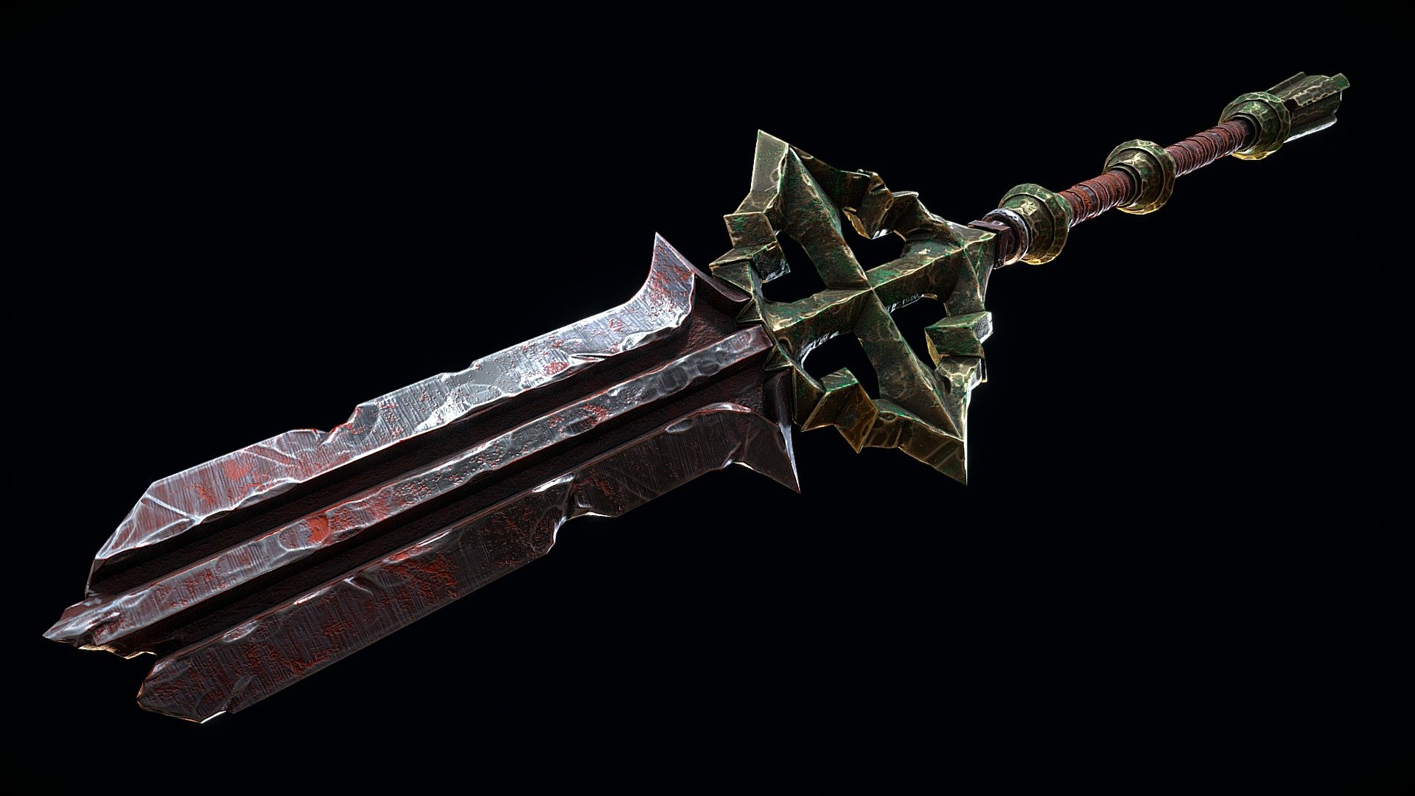
Obtaining the Broken Hero Sword
- The Broken Hero Sword can be obtained by defeating:
- Mothron in the Solar Eclipse event.
- It has a chance to drop, making it a rare item.

Slide 6
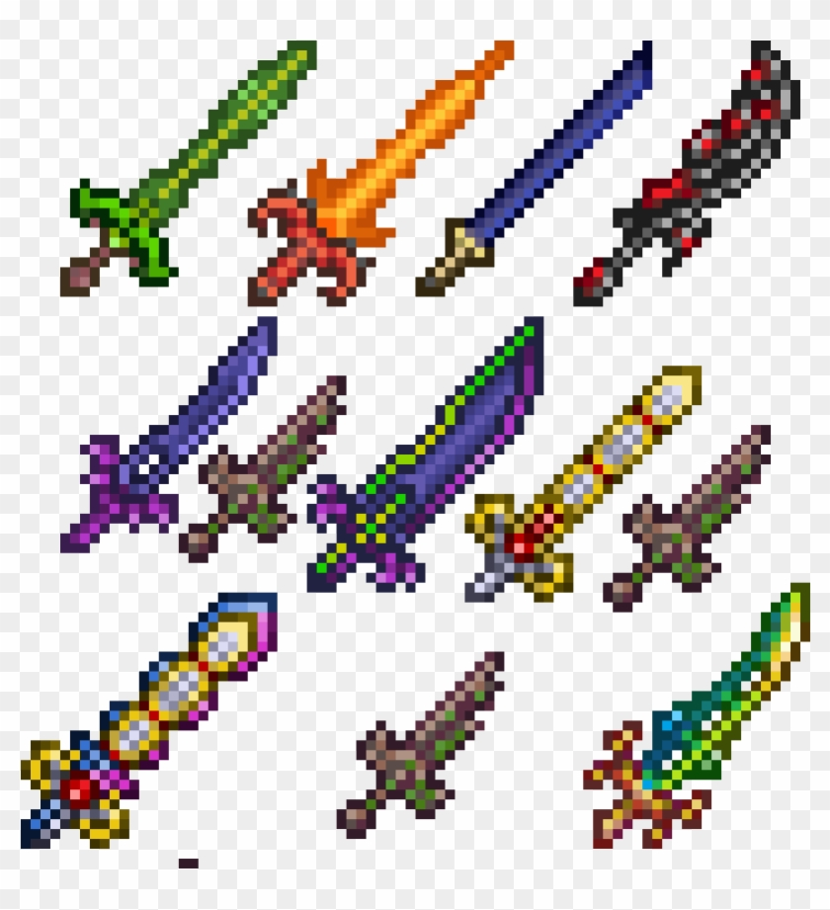
Crafting the Terrablade
- Once you have all the required materials, go to a Mythril or Orichalcum Anvil.
- Combine the True Excalibur, True Night's Edge, and Broken Hero Sword to craft the Terrablade.
- Enjoy wielding one of the most powerful weapons in Terraria!

