Slide 1

Introduction to Whales
- Whales are large marine mammals.
- They belong to the order Cetacea.
- Whales are divided into two main groups: baleen whales and toothed whales.

Slide 2
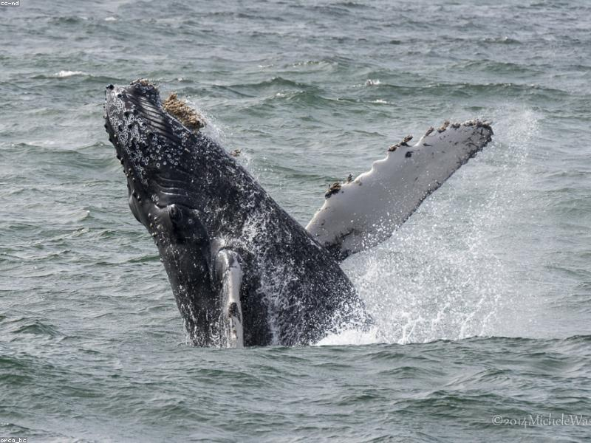
Baleen Whales
- Baleen whales filter feed using baleen plates.
- Examples include the Blue Whale and Humpback Whale.
- They are generally larger than toothed whales.

Slide 3
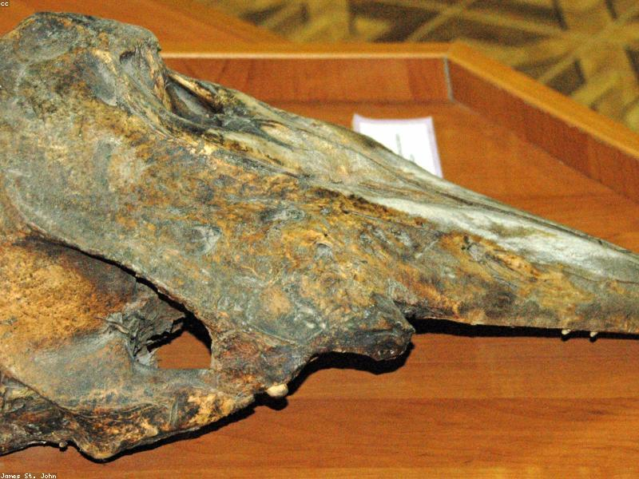
Toothed Whales
- Toothed whales have teeth and are typically predatory.
- Examples include the Sperm Whale and Orca.
- They use echolocation to find prey.

Slide 4

Blue Whale
- The largest animal on Earth.
- Can weigh up to 200 tons.
- Feeds primarily on krill.

Slide 5
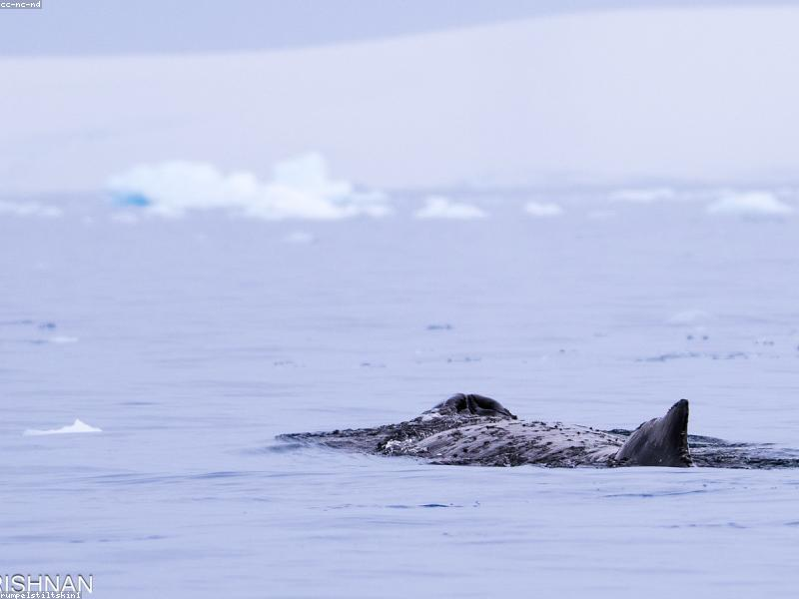
Humpback Whale
- Known for its acrobatic breaches.
- Migrates up to 16,000 miles annually.
- Has complex songs used for communication.

Slide 6
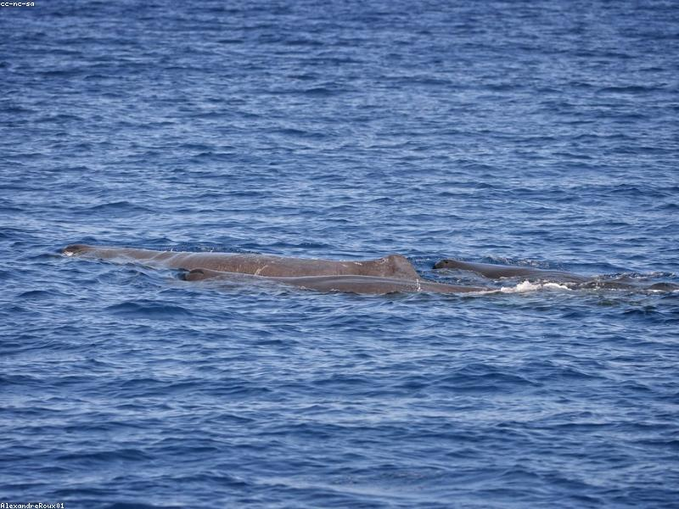
Sperm Whale
- The largest toothed whale.
- Known for deep diving to hunt squid.
- Can hold its breath for over an hour.

Slide 7
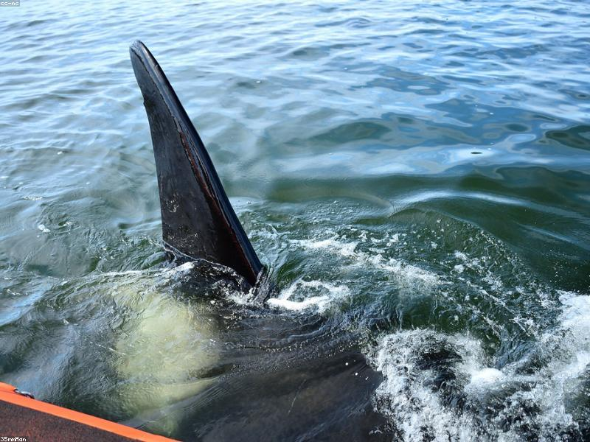
Orca (Killer Whale)
- Highly social and intelligent.
- Known for their distinctive black and white coloring.
- They hunt in pods and have diverse diets.

Slide 8

Conclusion
- Whales play a crucial role in marine ecosystems.
- Conservation efforts are vital for their survival.
- Understanding different types of whales helps in their protection.

