Slide 1

Introduction to Whale Species
- Whales are large marine mammals...
- They are divided into two main groups: baleen whales and toothed whales.
- There are over 80 species of whales worldwide.

Slide 2

Blue Whale
- The blue whale is the largest animal known to have ever existed.
- They can reach lengths of up to 100 feet and weigh as much as 200 tons.
- Blue whales primarily feed on tiny shrimp-like animals called krill.

Slide 3
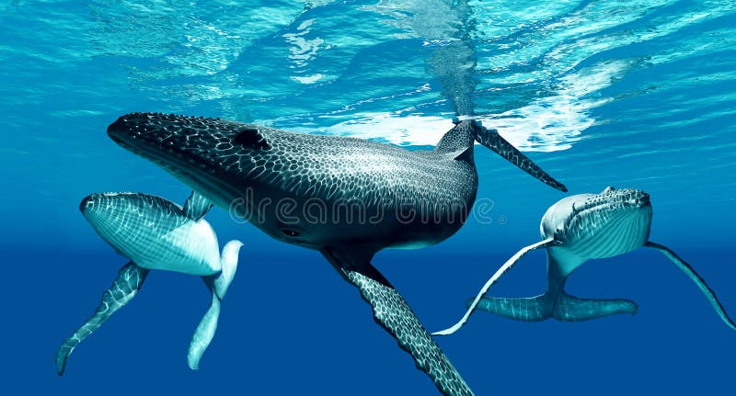
Humpback Whale
- Humpback whales are known for their incredible acrobatics and complex songs.
- They can grow up to 60 feet long and weigh around 40 tons.
- Humpbacks migrate up to 16,000 miles each year between feeding and breeding grounds.

Slide 4

Orca (Killer Whale)
- Orcas, or killer whales, are highly social and live in family groups called pods.
- They are the largest members of the dolphin family and can grow up to 32 feet long.
- Orcas are known for their intelligence and complex hunting techniques.

Slide 5
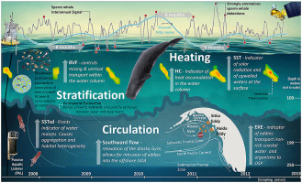
Sperm Whale
- Sperm whales are the largest toothed whales and can dive to depths of over 3,000 feet.
- They have a distinctive block-shaped head and can grow up to 60 feet long.
- Sperm whales primarily feed on squid, including giant squid.

Slide 6
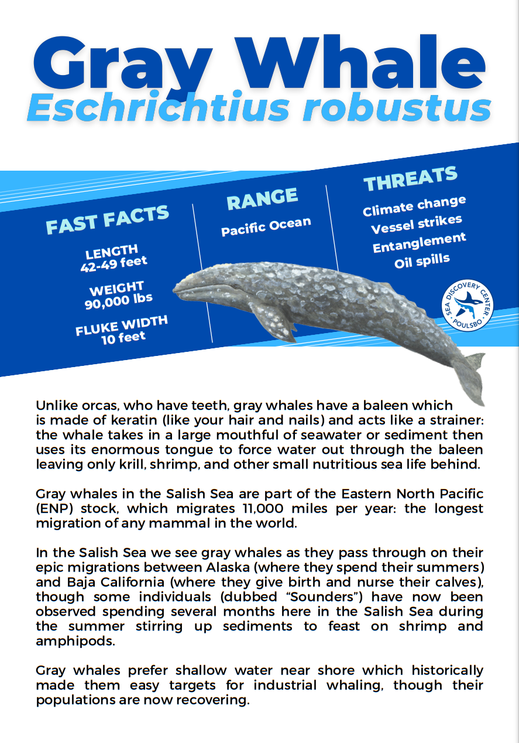
Gray Whale
- Gray whales are known for their long migrations, traveling up to 12,000 miles round trip.
- They can grow up to 49 feet long and weigh around 40 tons.
- Gray whales feed by scooping up sediment from the ocean floor and filtering out small organisms.

Slide 7
Beluga Whale
- Beluga whales are known for their vocalizations and are often called the 'canaries of the sea'.
- They are smaller than many other whale species, reaching lengths of about 15 feet.
- Belugas are social animals and often found in pods.

Slide 8

Bowhead Whale
- Bowhead whales are native to Arctic and sub-Arctic regions and can live over 200 years.
- They have a large bow-shaped head and can grow up to 60 feet long.
- Bowheads primarily feed on zooplankton using their baleen plates.

Slide 9
Fin Whale
- Fin whales are the second-largest whale species, reaching lengths of up to 88 feet.
- They are known for their speed and can swim up to 23 miles per hour.
- Fin whales primarily feed on small fish and krill.

Slide 10
Conclusion
- Many whale species are endangered due to hunting, habitat loss, and climate change.
- Conservation efforts are crucial to protect these magnificent creatures and their habitats.
- Understanding and appreciating whale diversity is essential for their preservation.

