Slide 1
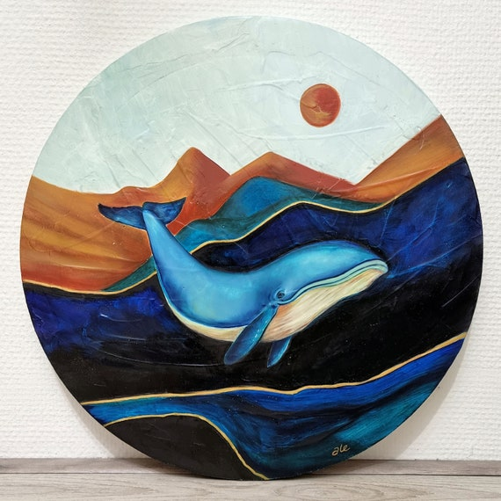
Introduction to Whales
- Whales are large marine mammals that belong to the order Cetacea.
- They are known for their size, intelligence, and complex behaviors.
- There are two main types of whales: baleen and toothed.

Slide 2

Types of Whales
- Baleen whales, such as the blue whale, filter feed using baleen plates.
- Toothed whales, like the sperm whale, hunt for fish and squid.
- Each type has unique adaptations for survival in the ocean.

Slide 3

Blue Whale
- The blue whale is the largest animal known to have ever existed.
- They can reach lengths of up to 100 feet and weigh as much as 200 tons.
- Blue whales primarily feed on small shrimp-like animals called krill.

Slide 4
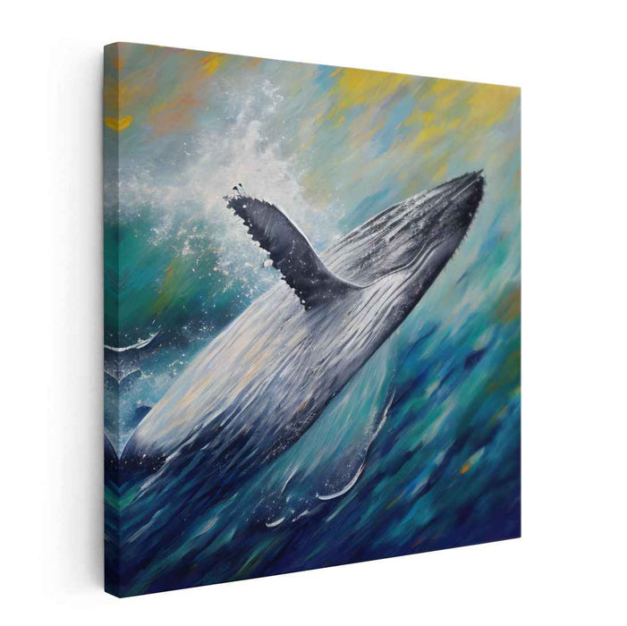
Humpback Whale
- Humpback whales are known for their complex songs and acrobatic breaches.
- They migrate up to 16,000 miles each year between feeding and breeding grounds.
- Their songs can last for hours and are believed to play a role in mating.

Slide 5
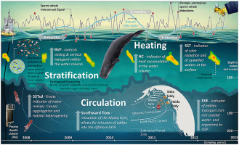
Sperm Whale
- Sperm whales are the largest toothed whales and can dive over 3,000 feet.
- They have a unique block-shaped head and are known for their deep vocalizations.
- Sperm whales primarily feed on squid and are known for their social structures.

Slide 6
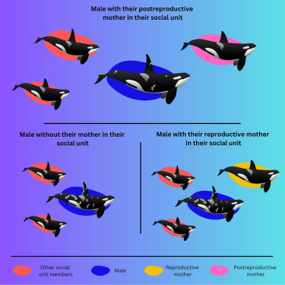
Orca (Killer Whale)
- Orcas, or killer whales, are highly social and live in family groups called pods.
- They are apex predators and have a diverse diet, including fish, seals, and even whales.
- Orcas are known for their intelligence and complex hunting techniques.

Slide 7
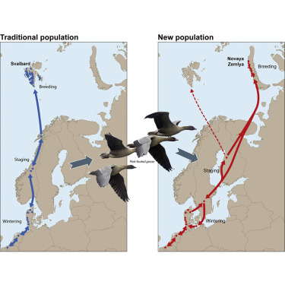
Whale Migration
- Many whale species migrate long distances to find food and breed.
- Migration patterns can be influenced by water temperature and food availability.
- Understanding these patterns is crucial for conservation efforts.

Slide 8
Threats to Whales
- Whales face numerous threats, including hunting, habitat loss, and climate change.
- Ship strikes and entanglement in fishing gear are significant dangers.
- Conservation efforts are essential to protect whale populations.

Slide 9

Whale Conservation
- Various organizations work to protect whales through research and advocacy.
- Marine protected areas help safeguard critical habitats for whales.
- Public awareness and education are vital for conservation success.

Slide 10

Fun Facts about Whales
- Whales can hold their breath for over an hour while diving.
- The heart of a blue whale can weigh as much as a small car.
- Some whale species can communicate over vast distances underwater.

Slide 11

Conclusion
- Whales are vital to marine ecosystems and have a significant cultural impact.
- Protecting whales ensures the health of our oceans for future generations.
- Continued research and conservation efforts are crucial for their survival.

