Slide 1

Reproducible Research
TAXI FARES
PREDICTION
Ahmed Haitham 454778
Irena Zimovska 414522
Jakub Bandurski 417911
Pearly Tantra 455722

Slide 2

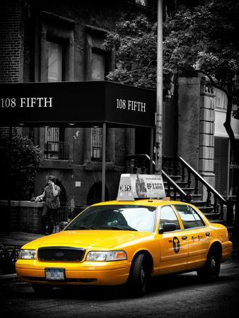
Reproducible Research
01
BACKGROUND
Why Choose Taxi Fares Prediction
for Reproducible Research?
Relevance and Practicality
Complexity of Factors
Opportunity for Improvement
Transition to Python
Structured Programming Approach
GIT for Team Collaboration
Focus on Model Optimization
Overall Impact

Slide 3

Reproducible Research
02
BACKGROUND
how we want to solve the problem
Enhanced ETL Process
Structured Codebase
GIT for collaboration
Model Selection and Optimization
Validation and Testing
Documentation and Reproducibility

Slide 4







Reproducible Research
03
TOOLS
Programming
Language
Collaboration
Enhancement
ETL
Process
Extract.py
Class
….def
…….
def
…..
## RMarkDown
```{r}
Data <- ……
```
###
```{r}
````
Transform.py
Class
….def
…….
def
…..
Load.py
Class
….def
…….
def
…..
main.py
Import …
Import ….
Import….

Slide 5
Reproducible Research
04
TASK
ALLOCATION
AHMED
Feature engineering + feature selection (more than 1 method)
IRENA
EDA + visualization
JAKUB
Modelling + Testing Pipeline
PEARLY
Clustering + Documentation

Slide 6
Reproducible Research
05
THANK
YOU

