Slide 1







TOOLS
Prior Project
Current Project
Programming Language
Environment
Render

Slide 2


STRUCTURE
Prior Project
Current Project
Extract.py
Class
….def
…….
def
…..
Line by line code
## RMarkDown
```{r}
Data <- ……
```
###
```{r}
````
Transform.py
Class
….def
…….
def
…..
Structured Code:
OOP, ETL Process, etc
Load.py
Class
….def
…….
def
…..
main.py
Import …
Import ….
Import….
Individual
Collaboration

Slide 3




ETL
Feature
Engineering
model
visualization
BACK-END
FRONT-END

Slide 4
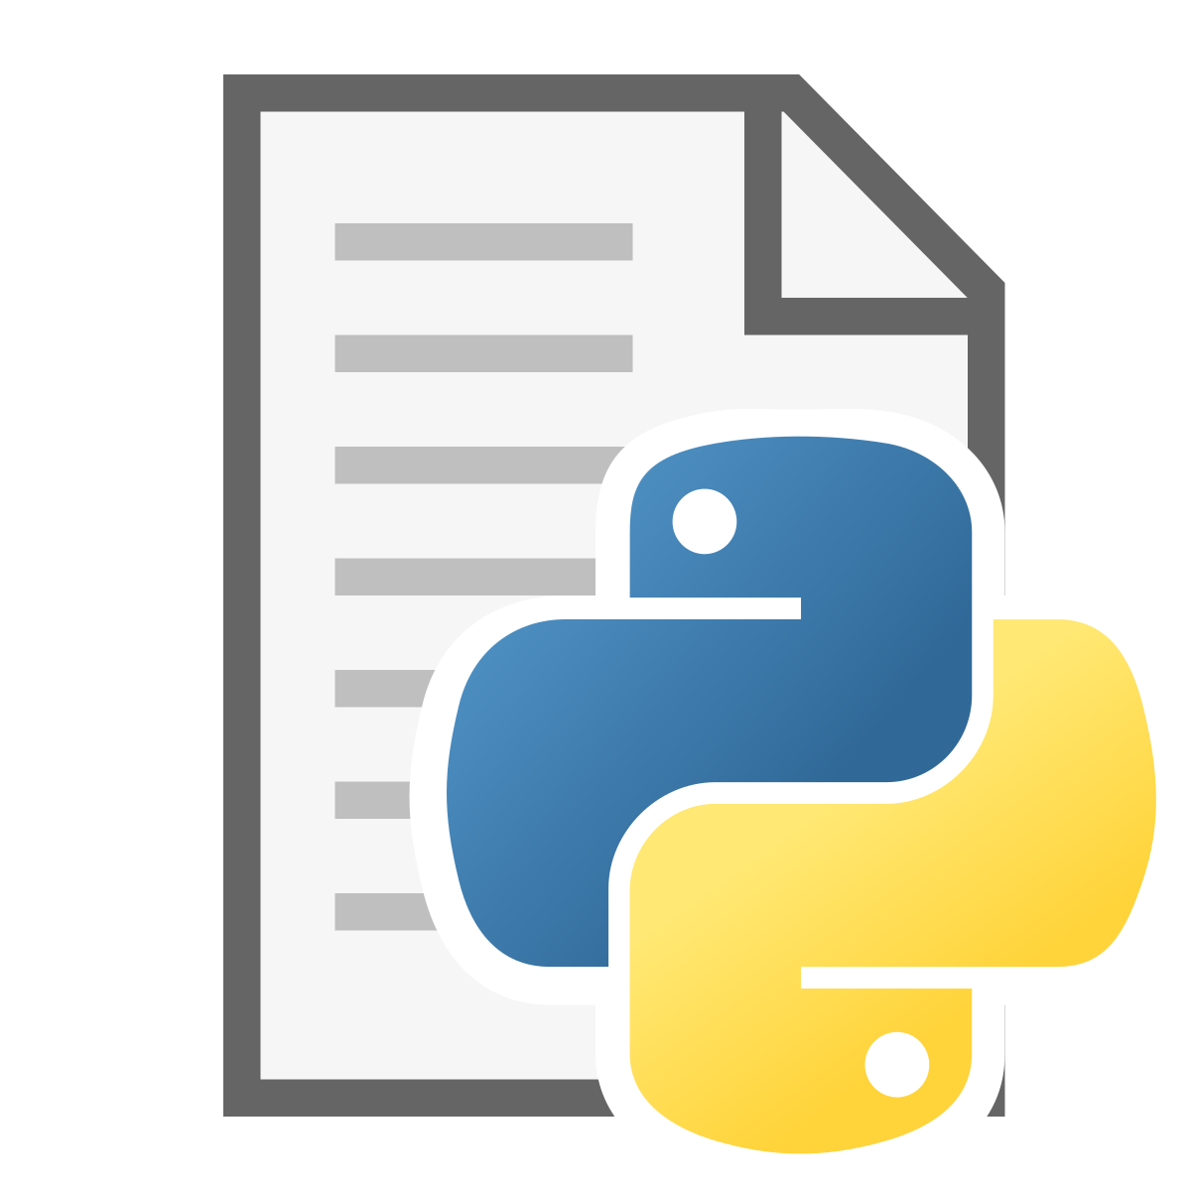
extract_df.py
Read data for csv and shp
Data manipulation
Handling missing values (coordinates)
ETL
transform.py
Adding Trip Distance
transform.py
Adding cluster of Kmeans
cluster.py
Feature
Engineering
Adding average temperature
Feature_Engineering.py

Slide 5
XGB
model.py
model
Dashboard
Homepage.py
visualization

Slide 6


REPRODUCIBLE-RESEARCH-PROJECT
app
ProjectDocumentation.ipynb
data
Selected model
taxi_data, nyc_temperature
nyc map coordinates
utils
All python functions and files
Documentation materials
documentation
images
Images for the streamlit app
pages
Python files for streamlit app
model
Various models run before selection
presentation
Proposal presentation
R Scripts
Rmd from the previous project

