Slide 1
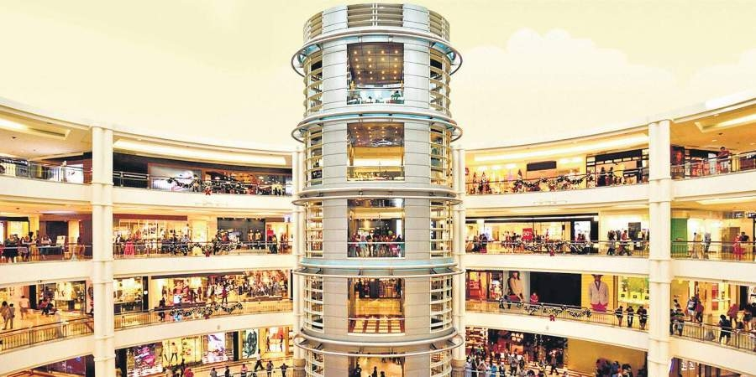
K-Means clustering with Mall Customer
Segmentation Data

Slide 2
Team 7 Members
Ahmed Mohamed Hassaneen
Ahmed Mohamed Abdullah Hammam
Ahmed Magdy Abdulrahman
Kirollos Magdy
Mario George Shafik

Slide 3
Introduction
In the field of marketing, clustering can be used to identify various customer groups with existing customer data. Based on that, customers can be provided with discounts, offers, promo codes etc.
Mall Customer data is an interesting dataset that has hypothetical customer data. It puts you in the shoes of the owner of a supermarket. You have customer data, and on this basis of the data, you have to divide the customers into various group

Slide 4
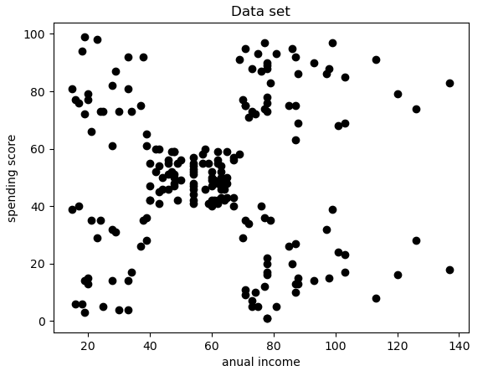
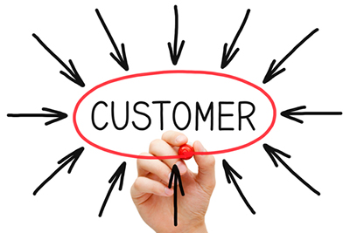
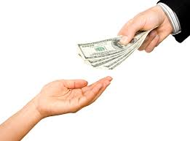
Dataset
Customer dataset with 200 entries, using annual income and spending amount (score) to split data points in 2d.

Slide 5
Step 1:
Choose the number of clusters K.
Step 4:
Recompute centroids of the newly formed clusters .
Step 2:
Select k random points as centroids.
Step 5:
Repeat steps 3 and 4 till centroids don’t change.
Step 3:
Assign each point to its closest centroid.

Slide 6
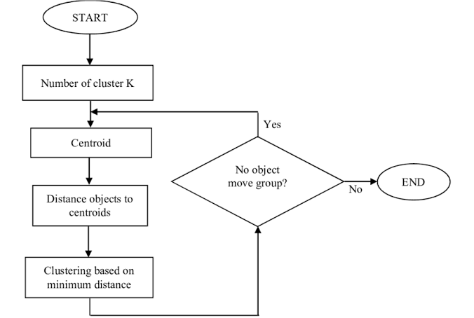

Slide 7
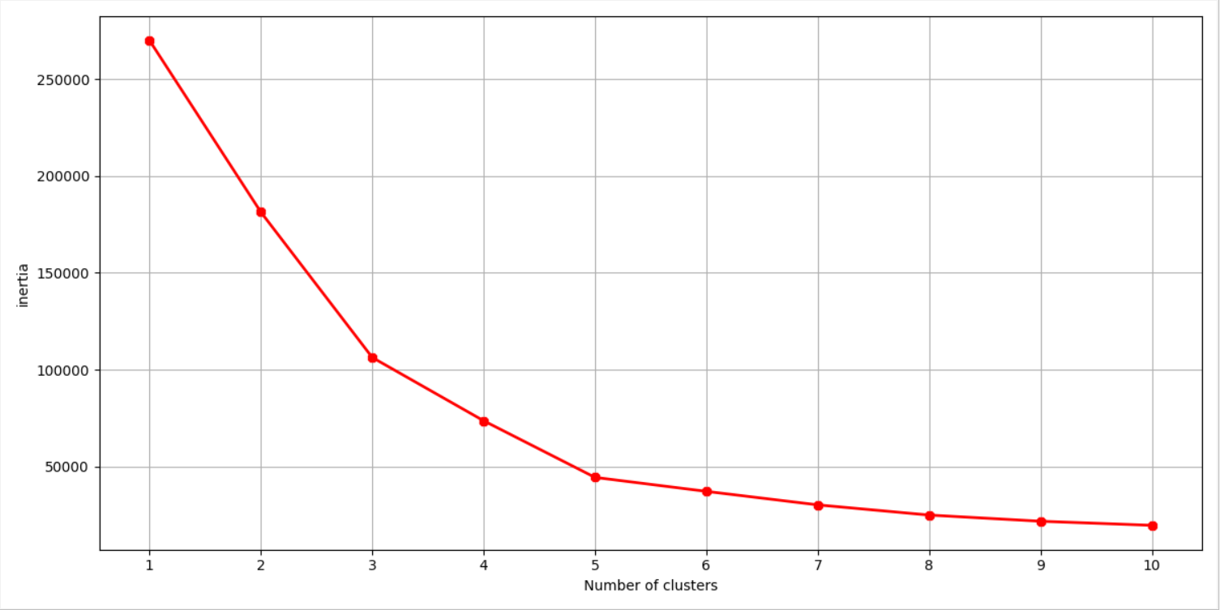
Calculate the Within Cluster Sum of Squared Errors (WSS) for different values of k, and choose the k for which WSS first starts to diminish. In the plot of WSS-versus k, this is visible as an elbow.
The optimal value of K = ??
Why not 10??
The change in inertia isn’t worthy enough to afford the computation cost of 10 clusters.

Slide 8
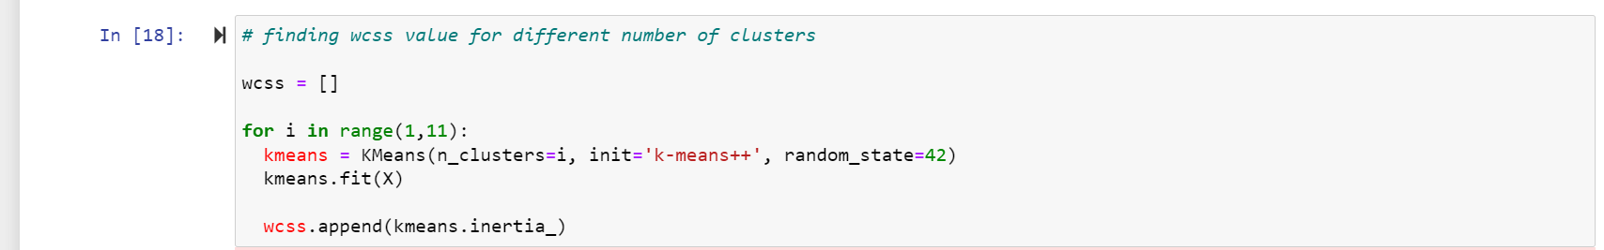
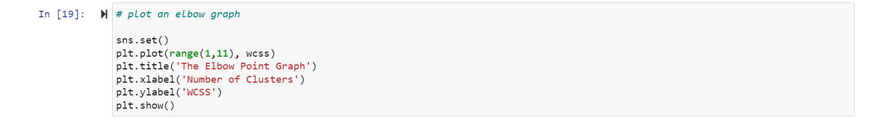
Choose K

Slide 9
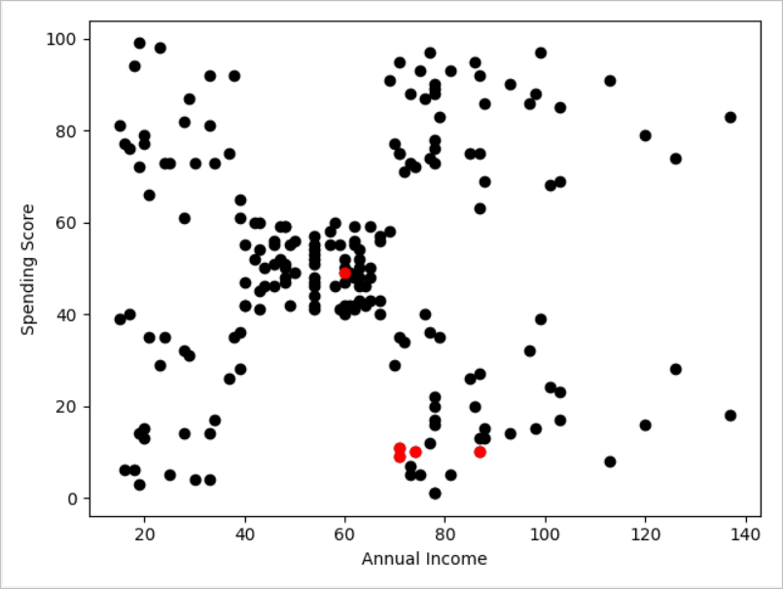
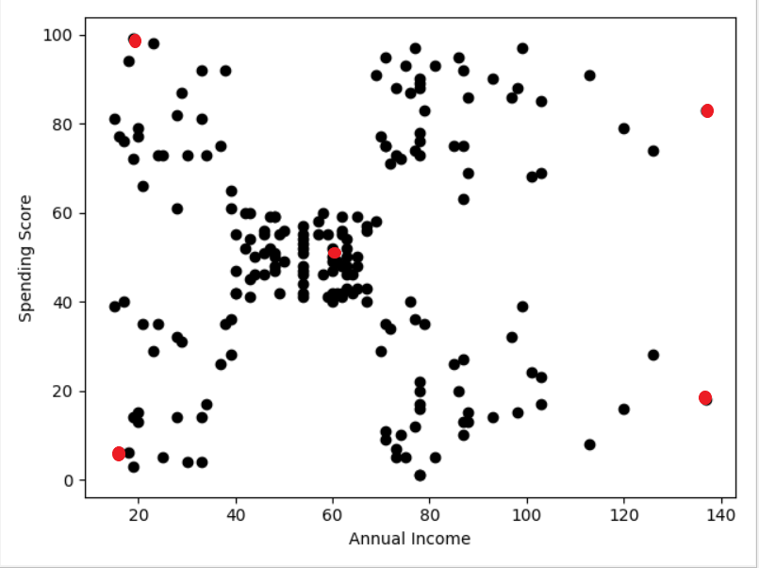
K-means++
Instead of randomly picking the centroids, k-means++ algorithm is used to speed up the convergence, hence decreases the number of iterations.

Slide 10
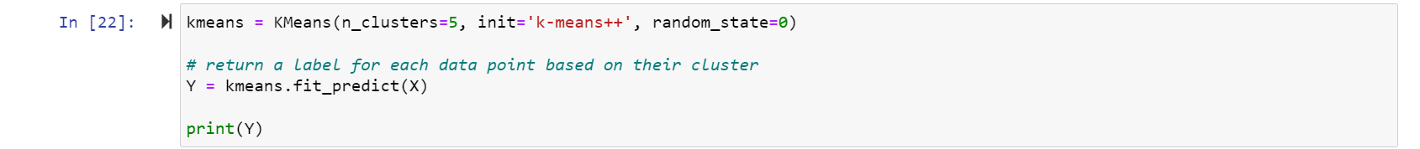
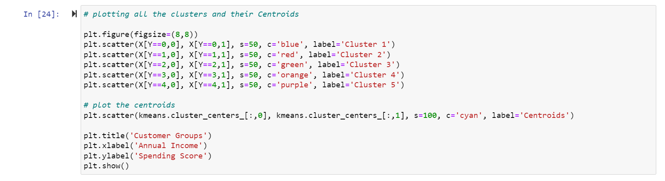
Modeling stage

Slide 11
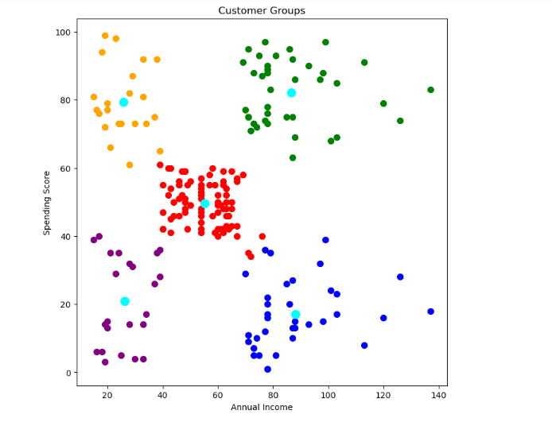
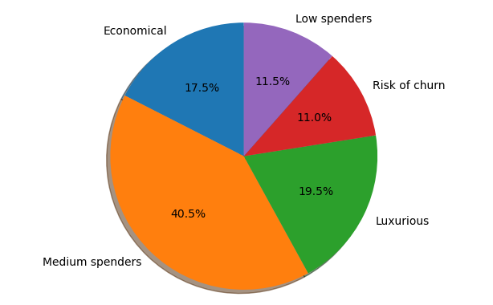
Market segmentation
K-Means clustering in marketing is to accurately segment customers in order to achieve more effective customer marketing

