Slide 1


32-Bit Pipelined
MIPS Processor
5-Stage Pipelined MIPS Processor in VHDL
Team Members
Ahmed Khaled Mohamed
Ahmed Tarek Elmarghany
Ibrahim Sameh Salah

Slide 2
What is Pipelining?
Executing multiple instructions simultaneously
Laundry Analogy
Key Benefit
Without pipeline:
Wash → Dry → Fold → Repeat (one at a time)
With pipeline:
Wash #2 while Drying #1 while Folding #0
Throughput increases up to 5x Each stage takes 1 clock cycle
Ideal CPI approaches 1.0
Latency per instruction unchanged
Pipeline Execution Timeline
Cycle 1
Cycle 2
Cycle 3
Cycle 4
Cycle 5
Instr 1
IF
ID
EX
MEM
WB
Instr 2
IF
ID
EX
MEM
Instr 3
IF
ID
EX
Instr 4
IF
ID
Instr 5
IF

Slide 3
5 Pipeline Stages
Each instruction passes through all 5 stages
IF
ID
EX
MEM
WB
Instruction Fetch
Instruction Decode
Execute
Memory Access
Write Back
Fetch instruction from memory
Increment PC by 4
Store in IF/ID register
Decode opcode & fields
Read register file (rs, rt)
Sign-extend immediate
Generate control signals
ALU performs operation
Compute memory address
Forwarding MUX selects inputs
Branch target computed
Read from data memory (LW)
Write to data memory (SW)
Branch decision evaluated
Pass ALU result through
Write result to register file
Select: ALU result or memory
JAL writes PC+4 to $ra
Completes instruction

Slide 4
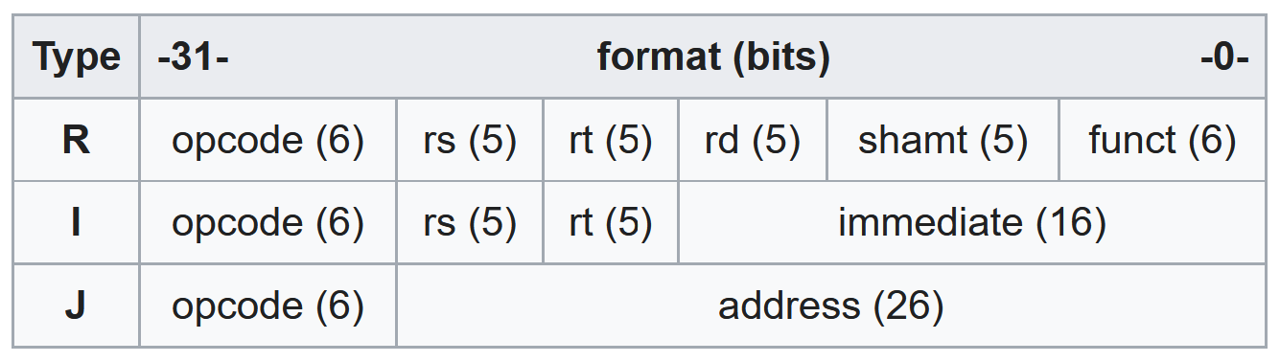
Supported Instructions
Complete MIPS-I subset
R-Type
I-Type Arithmetic
Memory
Branch
Jump
ADD / ADDU
SUB
AND
OR
XOR
NOR
SLT / SLTU
SLL / SRL / SRA
JR
ADDI / ADDIU
ANDI / ORI / XORI
SLTI / SLTIU
LUI
LW (load word)
LB / LBU
SW (store word)
BEQ (branch equal)
BNE (branch not equal)
J (jump)
JAL (jump & link)
JR (jump register)

Slide 5
State Registers
Buffers that carry data between stages to isolate them
IF/ID
ID/EX
EX/MEM
MEM/WB
PC + 4
Instruction[31:0]
PC + 4
RS data
RT data
Imm (sign-ext)
RS, RT, RD addr
Shamt
Control signals
Branch target
ALU result
RT data (for SW)
Dest register
Zero flag
PC + 4 (JAL)
Branch target
Control signals
Memory data
ALU result
Dest register
PC + 4 (JAL)
Control signals
Each register is clocked on the rising edge | Reset flushes to NOP (bubble)

Slide 6
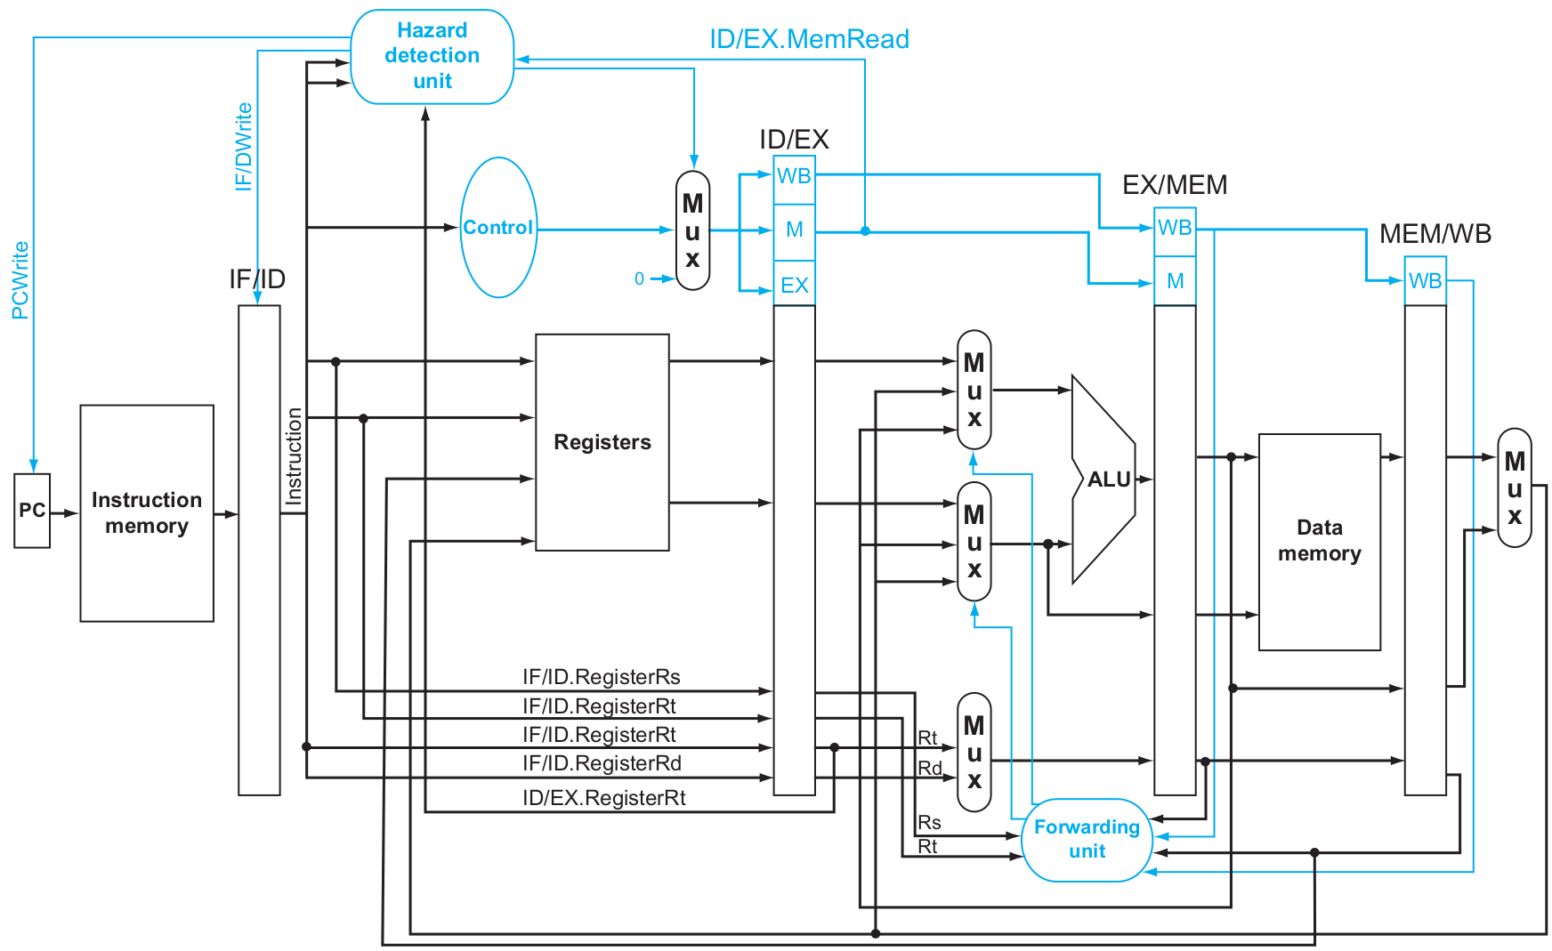

Slide 7
Hazard Handling
Three types of hazards solved automatically
RAW
Data Hazard
Problem: Read After Write: instruction reads a register before a previous instruction writes it
Solution: Full Forwarding: EX/MEM and MEM/WB values forwarded directly to ALU inputs without stalling
LU
Load-Use Hazard
Problem: LW followed immediately by an instruction that uses the loaded value
Solution: 1-cycle stall: PC and IF/ID frozen, bubble inserted into ID/EX pipeline register
BR
Control Hazard
Problem: Branch/Jump destination unknown until MEM stage (branch) or ID stage (jump)
Solution: Branch: assume not-taken, flush 2 instructions if taken. Jump: flush 1 instruction (J/JAL/JR)

Slide 8
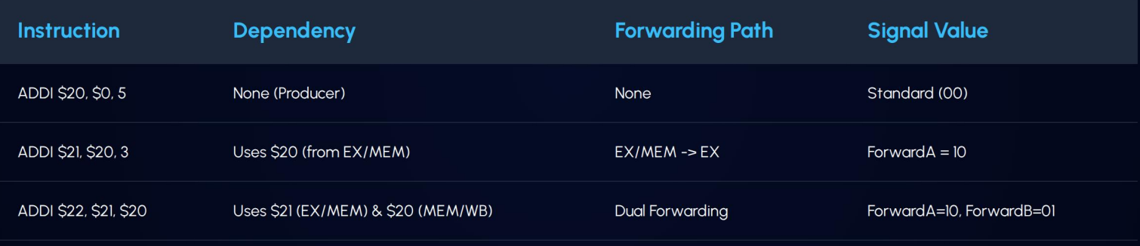
Forwarding Unit
Eliminates most data hazards without stalling
ForwardA (rs input to ALU)
ForwardB (rt input to ALU)
forwardA | Source
00 | Register file (no hazard)
01 | MEM/WB stage (2 cycles ago)
10 | EX/MEM stage (1 cycle ago)
forwardA
Source
forwardB | Source
00 | Register file (no hazard)
01 | MEM/WB stage (2 cycles ago)
10 | EX/MEM stage (1 cycle ago)
forwardB
Source
Example:

Slide 9
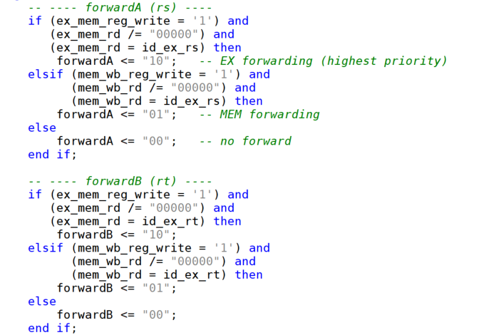
Double Data Hazard
Example:
add $1,$1,$2 add $1,$1,$3 add $1,$1,$4
Source
Priority Rule:
EX/MEM forwarding takes priority over MEM/WB forwarding. If both match, use the most recent (EX/MEM). Destination register $0 is never forwarded.

Slide 10
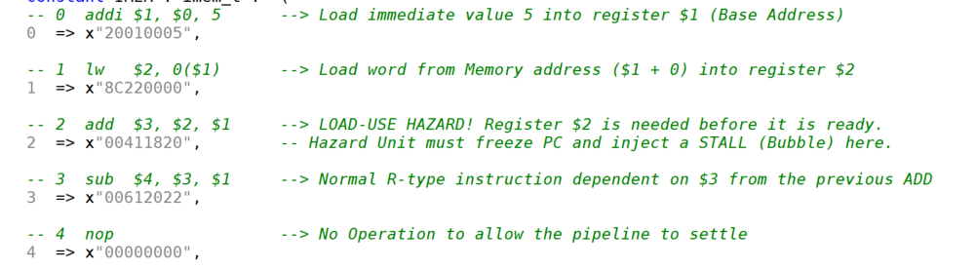
Test Program

Slide 11
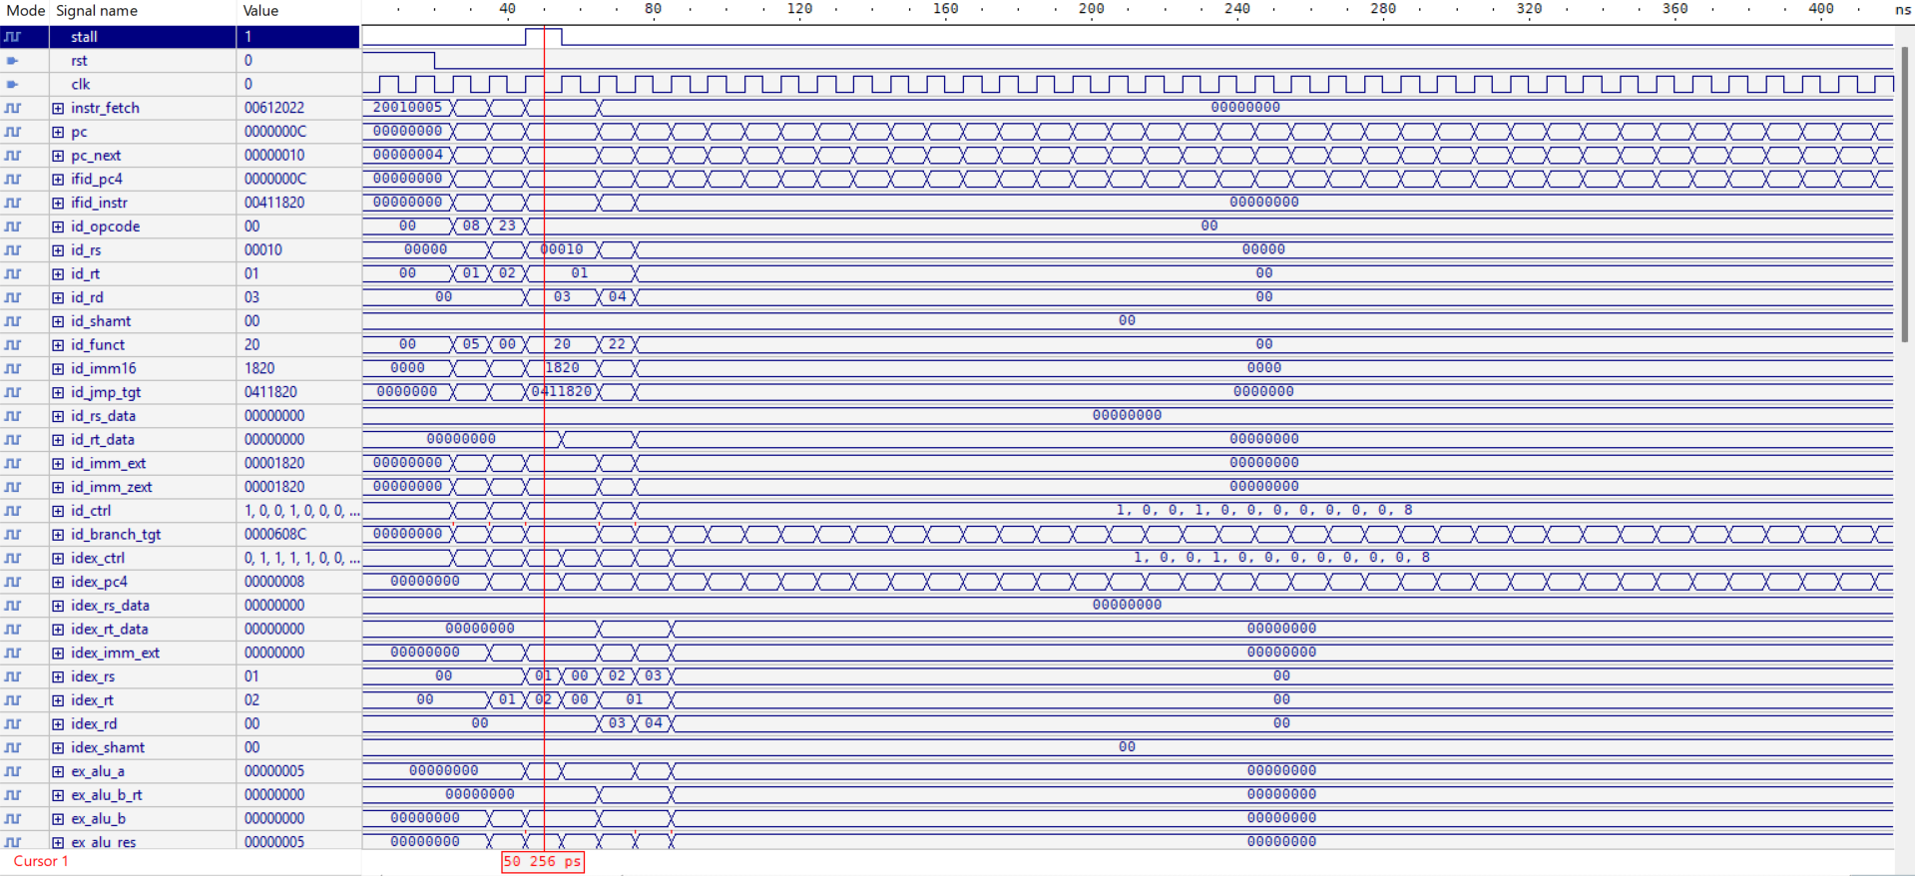
Waveform result

Slide 12
Simulation Waveform
How to Read the Waveform
clk
System clock - all pipeline registers update on rising edge
pc
Program counter - increments by 4 each cycle, jumps on branch/jump
ifid_instr
Instruction entering the pipeline - changes every cycle
stall
Goes HIGH for 1 cycle after LW when next instr uses loaded register
branch_taken
Goes HIGH when BEQ/BNE condition is true - PC jumps to target
forwardA/B
00=no forward, 01=from MEM/WB, 10=from EX/MEM
wb_rd
Destination register being written (in decimal: 1-31)
wb_data
Value written to destination register - verify against expected

Slide 13
Conclusion
5-stage pipeline: IF, ID, EX, MEM, WB - implemented fully in VHDL
Full data forwarding eliminates most RAW hazards with zero stalls
Load-use hazard detected and resolved with a single stall cycle
Branch and jump hazards resolved with flush - assume not-taken policy
Verified with ModelSim: all instruction groups and hazard scenarios pass
Thank You

