Slide 1
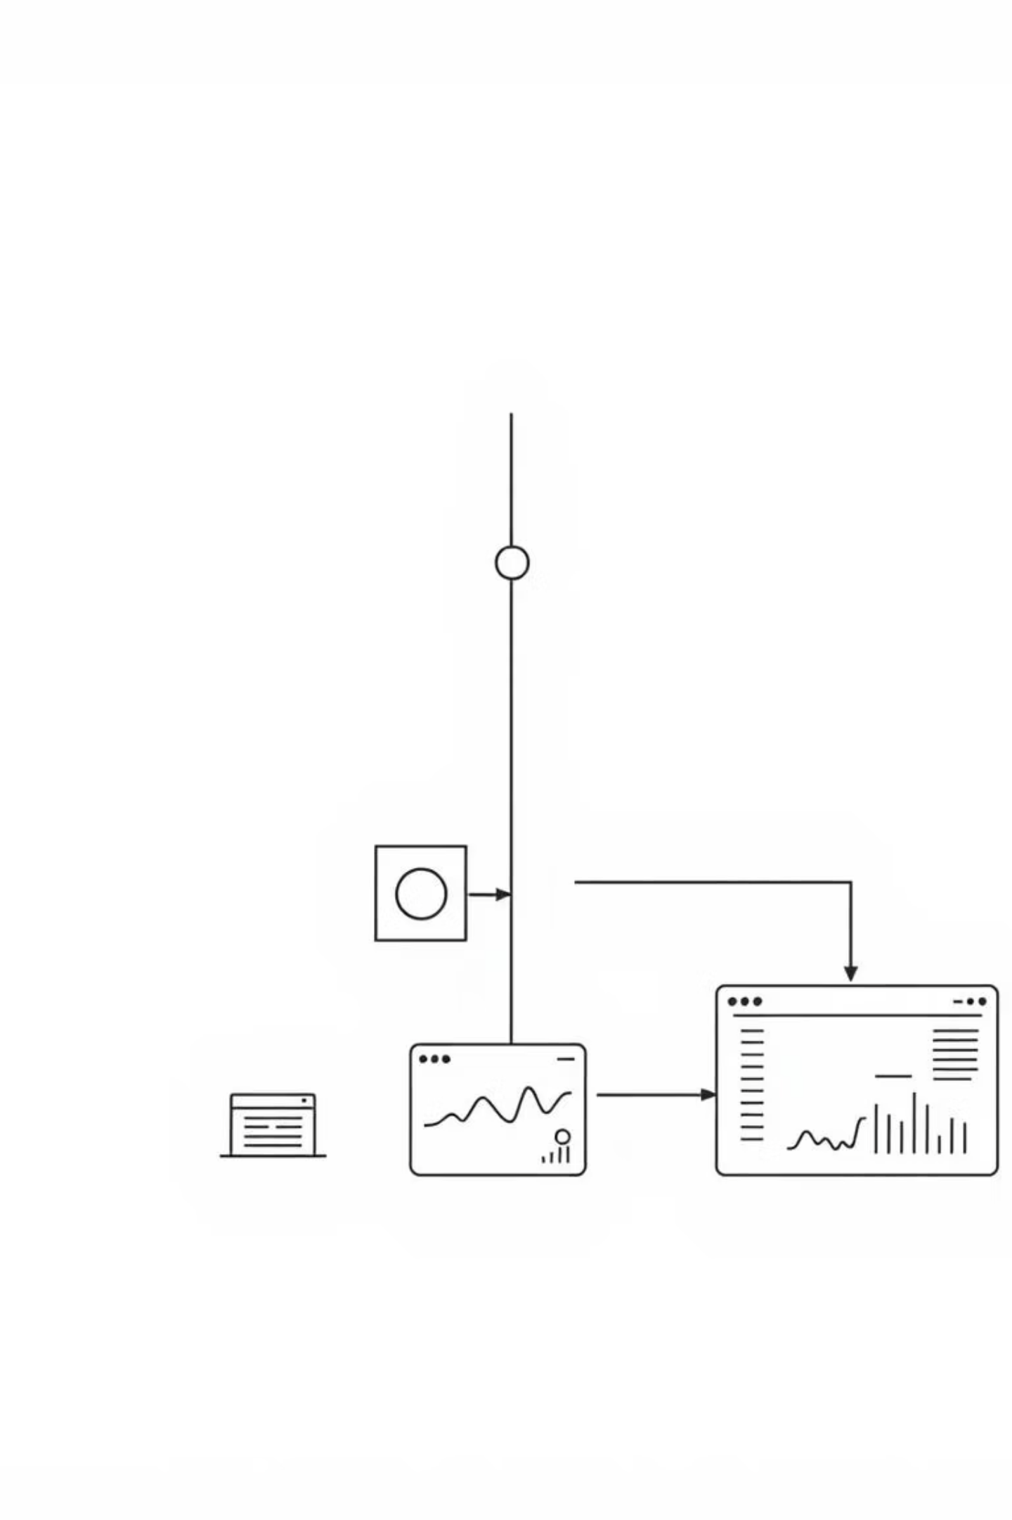
Retail Data Pipeline: Automated ETL & Business Intelligence
Smart data processing from raw CSV to actionable insights

Slide 2
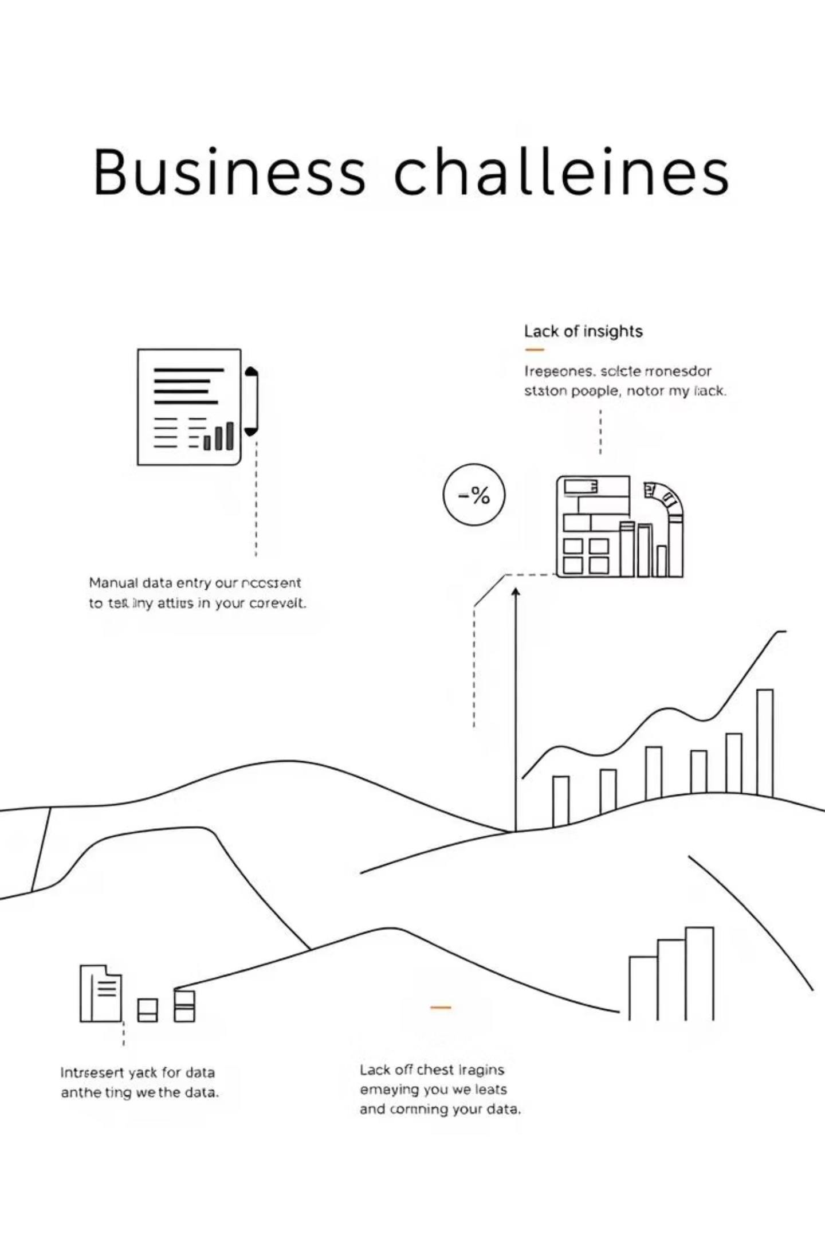
Business Challenge
Addressing critical pain points in retail data management.
Manual Data Handling
Time-consuming, error-prone processes.
Inconsistent Data
Quality issues across 9 datasets.
No Automated SQL
Lack of direct database loading.
Limited BI Reports
Absence of real-time insights.

Slide 3

Pipeline Architecture
A robust, automated solution for data integrity and insight generation.
Raw CSV Data
Transform Data
Analytics Reports
Quality Check
SQL Server Load

Slide 4
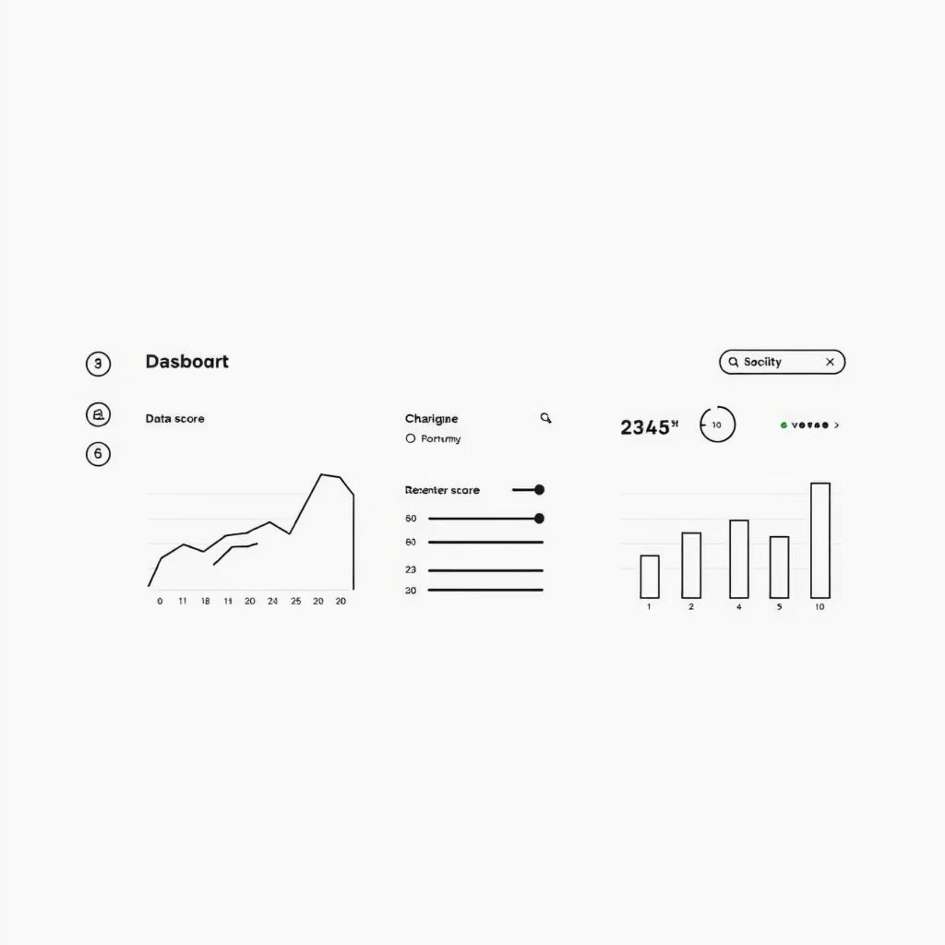
Stage 1: Data Quality Assessment
Ensuring data reliability from the very beginning.
Automatic Analysis
Scans 9 diverse datasets.
Detects Issues
Finds duplicates, missing values, type errors, rule violations.
Generates Quality Score
Provides a percentage (0-100%).
Creates Config File
Outputs smart `pipeline_config.yaml`.

Slide 5

Stage 2: Smart Data Transformation
Intelligent processing for clean, usable data.
Column Standardization
Lowercase, consistent underscores.
Advanced Data Cleaning
Handles duplicates, nulls, invalid values.
Type Conversions
Accurate date parsing, format adjustments.
Business Calculations
Automates order totals, data enrichment.
Cleaned CSV Output
Ready for database loading.

Slide 6
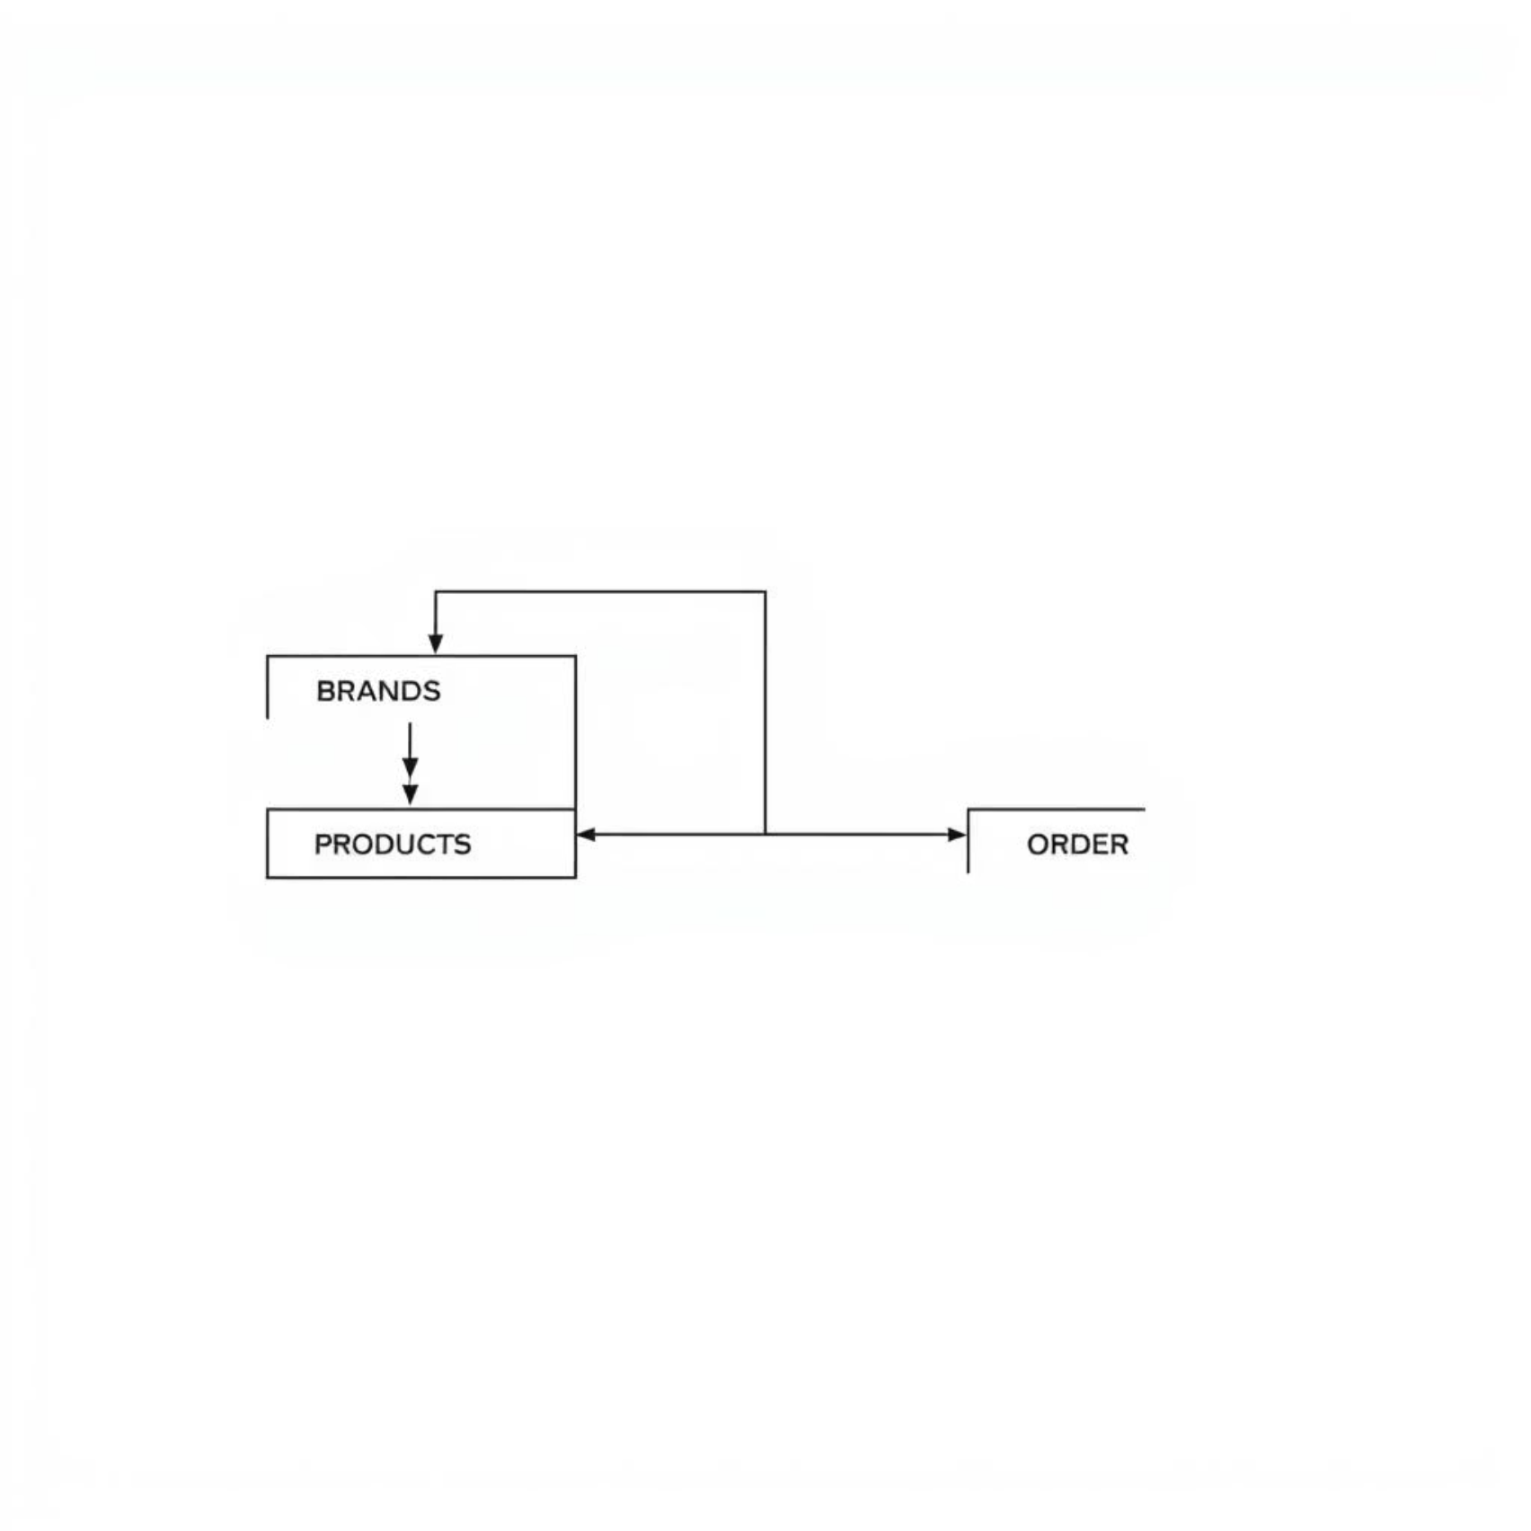
Stage 3: Database Integration
Seamless loading into SQL Server with defined relationships.
Automated Schema
Creates 9 new tables.
Configured FKs
Foreign key relationships set.
Intelligent Loading
Respects data dependencies.
Data Verification
Ensures accuracy, integrity.

Slide 7
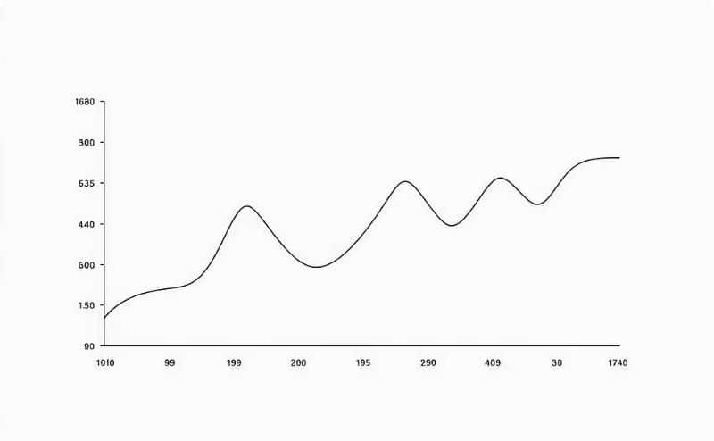
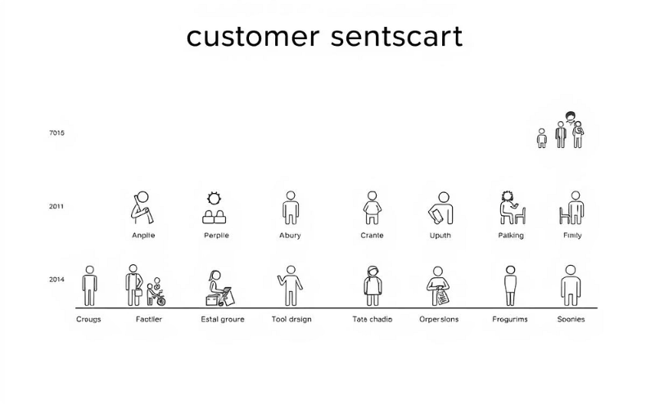
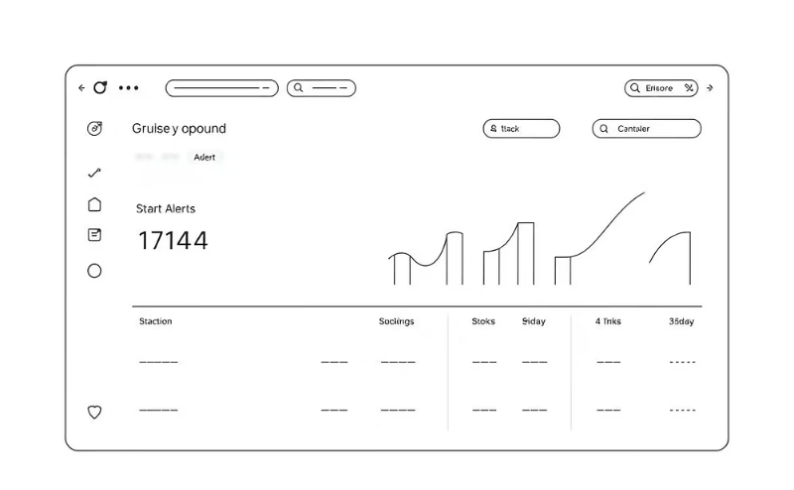
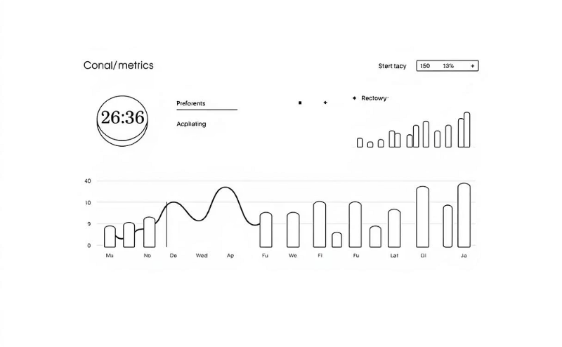
Stage 4: Business Intelligence Reports
Actionable insights delivered through pre-built analytics.
Sales Analysis
Customer Insights
Inventory Management
Staff Performance
Top products, revenue trends.
Segmentation, spending patterns.
Stock levels, automated alerts.
Key operational metrics.
Over 15 pre-built analytical queries ensure comprehensive reporting.

Slide 8
Why This Pipeline?
Unlocking efficiency and accuracy for retail data.
Key Features
Benefits
Fully Automated
Save 10+ Hours
End-to-end workflow.
Per week on data tasks.
Intelligent Config
YAML-driven settings.
98.999% Accuracy
Reliable data, fewer errors.
Modular Design
Flexible, scalable architecture.
Real-Time Insights
Faster, informed decisions.
Comprehensive Testing
Ensures robust functionality.
Easy to Maintain
Streamlined operations.

Slide 9
Technology & Architecture
Leveraging modern tools for a robust and scalable solution.
Python 3.7+
SQL Server 2016+
Matplotlib/Seaborn
Pandas, NumPy, SQLAlchemy.
Efficient ODBC connectivity.
Rich data visualizations.
PyTest
YAML Config
85% code coverage.
Declarative setup.

Slide 10
Real-World Impact
Tangible results showcasing the pipeline's effectiveness.
10,000+
65% to 95%
< 5 Min
Records Processed
Quality Score
Report Generation
Automatically handled daily.
Significant improvement achieved.
Rapid insight delivery.
9
1
Interactive Visuals
HTML Dashboard
Key metrics at a glance.
Centralized data view.

