Slide 1

Daimoma — ديمومة
«سجّل وانسَ — ديمومة مستمرة»
Record and forget — Daimoma is ongoing.
Employee operations, in one place: requests · timesheets · approvals · reports
Employee Requests & Time Tracking — final presentation
Notes:
Daimoma — ديمومة. Slogan: Record and forget — Daimoma is ongoing. Root د-و-م = continuity.

Slide 2
The Problem
Requests and hours scattered across chat, paper, spreadsheets
No answers to: who approved it? where did the hours go? what is pending?
Result: lost requests, unverifiable timesheets, zero audit trail
Notes:
Everyone has lost an approval in a chat thread — keep it relatable.

Slide 3
What Daimoma Is
One workspace: employees submit and track, managers review their team, HR runs the organization
Ownership and status always visible — nothing disappears into a queue
Bilingual EN/AR, accessible, deployed and live
Notes:
One organization per deployment — deliberately scoped, not SaaS.

Slide 4
Users & Roles
Employee — own requests, timesheets, balances
Manager — direct team's non-draft work + own employee view
HR — organization-wide work, admin, request types, allocations
Notes:
Scoping enforced server-side — not just hidden UI.

Slide 5

Brand
Name: Daimoma — ديمومة (continuity)
Tagline: «سجّل وانسَ — ديمومة مستمرة»
Teal/gold palette, light + dark themes, approved logos
Full RTL Arabic — not a translation bolt-on
Notes:
ديمومة is both the name and the word for continuity — double meaning in the tagline.

Slide 6
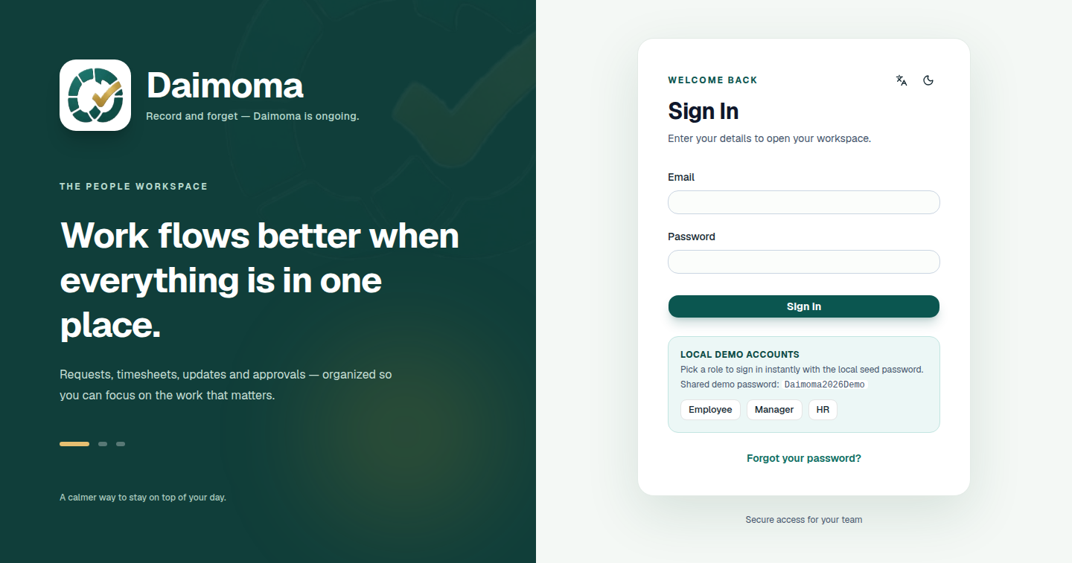
Live & Ready to Try
Quick-login panel: one click per role — no typing for judges.
Notes:
Live at 13.53.139.255:8380. If demoing live, switch to the site here per demo-script.md.

Slide 7
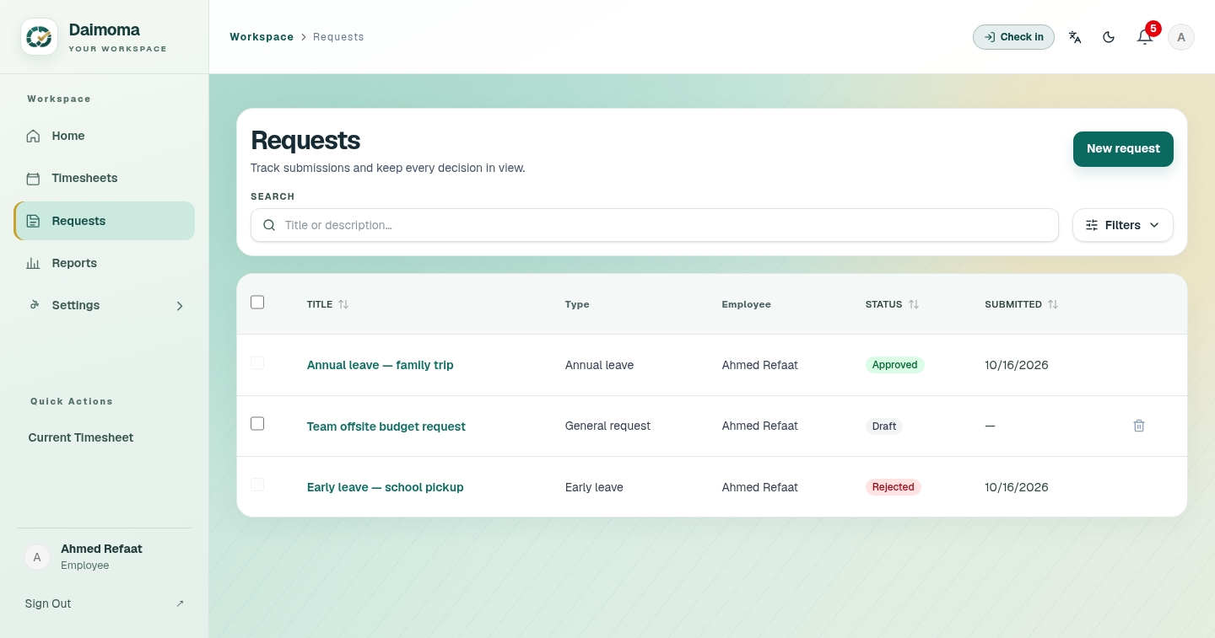
Requests — Every State Visible
Status badges, filters, "Only mine" toggle, bulk draft cleanup.
Notes:
6 types; draft → pending → approved/returned/rejected; manager-first routing, no self-approval.

Slide 8
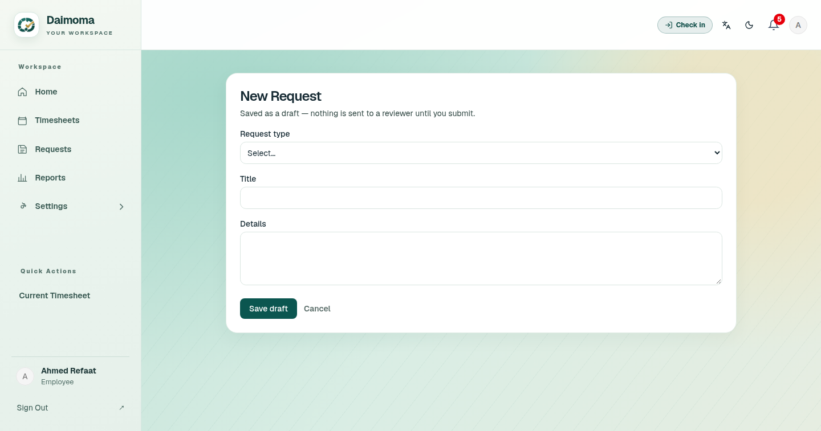
New Request
Type-aware fields: dates, quantity, or same-day times for early leave.
Notes:
Server derives quantities — client input validated twice.

Slide 9
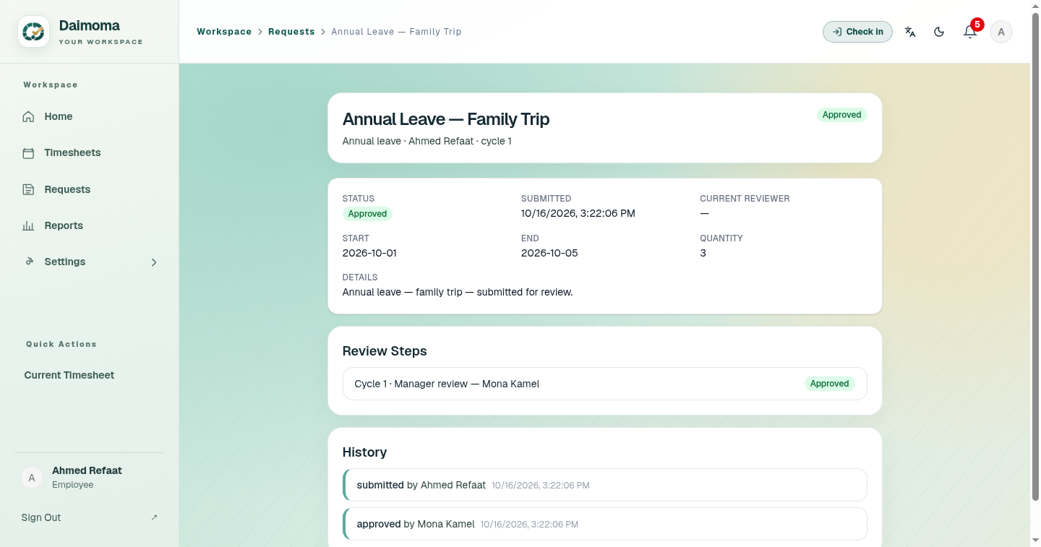
Request Detail
Full lifecycle view — state, history, and the decision actions.
Notes:
Return/reject require a reason; decisions are audited.

Slide 10
Allocations — Controlled Allowances
HR grants dated allowances per employee per request type
Reserve on submit → release on return/reject → settle on approve
Balances always reconcile; no overlapping grants
Early-leave billing: 15-minute blocks, 30-minute minimum
Notes:
Feature 008 — a full spec on its own.

Slide 11
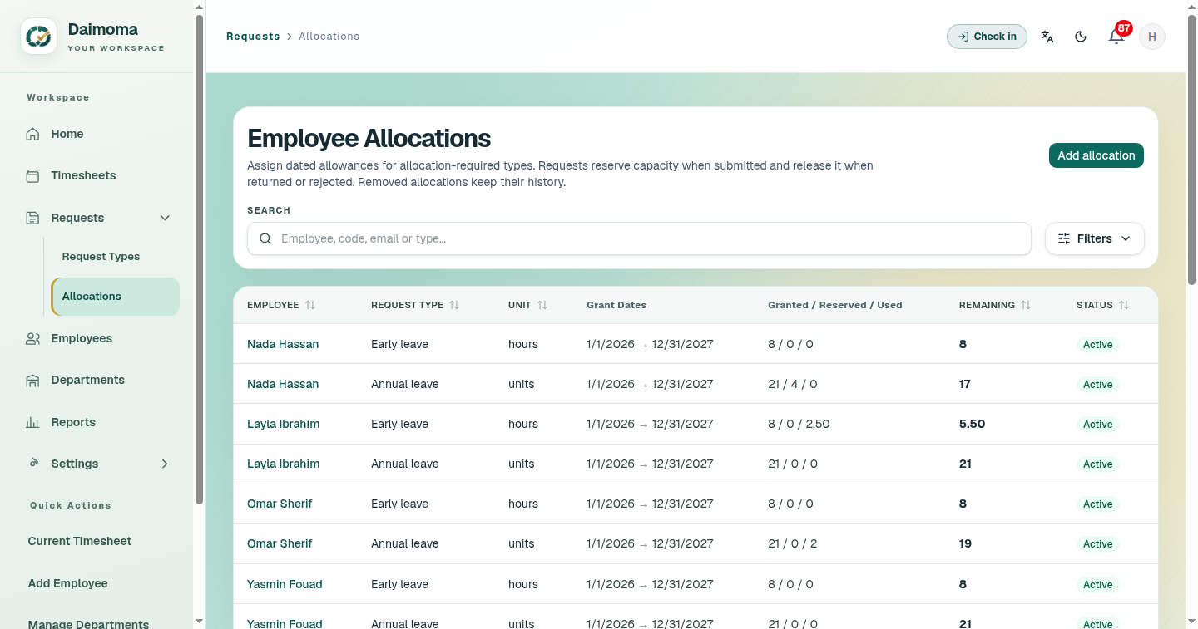
Allocation Grants
Granted / reserved / used / remaining — visible per employee and type.
Notes:
Expired grants keep history while pending reservations stay reserved.

Slide 12
Timesheets — Per-Day Submission
Weekly sheet; each day submitted independently
Start/end + unpaid breaks, overnight split, no future work
Outside-window entries flagged — employee reason required
Two-stage review always: manager → HR; HR-only reopen
Punch widget: real check-in/out from the topbar
Notes:
D-005 decisions — all recorded.

Slide 13
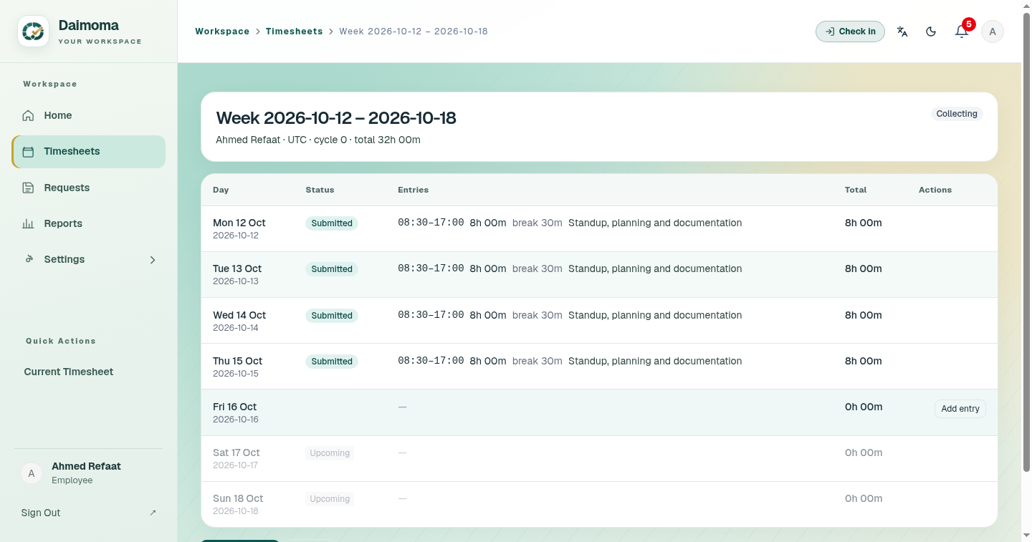
The Week at a Glance
One row per day — status, entries, totals, actions; today highlighted.
Notes:
Redesigned from stacked cards to this grid after live user feedback.

Slide 14
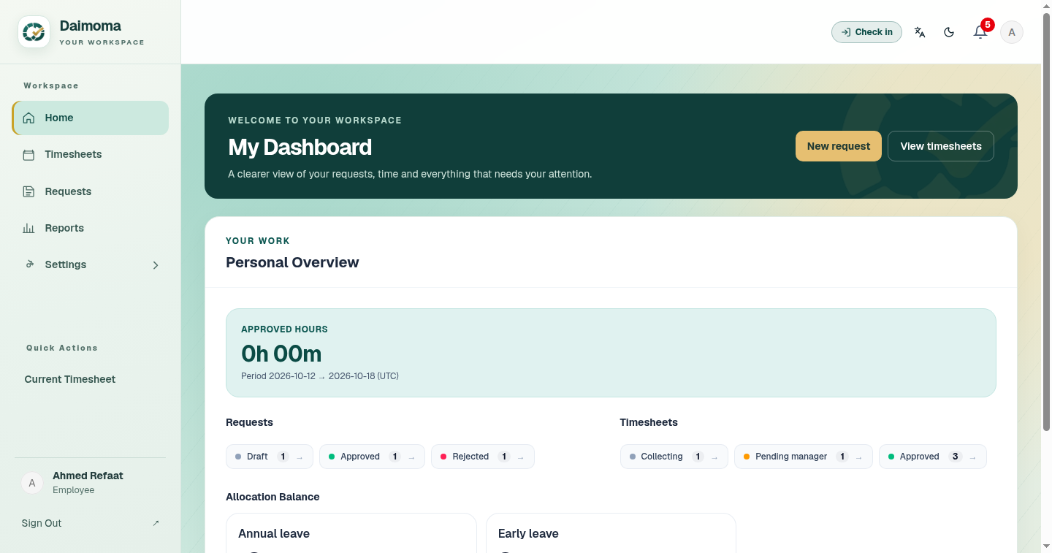
Employee Dashboard
Clickable status chips → filtered lists; allocation balance visible.
Notes:
Role-scoped: this is Ahmed's personal view.

Slide 15
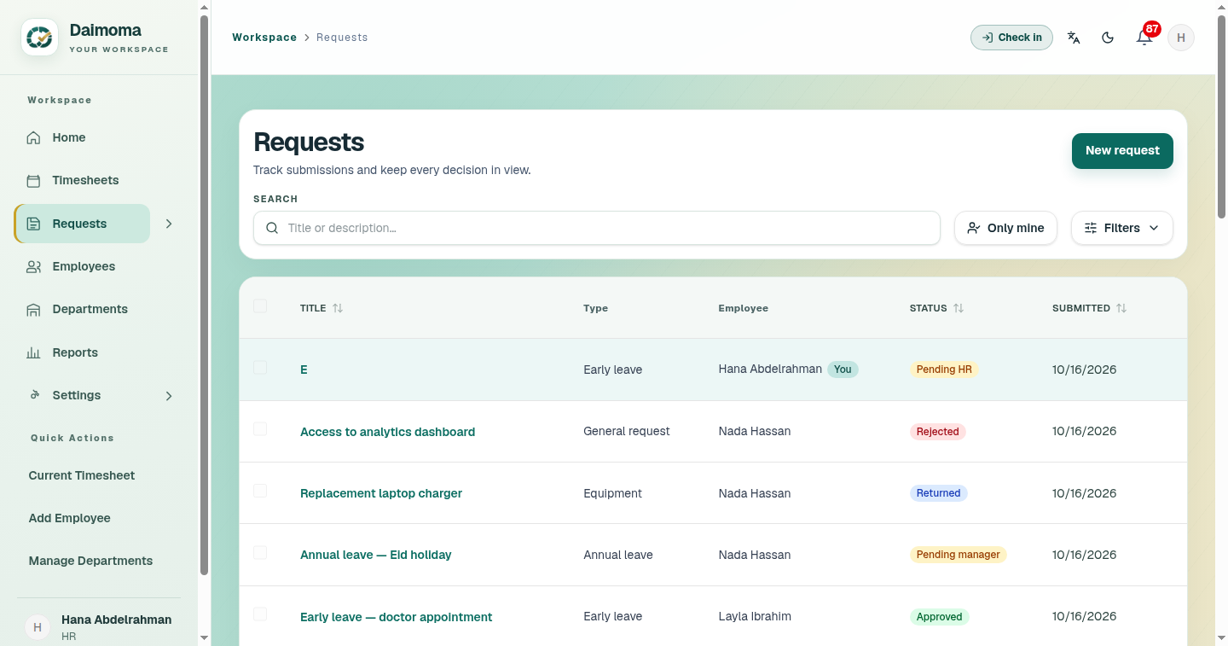
Manager / HR Scoped Views
Team and org queues; own rows highlighted with a "You" badge.
Notes:
Managers see non-draft team work only; HR sees the org.

Slide 16
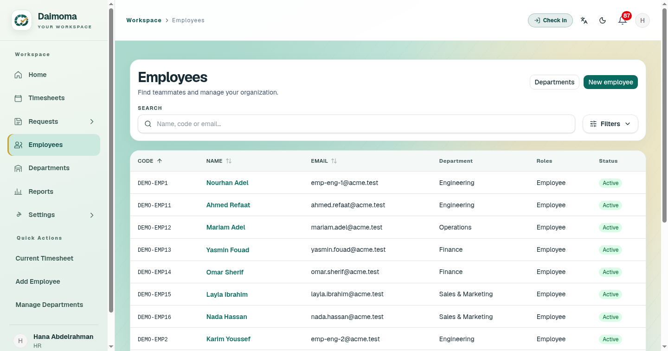
Employee Directory
Searchable, sortable directory — departments, roles, status.
Notes:
HR provisions accounts — no self-signup, per D-003.

Slide 17
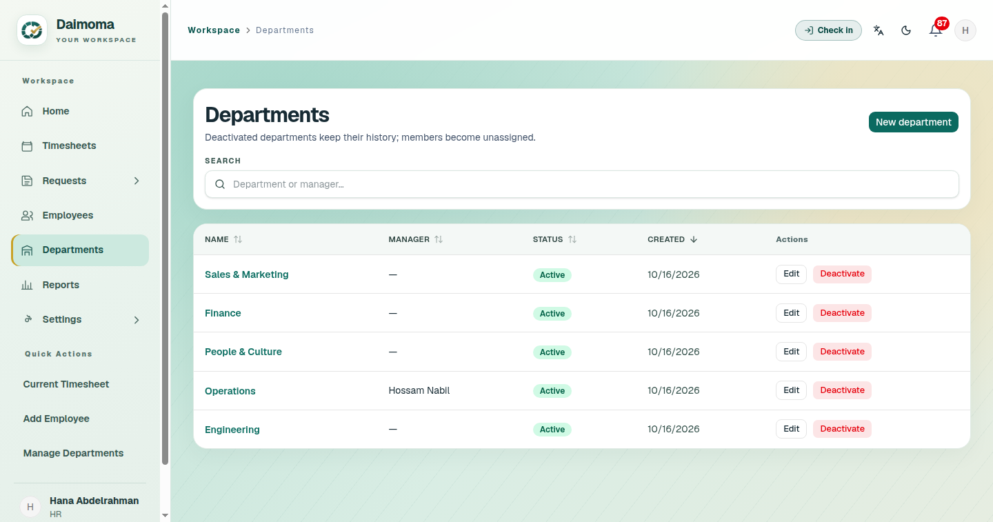
Departments
Org structure with manager assignment and member lists.
Notes:
Manager changes re-route pending reviews automatically (D-004).

Slide 18
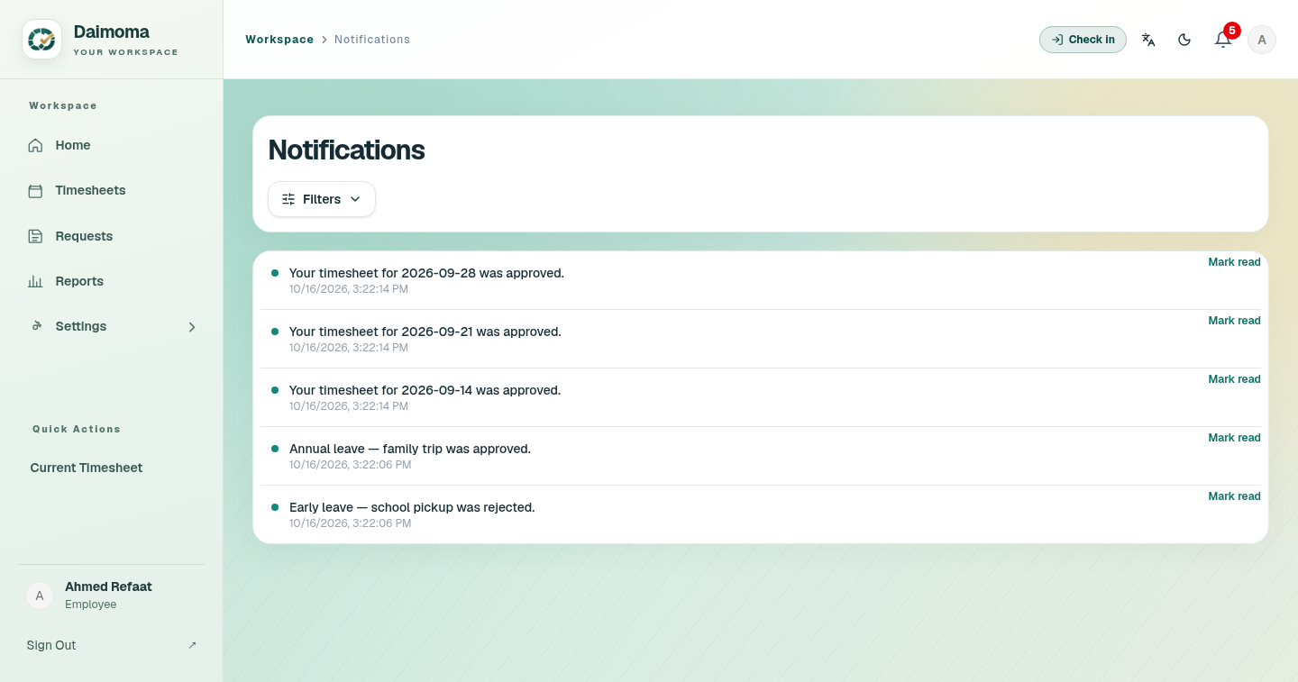
Notifications
Persistent inbox: unread badge, filters, click-through to the record.
Notes:
60-second polling paused while hidden — per D-009.

Slide 19
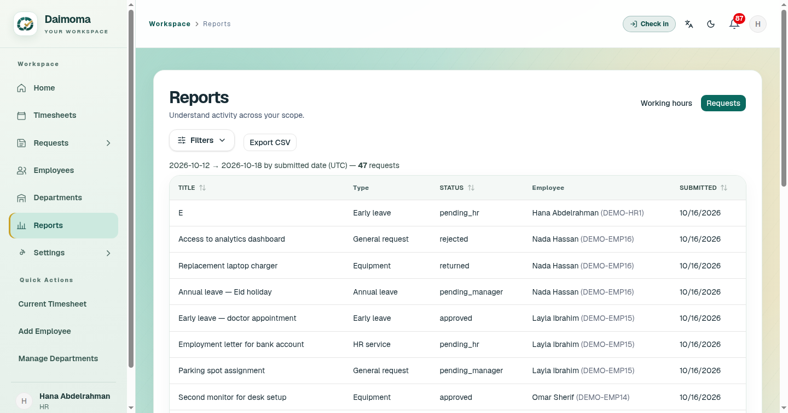
Reports
Working-hours and requests reports, date-ranged, CSV export.
Notes:
Requests tab is the default; 366-day cap, ≤10k rows, formula-injection neutralized.

Slide 20
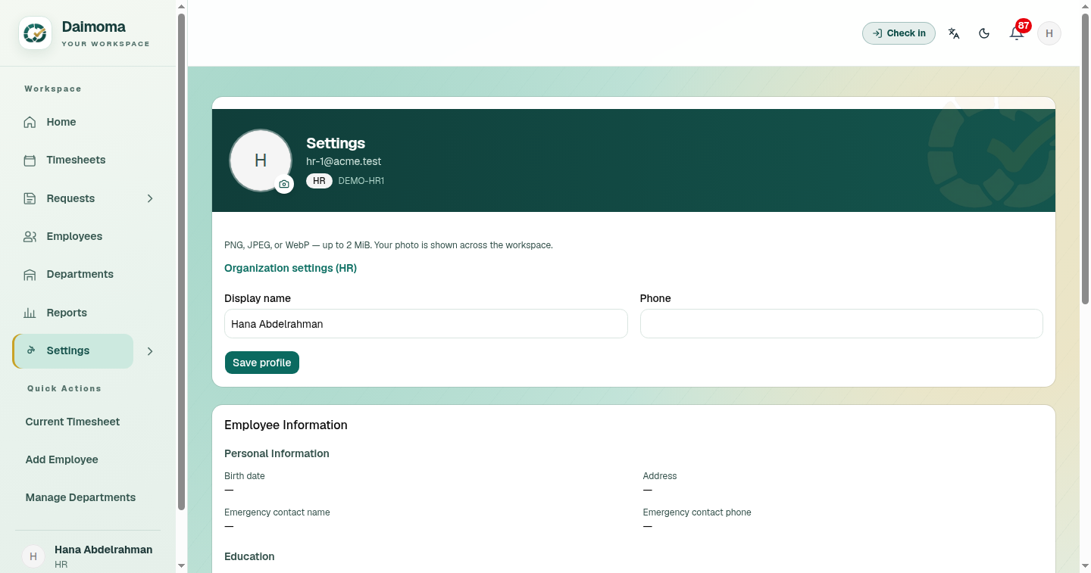
HR Administration
Request types, review stages, allocations, departments, audit.
Notes:
HR-only area — managers get a reduced settings menu.

Slide 21
Architecture
React + TypeScript SPA → same-origin Nginx → Django/DRF → PostgreSQL 17
Modular monolith: explicit services, scoped querysets, thin API layer
One org per deployment; database unreachable from outside Docker network
Documented: architecture/api.md + erd.md + OpenAPI schema
Notes:
Deliberate choice over microservices — right-sized for the brief.

Slide 22
Security
Server-enforced RBAC + ownership scoping on every endpoint
Session auth + CSRF; throttling: 5/5min per account, 20/5min per IP
No secrets in git; database unreachable from outside the Docker network
Evidence: 31 security tests, negative tests per endpoint

Slide 23
Deployment & Operations
Docker Compose stack; Nginx Proxy Manager public edge
CI → deploy: push to main → test gate → rebuild → smoke check
Portainer for container ops; runbook: deploy/rollback/backup/triage
Notes:
The pipeline literally deployed itself during this project.

Slide 24
Spec Kit Process
Constitution ratified first (v1.0.0)
8 features: spec → plan → tasks → implement → evidence → acceptance
11 recorded decisions (D-001…D-011): asked, dated, traced
All phases owner-accepted — including the live deployment

Slide 25
AI-Assisted Development — Disclosed
Built by Devin (Cognition) under spec-kit discipline
Humans approved every decision and every phase acceptance
Evidence separates verified checks from unrun ones — nothing fabricated
Notes:
A strength: honest, reviewed AI work is what the rubric rewards.

Slide 26
Quality Evidence
427 backend tests · 45 frontend tests · 60 e2e (13 accessibility)
Load: 500 employees, ~130k entries, 25 users — all p95 budgets pass
Real N+1 found and fixed under load: 13.3 s → 0.2 s

Slide 27
Honest Limitations
HTTP only — domain + TLS pending (one click once a domain exists)
Demo quick-login shares a password — demo mode, off before real data
No automated backups (owner-waived); attachments deferred
Notes:
Owning limits builds trust — judges reward honest evidence.

Slide 28
Thank You — شكراً
Complete, live, bilingual, accessible employee-operations product
Spec-led · tested · deployed · operable
«سجّل وانسَ — ديمومة مستمرة»
Notes:
Appendix: URL 13.53.139.255:8380 · repo github.com/Ahmed-Mahdyy/Daimoma

