Slide 1

ENTERPRISE STREAMING / ANTI-FRAUD
SIC8
REAL-TIME
PAYMENTS
Zero DB inserts. Sub-10ms scoring. One governed lakehouse.

Slide 2
Velocity without contention
The platform treats database writes as a scalability tax—and removes them from the payment hot path.
10–100 TPS
BURSTS
ZERO DB
INSERTS
SUB-10ms
DECISION
INVARIANTS • replayable events • idempotent processing • no target leakage • zero data loss

Slide 3
Four paths. One governed truth.
Streaming, CDC, batch and inference converge without coupling the payment authorization path.
1 / PAYMENTS
→ MSK
2 / POSTGRES
→ CDC
3 / REFERENCE
→ PARQUET
4 / FEATURES
→ SCORE
S3 + DELTA LAKEHOUSE

Slide 4
Path 1 / Write events, not rows
The transaction service publishes directly to managed Kafka. Partitioning unlocks horizontal scale; consumers remain independently deployable.
PAYMENT
SERVICE
AMAZON MSK
PARTITIONS
STREAM
CONSUMERS
BRONZE
LANDING

Slide 5
Path 2 / Read the WAL once
Debezium captures customer and account mutations from PostgreSQL logs—no application double-write, no polling loop.
POSTGRESQL
WAL
DEBEZIUM
CONNECTOR
CDC TOPIC
KEYED EVENTS
SCD2
CUSTOMER DIM

Slide 6
Path 3 / Batch, made deterministic
Daily reference snapshots are extracted, validated and encoded as columnar Parquet for fast joins and reproducible backfills.
DIMENSION
TABLES
DAILY
EXTRACT
QUALITY
GATES
PARQUET
SNAPSHOT

Slide 7
Bronze is an immutable contract
Partitioning balances write throughput, replay precision and downstream scan efficiency.
SOURCE
payments | cdc
DATE
yyyy / mm / dd
HOUR
hh
OBJECT
compressed files
RAW ≠ MESSY • append-only • schema stamped • lineage preserved

Slide 8
Decision before authorization
A lean LightGBM v2 inference path evaluates each payment against hydrated behavioral state in under ten milliseconds.
EVENT
DESERIALIZE
34 FEATURES
ASSEMBLE
LIGHTGBM v2
INFER
ALLOW / HOLD
DECIDE
< 10 ms

Slide 9
34 features. One definition.
The zero-leakage contract makes offline training and online scoring mathematically identical.
EVENT-TIME
WINDOWS
CUSTOMER
VELOCITY
MERCHANT
RISK
TRAIN = SERVE
PARITY
same source + same clock + same defaults + same transforms

Slide 10
Fast state, resilient state
Redis is the primary online feature store; a thread-safe local cache absorbs outages without stopping authorization.
STREAM
UPDATES
REDIS
PRIMARY
IN-MEMORY
FALLBACK
MODEL
CONTEXT
SUB-MILLISECOND HYDRATION / BOUNDED STALENESS / ZERO-DOWNTIME FALLBACK

Slide 11
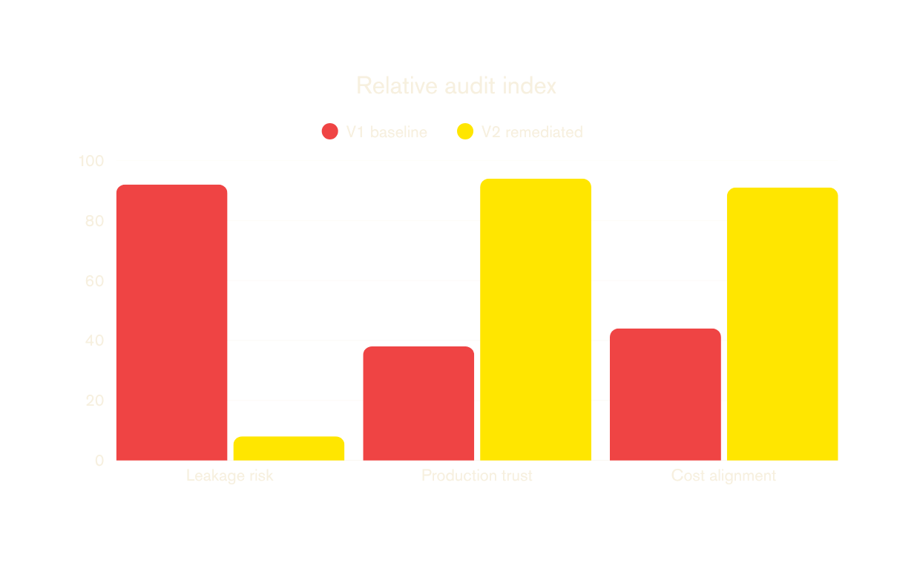
V2 optimizes the cost of being wrong
Leakage remediation trades inflated offline confidence for trustworthy production decisions.
NO
LEAKAGE
Empirical thresholds tuned to the banking cost curve—not vanity accuracy.

Slide 12
Failure becomes a replayable event
Malformed payloads, poison pills and contract violations are isolated with full context—never silently dropped.
VALIDATE
ENVELOPE
ROUTE
FAILURE
DLQ + ERROR
CONTEXT
FIX +
REDRIVE

Slide 13
Medallion turns events into evidence
Continuous Delta processing adds quality, identity and business meaning without erasing the source record.
BRONZE
RAW + REPLAY
SILVER
DEDUP + REFUNDS
GOLD
FRAUD MART
Delta Lake • checkpoints • MERGE semantics • refund matching • SCD Type 2

Slide 14
Orchestration is control, not compute
Airflow coordinates incremental extracts, quality gates and infrastructure tasks while preserving idempotent retries.
SCHEDULE
DAG RUN
EXTRACT
INCREMENT
VALIDATE
CONTRACT
PUBLISH +
OBSERVE

Slide 15
Trust boundaries are explicit
Every layer is encrypted, identity-scoped and isolated; secrets never enter source code or runtime images.
IAM
LEAST PRIVILEGE
TLS + KMS
IN TRANSIT / REST
SECRETS
MANAGED
NETWORK
BOUNDARIES

Slide 16
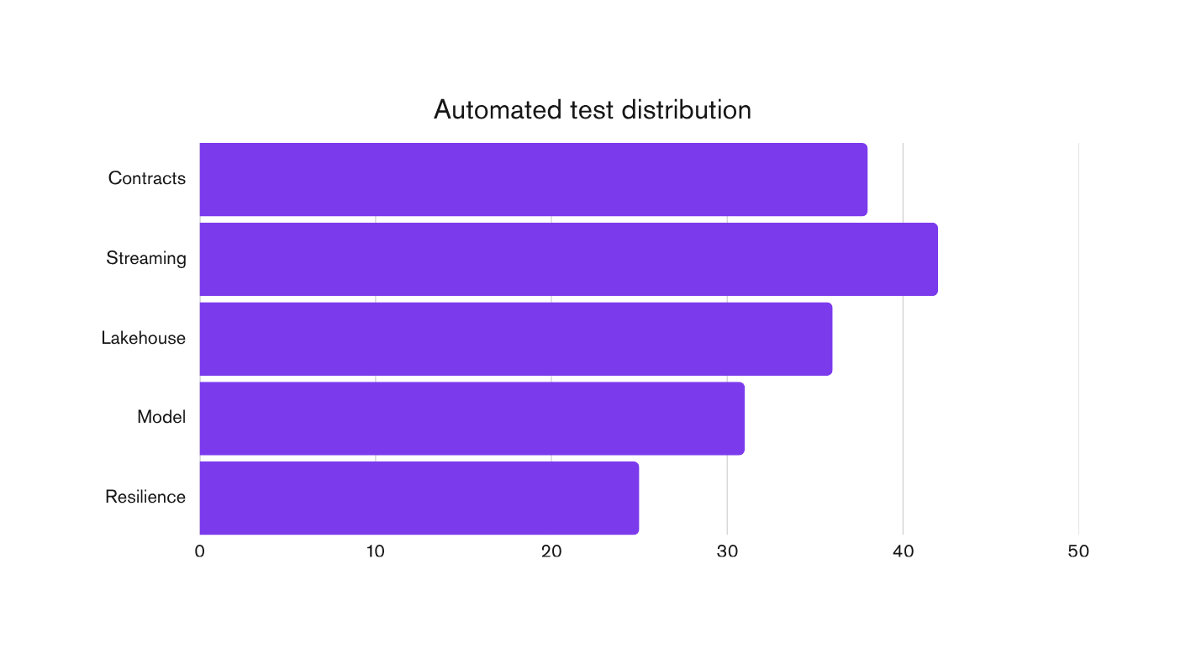
172 tests—and the cloud evidence
Contracts, transformations, model behavior and stress limits are verified as a single production acceptance system.
172
AUTOMATED TESTS
10–100 TPS
cloud stress envelope

Slide 17
Production-ready by design
A reproducible, observable anti-fraud lakehouse that scales payments without scaling database contention.
STREAM
WITHOUT LOCKS
SCORE
BEFORE AUTH
REPLAY
WITHOUT LOSS
GOVERN
END TO END
SIC8 / REAL-TIME PAYMENTS

