Slide 1

Master Thesis - Topic Modelling for Automated Journalism
Student:
Andrew Ellul
M.Sc Informatik
Technical University of Munich
Advisor:
Ahmed Mosharafa,
Working Group “Social Computing”
Department of Informatics
Technical University of Munich
Munich, Wednesday 13th October

Slide 2
Contents
High Level Update
I. Analysis: Selected Papers
I. Analysis: Topics
I. Analysis: Ideas

Slide 3
High Level Update: Wednesday 13th October 2021
Doing
Todo
Done
Survey Papers Review
Done since last update
Next Steps
Blockers / Open Qs
Datasets Review
I. Analysis
Reviewed 8 Papers
Find more benchmarking papers for comparison
None
Algorithms Review
Found 1 great survey paper and did a deep dive
Investigate “Meme Ident.” in the context of Topic Modelling
Algorithm & Dataset Benchmarking
Identified 1 research gap in methodology
Collect and organise various combinations of techniques
Algorithm & Dataset Proposal
II. Implementation
Identified several methods for topic modelling
Algorithm Integration
Future Work
III. Summary

Slide 4
Long Meeting - Deep Dive: I. Analysis
Papers
Topics
Ideas

Slide 5
I. Analysis: Selected Papers
Paper | Datasets | Abstract | Conclusions
Type: Survey “An evaluation of document clustering and topic modelling in two online social networks: Twitter and Reddit“ Curiskis, S. A., Drake, B., Osborn, T. R., & Kennedy, P. J. (2020). An evaluation of document clustering and topic modelling in two online social networks: Twitter and Reddit. Information Processing and Management, 57(2). https://doi.org/10.1016/j.ipm.2019.04.002 | Twitter Reddit | A survey paper evaluating various combinations of topic modelling methods on OSN datasets (Online Social Networks) | The quality and nature of the underlying dataset will determine the best combination of methods for topic modelling. Overall, an embedded method via doc2vec combined with k-means yielded consistently good results.

Slide 6
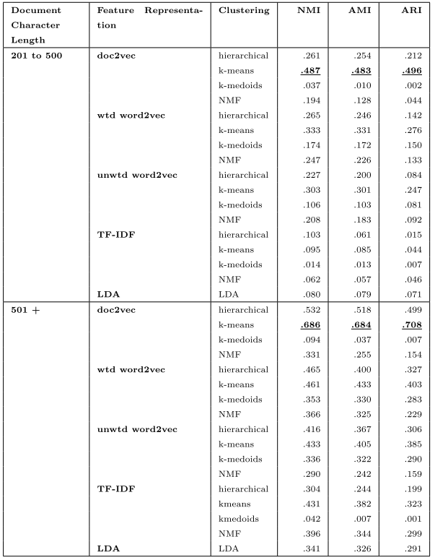
“An evaluation of document clustering and topic modelling in two online social networks: Twitter and Reddit“
Curiskis, S. A., Drake, B., Osborn, T. R., & Kennedy, P. J. (2020). An evaluation of document clustering and topic modelling in two online social networks: Twitter and Reddit. Information Processing and Management, 57(2). https://doi.org/10.1016/j.ipm.2019.04.002
Summary: Curiskis et al (2020) conducted an exemplary investigation into topic modelling for Online Social Networks (OSNs). They found that overall a doc2vec model with k-means delivered the best performance on Twitter and Reddit datasets for topic discovery. However, this was not exclusive, as in certain cases such as with the REpLab 2013 Twitter dataset, Curiskis et al observed that a word2vec model outperformed the doc2vec approach. Another interesting outcome of this paper is the topic of the platform dependent context with regards to the dataset and text quality. Curiskis et al. observerd that TF-IDF showed low performance on Reddit datasets until the document size rose about 200 characters, whereas when applying TF-IDF to Twitter datasets (tweets are naturally restricted to 280 characters), TF-IDF performed “comparatively well”. This indicates that a 280 character Reddit comment is not equal to a 280 character tweet, as the later’s platform is built around this restriction that incentivizes efficient and concise use of language. To the end, Curiskis et al suggested assigning heavier weights to hashtags and mentions in Twitter datasets to aid the doc2vec approach. They also stressed that doc2vec performance increases with the length of the documents. By far the most intriguing factor in this investigation is the notion that a platform’s culture and organic use influences the type of text contained in its documents. Tweets are condensed, efficient 280 character strings which expect to have a high keyword volume (hashtags, mentions). Reddit comments are more free-form and discussion based but may contain memes and syntactic jargon specific to the subreddit, such as codewords adopted from within the subreddit.
Techniques:
LFK-NMI – clustering for meme identification (Ferrara et al.)
K-core degeneracy process - Shabunina and Pasi (2018)
Non-Negative Matrix Factorization (NMF) – Godfrey et ak,
Other Evaluation methods: 4-measure, NMI, Entropy. TF-IDF
DBSCAN, k-means, k-medoids
Ailment Topic Aspect Model
Dynamic Topic Models (temporal data)
Doc2vec clustering
Methodology:
Consider ’meme identification’ as a necessary pre-processing step in order to better identify topics
- Created work embeddings and then used k-means to find topical clusters
- Benchmarked NN performance
- doc character length vs feature representation, clustering, NMI, AMI

Slide 7
Long Meeting - Deep Dive: I. Analysis
Papers
Topics
Ideas

Slide 8
I. Analysis: Topics
Meme Identification – Memes as a latent representation of textual content. A key process in topic modelling for OSN (Online Social Networks)
Dataset textual quality / Platform’s linguistic culture – Twitter has a naturally high keyword density due to its use as a notification tool and its character restriction. Reddit comments are more long-form however are likely to contain semantic codewords and memes specific to the culture of the subreddit.

Slide 9
Long Meeting - Deep Dive: I. Analysis
Papers
Topics
Ideas

Slide 10
I. Analysis: Ideas
Methodology for dataset ‘keyword density’ evaluation: Curiskis et al. highlights that a 200 character Tweet is not of the same textual quality as a Reddit comment of the same length. They show empirically that TF-IDF methods perform comparatively much better on twitter documents of the exact same length. They hypothesise that this may be due to the relatively high keyword density found in average tweets. Either way, there is a clear incentive to tailor different combinations of embeddings and clustering methods to the dataset. Currently it seems there is no general methodology or investigation into how to determine the quality of a dataset. I propose developing a method to quantitatively analyse datasets in order to determine keyword density – as a necessary pre-processing step to choose the correct Topic Modelling method

