Slide 1

Apple Sales Analysis Report
Sales, Products & Warranty Performance
Author: Ahmed Mostafa
Date: November 2025
Period: 2020 - 2024

Slide 2
Story
This report done by Python and provides a comprehensive analysis for Apple Company from year 2020 till 2024.
The provided datasets were sales, product, store, category, and warranty data.
- The analysis covers overall performance, sales trends by product category and geography, and an initial assessment of warranty claim performance.

Slide 3

Strong Revenue Performance with Exceptional Product Reliability
Total revenue reached $6.17 billion across 1.04 million transactions with a low 2.88% warranty claim rate, demonstrating robust market performance and high product quality.
$6.17B
5.72M
Total Revenue
Units Sold
1.04M
2.88%
Sales Transactions
Warranty Claim Rate

Slide 4

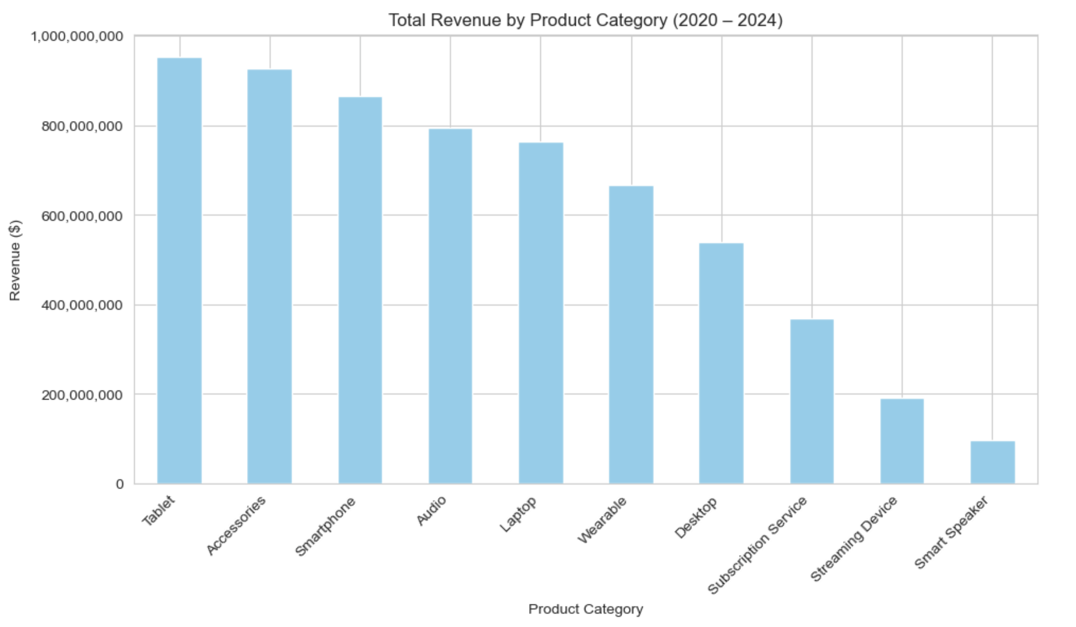
Total Revenue for Each Product
Tablet and Accessories Categories Drive 40% of Total Revenue
The top five product categories generate the majority of revenue, with Tablets ($953M) and Accessories ($927M) leading the market. This concentration indicates strong market demand in specific segments.
Top 5 Categories:
1. Tablet: $953.4M
2. Accessories: $927.1M
3. Smartphone: $865.1M
4. Audio: $794.9M
5. Laptop: $763.3M

Slide 5

Subscription Services Outperform Hardware in Individual Product Revenue
Apple Music leads all products with $125.4M in revenue, surpassing premium hardware like the iMac 27-inch. This demonstrates the strategic value of recurring revenue models.
1st Place
2nd Place
3rd Place
Apple Music
iMac 27-inch
iPad mini (5th Gen)
Subscription Service
Desktop
Tablet
$125.4M
$124.0M
$123.9M
Key Insight: The success of Apple Music demonstrates that recurring revenue models generate comparable or superior returns to high-value hardware sales. This suggests a strategic opportunity for cross-selling and upselling additional services across the product portfolio.

Slide 6
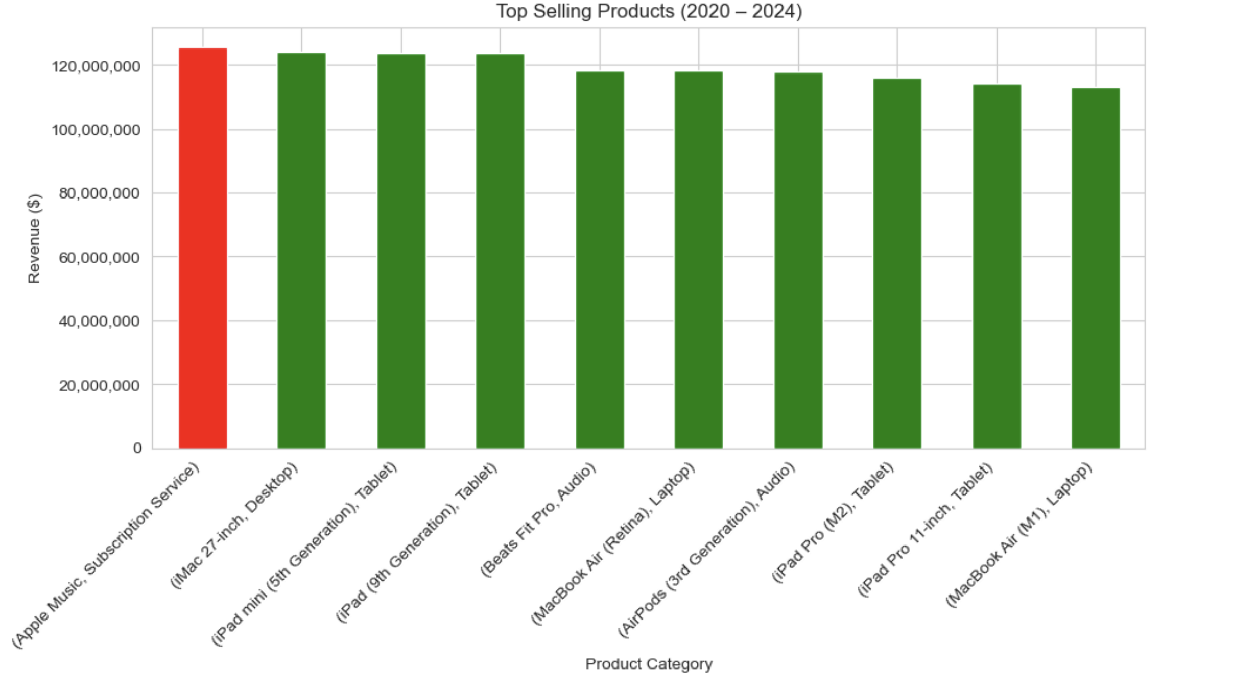
Top Selling Products (2020 – 2024)

Slide 7

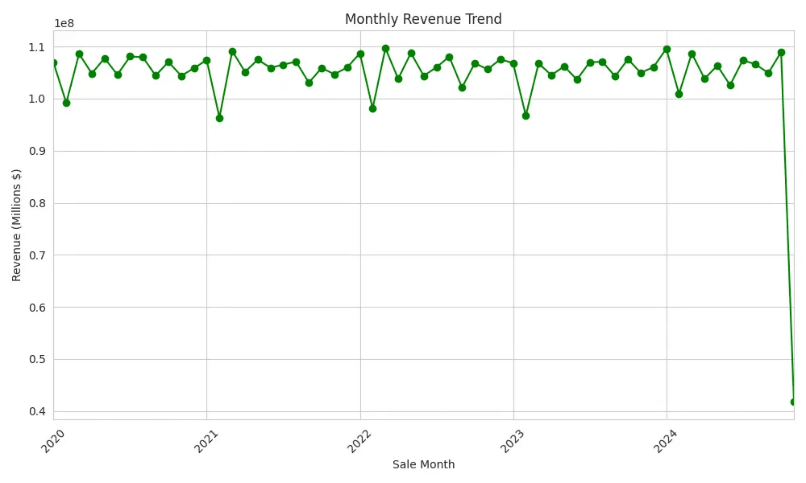
Monthly Revenue Remains Remarkably Stable Across Five Years
Sales volume consistently hovers between $100M-$110M monthly from 2020-2024, indicating stable demand and predictable business operations.
Average Monthly
Revenue Range
Period
~$105M
$96M-$110M
60 Months

Slide 8

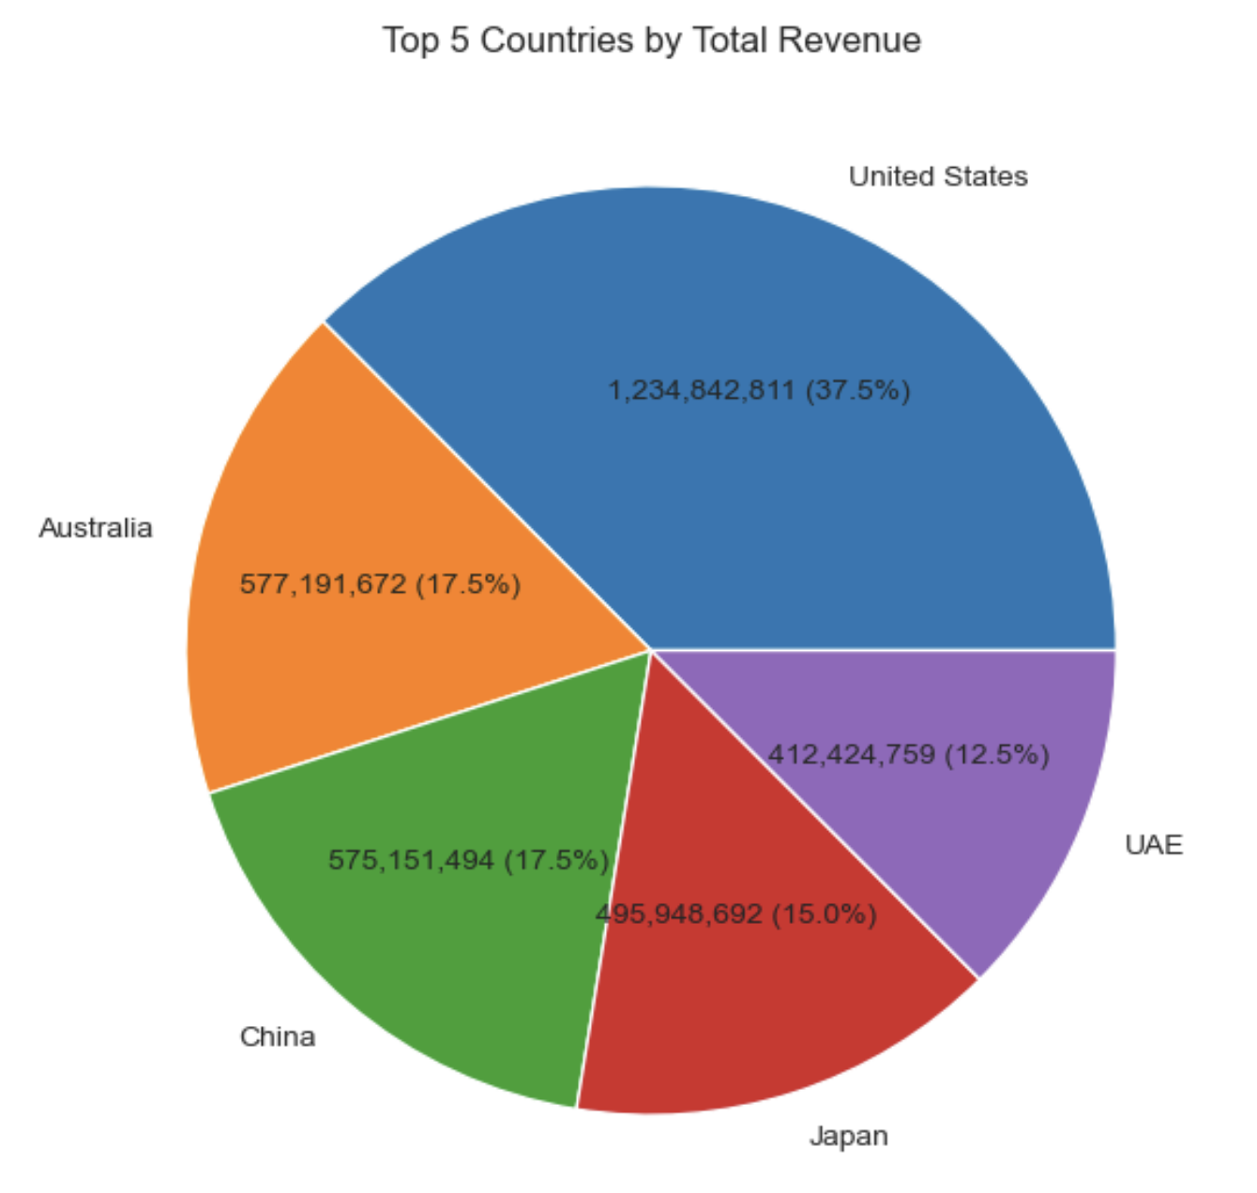
United States Market Dominance Creates Geographic Risk Concentration
The US generates about $1.23 billion (37.5% of revenue), more than twice any other country, presenting strategic risk and growth opportunity.
First Place: US Market
Next Largest: Australia & China
4th & 5th Place: UAE & Japan
$1.23B
$577M
2.1x

Slide 9
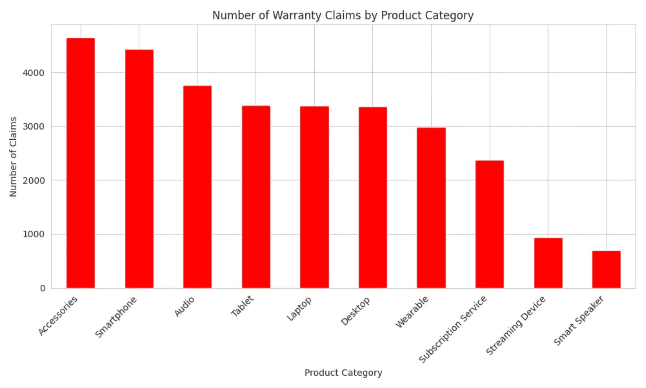
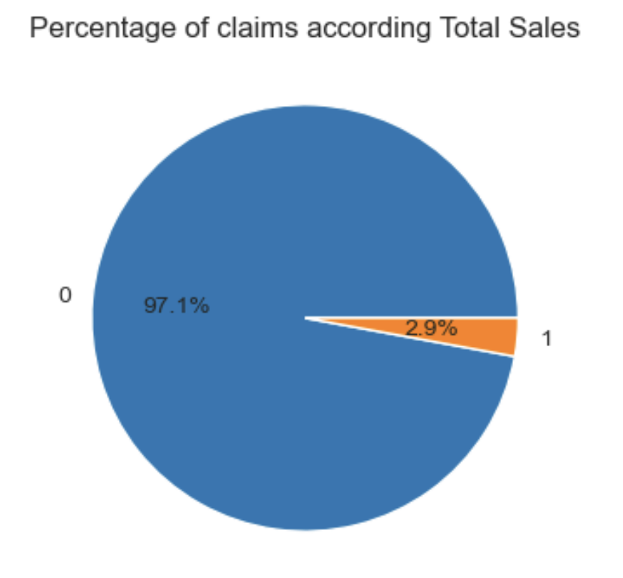
Accessories and Smartphones Require Immediate Quality Control Review
While overall claim rate is low at 2.88%, Accessories (4,650 claims) and Smartphones (4,434 claims) show elevated warranty activity, suggesting potential quality issues in these categories.
Top 3 Claim Categories:
1. Accessories: 4,650 Claims
2. Smartphone: 4,434 Claims
3. Audio: 3,768 Claims

Slide 10

Four Strategic Priorities for Sustainable Growth and Risk Mitigation
Focus on quality control investigation, service expansion, geographic market diversification, and replication of top-performing product success factors to drive future growth.
1
2
Quality Control Investigation
Service Expansion
Immediately investigate the root causes of high warranty claims in the Accessories and Smartphone categories to improve product reliability and reduce post-sale costs.
Leverage the success of the Subscription Service model (Apple Music: $125.4M) to drive higher-margin recurring revenue and increase customer lifetime value.
3
4
Market Diversification
Success Replication
Develop targeted strategies to increase market share in high-potential countries (China, Japan, Australia) to reduce reliance on the US market and mitigate geographic risk.
Analyze success factors of top-performing products (Tablets, Services) and apply lessons learned across the entire portfolio to maximize revenue potential.

