Slide 1
Multi-stage Image Restortion and Enhancement
Presented by: Muhammad Ahmed Naseer

Slide 2
Objective
Model
Image restoration :
De-noising
De-blurring
Resolution enhancement
Image enhancement
Degraded image
Required output

Slide 3

MirNETv2 working
Noisy
RRGs
Image
feature maps
deep features
Final output
Optimal
Blurry
CNN
CNN
Charbonnier loss

Slide 4

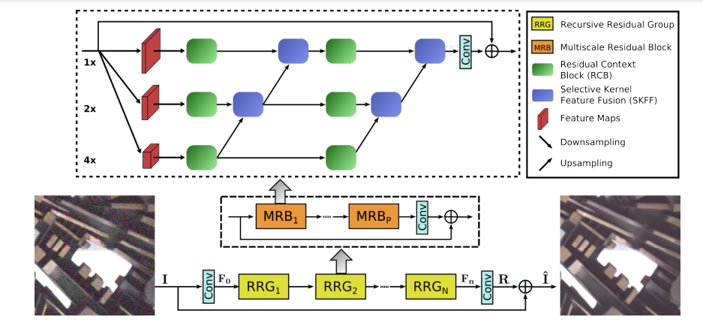
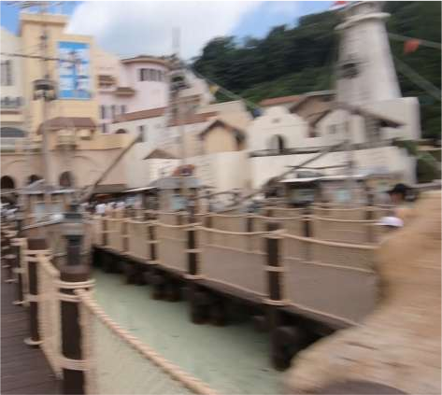
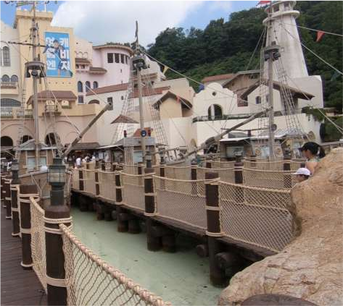

Hello!

Slide 5

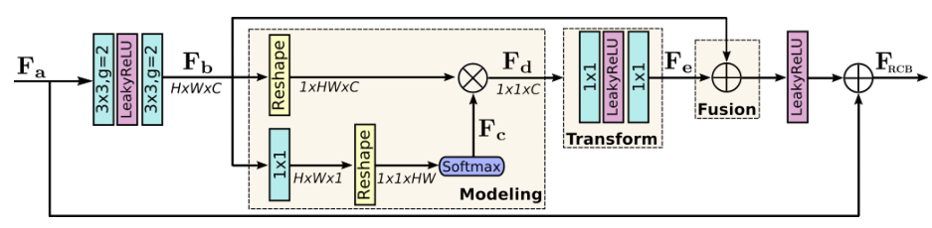

Slide 6
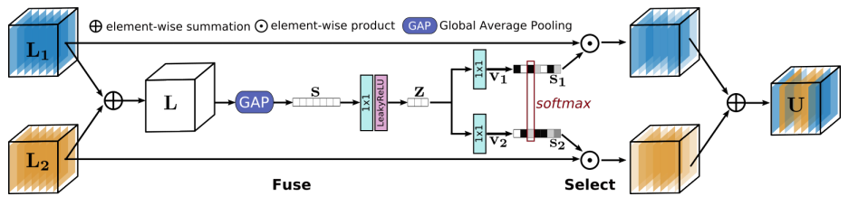

Slide 7
Datasets
Six datasets:
DPDD for deblurring
DND and SIDD for image denoising
Real SR for super resolution
LOL and MIT-Adobe Five-K for image enhancement

Slide 8
Activation Functions
Relu activation function
SoftMax activation function

Slide 9
Libraries
Basic SR Toolbox(Pytorch)
Opencv
Numpy
Etc..

Slide 10
Thank You!

