Slide 1

Document Management System

Slide 2
File Explorer Function
Browse and manage server files
Create, upload, download files
Organize project folders

Slide 3
Version Control
Track file changes over time
Maintain historical records

Slide 4
Version Control in DMS
Each file has a history: V1, V2, V3, etc.
Changes are tracked, reversible, and auditable
Visual: Screenshot or diagram showing versions of a file
Benefits:
Avoid data loss
Enable review and approval workflows
Support rollback

Slide 5
Naming Convention
ISO-19650 Standardized object identification
Facilitates quick location
Uniform naming across all files
Reduces information retrieval time
Eliminates file name confusion

Slide 6
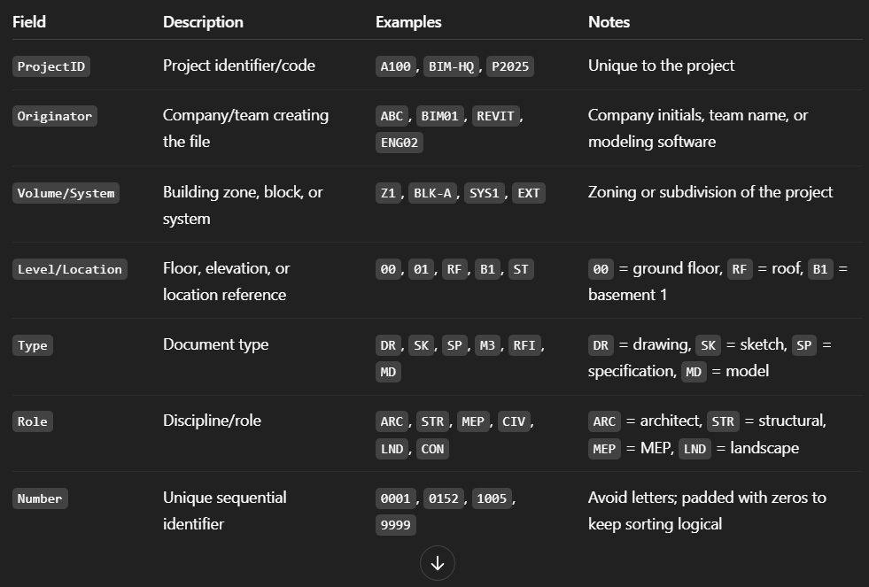
Naming ConventioN WiTH ISO-19650 Standards
Project-Originator-Zone-Level-Type-Role-Number

Slide 7
CDE Workflow Overview
Work in Progress (WIP)
Shared
Published
Archive

Slide 8
Stage | Description | Who Works Here | File Status & Naming | Purpose
1. Work in Progress (WIP) | Private area where individuals or teams work on their own content before sharing. | Internal team members only | Draft / WIP version A100-ABC-Z1-00-DR-ARC-0001-WIP | Develop and test information
2. Shared | Information shared across disciplines for coordination and review. | Collaborating teams (e.g. ARC, STR, MEP) | Reviewed but not final A100-ABC-Z1-00-DR-ARC-0001-SHD | Multi-disciplinary coordination
3. Published | Official, validated content used for construction or decision-making. | All stakeholders | Controlled release A100-ABC-Z1-00-DR-ARC-0001-PUB | Issue for Tender / Construction
4. Archive | Static, immutable snapshot of published data for future reference. | Document controllers, QA/QC | Frozen versions A100-ABC-Z1-00-DR-ARC-0001-ARC | Legal, QA, and traceability

Slide 9
Document Movement Flow
WIP → Shared: After internal checks, models or drawings are exported to a shared space for others to review.
Shared → Published: Once coordination is done and content is approved, it's officially published.
Published → Archive: After publishing, data is archived for traceability and auditing.

Slide 10
Role-Based Access Control (RBAC)
Viewer
Editor
Reviewer
Admin

Slide 11
Access Levels
View only
View and download
View, download, upload
Upload only
View, download, upload, edit

Slide 12
Role determines:
Access level (read/write/approve)
Permissions per folder or document type

Slide 13
Benefits of an OpenBIM-Ready DMS
Interoperability across platforms and vendors
Longevity of data (future-proof)
Collaboration with different stakeholders
Compliance with ISO 19650 and EU regulations

