Slide 1
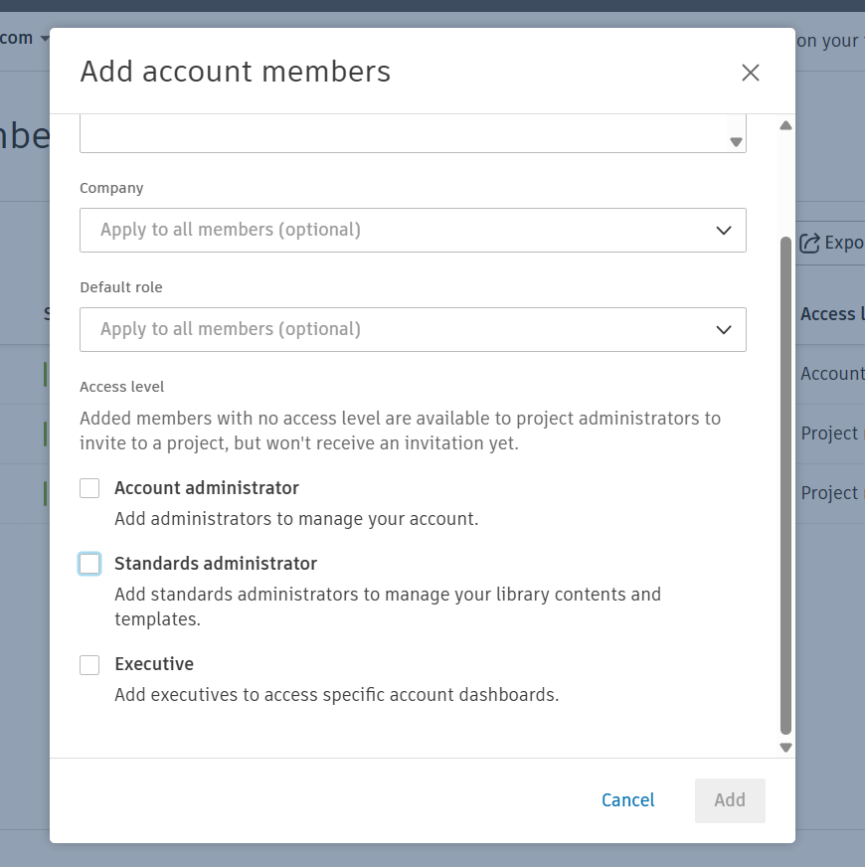
Required Global Access Levels

Slide 2
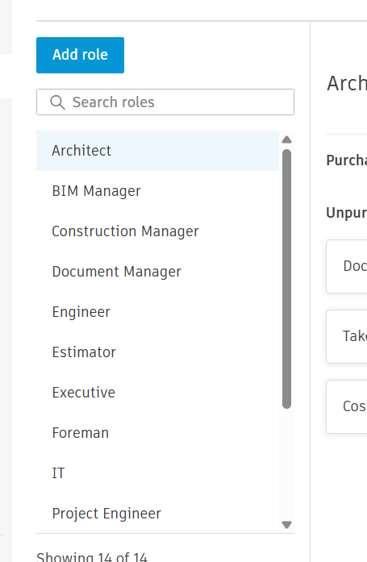
Required roles

Slide 3
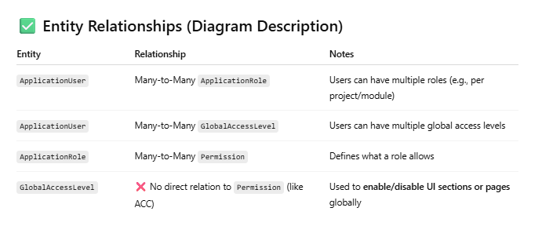
Understand the relations specially for permissions

Slide 4
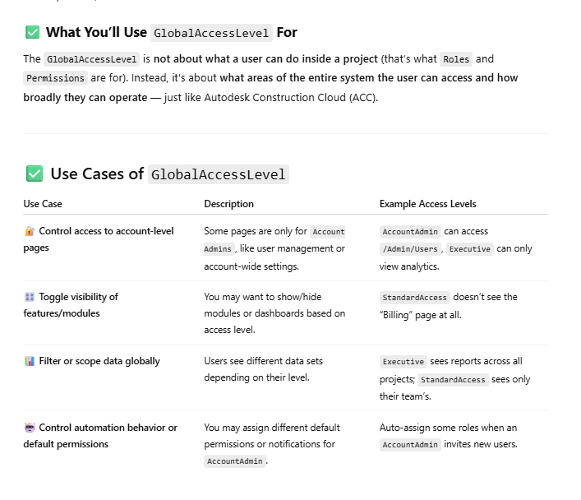
Understand difference between global Access Levels and Roles in our development scope

Slide 5
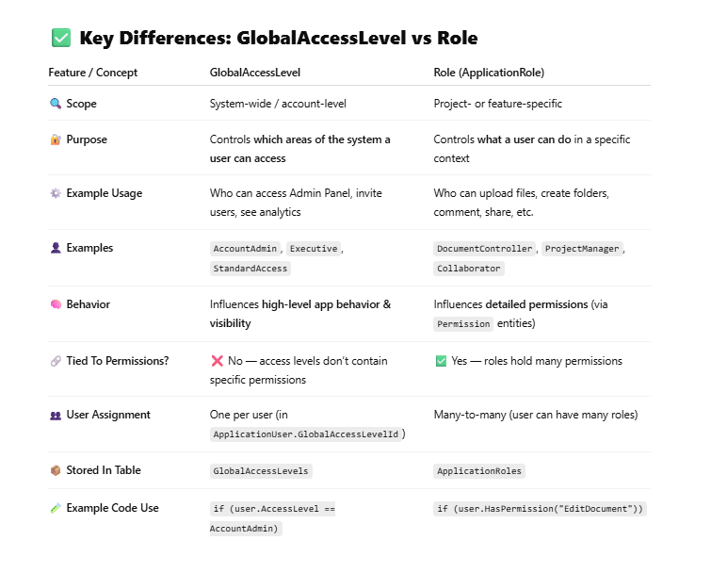
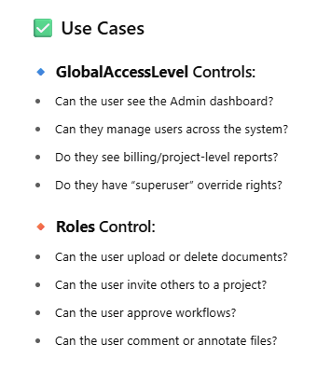
Understand difference between global Access Levels and Roles in our development scope

