Slide 1

Feedback Circuits
Note (01)
Dr. Ahmed Reda Mohamed
Ahmed.Mohamed@kfupm.edu.sa
IRC for Communication Systems and Sensing, King Fahd University of Petroleum & Minerals, Dhahran 31261, Saudi Arabia
01

Slide 2
Outlines
  Feedback Fundamentals
  Negative Feedback Topologies
  Negative Feedback: Benefits and Tradeoffs
    Gain Robustness
    Bandwidth Extension
    Internal Disturbance/Noise Suppression
    Lower In-Loop Distortion
    Impedance Control
  Resistance Derivations
02

Slide 3

Feedback Fundamentals (1/4)
Feedback Circuits
  Feedback circuits are classified according to the polarity of the returned signal.
Negative feedback
Positive feedback
The feedback signal is subtracted from the input.
The feedback signal is added to the input.
xᵢ
+
A
xₒ
xᵢ
+
A
xₒ
−
+
β
β
Closed-loop gain
A / (1 + Aβ)
Closed-loop gain
A / (1 − Aβ)
Application: amplifier design
Application: signal and waveform generation
Square
Triangular
Sinusoidal
Dr. Ahmed Reda
03
Notes:
Fundamentals

Slide 4

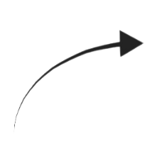
Feedback Fundamentals (2/4)
Negative Feedback: Definitions and Gain
  The closed-loop gain is derived from the error signal and the feedback factor.
Signal and gain definitions
Negative-feedback model
x
Input signal
x
x
i
Output signal
+
e
A
o
x
x
x
Feedback signal
i
o
f
−
x
=
x
−
x
Error signal
x
e
i
f
f
β
A =
x
/
x
Open-loop gain
o
e
A
=
x
/
x
Closed-loop gain
f
o
i
β =
x
/
x
Feedback factor
f
o
Closed-loop gain derivation
Negative feedback
x
= A
x
= A(
x
−
x
)
x
A
o
e
i
f
A
=
o
=
x
= β
x
f
x
1 + Aβ
f
o
i
x
= A(
x
− β
x
)
Closed-loop gain = Forward gain / (1 + Loop gain)
o
i
o
x
(1 + Aβ) = A
x
o
i
Aβ denotes the loop gain.
Note: Positive-feedback counterpart
A
A
=
Dr. Ahmed Reda
f
1 − Aβ
04

Slide 5
Feedback Fundamentals (3/4)
Negative Feedback: Definitions and Gain
  The same amplifier is compared with and without a negative-feedback network.
With negative feedback
Without feedback
Feedback factor β = 0.01
Open-loop operation
+
V
A = 1000
V
V
A = 1000
V
i
o
i
o
−
β = 0.01
V
A
V
A
=
o
=
A =
o
= 1000
Open-loop voltage gain
f
V
1 + Aβ
V
i
i
A
= 1000 / 11 ≈
90.9
f
Loop gain: Aβ = 10
Feedback denominator: 1 + Aβ = 11
The gain trade-off:
The reduced gain motivates analysis of feedback advantages and limitations.
Dr. Ahmed Reda
05
Notes:
The reduced gain motivates analysis of feedback advantages and limitations.

Slide 6
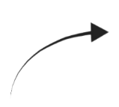
Feedback Fundamentals (4/4)
Example→ Non-Inverting Amplifier with Negative Feedback
  A high loop gain allows the resistor ratio to define the closed-loop gain.
Feedback factor and gain
Non-inverting topology
V
A
Open-loop gain
A
=
o
=
f
V
1 + Aβ
V
+
i
i
A
V
V
R
V
o
β =
f
=
1
f
V
R
+
R
−
o
1
2
A
= 1 / [1/A +
R
/(
R
+
R
)]
f
1
1
2
For Aβ ≫ 1, the gain simplifies to
R
R
2
R
1
R
A
≈ 1 +
2
A
= 1 +
2
f
R
f
R
1
1
Gain robustness
The resistor ratio sets the nominal closed-loop gain.
A high loop gain reduces sensitivity to process and temperature variations in A.
Illustrative open-loop gain variation
A: 1000 → 500 (−50%)
Dr. Ahmed Reda
06

Slide 7
Outlines
  Feedback Fundamentals
  Negative Feedback Topologies
  Negative Feedback: Benefits and Tradeoffs
    Gain Robustness
    Bandwidth Extension
    Internal Disturbance/Noise Suppression
    Lower In-Loop Distortion
    Impedance Control
  Resistance Derivations
07

Slide 8
Negative Feedback Topologies (1/8)
Each topology is named by its input mixing and output sampling connections.
No. | Topology (input–output) | Input mixing | Output sampling
1 | Series–series | Series | Series
2 | Series–shunt | Series | Shunt
3 | Shunt–shunt | Shunt | Shunt
4 | Shunt–series | Shunt | Series
Input → mixing
Output → sampling
Series mixing subtracts feedback voltage.
Shunt sampling senses output voltage.
Shunt mixing subtracts feedback current.
Series sampling senses output current.
Dr. Ahmed Reda
08
Notes:
Negative Feedback Topologies

Slide 9
Negative Feedback Topologies (2/8)
Voltage Amplifier: Series–Shunt Feedback
  Voltage mixing at the input and voltage sampling at the output.
R
V
R
s
i
o
+
+
V
+
R
+
A
V
R
V
V
o
s
−
id
−
v
i
L
o
A
=
−
−
v
V
i
V
o
A
vs
=
β
V
s
V
+
f
−
Feedback network
Input mixing
Output sampling
Series voltage mixing
Shunt voltage sampling
Input resistance increases
Output resistance decreases
Dr. Ahmed Reda
09

Slide 10
Negative Feedback Topologies (3/8)
Current Amplifier: Shunt–Series Feedback
  Current mixing at the input and current sampling at the output.
I
I
i
o
I
R
R
A
I
R
R
I
s
s
id
i
i
o
L
A
=
o
i
I
i
I
I
f
A
=
o
β
s
I
s
Feedback network
Input mixing
Output sampling
Shunt current mixing
Series current sampling
Input resistance decreases
Output resistance increases
Dr. Ahmed Reda
10

Slide 11
Negative Feedback Topologies (4/8)
Transconductance: Series–Series Feedback
  Voltage input and current output define the transconductance amplifier.
R
V
I
s
i
o
+
V
+
R
G
V
R
R
I
s
−
id
m
i
o
L
G
=
o
−
m
V
i
I
o
G
ms
=
V
+
β
V
f
s
−
Feedback network
Input mixing
Output sampling
Series voltage mixing
Series current sampling
Input resistance increases
Output resistance increases
Dr. Ahmed Reda
11

Slide 12
Negative Feedback Topologies (5/8)
Transresistance: Shunt–Shunt Feedback
  Current input and voltage output define the transresistance amplifier.
I
R
i
o
+
I
R
R
+
R
I
R
V
V
s
s
id
−
m
i
L
o
R
=
o
−
m
I
i
I
V
o
f
R
=
β
ms
I
Feedback network
s
Input mixing
Output sampling
Shunt current mixing
Shunt voltage sampling
Input resistance decreases
Output resistance decreases
Dr. Ahmed Reda
12

Slide 13
Negative Feedback Topologies (6/8)
Circuit Examples
Series–Shunt
Series–Shunt
+VDD
+VDD
R
s
R
V
R
C2
o
C1
+
V
o
V
Q
+
in
2
−
−
Q
1
V
R
1
s
R
F
R
2
R
E
Non-inverting amplifier circuit
Two-stage BJT amplifier circuit
Dr. Ahmed Reda
13

Slide 14
Negative Feedback Topologies (7/8)
Circuit Examples
Shunt–Series
Series–Series
+VDD
+VDD
+VDD
R
D1
+
M
1
M
2
−
+
M
−
1
V
V
R
G
R
I
s
1
I
o
L
o
R
F
V
f
I
s
R
R
B
2
MOS amplifier circuit
Transconductance amplifier circuit
Dr. Ahmed Reda
14

Slide 15
Negative Feedback Topologies (8/8)
Circuit Examples
Shunt–Shunt
Shunt–Shunt
+VDD
+VDD
R
R
F
C
Q
R
s
2
−
V
Q
o
1
+
V
o
+
−
I
s
R
V
s
E
R
F
Two-stage BJT amplifier circuit
Inverting amplifier circuit
Dr. Ahmed Reda
15

Slide 16
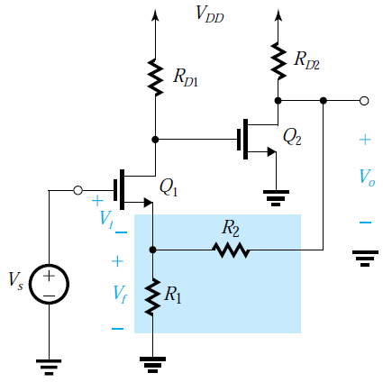
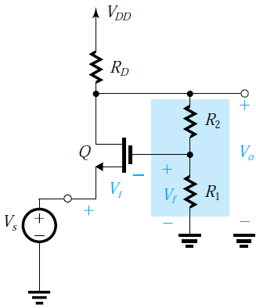
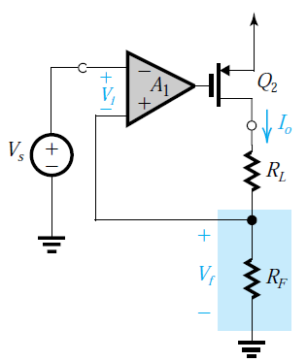
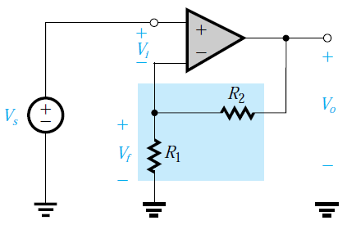
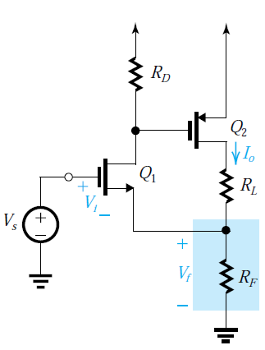
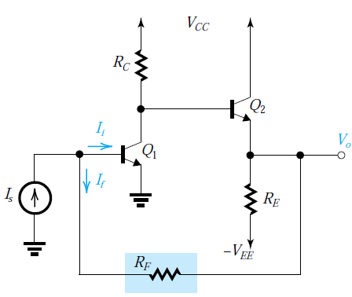
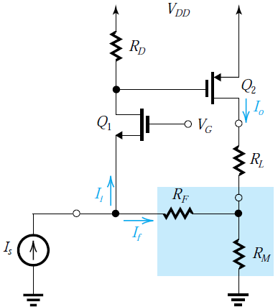
Concept check !
(a)
(b)
(c)
(d)
Solution
a,b,c: Series – Shunt
d→e : Series – Series
f: Shunt – Shunt
g: Shunt – Series
(e)
(f)
(g)
Dr. Ahmed Reda
16

Slide 17
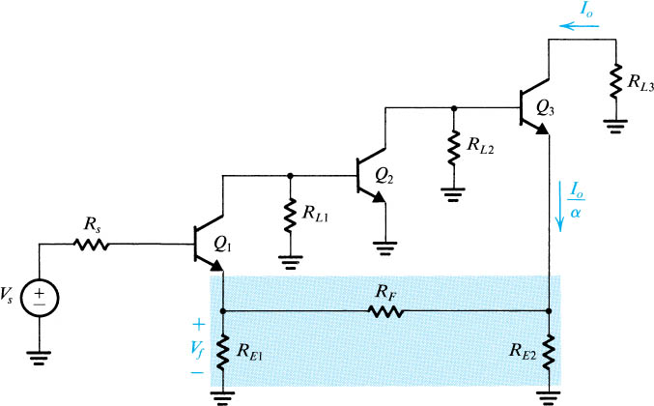
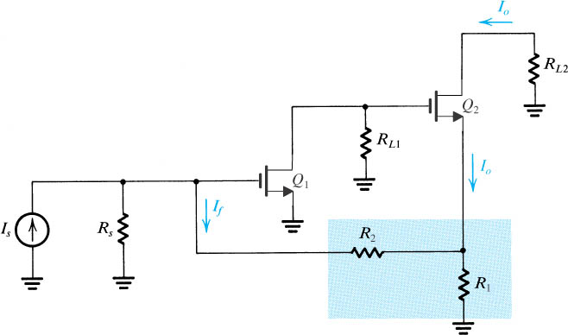
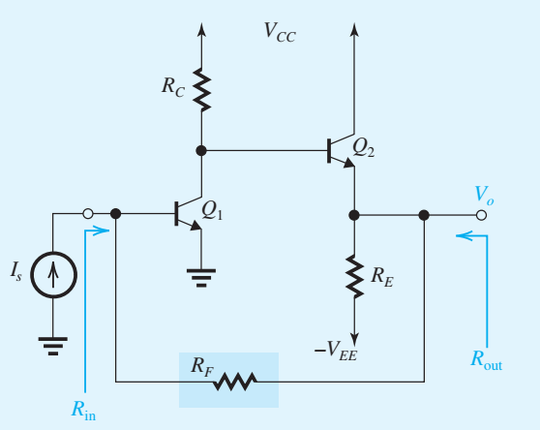
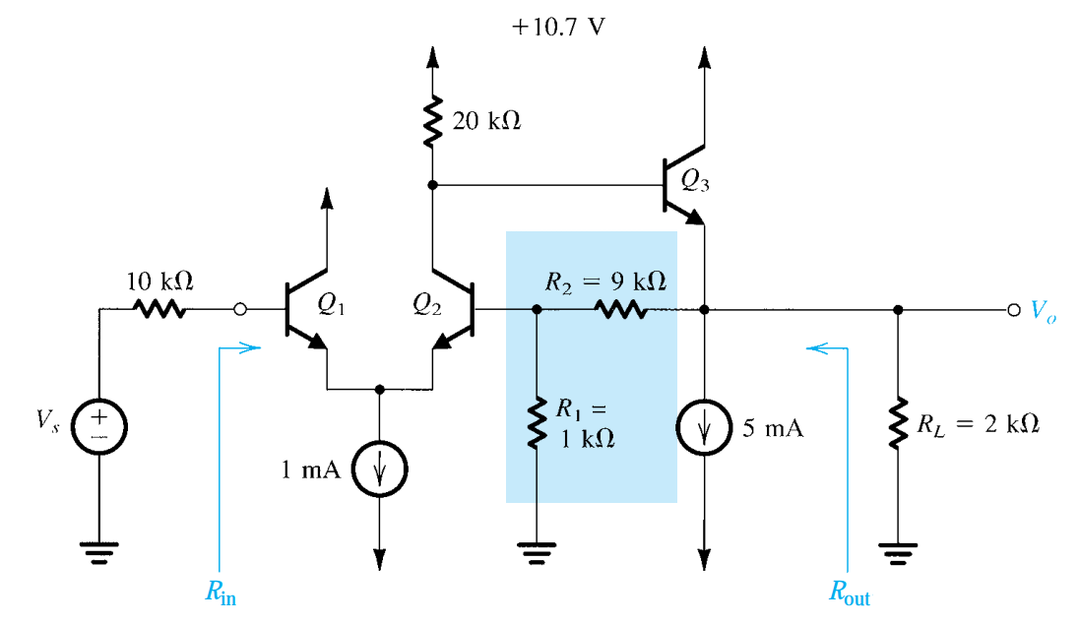
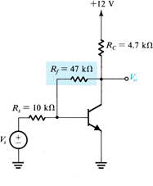
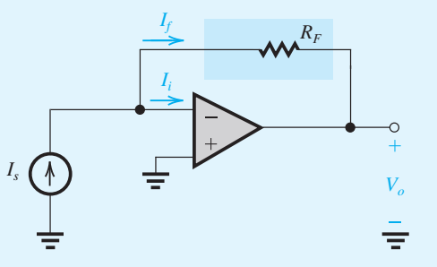
Concept check !
(a)
(b)
Shunt–Series
(c)
Shunt–Shunt
Series–Series
(d)
Series–Shunt
(e)
Shunt–Shunt
(f)
Shunt–Shunt
Dr. Ahmed Reda
16

Slide 18
Outlines
  Feedback Fundamentals
  Negative Feedback Topologies
  Negative Feedback: Benefits and Tradeoffs
    Gain Robustness
    Bandwidth Extension
    Internal Disturbance/Noise Suppression
    Lower In-Loop Distortion
    Impedance Control
  Resistance Derivations
17

Slide 19
Negative Feedback: Benefits and Tradeoffs
Feedback exchanges closed-loop gain for more controlled amplifier behavior.
Benefits
Tradeoffs
1-Gain robustness
1-Reduced gain
Less sensitivity to forward-gain variation.
Lower gain from input to output.
2-Bandwidth extension
Extension within the assumed frequency model.
2-Stability constraints
3-Internal disturbance/noise suppression
Loop dynamics require assessment.
Effect depends on the noise injection point.
4-Lower in-loop distortion
3-Circuit complexity
Improved linearity within the output swing.
Added networks, loading, and power.
5-Impedance control
Resistance changes depend on topology.
Dr. Ahmed Reda
18

Slide 20
Outlines
  Feedback Fundamentals
  Negative Feedback Topologies
  Negative Feedback: Benefits and Tradeoffs
    Gain Robustness
    Bandwidth Extension
    Internal Disturbance/Noise Suppression
    Lower In-Loop Distortion
    Impedance Control
  Resistance Derivations
19

Slide 21
Gain Robustness (1/2)
How Negative Feedback Desensitizes Gain
1. Express the closed-loop gain
3. Normalize the gain change
A
A
=
= A(1 + Aβ)⁻¹
d
A
1
dA
f
1 + Aβ
f
=
·
A
1 + Aβ
A
f
2. Differentiate with respect to A
The fractional gain variation
d
A
is reduced by the factor
f
=
(1 + Aβ)⁻¹ − Aβ(1 + Aβ)⁻²
dA
1 / (1 + Aβ).
1 + Aβ − Aβ
1
=
=
For high loop gain
(1 + Aβ)²
(1 + Aβ)²
Aβ ≫ 1
Changes in open-loop gain cause
The feedback factor β is held constant.
much smaller fractional changes
in closed-loop gain.
Dr. Ahmed Reda
20

Slide 22
Gain Robustness (2/2)
Gain Robustness: Numerical Comparison
Illustrative parameters: β = 0.01
Quantity | Initial value | Changed value
Forward gain A | 1000 | 500
Loop gain Aβ | 10 | 5
Closed-loop gain | 90.91 | 83.33
A falls by 50%; the closed-loop gain falls by approximately 8.33%.
Dr. Ahmed Reda
21

Slide 23
Outlines
  Feedback Fundamentals
  Negative Feedback Topologies
  Negative Feedback: Benefits and Tradeoffs
    Gain Robustness
    Bandwidth Extension
    Internal Disturbance/Noise Suppression
    Lower In-Loop Distortion
    Impedance Control
  Resistance Derivations
22

Slide 24
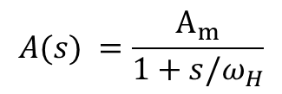
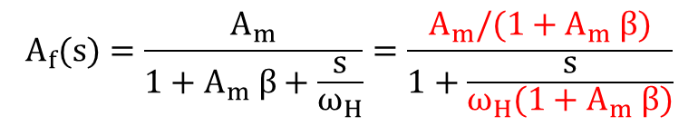
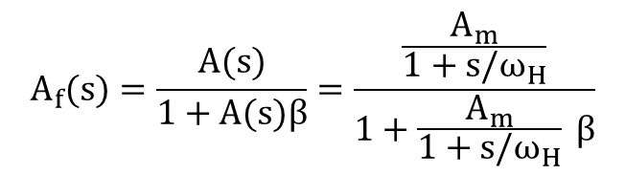
Bandwidth Extension (1/3)
For upper Cutoff, negative feedback reduces midband gain and raises the upper cutoff frequency
1. Open-loop response
Magnitude response
Open loop
With feedback
$$A(s) =\frac{A_{m}}{1+s/ω_{H}}$$
Gain (dB)
A
m
2. Apply negative feedback
A
mf
$$A_{f}(s)=\frac{A(s)}{1+A(s)β}=\frac{\frac{A_{m}}{1+s/ω_{H}}}{1+\frac{A_{m}}{1+s/ω_{H}} β}$$
3. Normalize the response
ω
ω
ω (log scale)
H
Hf
$$A_{f}(s)=\frac{A_{m}}{1+A_{m} β+\frac{s}{ω_{H}}}=\frac{A_{m}/(1+A_{m} β)}{1+\frac{s}{ω_{H}(1+A_{m} β)}}$$
A
A
=
m
mf
1 +
A
β
m
Constant gain–bandwidth product
A
ω
=
ω
(1 +
A
β)
A
ω
=
A
ω
(s) =
mf
Hf
H
m
mf
Hf
m
H
A
(s) =
f
1 + s/
Dr. Ahmed Reda
ω
23
Hf

Slide 25

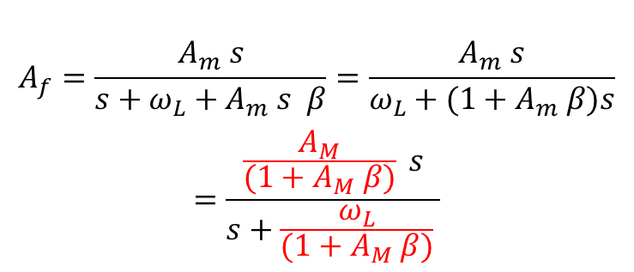
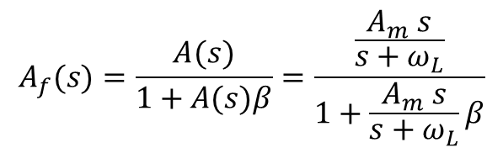
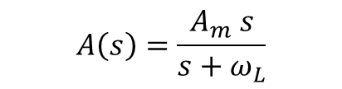
Bandwidth Extension (2/3)
For Lower Cutoff, negative feedback reduces gain and lowers the lower cutoff frequency.
1. Open-loop response
Magnitude response
Open loop
With feedback
$$A\left(s\right)=\frac{A_{m} s}{s+ω_{L}}$$
Gain (dB)
A
m
2. Apply negative feedback
A
mf
$$A_{f}(s)=\frac{A(s)}{1+A(s)β}=\frac{\frac{A_{m} s}{s+ω_{L}}}{1+\frac{A_{m} s}{s+ω_{L}}β}$$
3. Normalize the response
ω
ω
ω (log scale)
$$A_{f}=\frac{A_{m} s}{s+ω_{L}+A_{m} s β}=\frac{A_{m} s}{ω_{L}+{(1+A}_{m} β)s}$$
$$=\frac{\frac{A_{M}}{{(1+A}_{M} β)} s}{s+\frac{ω_{L}}{{(1+A}_{M} β)} }$$
Lf
L
A
A
=
m
mf
1 +
A
β
m
$$=\frac{A_{mf} s}{s+ω_{Lf}}$$
ω
ω
=
L
Lf
1 +
A
β
m
Dr. Ahmed Reda
24

Slide 26
Bandwidth Extension (3/3)
Bandwidth Extension Across Both Cutoffs
Negative feedback lowers midband gain while widening the useful frequency range.
Asymptotic magnitude response
Open loop
With feedback
Gain (dB)
20 log₁₀
A
m
20 log₁₀
A
mf
ω
ω
ω
ω
ω (log scale)
1f
1
2
2f
A
=
A
/ (1 +
A
β)
mf
m
m
Lower cutoff decreases
Upper cutoff increases
ω
ω
=
1
ω
=
ω
(1 +
A
β)
1f
1 +
A
β
2f
2
m
Dr. Ahmed Reda
m
25

Slide 27
Outlines
  Feedback Fundamentals
  Negative Feedback Topologies
  Negative Feedback: Benefits and Tradeoffs
    Gain Robustness
    Bandwidth Extension
    Internal Disturbance/Noise Suppression
    Lower In-Loop Distortion
    Impedance Control
  Resistance Derivations
26

Slide 28
Internal Disturbance/Noise Suppression
Case 1: signal and noise enter the same amplifier input.
V
n
V
+
A
V
s
1
o
Signal + noise
Output components
Interpretation
V
=
A
V
+
A
V
The amplifier applies the same gain
o
1
s
1
n
to the input signal and input noise.
Signal contribution
Noise contribution
Increasing A₁ leaves their ratio unchanged.
Signal-to-noise amplitude ratio
A
V
V
S/N =
1
s
=
s
A
V
V
1
n
n
Dr. Ahmed Reda
27

Slide 29
Internal Disturbance/Noise Suppression
Case 2: noise is introduced after a low-noise preamplifier inside the feedback loop.
Low-noise gain stage
V
n
V
+
V
s
+
A
+
A
o
2
1
−
β
Negative feedback
Output signal and noise contributions
A
A
A
V
=
V
1
2
+
V
1
o
s
1 +
A
A
β
n
1 +
A
A
β
1
2
1
2
Signal transfer
Noise transfer
A
V
S/N =
2
s
V
The S/N improvement comes from low-noise gain A₂ before noise injection.
n
Dr. Ahmed Reda
28

Slide 30
Outlines
  Feedback Fundamentals
  Negative Feedback Topologies
  Negative Feedback: Benefits and Tradeoffs
    Gain Robustness
    Bandwidth Extension
    Internal Disturbance/Noise Suppression
    Lower In-Loop Distortion
    Impedance Control
  Resistance Derivations
29

Slide 31
Lower in-loop distortion
A lower closed-loop gain widens the input range before output saturation.
Without feedback
Transfer characteristic
V
Without feedback
With feedback
A =
o
= 1000
V
V
Output saturation
i
o
The open-loop gain is the transfer-curve slope.
Slope = 1000
With negative feedback
β = 0.01 Aβ = 10
A
Slope ≈ 90.91
A
=
f
1 + Aβ
V
Open-loop limit
i
1000
Feedback limit
A
=
≈ 90.91
f
11
11× larger input range
For the same output swing, negative feedback increases the input range by 11×.
Dr. Ahmed Reda
Feedback suppresses in-loop distortion within the output swing; saturation still causes clipping.
30

Slide 32
Outlines
  Feedback Fundamentals
  Negative Feedback Topologies
  Negative Feedback: Benefits and Tradeoffs
    Gain Robustness
    Bandwidth Extension
    Internal Disturbance/Noise Suppression
    Lower In-Loop Distortion
    Impedance Control
  Resistance Derivations
31

Slide 33
Impedance control (1/2)
Series–Shunt Feedback→ Series voltage mixing raises input resistance; shunt voltage sampling lowers output resistance.
Ideal voltage-feedback model
I
Forward amplifier A
I
i
o
+
R
+
V
+
V
R
+
A
V
o
R
V
s
−
i
id
−
i
L
o
−
−
β
V
+
f
−
Ideal feedback network
Sampling current = 0
Series mixing at the input
Shunt sampling at the output
R
=
R
(1 + Aβ)
R
if
id
R
=
o
Dr. Ahmed Reda
of
1 + Aβ
32

Slide 34
Impedance control (2/2)
Shunt–Series Feedback → Shunt current mixing lowers input resistance; series current sampling raises output resistance.
Ideal current-feedback model
I
I
Forward amplifier A
I
s
i
o
+
+
I
V
R
A
I
R
R
V
s
i
id
i
o
L
o
−
−
I
f
β
Ideal feedback network
Sampling voltage = 0
Shunt mixing at the input
Series sampling at the output
R
R
=
R
(1 + Aβ)
R
=
id
of
o
if
1 + Aβ
Dr. Ahmed Reda
33

Slide 35
Outlines
  Feedback Fundamentals
  Negative Feedback Topologies
  Negative Feedback: Benefits and Tradeoffs
    Gain Robustness
    Bandwidth Extension
    Internal Disturbance/Noise Suppression
    Lower In-Loop Distortion
    Impedance Control
  Resistance Derivations
34

Slide 36


Resistance Derivations (1/4)
Series–Shunt Feedback→ Series voltage mixing raises input resistance; shunt voltage sampling lowers output resistance.
Ideal voltage-feedback model
I
Forward amplifier A
I
i
o
+
R
+
V
+
V
R
+
A
V
o
R
V
s
−
i
id
−
i
L
o
−
−
β
V
+
$$R_{if}$$
f
Ideal feedback network
$$R_{of}$$
−
Series mixing at the input
Shunt sampling at the output
R
=
R
(1 + Aβ)
R
if
id
R
=
o
Dr. Ahmed Reda
of
1 + Aβ
35
Notes:
Resistance Derivations

Slide 37
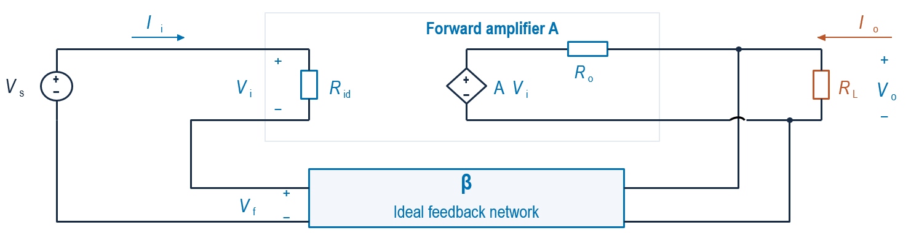



Resistance Derivations (2/4)
Topology: Series–Shunt
I=0
$$R_{if}$$
$$R_{of}$$
1. Input resistance
2. Output resistance
Open-circuit output:
R
→ ∞
Set Vₛ = 0 and apply an output test current.
L
V
V
&
V
V
R
=
o
I=0
R
=
s
I
=
i
R
=
s
R
of
if
i
if
id
I
I
R
V
o
V
− A
V
i
id
i
I
=
o
i
+
I
V
=
V
+
V
=
V
+ β
V
o
R
s
i
f
i
o
o
V
=
V
+
V
=0
V
=
V
V
= A
V
s
i
f
−
f
o
i
i
V
V
+ A
V
V
=
V
(1 + Aβ)
s
=
(1 + Aβ)
I
=
o
f
&
V
=
β
s
i
V
f
V
i
o
R
o
o
R
R
=
R
(1 + Aβ)
V
(1 + Aβ)
R
=
o
if
id
I
=
o
of
o
R
1 + Aβ
36
o
Notes:
Series–Shunt Feedback

Slide 38


Resistance Derivations (3/4)
Shunt–Series Feedback → Shunt current mixing lowers input resistance; series current sampling raises output resistance.
Ideal current-feedback model
I
I
Forward amplifier A
I
s
i
o
+
+
I
V
R
A
I
R
R
V
s
i
id
i
o
L
o
−
−
I
f
β
$$R_{if}$$
Ideal feedback network
$$R_{of}$$
Shunt mixing at the input
Series sampling at the output
R
R
=
R
(1 + Aβ)
R
=
id
of
o
if
1 + Aβ
Dr. Ahmed Reda
37

Slide 39
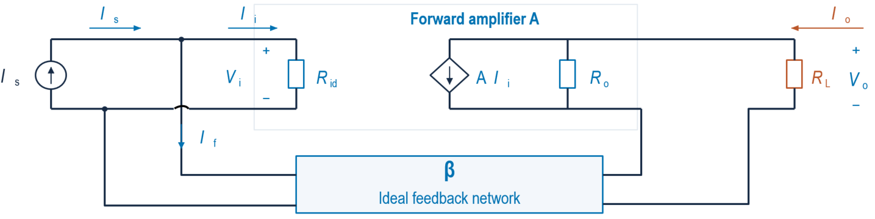


Resistance Derivations (4/4)
Topology: Shunt – Series
I
o
$$R_{if}$$
$$R_{of}$$
1. Input resistance
2. Output resistance
Short-circuit output:
R
→ 0
Set Iₛ = 0 and apply an output test current.
V
L
R
=
i
V
if
R
=
o
I
I
= A
I
of
I
s
V
o
i
o
I
=
I
+
I
=
i
β
&
V
V
I
=
I
+
I
= 0
s
i
f
+
I
i
o
&
s
i
f
R
o
I
=
I
=
+ A
I
id
i
R
o
R
i
I
= −
I
= −β
I
V
i
β
id
o
i
f
o
A
I
=
+
I
V
s
i
o
Aβ
R
I
=
-
I
id
o
R
o
V
o
V
V
i
β
i
R
o
I
=
+
A
R
=
id
I
(1 + Aβ) =
R
=
R
(1 + Aβ)
s
R
R
o
R
of
o
id
id
1 + Aβ
o
38
Notes:
Series–Shunt Feedback

Slide 40

Thanks!
39

