Slide 1

Feedback Circuits
(02-03)
Dr. Ahmed Reda Mohamed
Ahmed.Mohamed@kfupm.edu.sa
IRC for Communication Systems and Sensing, King Fahd University of Petroleum & Minerals, Dhahran 31261, Saudi Arabia
01

Slide 2
Outlines
  Practical Feedback Effect
  Steps for Practical Feedback Analysis
    Series-Shunt Topology: Example 01
    Series-Shunt Topology: Example 02
    Series-Series Topology: Example 03
    Series-Series Topology: Example 04
  Basic MOSFET Amplifier Topologies
  Basic BJT Amplifier Topologies
Dr. Ahmed Reda
02

Slide 3
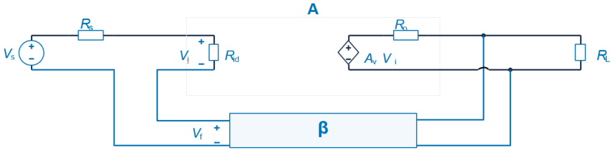
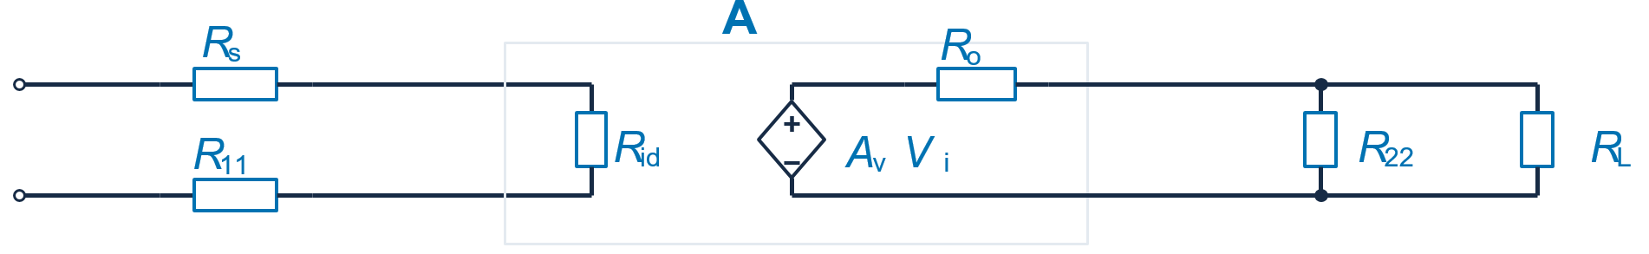
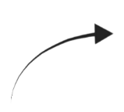

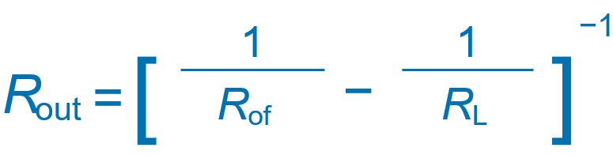













Practical Feedback Effect
Practical Series–Shunt Feedback Analysis
Feedback-network loading modifies the forward amplifier and its port resistances.
R₁₁ represents input loading. R₂₂ represents output loading.
r_{o}
+
V
o
−
$$R_{if}$$
$$R_{in}$$
$$R_{out}$$
$$R_{of}$$
$$R_{11}$$
$$R_{22}$$
Forward amplifier with feedback-network loading
r_{o}
+
+
V
s
V
o
$$R_{i}$$
−
−
R
r
$$R_{o}$$
=
∥
R
∥
R
=
R
+
R
R
+
R
A
=
i
s
11
id
$V_{o}$/$V_{s}$
o
o
22
L
A
R
R
=
R
(1 + Aβ)
A
=
R
=
o
if
i
f
of
1 + Aβ
1 + Aβ
Input resistance excluding Rₛ
Output resistance excluding the load
03
Notes:
Fundamentals

Slide 4
Outlines
  Practical Feedback Effect
  Steps for Practical Feedback Analysis
    Series-Shunt Topology: Example 01
    Series-Shunt Topology: Example 02
    Series-Series Topology: Example 03
    Series-Series Topology: Example 04
  Basic MOSFET Amplifier Topologies
  Basic BJT Amplifier Topologies
04

Slide 5



Steps for Practical Feedback Analysis (1/4)
Step 1. Topology identification
R
s
+
Forward amplifier A
+
V
+
V
R
L
V
o
s
−
i
−
−
$$R_{in}$$
$$R_{out}$$
+
V
β
−
f
Topology names list input mixing first and output sampling second.
Feedback topology | Input mixing | Output sampling
Series–series | Series | Series
Series–shunt | Series | Shunt
Shunt–series | Shunt | Series
Shunt–shunt | Shunt | Shunt
Dr. Ahmed Reda
05

Slide 6

Steps for Practical Feedback Analysis (2/4)
Step 2. Feedback-Network Loading: R₁₁ and R₂₂
  To get $R_{11}$ and $R_{22}$ → Measure the resistance at the port of interest after terminating/destroy the opposite port.
Input loading R₁₁
Output loading R₂₂
β
Shunt
Shunt
β
R
11
R
Short circuit
Short circuit
22
Series
Series
β
β
R
R
Open circuit
22
11
Open circuit
Opposite-port termination: shunt connection uses a short. Series connection uses an open.
Dr. Ahmed Reda
06
Notes:
Fundamentals

Slide 7
Steps for Practical Feedback Analysis (3/4)
Step 3. Feedback transfer ratio β
Feedback signal direction
Feedback signal
β =
v
f
or
i
f
v
o
or
i
o
β
Sampled signal
Feedback signal
Sampled signal
Note
Voltage feedback
Open the feedback output port
β
Current feedback
Short the feedback output port
β
Dr. Ahmed Reda
07
Notes:
Fundamentals

Slide 8
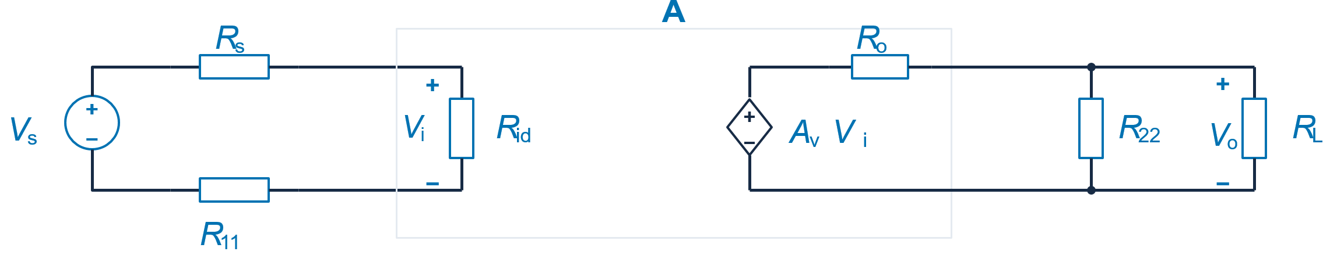



Steps for Practical Feedback Analysis (4/4)
Step 4: redraw the forward amplifier with the loading of the feedback network.
Step 5: Calculate the R_{i}, R_{o}, A
r_{o}
+
V
o
−
$$R_{i}$$
$$R_{o}$$
A
=
$V_{o}$/$V_{s}$
R
r
=
∥
R
∥
R
=
R
+
R
R
+
R
A
i
s
11
id
A
=
o
o
22
L
f
R
R
=
R
(1 + Aβ)
1 + Aβ
R
=
o
if
i
of
1 + Aβ
Step 6: remove source and load contributions using the corresponding port connection.
R
=
R
−
R
R
=
R
−
R
Series connection
Series connection
in
if
s
out
of
L
[
1
1
]
−1
]
[
1
1
−1
R
=
−
Shunt connection
Shunt connection
in
R
R
R
=
−
if
s
out
R
R
Dr. Ahmed Reda
of
L
08
Notes:
Fundamentals

Slide 9
Outlines
  Practical Feedback Effect
  Steps for Practical Feedback Analysis
    Series-Shunt Topology: Example 01
    Series-Shunt Topology: Example 02
    Series-Series Topology: Example 03
    Series-Series Topology: Example 04
  Basic MOSFET Amplifier Topologies
  Basic BJT Amplifier Topologies
09

Slide 10


Series-Shunt Topology: Example 01
Given circuit
Amplifier parameters
R
μ = Aᵥ₀ = 10⁴
s
V
+
o
V
+
μ
R
= 10 kΩ
s
−
s
−
$$R_{in}$$
R
id
= 100 kΩ
R
L
$$R_{out}$$
2 kΩ
1 kΩ
R
= 1 MΩ
r
= 1 kΩ
R
1
2
o
Required quantities
R
,
R
,
A
=
V
o
in
out
f
V
Dr. Ahmed Reda
s
10
Notes:
Series-Shunt Topology: Example 01

Slide 11
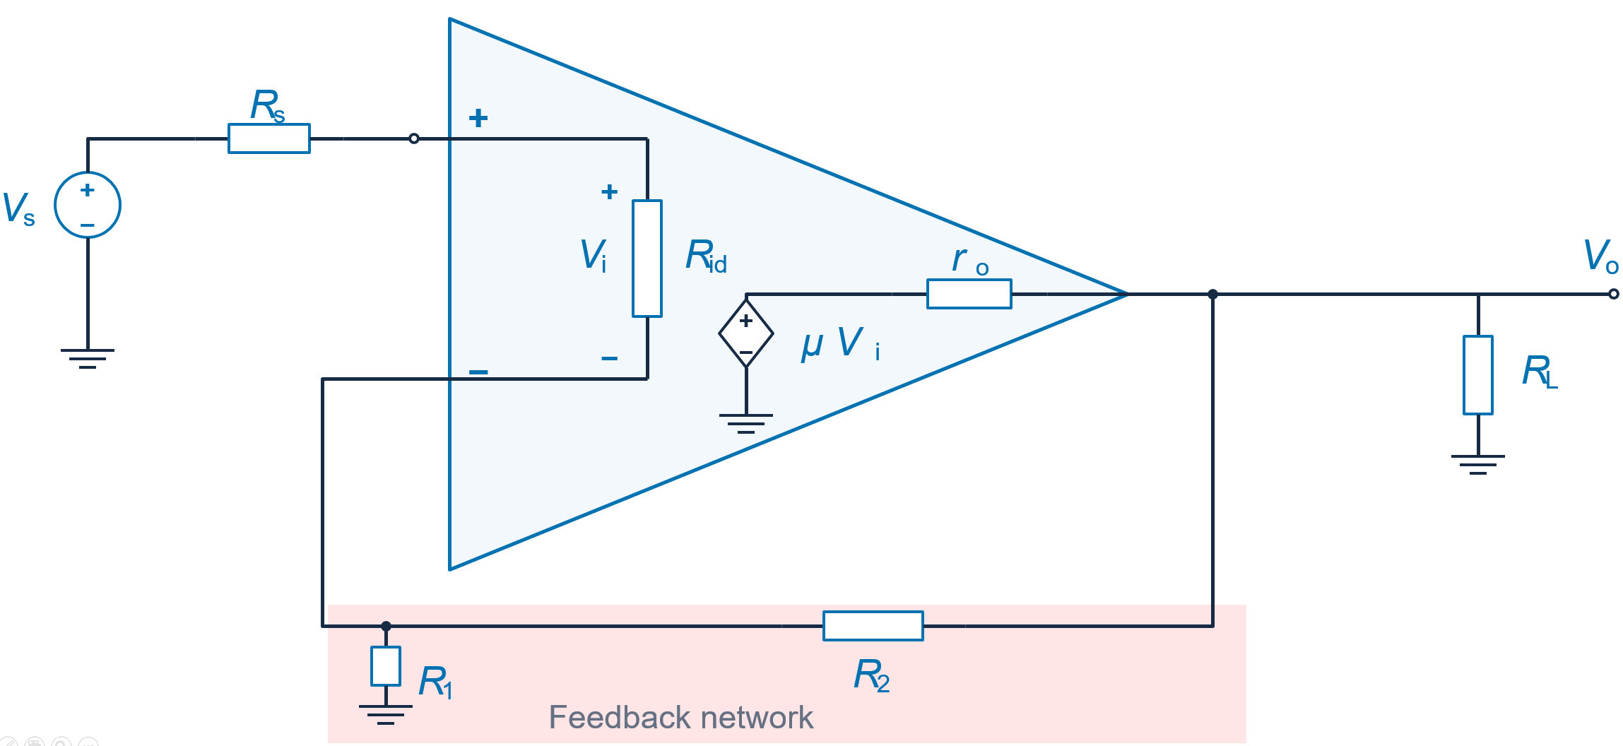
Series-Shunt Topology: Example 01
Step 1. Topology identification
Series –Shunt
(V)
(V)
Step 2. Feedback-Network Loading: R₁₁ and R₂₂
Input loading R₁₁
Output loading R₂₂
R
2
R
2
R
Shunt
Short
Series
Open
11
R
1
R
R
1
22
R
=
R
∥
R
R
=
R
+
R
11
1
2
22
1
2
=999.0 Ω ≈ 1 kΩ
=1.001 MΩ ≈ 1 MΩ
11

Slide 12
Series-Shunt Topology: Example 01
Step 3. Feedback transfer ratio β
R
V
2
V
f
o
1 MΩ
R
1
1 kΩ
Feedback signal direction
β =
V
R
1 kΩ
f
=
1
=
β = 9.990 × 10⁻⁴
V
R
+
R
1 kΩ + 1 MΩ
o
1
2
Dr. Ahmed Reda
12

Slide 13


Series-Shunt Topology: Example 01
Step 4: redraw the forward amplifier with the loading of the feedback network.
Step 5: Calculate the R_{i}, R_{o}, A
R
r_{o}
s
R
o
V
o
+
+
10 kΩ
1 kΩ
V
+
V
R
+
μ V
R
R
s
−
i
id
−
i
22
L
1 kΩ
100 kΩ
1 MΩ
2 kΩ
−
−
R
$$R_{o}$$
$$R_{i}$$
11
R
=
∥
=666.22 Ω
R
∥
R
=
R
+
= 111 kΩ
r
R
R
+
R
o
o
22
L
i
s
11
id
V
V
V
A
=
o
=
o
×
i
V
V
V
s
i
s
= μ
R
∥
R
R
L
22
×
id
(
R
∥
R
) +
r
R
+
R
+
R
L
22
o
id
s
11
A = 10⁴ × 0.6662 × 0.9009
≈ 6000 V/V
Dr. Ahmed Reda
13

Slide 14
Series-Shunt Topology: Example 01
A = 6000 β = 9.99 × 10⁻⁴ Rᵢ = 111 kΩ Rₒ = 666.2 Ω
Closed-loop gain
A
6000
A
=
=
≈ 857.88
f
1 + Aβ
6.994
Input resistance with feedback
As the topology
Series -Shunt
Output resistance with feedback
R
=
R
(1 + Aβ)
R
if
i
R
=
o
of
1 + Aβ
= 111 kΩ × 6.994
=666.2 / 6.994
≈ 776.33 kΩ
≈ 95.25 Ω
Dr. Ahmed Reda
14

Slide 15
Series-Shunt Topology: Example 01
Step 6: remove source and load contributions using the corresponding port connection.
Input port: series mixing
Output port: shunt sampling
R
=
R
+
R
R
=
R
∥
R
if
in
s
of
out
L
[
]
−1
R
=
R
−
R
1
−
1
in
if
s
R
=
out
R
R
of
L
≈ 776.33 kΩ − 10 kΩ
[
]
−1
R
=
1
−
1
out
95.25 Ω
2 kΩ
R
≈ 766.33 kΩ
R
≈ 100 Ω
in
out
Dr. Ahmed Reda
15

Slide 16
Outlines
  Practical Feedback Effect
  Steps for Practical Feedback Analysis
    Series-Shunt Topology: Example 01
    Series-Shunt Topology: Example 02
    Series-Series Topology: Example 03
    Series-Series Topology: Example 04
  Basic MOSFET Amplifier Topologies
  Basic BJT Amplifier Topologies
16

Slide 17
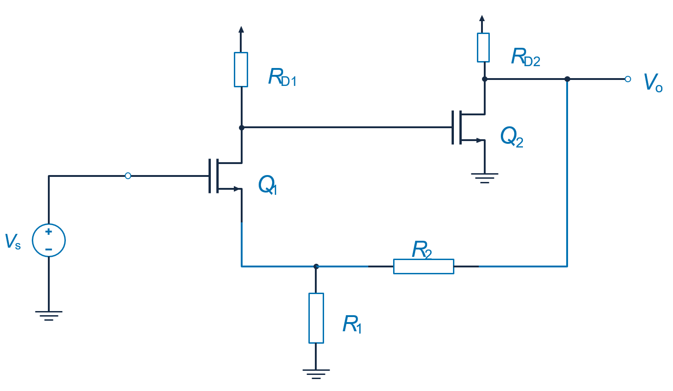


Series-Shunt Topology: Example 02
Given circuit
Two-Transistor Feedback Amplifier
g
m1
=
g
m2
=4 mA/V
R
D1
=
R
D2
=10 kΩ
$$R_{out}$$
R
= 1 kΩ
$$R_{in}$$
1
R
2
= 9 kΩ
Neglect transistor rₒ
r
o1
,
r
o2
→ ∞
Required quantities
R
,
R
,
A
=
V
o
in
out
f
V
Dr. Ahmed Reda
s
17
Notes:
Series-Shunt Topology: Example 01

Slide 18


Series-Shunt Topology: Example 02
Step 1. Topology identification
Series –Shunt
(V)
(V)
$$R_{out}$$
$$R_{in}$$
Step 2. Feedback-Network Loading: R₁₁ and R₂₂
Feedback-Network
Input loading R₁₁
Output loading R₂₂
R
R
2
2
Shunt
Short
Series
Open
R
R
R
R
11
1
1
22
R
=
R
∥
R
= 0.9 kΩ
R
=
R
+
R
= 10 kΩ
11
1
2
22
1
2
18
Notes:
Series-Shunt Topology: Example 01

Slide 19
Series-Shunt Topology: Example 02
Step 3. Feedback transfer ratio β
Port 1: open voltage-mixing port
Port 2: applied output voltage
R
2
+
+
V
R
9 kΩ
V
f
1
o
1 kΩ
−
−
β =
V
=
R
=
1 kΩ
= 0.1
f
1
V
R
+
R
1 kΩ + 9 kΩ
o
1
2
The feedback network returns 10% of the output voltage.
Dr. Ahmed Reda
19

Slide 20
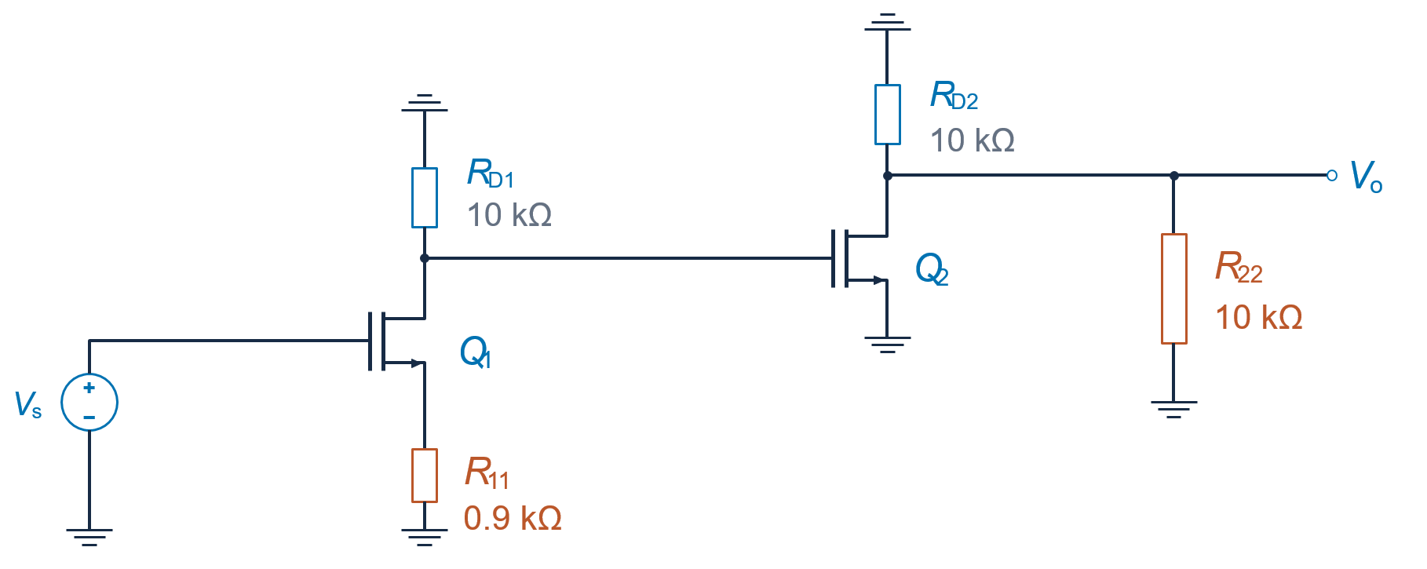


Series-Shunt Topology: Example 02
Step 4: redraw the forward amplifier with the loading of the feedback network.
Step 5: Calculate the R_{i}, R_{o}, A
V_{X}
X
$$R_{o}$$
$$R_{i}$$
I
= 0 (MOS gate current)
i
V
R
=
s
→ ∞
R
=
R
∥
R
= 10 kΩ ∥ 10 kΩ = 5 kΩ
i
o
D2
22
I
i
Dr. Ahmed Reda
20

Slide 21
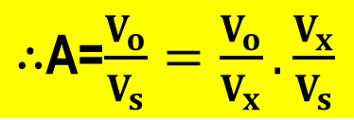
Series-Shunt Topology: Example 02
Step 4: redraw the forward amplifier with the loading of the feedback network.
Step 5: Calculate the R_{i}, R_{o}, A
$∴$A=$\frac{V_{o}}{V_{s}}=\frac{V_{o}}{V_{x}}.\frac{V_{x}}{V_{s}}$
V_{X}
X
$$R_{o}$$
$$R_{i}$$
Stage 1: source degeneration
Stage 2: loaded common source
A
=
V
/
V
A
=
V
/
1
x
s
2
o
V
x
−
g
R
A
=
m1
D1
≈ −8.696 V/V
A
= −
g
(
R
∥
R
)
1
2
m2
D2
22
= −20 V/V
1 +
g
R
m1
11
Overall loaded forward gain
A
=
A
×
A
= (40 / 4.6) × 20
≈ +173.91 V/V
1
2
21

Slide 22
Series-Shunt Topology: Example 02
Closed-Loop Gain and Port Resistances
A ≈ 173.913 V/V, β = 0.1, Rᵢ → ∞ and Rₒ = 5 kΩ.
Closed-loop voltage gain
A
173.913
≈ 9.456 V/V
A
=
=
f
1 + Aβ
18.3913
Input resistance with feedback
Output resistance with feedback
R
=
R
(1 + Aβ)
R
if
i
R
=
o
of
1 + Aβ
Rᵢ → ∞ in the ideal MOS model
5000 Ω
≈ 271.87 Ω
=
R
→ ∞
18.3913
if
Gate leakage and transistor output conductance are neglected.
Dr. Ahmed Reda
22

Slide 23
Series-Shunt Topology: Example 02
Step 6: remove source and load contributions using the corresponding port connection.
Input port: series connection
Output port: shunt connection
R
=
R
+
R
R
=
R
∥
R
if
in
s
of
out
L
[
]
−1
1
1
R
=
R
−
R
R
=
−
in
if
s
out
R
R
of
L
This circuit: ideal voltage source
This circuit: no external load
R
= 0 Ω
R
→ ∞
s
L
R
=
R
− 0
R
=
R
in
if
out
of
R
→ ∞
R
≈ 271.87 Ω
in
out
Dr. Ahmed Reda
23

Slide 24
Outlines
  Practical Feedback Effect
  Steps for Practical Feedback Analysis
    Series-Shunt Topology: Example 01
    Series-Shunt Topology: Example 02
    Series-Series Topology: Example 03
    Series-Series Topology: Example 04
  Basic MOSFET Amplifier Topologies
  Basic BJT Amplifier Topologies
24

Slide 25




Series-Series Topology: Example 03
Given circuit
Given parameters
S
Differential amplifier
R
s
2
−
A
1
,
R
id
,
R
o1
G
2
V
+
A
$$I_{o}$$
s
1
−
Q
MOSFET Q₂
+
2
D
2
g
,
r
$$R_{if}$$
$$R_{in}$$
D′
m2
o2
2
$$R_{of}$$
R
Circuit resistances
L
R
s
,
R
F
,
R
L
R
F
Output resistance $R_{out}$ is measured between the load terminals, looking into the output loop.
R
,
R
,
A
=
I
o
Required quantities
in
out
f
Dr. Ahmed Reda
V
s
25
Notes:
Series-Shunt Topology: Example 01

Slide 26
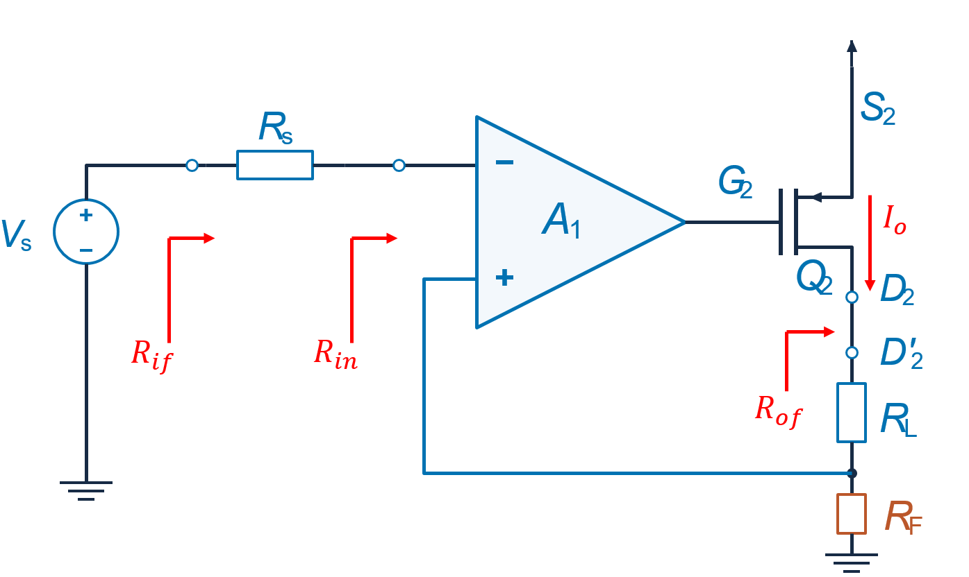
Series-Series Topology: Example 03
Step 1. Topology identification
Series –Series
(v)
(I)
Step 2. Feedback-Network Loading: R₁₁ and R₂₂
Series
Open
Series
Open
R
11
R
R
R
F
F
22
R
=
R
R
=
R
11
F
22
F
Dr. Ahmed Reda
26
Notes:
Series-Shunt Topology: Example 01

Slide 27
Series-Series Topology: Example 03
Step 3. Feedback transfer ratio β
Port 1: open voltage-mixing port
Port 2: applied output Current
I
o
+
V
R
f
F
−
V
V
=
I
R
β =
f
=
R
f
o
F
I
F
o
Dr. Ahmed Reda
27

Slide 28


Series-Series Topology: Example 03
Step 4: redraw the forward amplifier with the loading of the feedback network.
Step 5: Calculate the R_{i}, R_{o}, A
Differential stage
PMOS output loop
$$R_{o}$$
R
s
R
o1
G
D
D′
2
2
2
+
−
R
+
I
R
V
id
o
L
V
id
+
+
V
s
gs2
r
o2
A
V
−
g
V
R
F
1
id
m2
gs2
R
−
−
F
$$R_{i}$$
S
2
R
=
R
+
R
+
R
R
=
r
+
R
+
R
i
s
id
F
o
o2
L
F
Output test: set Vs = 0 and break the loop between D₂ and D′₂.
Dr. Ahmed Reda
28

Slide 29

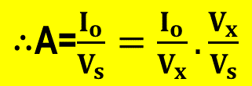



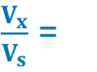
Series-Series Topology: Example 03
Step 4: redraw the forward amplifier with the loading of the feedback network.
Step 5: Calculate the R_{i}, R_{o}, A
Differential stage
PMOS output loop
$$R_{o}$$
R
R
$$V_{x}$$
D
D′
s
o1
x
G
2
2
2
+
−
R
+
I
R
V
id
o
L
V
id
+
+
V
s
gs2
r
o2
A
V
−
g
V
R
F
1
id
m2
gs2
R
−
−
F
$$R_{i}$$
S
2
$∴$A=$\frac{I_{o}}{V_{s}}=\frac{I_{o}}{V_{x}}.\frac{V_{x}}{V_{s}}$
A
R
g
r
r
A =
1
id
m2
o2
R
+
R
+
R
r
+
R
+
R
I
= −
g
V
o2
id
s
F
o2
L
F
o
m2
gs2
r
+
R
+
R
V
V
o2
L
F
gs2
=
X
V
V
A
V
R
gs2
=
=
1
id
id
X
A
$$\frac{I_{o}}{V_{x}}$$
r
R
$\frac{V_{x}}{V_{s}}$ =
= −
g
o2
V
id
1
R
+
R
+
R
m2
V
id
= −
s
id
s
F
r
+
R
+
R
R
+
R
+
R
o2
L
F
29
id
s
F

Slide 30
Series-Series Topology: Example 03
Closed-Loop Gain and Port Resistances
Closed-loop voltage gain
A
A
=
f
1 + Aβ
Input resistance with feedback
Output resistance with feedback
R
=
R
(1 + Aβ)
R
=
(1 + Aβ)
if
i
of
R
o
Dr. Ahmed Reda
30

Slide 31
Series-Series Topology: Example 03
Step 6: remove source and load contributions using the corresponding port connection.
Input resistance
R
=
R
−
R
in
if
s
Output resistance
R
=
R
−
R
out
of
L
Dr. Ahmed Reda
31

Slide 32
Outlines
  Practical Feedback Effect
  Steps for Practical Feedback Analysis
    Series-Shunt Topology: Example 01
    Series-Shunt Topology: Example 02
    Series-Series Topology: Example 03
    Series-Series Topology: Example 04
  Basic MOSFET Amplifier Topologies
  Basic BJT Amplifier Topologies
32

Slide 33


Series-Series Topology: Example 04
Given circuit
Given parameters
R
g
m1
=
g
m2
= 4 mA/V
D
Q
2
R
= 20 kΩ
D
$$I_{o}$$
Q
r
o2
= 20 kΩ
1
+
R
F
= 100 Ω
V
s
$$R_{of}$$
R
−
L
R
L
= 1 kΩ
$$R_{if}$$
R
F
Neglect rₒ₁. Use rₒ₂ only
for output resistances.
R
,
R
,
A
=
I
o
Required quantities
in
out
f
Dr. Ahmed Reda
V
s
33
Notes:
Series-Shunt Topology: Example 01

Slide 34
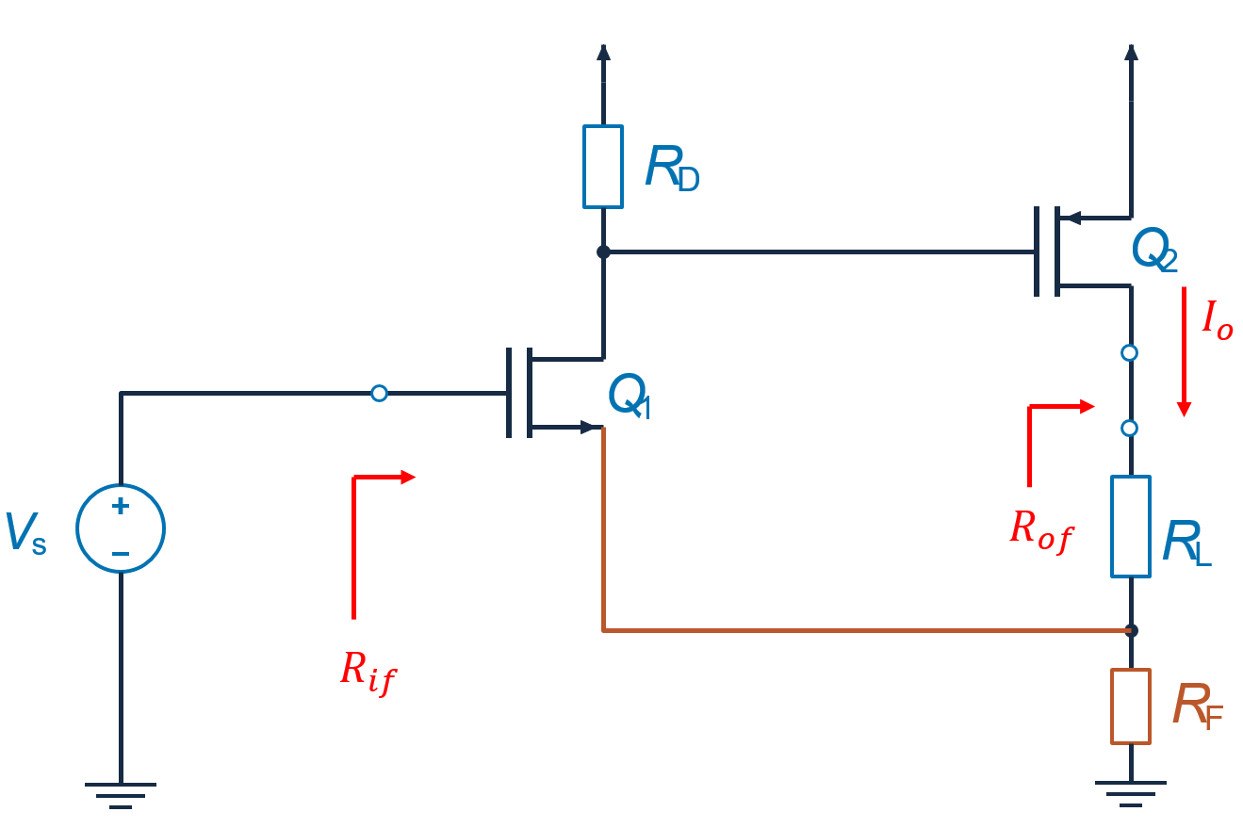
Series-Series Topology: Example 04
Step 1. Topology identification
Series –Series
(v)
(I)
Step 2. Feedback-Network Loading: R₁₁ and R₂₂
Series
Open
Series
Open
R
11
R
R
R
F
F
22
R
=
R
= 100 Ω
R
=
R
= 100 Ω
11
F
22
F
Dr. Ahmed Reda
34
Notes:
Series-Shunt Topology: Example 01

Slide 35
Series-Series Topology: Example 04
Step 3. Feedback transfer ratio β
Port 1: open voltage-mixing port
Port 2: applied output Current
I
o
+
V
R
f
F
−
V
V
=
I
R
β =
f
=
R
β = 100 Ω
f
o
F
I
F
o
Dr. Ahmed Reda
35

Slide 36




Series-Series Topology: Example 04
Step 4: redraw the forward amplifier with the loading of the feedback network.
Step 5: Calculate the R_{i}, R_{o}, A
R
D
$$V_{x}$$
x
Q
$$I_{o}$$
2
Q
R
L
1
$$R_{o}$$
+
V
s
R
R
=
R
=
11
F
22
R
F
−
$$R_{i}$$
I
= 0 (MOS gate current)
i
V
R
=
s
→ ∞
R
=
r
+
R
+
R
= 21.1 kΩ
i
I
o
o2
L
F
i
Dr. Ahmed Reda
36

Slide 37
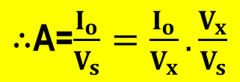


Series-Series Topology: Example 04
Step 4: redraw the forward amplifier with the loading of the feedback network.
Step 5: Calculate the R_{i}, R_{o}, A
V
g2
R
D
$$V_{x}$$
x
Q
$$I_{o}$$
2
Q
R
L
1
$$R_{o}$$
+
V
s
R
R
=
R
=
11
F
22
R
F
−
$$R_{i}$$
$∴$A=$\frac{I_{o}}{V_{s}}=\frac{I_{o}}{V_{x}}.\frac{V_{x}}{V_{s}}$
g
m1
g
m2
R
D
I
= −
g
V
A =
= 0.22857 A/V
o
m2
g2
1 +
g
m1
R
F
$$\frac{I_{o}}{V_{x}}$$
g
g
m1
R
D
V
$$\frac{V_{x}}{V_{s}}$$
g
R
= −
m2
V
X
= −
s
= −
m1
D
1 +
g
m1
R
F
1 +
g
R
m1
F
Dr. Ahmed Reda
37

Slide 38
Series-Series Topology: Example 04
Closed-Loop Gain and Port Resistances
Closed-loop voltage gain
A
A
=
= 9.58 mA/V
f
1 + Aβ
Input resistance with feedback
Output resistance with feedback
R
=
R
(1 + Aβ)
→ ∞
R
=
(1 + Aβ)
= 503.4 kΩ
if
i
of
R
o
Dr. Ahmed Reda
38

Slide 39
Series-Series Topology: Example 04
Step 6: remove source and load contributions using the corresponding port connection.
Input resistance
R
=
R
=
R
= ∞
i
if
in
Ideal MOS gate and zero external source resistance
Output resistance
R
=
R
−
R
out
of
L
= 503.3857 kΩ − 1 kΩ = 502.4 kΩ
Dr. Ahmed Reda
39

Slide 40
Outlines
  Practical Feedback Effect
  Steps for Practical Feedback Analysis
    Series-Shunt Topology: Example 01
    Series-Shunt Topology: Example 02
    Series-Series Topology: Example 03
    Series-Series Topology: Example 04
  Basic MOSFET Amplifier Topologies
  Basic BJT Amplifier Topologies
40

Slide 41
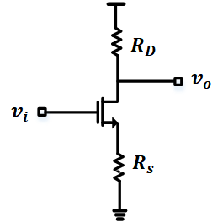
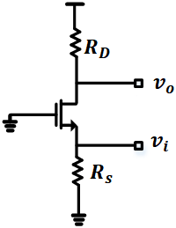
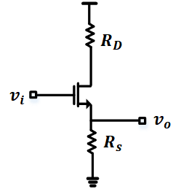


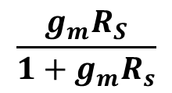




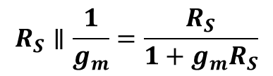

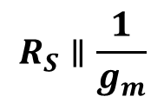

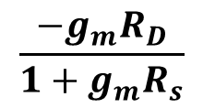

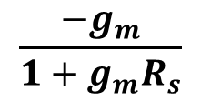


Basic MOSFET Amplifier Topologies
 | Common Source | Common Gate | Common Drain
$$R_{in}$$
$$R_{S}∥\frac{1}{g_{m}}$$
$$∞$$
$$∞$$
$$R_{out}$$
$$R_{D}$$
$$R_{S}∥\frac{1}{g_{m}}=\frac{R_{S}}{1+g_{m}R_{S}}$$
$$R_{D}$$
$$G_{m}$$
$$\frac{−g_{m}}{1+g_{m}R_{s}}$$
$$g_{m}$$
$$g_{m}$$
$$\frac{−g_{m}R_{D}}{1+g_{m}R_{s}}$$
$$\frac{g_{m}R_{S}}{1+g_{m}R_{s}}$$
$$A_{v}$$
$$g_{m}R_{D}$$
Dr. Ahmed Reda
41
Notes:
Summary of Basic MOSFET Amplifier Topologies

Slide 42
Outlines
  Practical Feedback Effect
  Steps for Practical Feedback Analysis
    Series-Shunt Topology: Example 01
    Series-Shunt Topology: Example 02
    Series-Series Topology: Example 03
    Series-Series Topology: Example 04
  Basic MOSFET Amplifier Topologies
  Basic BJT Amplifier Topologies
42

Slide 43

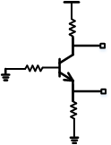


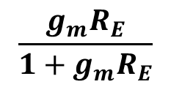









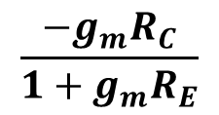
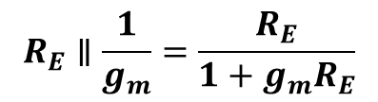


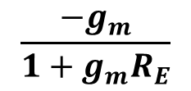



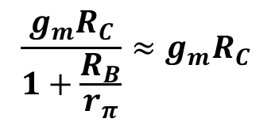


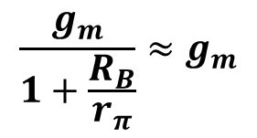




Basic BJT Amplifier Topologies
 | Common Emitter | Common Base | Common Collector
$$R_{C}$$
$$R_{C}$$
$$R_{C}$$
$$v_{o}$$
$$R_{B}$$
$$v_{o}$$
$$v_{i}$$
$$v_{i}$$
$$v_{i}$$
$$v_{o}$$
$$R_{E}$$
$$R_{E}$$
$$R_{E}$$
$$R_{in}$$
$$r_{π}\left[1+g_{m}R_{E}\right]$$
$$R_{E}∥\frac{1}{g_{m}}\left[1+\frac{R_{B}}{r_{π}}\right]≈R_{E}∥\frac{1}{g_{m}}$$
$$r_{π}\left[1+g_{m}R_{E}\right]$$
If $r_{π}≫R_{B}$
$$R_{out}$$
$$R_{C}$$
$$R_{E}∥\frac{1}{g_{m}}=\frac{R_{E}}{1+g_{m}R_{E}}$$
$$R_{C}$$
$$\frac{g_{m}}{1+\frac{R_{B}}{r_{π}}}≈g_{m}$$
$$G_{m}$$
$$\frac{−g_{m}}{1+g_{m}R_{E}}$$
$$g_{m}$$
If $r_{π}≫R_{B}$
$$\frac{g_{m}R_{C}}{1+\frac{R_{B}}{r_{π}}}≈g_{m}R_{C}$$
$$\frac{g_{m}R_{E}}{1+g_{m}R_{E}}$$
$$A_{v}$$
$$\frac{−g_{m}R_{C}}{1+g_{m}R_{E}}$$
If $r_{π}≫R_{B}$
Dr. Ahmed Reda
43
Notes:
Summary of Basic MOSFET Amplifier Topologies

Slide 44

Thanks!
Dr. Ahmed Reda
44

