Slide 1
GRADUATION PROJECT | GPJ2617
Secure, Auto-Scaling Multi-Service Infrastructure Using GitOps and Kubernetes
Design and implementation, measured on Amazon EKS
Team
[Student Name 1] [Student Name 2]
[Student Name 3] [Student Name 4]
Supervisor
[Supervisor Name and Title]
[University] | [Faculty] | [Academic Year]
Notes:
Introduce the team and the title. One sentence: we built the platform that builds, deploys, scales and heals an application without manual steps, and we measured it on AWS.

Slide 2
Manual deployment is slow, fragile and invisible
1
2
3
Depends on one person
No reliable record
Environments drift
Releases wait for the one person who knows the steps.
Nobody can say what changed on the server, when, or by whom.
Fixes applied by hand make every environment different.
4
5
6
Fixed capacity
Failures found by users
Inconsistent security
A traffic surge degrades or stops the service.
Without monitoring, the first alert is a complaint.
Controls depend on someone remembering to apply them.
Notes:
These are the weaknesses the project sets out to remove. Each one maps to a part of the solution on the next slide.

Slide 3
We built the platform, not the application
TaskBoard, a small React + FastAPI + PostgreSQL app, is only the workload. The deliverable is everything that builds, deploys, scales and recovers it.
Infrastructure as code
Validated changes
GitOps delivery
Terraform creates the whole AWS environment and removes it again.
Every pull request passes tests and security scans before merge.
ArgoCD keeps the cluster identical to Git. No deploy command.
Scale and heal
Observe
Secure every layer
Pods follow load and survive the loss of a pod or a node.
Prometheus and Grafana show traffic, errors and latency.
Controls from the repository to the cloud, each verified by test.
Notes:
The application is deliberately small. It is the workload. What we deliver and evaluate is everything around it.

Slide 4
Everything runs in private subnets behind one load balancer
Developer
AWS | eu-north-1
VPC 10.0.0.0/16 | two Availability Zones
ECR
images
Public subnets
Private subnets | EKS, two nodes
GitHub repository
app / infra / deploy
Load balancer
HTTP from users
Frontend pods
2 to 4
Backend pods
2 to 10
S3
Terraform state
GitHub Actions
tests and security scans
Autoscaler
PostgreSQL
EBS volume
KMS
secrets key
ArgoCD pulls the desired state from the repository. The pipeline has no access to the cluster.
NAT gateway
outbound only
ArgoCD
Prometheus
Grafana
Notes:
Walk left to right: developer and GitHub on the left, AWS on the right. Only the load balancer and NAT gateway are public. ArgoCD inside the cluster pulls from Git; nothing outside holds cluster credentials.

Slide 5
One tool per job, each chosen against an alternative
Area | Chosen | Why
Cloud | AWS, Amazon EKS | Managed control plane, standard Kubernetes
Infrastructure as code | Terraform | Declarative, cloud-independent, testable
Continuous integration | GitHub Actions | Lives with the repository, no server to run
Continuous delivery | ArgoCD | Pull model: no cluster credentials outside the cluster
Manifests | Kustomize | Plain YAML with small per-environment overlays
Monitoring | Prometheus, Grafana | Same open-source stack locally and on AWS
Security scanning | Trivy, Gitleaks | Images, configuration and Git history
Load testing | k6 | Scripted scenarios with pass or fail thresholds
Notes:
Be ready to justify each choice: the defence questions file has an answer for every row.

Slide 6
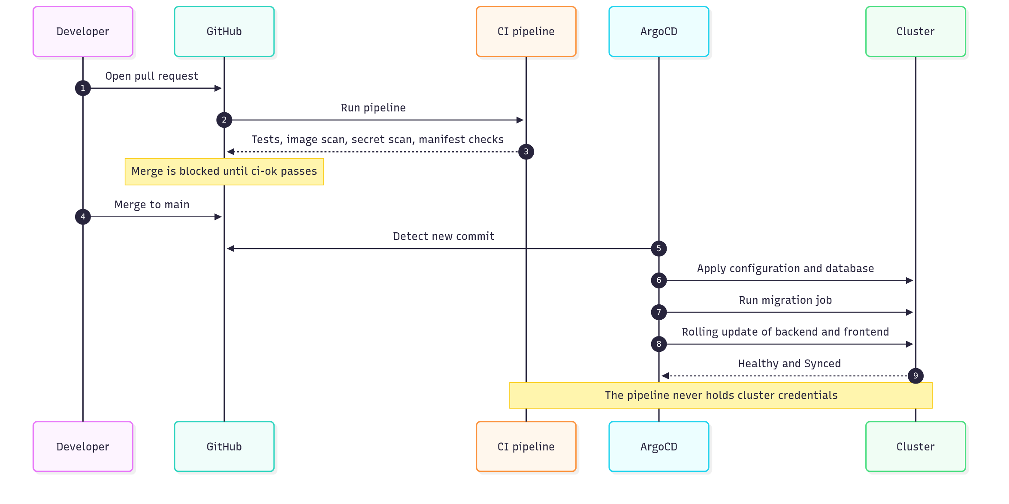
A change reaches production by being merged, nothing else
Sync order
Namespace
Configuration and network policies
Database
Migration job
Backend and frontend
Ingress
If the migration fails, the sync stops and the running version stays.
Notes:
Two stages: the pipeline validates, ArgoCD deploys. The pipeline never touches the cluster.

Slide 7
No change merges without passing seven checks
Secret scan
Backend
103 s
1
2
Gitleaks over the full Git history
Lint, 86 unit and integration tests
median pipeline time over 17 pull requests
Frontend
Build and scan
0
3
4
Type check, 29 tests
Production images, Trivy, end-to-end smoke test
cloud credentials held by the pipeline
Configuration
Terraform
Main branch: pull request required, ci-ok required, rules apply to admins.
5
6
Dockerfiles, manifests and Terraform checked
Format, validate, 25 plan tests on a mocked provider
Notes:
ci-ok is the only required check; it passes only if all the others passed or were skipped by the path filter.

Slide 8
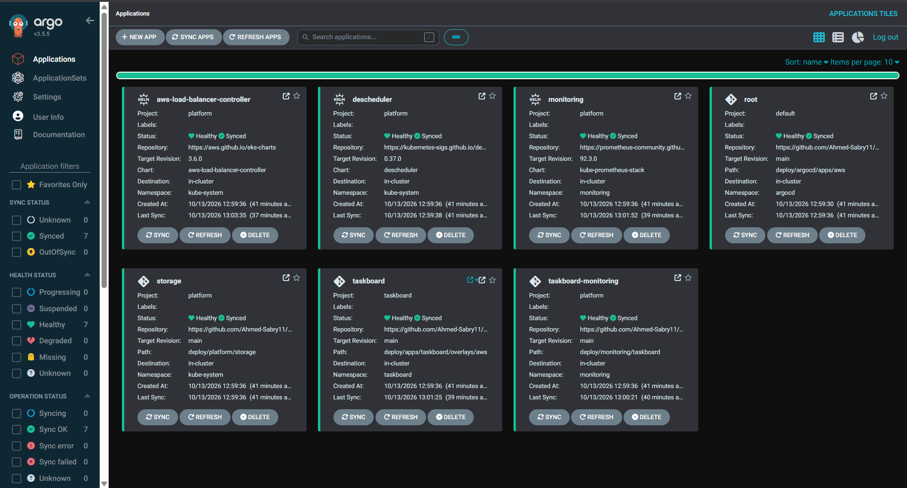
Git is the only way to change the cluster
155 s
empty cluster to seven healthy applications
1.5 s
to revert a manual change to the cluster
18 s
to roll back by reverting a commit
ArgoCD on EKS: seven applications created from one root application
Notes:
Screenshot from the AWS session: seven applications, all Synced and Healthy. We changed the cluster by hand and ArgoCD reverted it in 1.5 seconds.

Slide 9
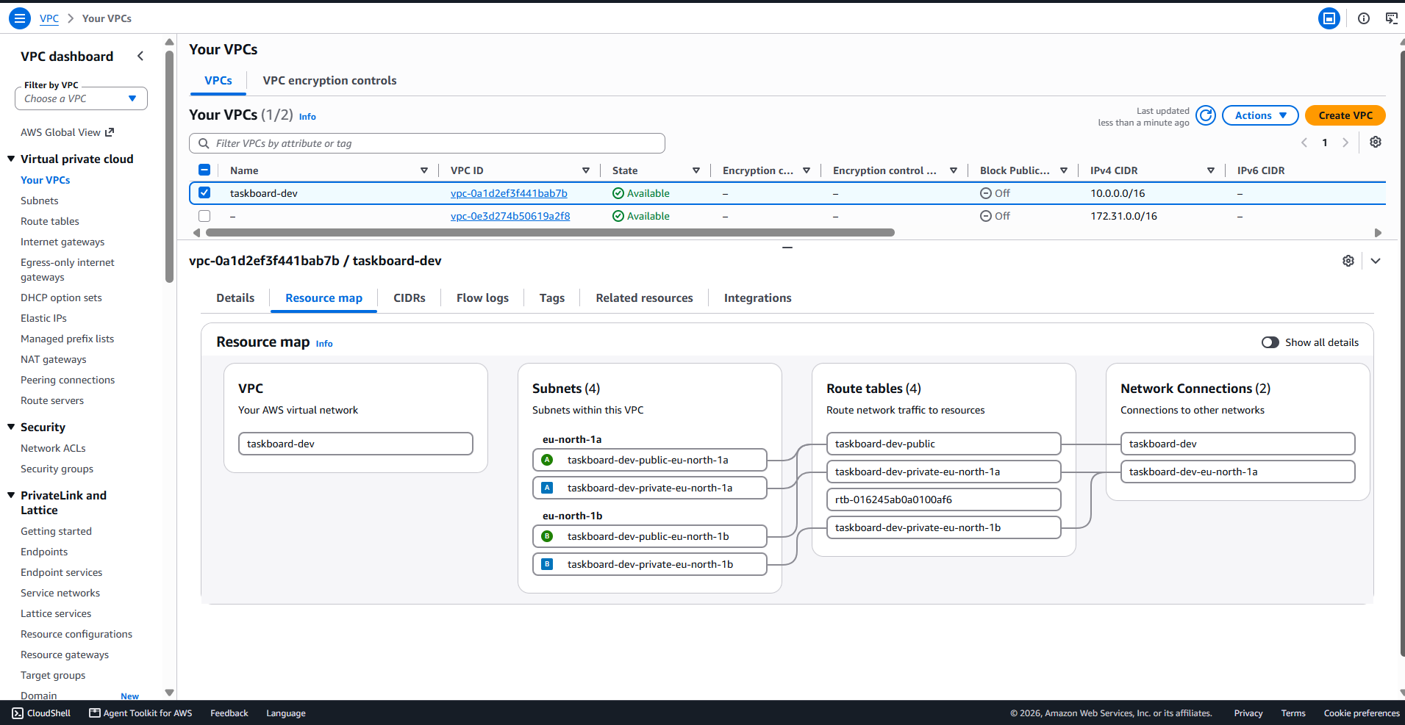
The whole AWS environment is created from code in 12 minutes
49
resources in the platform stack, from 7 reusable modules
0
changes in the plan after apply, and nothing left after destroy
State in encrypted, versioned S3 with locking
Least-privilege role per controller
About 0.40 USD per hour while it exists
The VPC as created by Terraform: subnets, route tables and gateways
Notes:
The environment was created and destroyed for each session. After destroy we verified ten resource types to confirm nothing billable was left.

Slide 10
Security is applied at eight layers, each verified by a test
1
Repository
2
Build
Pre-commit hook and server-side scanning keep secrets out of Git
A fixable high or critical vulnerability fails the pipeline
3
Container
4
Pod
Non-root user, no build tools in the final image
Read-only filesystem, no capabilities, enforced at admission
5
Cluster network
6
Cloud network
Default deny; only four paths opened
Nodes in private subnets; only the load balancer is public
7
Cloud identity
8
Data
No long-lived keys; one role per controller
Secrets, volumes and Terraform state encrypted
Notes:
The point is defence in depth: if one control fails, the next still holds. Every row was tested, not assumed.

Slide 11
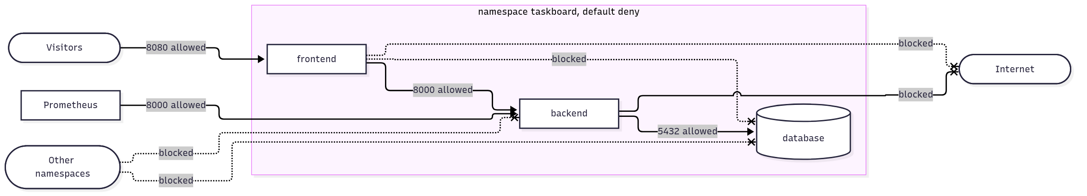
The frontend cannot reach the database, and we proved it
11 / 11
Allowed
Blocked
Visitors to frontend
Frontend to backend
Backend to database
Prometheus to backend
Frontend to database
Other namespaces to the app
Any pod to the internet
connection checks gave the intended result, on both clusters
Notes:
Before the policies the same script showed the frontend could open a connection to PostgreSQL. After: blocked. Same result on kind and on EKS, which use different network plugins.

Slide 12
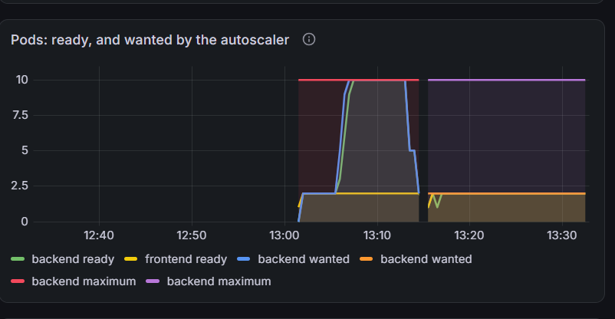
Under load the backend grew from 2 to 10 pods with zero failed requests
63,108
requests sent, 0 failed, 0 lost writes
171 ms
95th percentile response time (target under 500 ms)
164 s
to reach 10 pods; back to 2 pods 266 s after the load ended
Grafana on EKS: pods ready and pods wanted by the autoscaler during the load test
Scale-up is immediate. Scale-down waits three minutes so short dips do not remove capacity.
Notes:
k6 ramps to 50 virtual users. The graph is the real Grafana panel from the AWS session: ready pods follow the number the autoscaler asks for, then return to 2.

Slide 13
Losing a whole virtual machine cost 0.57% of requests
30 s
to full capacity after a node was terminated on AWS
0 of 305
requests failed while every pod was replaced
Spread across nodes, disruption budgets, 30-second eviction and a delay before shutdown.
Notes:
The chart shows failed requests in each drill. The tall bar is the defect we found locally: both backend pods were on the node we stopped. After the fix the same drill is 3.5% locally and 0.57% on AWS, where the load balancer removes dead targets in seconds.

Slide 14
Testing by failure found three defects that health checks missed
1
2
3
Proxy cached the backend address
Pods exited while still receiving traffic
Both backend pods on one node
SYMPTOM
SYMPTOM
SYMPTOM
After a Service was recreated, every API request timed out.
4 of 192 requests failed during a rollout.
Stopping that node removed the backend for 85 s.
FIX
FIX
FIX
Resolve the name per request.
Wait before shutdown.
Descheduler restores the spread.
Service back 2 s after recreation
0 failed of 305
15.8% failed, now 0.57% on AWS
Notes:
This is the most important lesson. In all three cases every pod was Running and Ready while users saw errors.

Slide 15
21 of 29 acceptance criteria met, and every gap has a named cause
Partly met (4)
Publishing images and building the environment need one manual step: the cloud account forbids the identity provider the pipeline needs. One dashboard instead of four.
Not met (1)
HTTPS. A certificate needs a domain name, and the project has none.
Not measured (3)
Node auto-scaling (account quota of two nodes), a two-hour soak, and a timed manual-deployment comparison.
Notes:
The criteria were written before implementation. We report the ones we missed as openly as the ones we met.

Slide 16
What is missing today is what we would build next
LIMITATION
NEXT STEP
HTTP only
Register a domain, issue a certificate, redirect to HTTPS
Images pushed by a script
Standard account, pipeline role, fully automatic path
Single database pod, no backup
Managed database across two zones
Two nodes at most
Node autoscaler and a cluster scaling test
Alerts are not delivered
Send alerts to email or chat; external uptime probe
Notes:
Each limitation on the left has its next step on the right.

Slide 17
A platform should be judged by what users see when things fail
12 min
0
2 to 10
0.57%
environment from code
manual deploy commands
pods under load, 0 failed
failed when a node died
Thank you. Questions?
github.com/Ahmed-Sabry11/taskboard-platform
Notes:
Close on the lesson, then offer the live demo on the local cluster: change a replica count by hand and watch ArgoCD revert it.

