Slide 1
Robot Web Controls
Web applications protocols and components

Slide 2
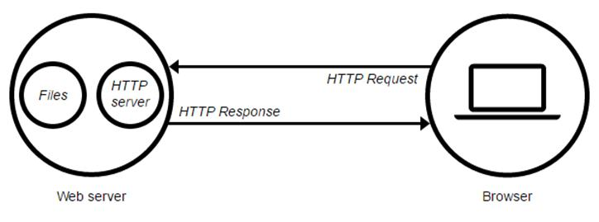
HTTP Protocol
HTTP is the underlying protocol used by the World Wide Web. It’s a stateless protocol

Slide 3
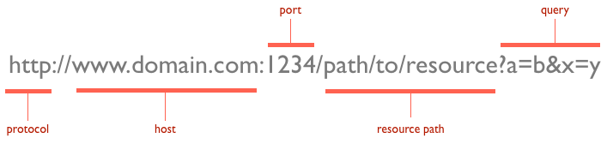
URLs
Routes specifying a resource within a specific host

Slide 4
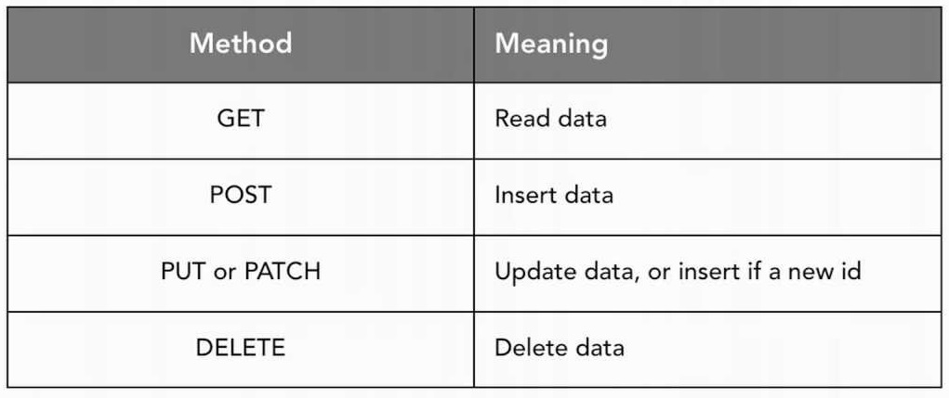
HTTP Verbs

Slide 5
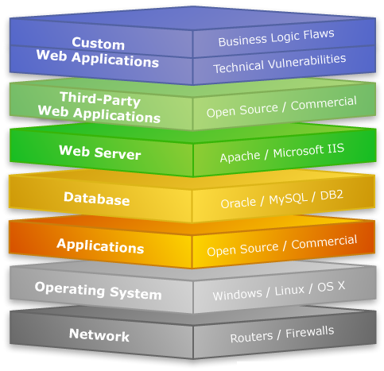
Web Stack structure
A Web stack is the collection of software required for Web development. At a minimum, a Web stack contains an OS, a programming language, database software and a Web server.

Slide 6
Selecting a stack
Comparison between candidates

Slide 7
Characteristics of robot user interface
Single user
Real-time System
Direct access to hardware drivers

Slide 8
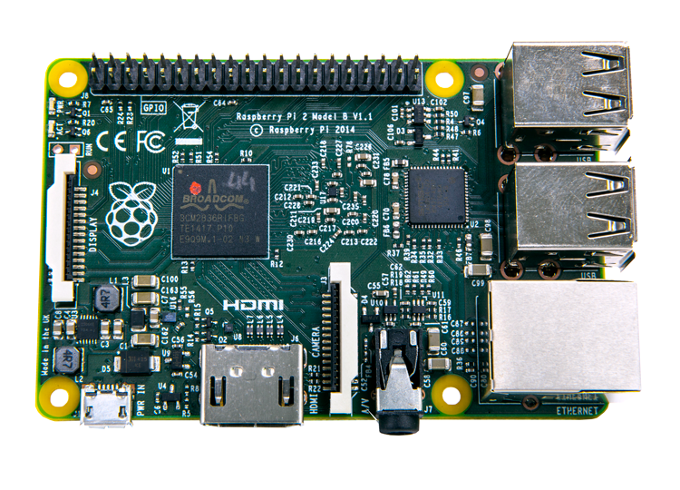
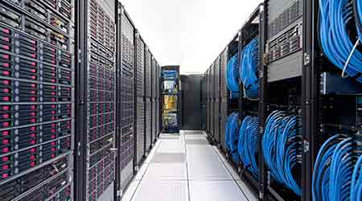
Hosting Machine

Slide 9
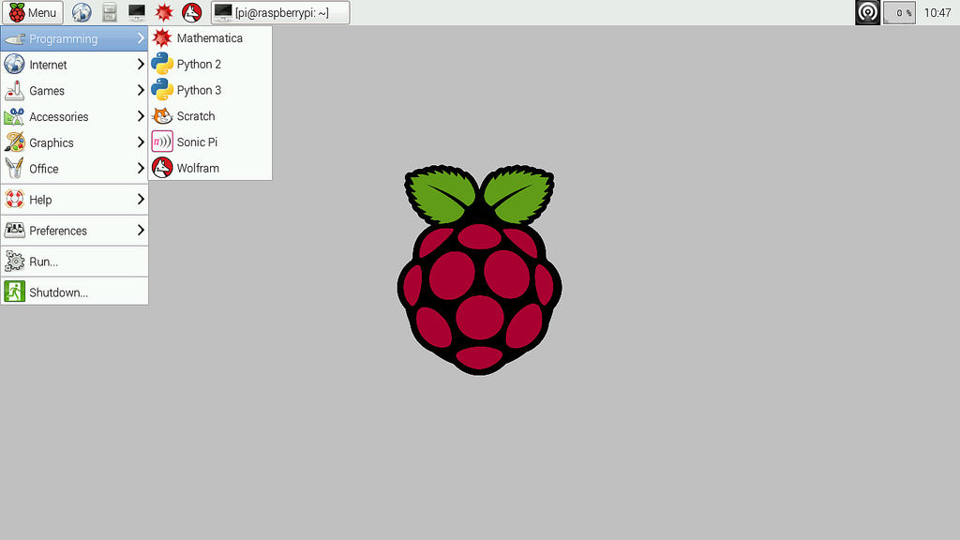
Operating system

Slide 10
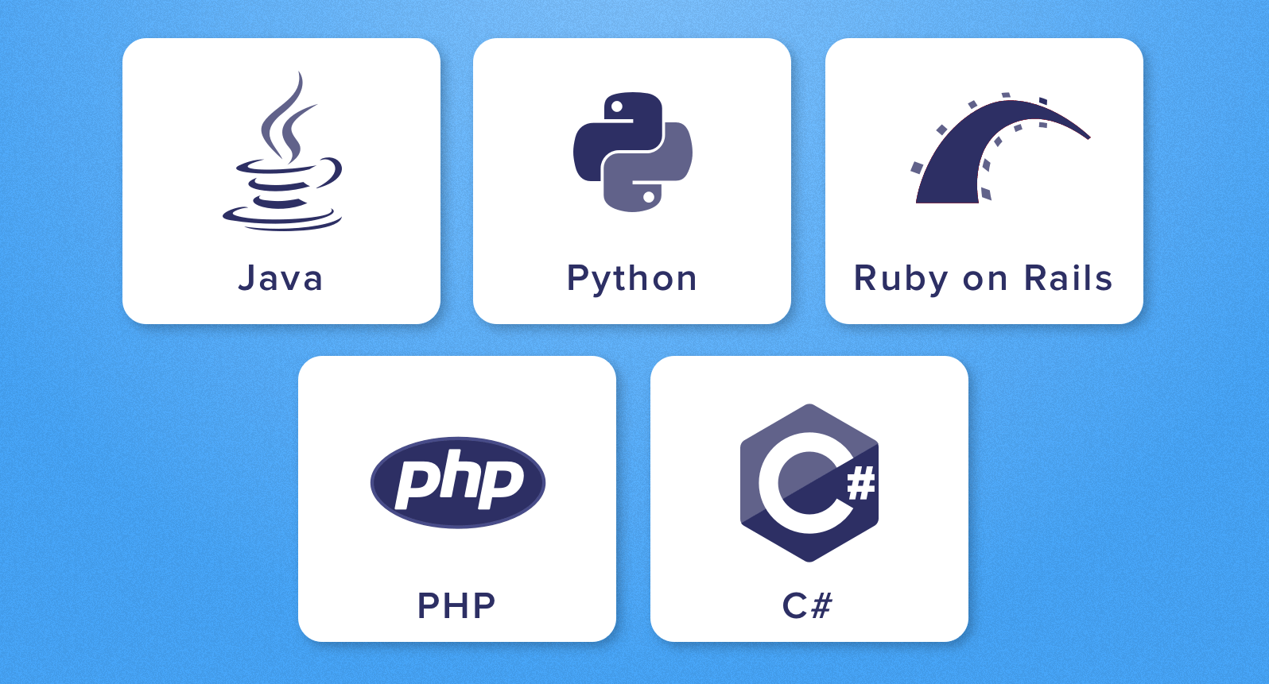
Server-side scripting language

Slide 11
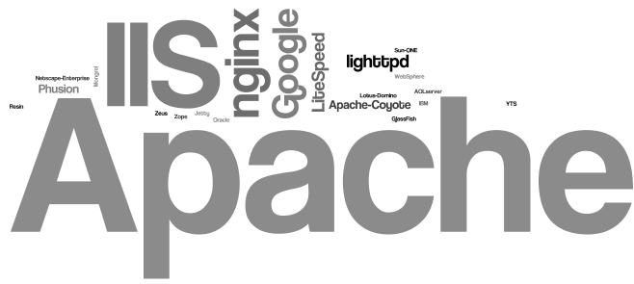
Web Server

Slide 12

Database
It’s a real-time application that doesn’t store any previous or old data or states

Slide 13
Robot Control Interface
Interface Components

Slide 14
Robot Main Functions
Receiving the robot state:
Getting the current moving state
Getting the camera stream
Getting the current object recognition results for a specific frame
Sending commands to the robot:
Sending move instructions to robot
Request camera stream
Request recognition of objects in a specific frame

Slide 15
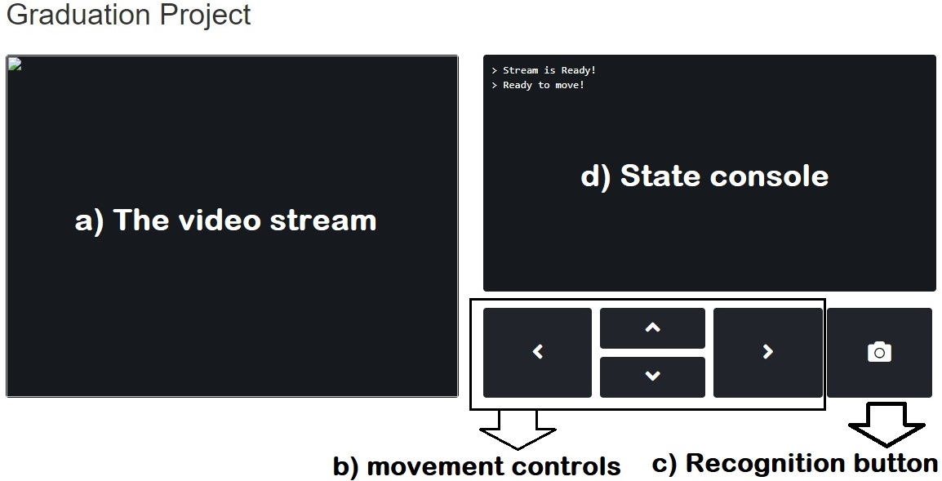
Interface Components

Slide 16
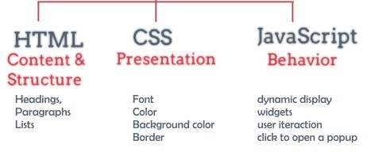
Interface Layers

Slide 17
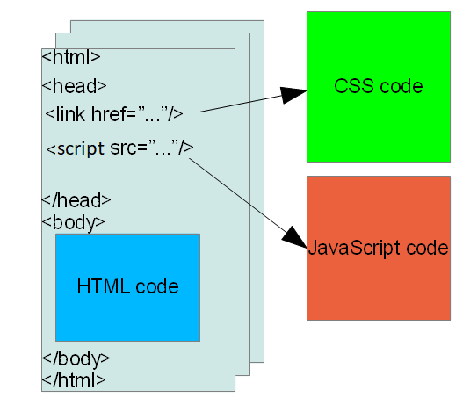
Structure Layer
Every aspect of a site's content should be represented in the structure layer, including other layers resources as well

Slide 18
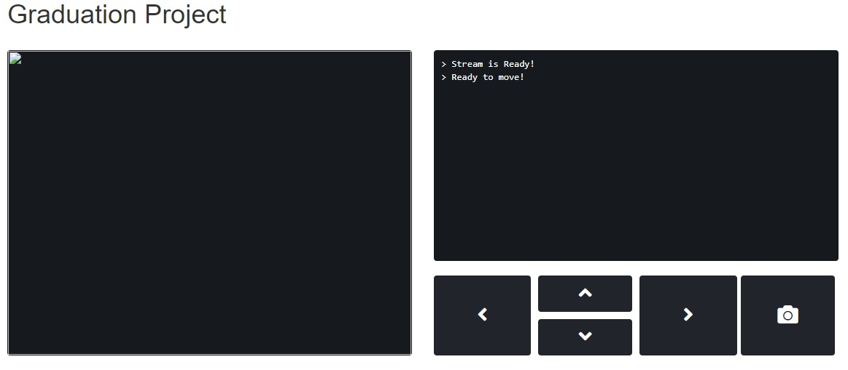
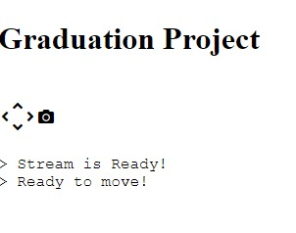
Presentation Layer

Slide 19
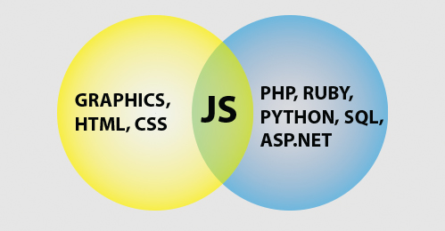
Behavior Layer
Capture user interactions
Highlight user actions
Check robot availability

Slide 20
Server-Side Logic
Backend functionalities

Slide 21
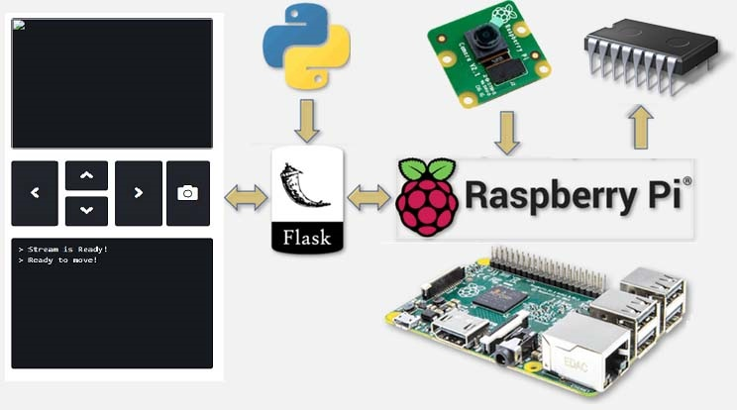
Raspberry Pi backend Interactions

Slide 22
Backend functionalities
Serving the control interface upon request
Capture camera frames and send it back to as stream
Send movement instructions to the underlying microcontroller via a common communication protocol
Recognize objects in a frame and send the results back

Slide 23
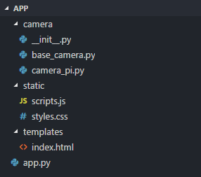
Backend Routes
Routes are the logical structure of paths used by the control interface to access robot functionalities.

Slide 24
Backend Example
IP address: 192.168.0.1
Web server port: 5000
Camera stream route: `/video_feed`
Route HTTP method: GET
URL: http://192.168.0.1:5000/video_feed

Slide 25
Serving the control interface
Route: `/`
HTTP verb: GET
Required query data: None
Response: returns the control interface to the browser
The response containing the HTML document of the control interface

Slide 26
Video Streaming
Route: `/video_feed`
HTTP verb: GET
Required query data: None
Response: MJPEG stream
Streaming is a technique in which the server provides the response to a request in chunks

Slide 27
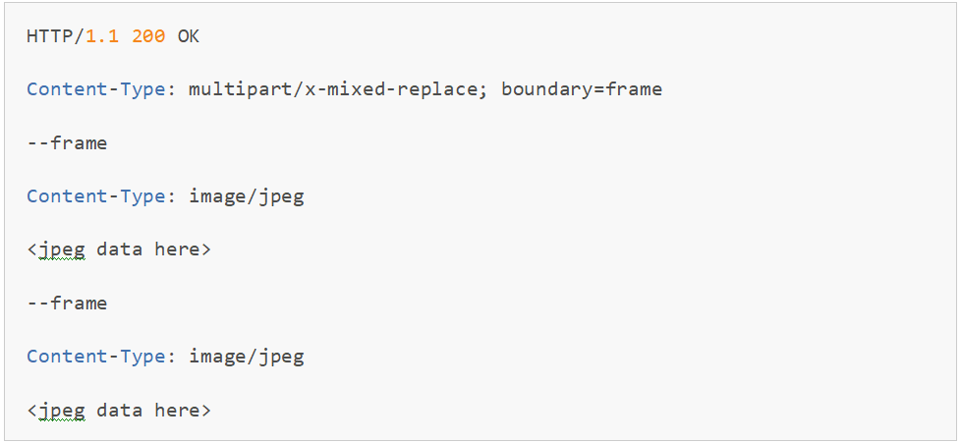
Video Streaming

