Slide 1
Lists
Data Structures
CS 2014
By
Marwa M. A. Elfattah

Slide 2
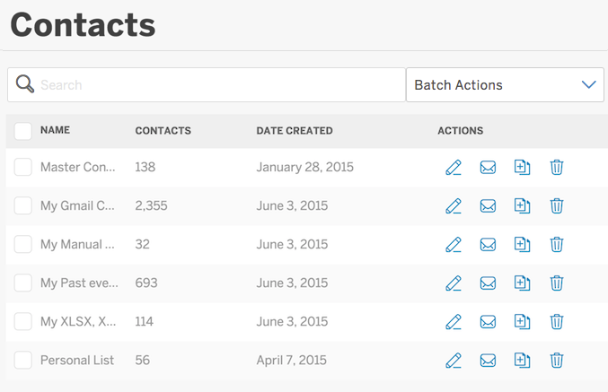


List- What?

Slide 3
Lists
A list is an sequential set of data items (values).
In a general list:
New values are added in position determined by the user.
Element is removed from a position determined by the user.

Slide 4
How Lists Work?
Insertion position
0
n
MAX-1
Insertion range
Should be shifted one cell right
Insert New Element
??
New element
0
n+1
MAX-1
Shifted elements
We can insert a new element in position 0≤p≤n+1, where n is the number of elements within the list.

Slide 5
How Lists Work?
Deletion position
0
n
MAX-1
Deletion range
Should be shifted one cell left
Delete an Element
??
0
n
MAX-1
Shifted elements
We can delete an element from position 0≤p≤n,where n is the number of elements within the list.
.

Slide 6

Lists
?
Implementation
User View

Slide 7

Lists
Many applications require resizing, and the required size not always immediately available.
For those applications, the linked list is preferred.

Slide 8

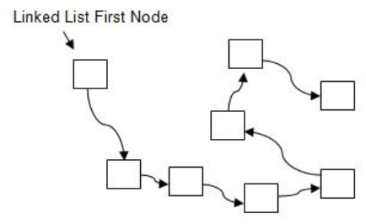
Linked Lists
Linked list is a linear data structure consisting of a sequence of nodes connected to each other
Each node stores:
Data
Link to the next node

Slide 9
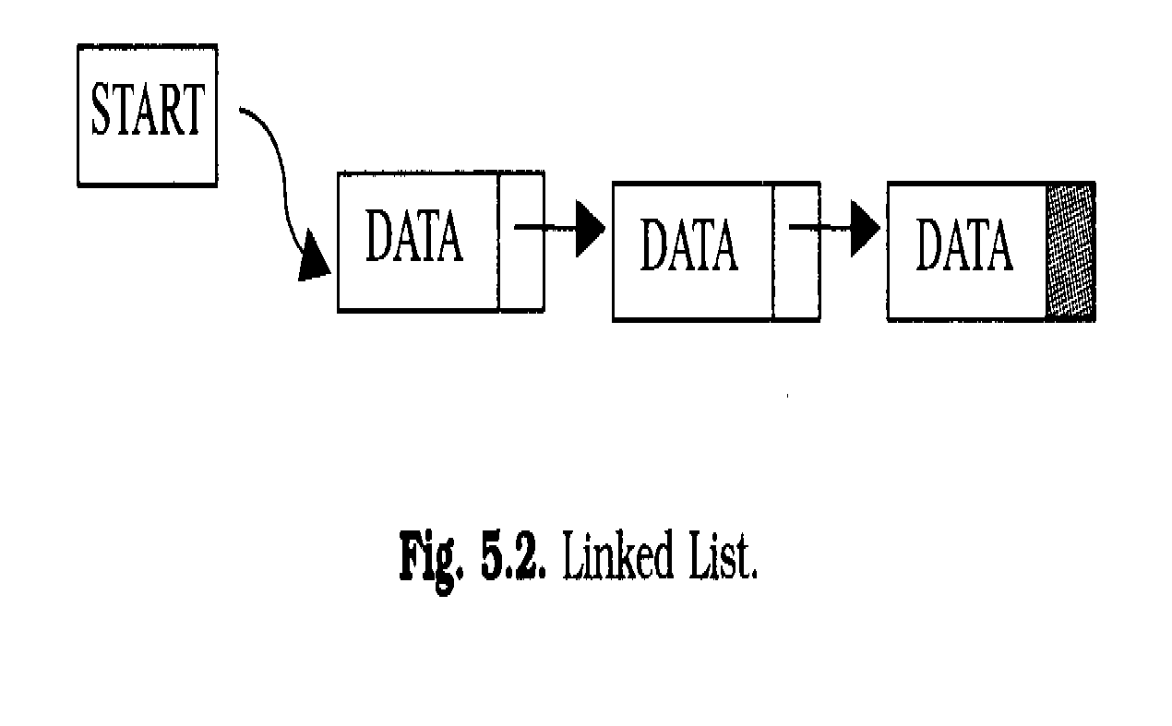

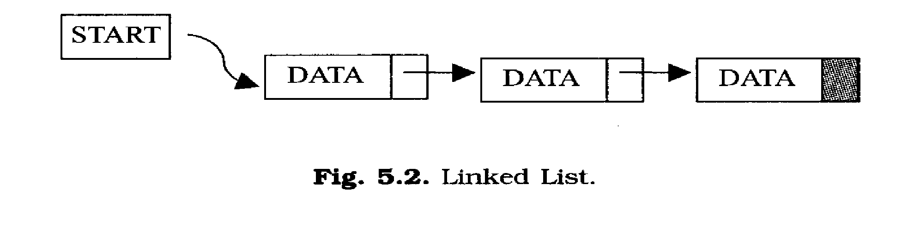
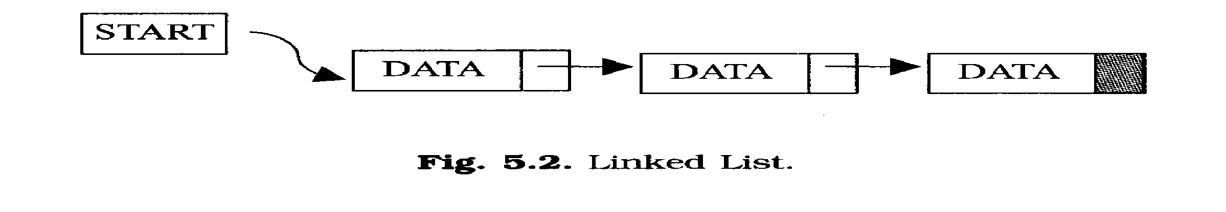
Linked List
NULL

Slide 10
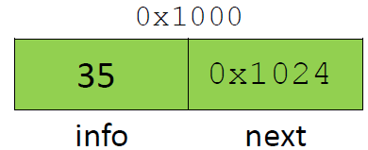
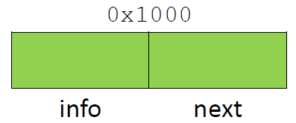
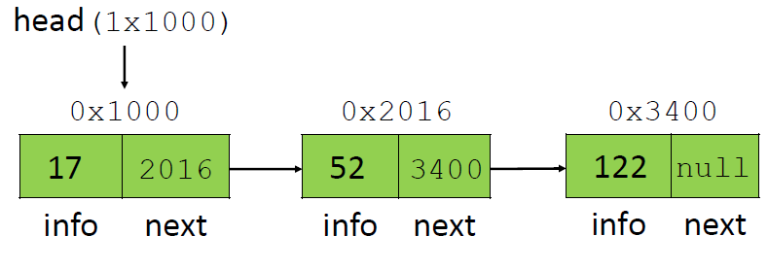
Linked List
Pointer to first node
Pointer to next node
Data member
NULL pointer (points to nothing)

Slide 11
Linked List
They are dynamic data structure: That grow or shrink during the execution of a program.
Efficient memory utilization: Memory is allocated whenever it is required. And it is de-allocated when it is not needed.

Slide 12
Linked List Implementation
typedef char Entrytype;
typedef struct node {
Entrytype info;
struct node *next;
}Node;
typedef Node * ListType;
info
next
Node is the basic block for the list
List

Slide 13
OPERATIONS PERFORMED ON LINKED LIST
Create the list, leaving it empty.
Determine whether the list is empty or not.
Determine whether the list is full or not.
Insert a new entry in a specific position.
Retrieve an entry from a specific position.
Clear the list to make it empty

Slide 14
Linked List Implementation
Create operation:
Pre: None.
Post: The list is initialized to be empty.
void CreateList(ListType *L){
*L= NULL;
}

Slide 15
Linked List Implementation
Empty operation:
Pre: The list is initialized.
Post: If the list is empty (1) is returned. Otherwise (0) is returned.
int EmptyList(ListType L){
return (L==NULL);}
Full operation:
Pre: The list is initialized.
Post: If the list is full (1) is returned. Otherwise (0) is returned.
int FullList(ListType L){
return 0;}

Slide 16
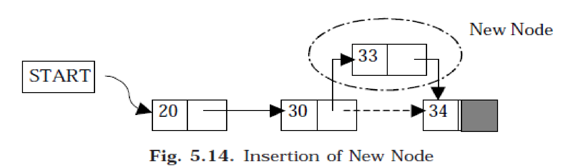
Linked List Implementation
Insert operation:
Pre: The list is initialized, not full and 0<=pos<=size of the list.
Post: Item is added to specific position of the list.
void Insert(ListType *L, Entrytype item, int pos){
Node *p = (Node *)malloc(sizeof(Node));
p->info = item;
if (pos==0){ //will work also for empty list
p->next=*L; *L = p; }
else{ Node *q; int i;
for(q=*L, i=0; i<pos-1; i++)
q=q->next;
p->next=q->next;
q->next=p;
} }
P
33
We should make sure that the memory is not full when we call malloc .
HOW?
If we do so, Should we change the pre/post condition(s)?
P
q
L

Slide 17
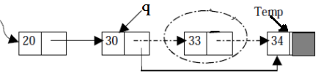
Linked List Implementation
Retrieve operation:
Pre: The list is initialized, not empty and 0<=pos<=size of the list.
Post: An element has been retrieved from position pos.
void Retrieve(ListType *L, Entrytype *item, int pos){
int i; Node *q, *tmp;
if (pos==0){
*item=(*L)->info; tmp=*L; *L=(*L)->next;
free(tmp);} // it works also for one node
else{
for(q=*L, i=0; i<pos-1; i++) q=q->next;
*item=q->next->info;
tmp=q->next; q->next=tmp->next;
free(tmp); }// check for retrieving last node
}
tmp
tmp
L
L

Slide 18
Linked List Implementation
Clear operation:
Pre: The list is initialized.
Post: the list is cleared to be empty.
void ClearList(ListType *L){
Node *q;
while(*L){
q = *L;
*L=(*L)->next;
free(q);
}
}

Slide 19
Think
Could you keep track with the list size in the List ADT?!! How?!! is that useful?!!
Discuss, which is better array based or linked implementation for lists.
How to use the Linked List as a Linked Stack?!!
How to use the Linked List as a Linked Queue?!!

Slide 20
Thank you

