Slide 1
Trees
Data Structures
CS 2014
By
Marwa M. A. Elfattah

Slide 2
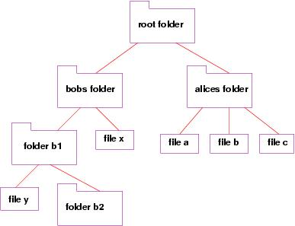

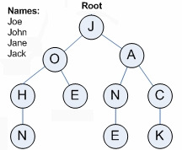
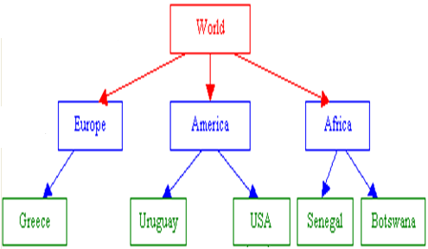
Tree – What?

Slide 3
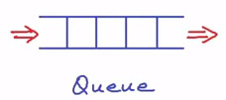
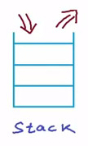
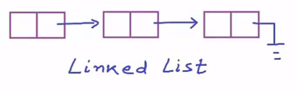
Tree – What?
Remember (Linear ADT)
Is a powerful non-liner data structure
Used to represent data items possessing hierarchical relationship
It is acyclic structure of linked nodes.

Slide 4
Tree – What?
A tree is a collection of nodes.
The collection can be empty.
If not empty, a tree consists of:
  a node r (the root)
  zero or more nonempty subtrees T1, T2, ...., Tk, each of whose subtrees are connected by an edge from r.

Slide 5
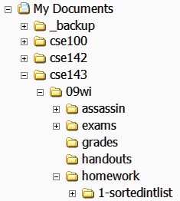
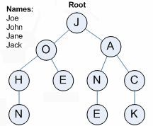
Trees in computer science
Folders/files on a computer
Family or organizational charts
Compilers: expression parse Tree
a = (b + c) * d;
Cell phone
Decision Tree
=
a
*
+
d
b
c

Slide 6
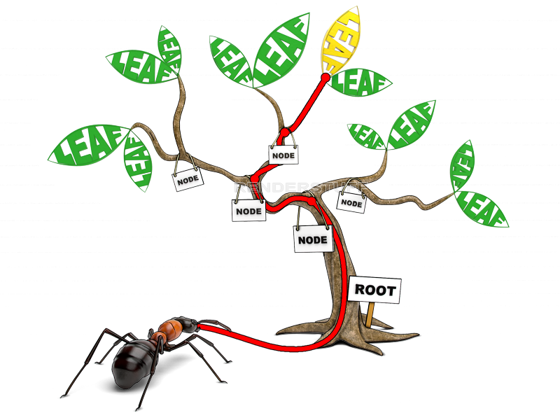
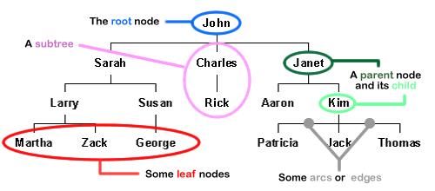
Terminologies

Slide 7
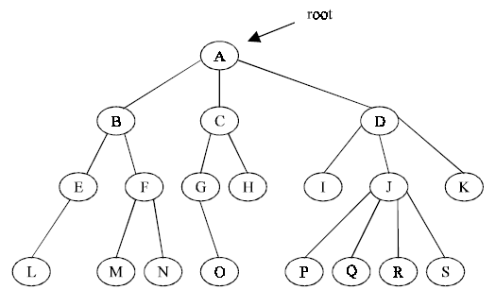
Terminologies
Parent of J, K , I
Child of A
Node : an object containing a data value and children
Root : topmost node of a tree
Leaf : a node that has no child
Parent : a node that refers to this one.
Child : a node that this node refers to.
Sibling : a node with a common parent node.

Slide 8
Terminologies
Path : a sequence of edges.
Size : the number of nodes in a tree.
Subtree : a smaller tree of nodes, which is one of
the current node children.

Slide 9
Terminologies
The degree of this is 4 or more
Level 0
2
Level 1
Level 2
2
Level 3
Height : length of the longest path from the node
to any node.
Level : length of the path from a root to a given
node.
Depth : number of levels within a tree.
Degree : the maximum number of subtrees.

Slide 10
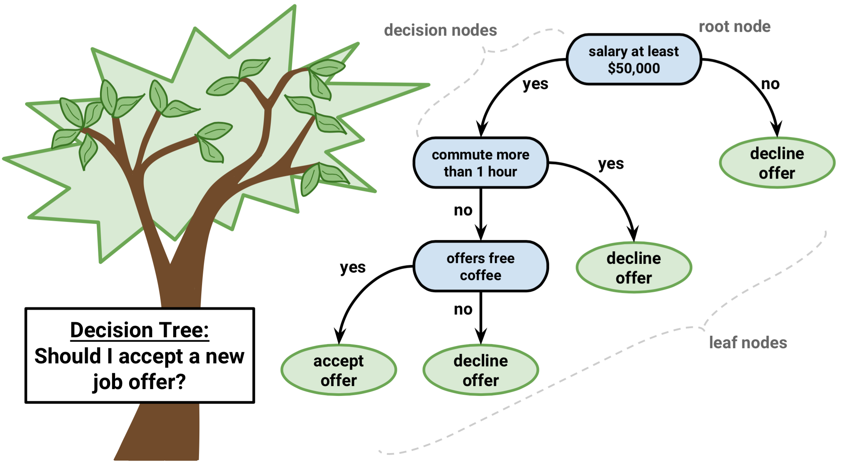
Binary Tree

Slide 11
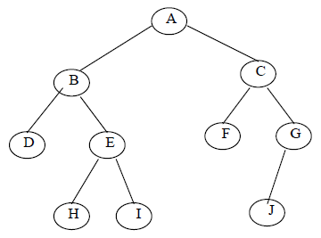
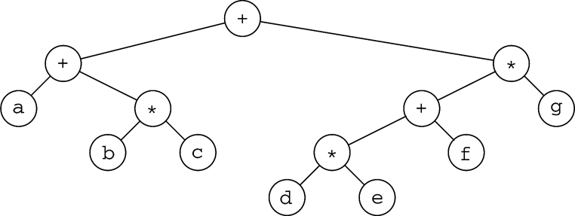
Binary Trees
A tree in which no node can have more than two children (tree of degree 2)
A binary tree is an empty tree, or is a root node that has two children each of them is a binary tree
Left successor
Right successor
Generic
binary tree
Examples
Never joined

Slide 12
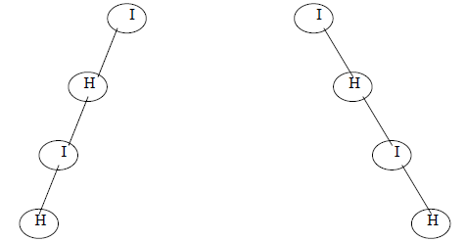
Binary Tree
Left Skewed
Right Skewed
If a binary tree has only right sub trees, then it is called right skewed binary tree.
If a binary tree has only left sub trees, then it is called left skewed binary tree.

Slide 13
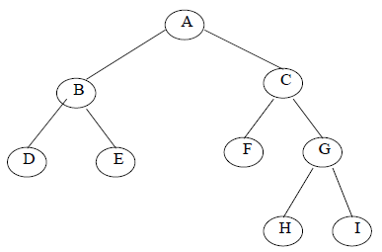
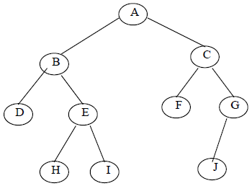
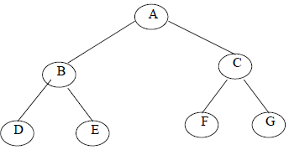
Complete Binary Tree
a binary tree in which every level, except possibly the last, is completely filled- or has 2^{L} node.

Slide 14
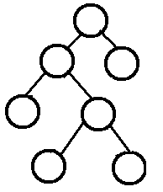
Full (Strictly) Binary Tree
A binary tree in which every node other than the leaves has exactly two children.

Slide 15
Binary Tree
Full and Complete
Not Full but Complete
Full but not Complete

Slide 16
Binary Tree Traversals
Traversal: An examination of the elements of a tree.
Common orderings for traversals:
  pre-order: process root node, then its left/right subtrees
  in-order: process left subtree, then root node, then right
  post-order: process left/right subtrees, then root node

Slide 17
Traversal example
Root
in-order (LVR):
41
6
17
81
9
17
41
9
6
81

Slide 18
Traversal example
Root
pre-order (VLR):
17
41
6
9
81
17
41
9
6
81

Slide 19
Traversal example
Root
post-order (LRV):
6
41
81
9
17
17
41
9
6
81

Slide 20
Exercise
  Pre-order:
  42 15 27 48 9 86 12 5 3 39
  In-order:
  15 48 27 42 86 5 12 9 3 39
  Post-order:
  48 27 15 5 12 86 39 3 9 42
Root
42
15
9
27
86
3
48
12
39
5

Slide 21
Example: Expression Trees
It is a binary tree contains an arithmetic expression with some operators and operands.
Leaves are operands (constants or variables)
The internal nodes contain operators
For each node contains an operator, its left subtree gives the left operand, and its right subtree gives the right operand.
*
a
b
a* b

Slide 22
Example: Expression Trees
Building Expression Trees has great importance in syntactical analysis and parsing, along with the validity of expressions

Slide 23
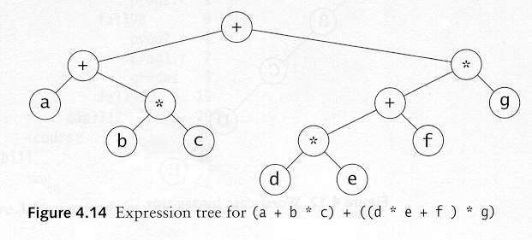
Example: Expression Trees
(d * e + f ) *g
-
b
- b
++
*
a
a
b
a++
a* b

Slide 24
Example: Expression Trees

Slide 25
Tree
?
Implementation
User View

Slide 26
Tree Implementation
root

Slide 27
Tree Implementation
typedef struct nodeType {
EntryType info;
struct nodeType *right;
struct nodeType *left;
} NodeType;
typedef NodeType * TreeType

Slide 28
Tree Implementation
  Pre: None.
  Post: The tree is initialized to be empty.
void CreateTree(TreeType *t){
*t=NULL;}
Pre: The tree is initialized.
Post: If the tree is empty (1) is returned. Else (0) is returned.
int EmptyTree(TreeType t){
return (!t);}
Pre: The tree is initialized.
Post: If the tree is full (1) is returned. Else (0) is returned.
int FullTree(TreeType t){
return 0;}

Slide 29
Tree Implementation
  Pre: The tree is initialized.
  Post: The tree has been been traversed in infix order sequence.
void Inorder(TreeType t, void(*pvisit)(EntryType)){
Stack s; NodeType *p=pt;
if(p){
CreateStack(&s);
do{
while(p){Push(p, &s); p=p->left;}
Pop(&p, &s);
(*pvisit)(p->info);
p=p->right);
}while(!StackEmpty(&s) || p);
}}}

Slide 30
Tree Implementation
  Pre: The tree is initialized.
  Post: The tree has been been traversed in infix order sequence.
void Inorder(TreeType t, void(*pvisit)(EntryType)){
if(t){
Inorder(t->left, pvisit);
(*pvisit)(t->info);
Inorder(t->right, pvisit);
}
}

Slide 31
Tree Implementation
  Pre: The tree is initialized.
  Post: The tree has been been traversed in prefix order sequence.
void Preorder(TreeType t, void(*pvisit)(EntryType)){
if(t){
(*pvisit)(t->info);
Preorder(t->left, pvisit);
Preorder(t->right, pvisit);
}
}

Slide 32
Tree Implementation
  Pre: The tree is initialized.
  Post: The tree has been been traversed in Postfix order sequence.
void Postorder(TreeType t, void(*pvisit)(EntryType)){
if(t){
Postorder(t->left, pvisit);
Postorder(t->right, pvisit); (*pvisit)(t->info);
}
}

Slide 33
Tree Implementation
int Size(TreeType t){
if (!t)
return 0;
return (1+Size(t->left)+
Size(t->right));
}

Slide 34
Tree Implementation
int Depth(TreeType t){
if (!t)
return 0;
int a=Depth(t->left);
int b=Depth(t->right);
return (a>b)? 1+a : 1+b;
}

Slide 35
Tree Implementation
void ClearTree(Tree *t){
if (*t){
ClearTree(&(*t)->left);
ClearTree(&(*t)->right);
free(*t);
*t=NULL;
}
}

Slide 36
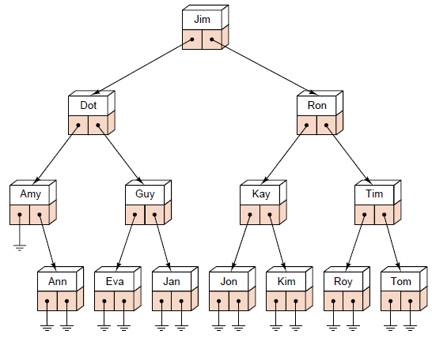
Binary Search Trees
A binary search tree is a binary tree that is either empty or in which every node has a key (within its data entry) and satisfies the following conditions:
The key of the root (if it exists) is greater than the key in any node in the left subtree of the root.
The key of the root (if it exists) is less than the key in any node in the right subtree of the root.
The left and right subtrees of the root are again binary search trees.

Slide 37
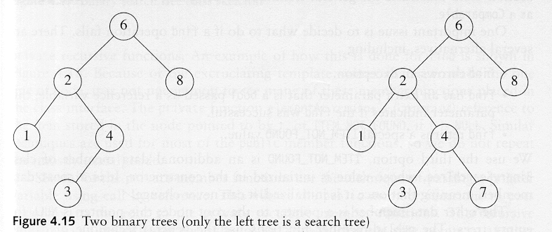
Binary Search Trees
A binary search tree
Not a binary search tree

Slide 38
Tree Implementation
Void Insert(TreeType *t, EntryType item){
/*Recursion is not good here WHY??*/
NodeType*p=(TreeNode*) malloc(sizeof(TreeNode));
p->info=item; p->left=NULL; p->right=NULL;
if (!(*T)) *t= p;
else{
NodeType *pre,*cur;
cur=*t;
while(cur){
pre=cur;
if(item<cur->info) cur=cur->left;
else cur=cur->right;
}
if(item <pre->info) pre->left=p;
else pre->right=p;
} }

Slide 39
Tree Implementation
int DeleteItem(TreeType *t,EntryType k){
int found=0; Node *q=*t; Node *r=NULL;
while(q && !(found=(k==q->info))){
r=q;
if(k<q->info) q=q->left;
else q=q->right;
}
if (found){
if(!r)//Case of deleting the root
DeleteNode(t);
else if((k< r->info))
DeleteNode(&r->left);
else
DeleteNode(&r->right);
}
return found;
}

Slide 40
Tree Implementation
void DeleteNode(tree *pt){
Node *q=*pt; Node *r=Null;
if(!(*pt)->left) *pt=(*pt)->right;
else if(!(*pt)->right) *pt=(*pt)->left;
else{//third case
q=(*pt)->left;
while(q->right){
r=q;
q=q->right;
}
(*pt)->info=q->info;
if(!r) (*pt)->left=q->left;
else r->right=q->left;
}
free(q);
}
Root
pt
pt
20
15
29
pt
17
26
30
16
28
39
27

Slide 41
Thank you

