Slide 1
Graphs
Data Structures
CS 2014
By
Marwa M. A. Elfattah

Slide 2
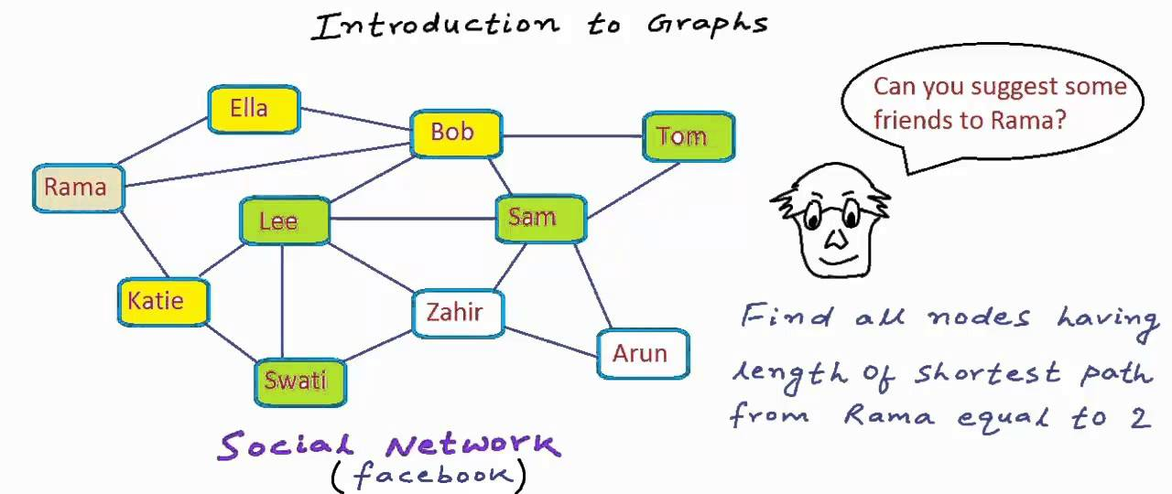
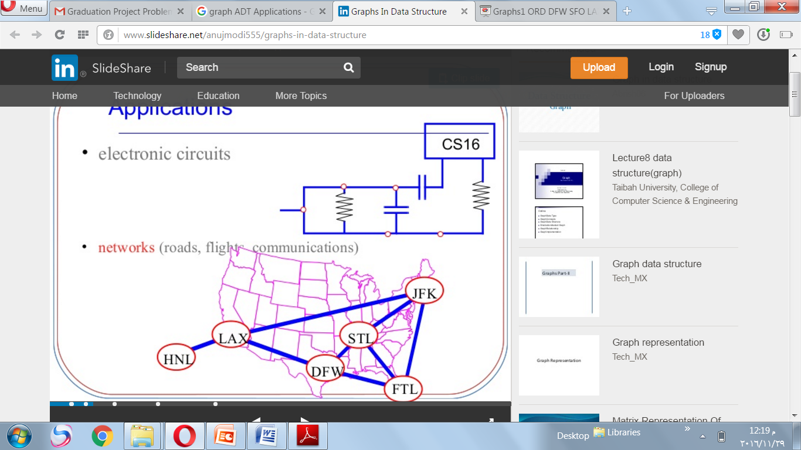
Graphs
A graph is a set of nodes (vertices) interconnected by links (edges).

Slide 3
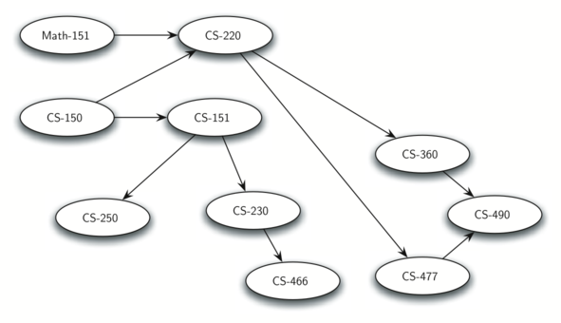
Graphs
Graphs can be used to represent many interesting things about our world, including systems of roads, airline flights, network connections, or even courses prerequistes.

Slide 4
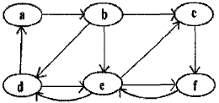
Graphs
Definition: A graph G = (V, E) consists of two sets called the set of vertices V and the set of edges E.
V is a finite not empty set of items named vertices or nodes.
An edge in E is a pair of vertices in V.

Slide 5
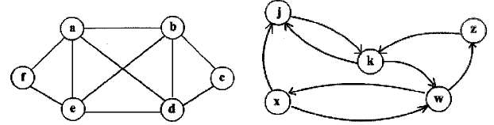
Graphs
Undirected
Directed
V = {a,b,c,d,e,f} and E = {(a,d), (d,a), (a,b) (b,a), (e,a), (a,e), (a,f), (f,a), (b,e), (e,b), …. }.
V = (j, k, w, x, z) and E = {(j, k), (k,j), (k, w), (w, x}, (w, z), (x,j), (x, w), (z, k)}.
If the edges are ordered pairs, i.e. (u, v) not equal (v, u) the graph is directed, otherwise it is undirected.
Each undirected graph can be represented by a directed graph by associating two directed edges to each undirected edge.

Slide 6
Graphs
Undirected
Directed
A vertex u is adjacent to a vertex v if there exists an edge (v, u) in E.
The adjacency relationship is symmetric if the graph is undirected. In a directed graph we can have that u is adjacent to v and the vice versa does not hold. AS WHATE HERE??

Slide 7
Graphs
Undirected
Directed
The number of vertices adjacent to a vertex is called degree of v.
WHATE IS THE DGREE OF a??
out-degree is the number of vertices exit from a vertex.
in-degree is the number of vertices entered to the vertex u.
WHATE IS THE IN-DGREE AND THE OUT-DGREE OF j??

Slide 8
Graphs
Undirected
Directed
A path is a sequence of vertices (V0,..., Vn) such that each Vi is adjacent to Vi+i. The length of this path is n. Vo and Vn are, respectively, called the source and the target vertices. We have a path (j, k, w, x) of length 3, source j and target x.
A cycle is a path (Vo,..., Vn) that has V0 = Vn. SUCH WHATE?

Slide 9
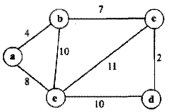
Graphs
Unconnected
Weighted
A graph is connected if there is a path between any pair of vertices.
A graph G = (V, E) is weighted if each edge in E has a weight.

Slide 10
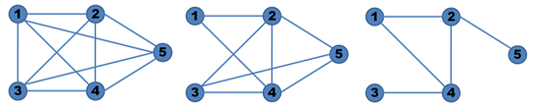
Graphs
Complete
Dense
Sparse
  A graph is called:
  Complete: when there's an edge between any two nodes.
  Dense: when the number of edges is close to the maximal number of edges.
  Sparse when it has only a few edges

Slide 11
Graph
?
Implementation
User View

Slide 12
Graph Representation
The most commonly used representations for graphs are the:
Adjacency matrix
Adjacency lists.

Slide 13
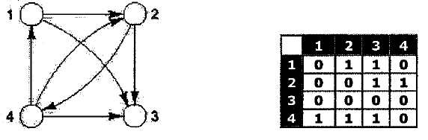
Adjacency Matrix
The graph vertices are numbered from 1 to N and are represented as an (N X N) adjacency matrix of o‘s and 1‘s or of weights for weighted graphs.
This representation is very convenient if there is the need to test the existence of an edge. On the other hand, it requires an O(NXN) storage space, even if the number of edges is smaller

Slide 14
Adjacency Matrix Implementation
#define MAXVERTEX 20
typedef struct
int size;
int matrix[MAXVERTEX][MAXVERTEX];
}Graph;

Slide 15
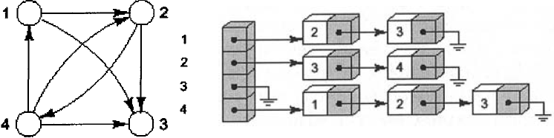
Adjacency List
ListArr
The graph is represented by number of adjacency lists. Thus, for each vertex v its adjacency lists ListArr[v] contains pointers to the vertices adjacent to it.
If the graph is weighted, then the weight w(v,u) is stored together with the vertex u in the adjacency list of v.
If the graph is undirected, the sum of the lengths of the lists in ListArr is double of number of eadges, because each edge (u, v) appears in u and v the adjacency lists.

Slide 16
Adjacency List Implementation
#define MAXVERTEX 20
typedef struct edge{
int endpoint;
struct edge *next;
}Edge;
Typedef Edge *Vertex;
typedef struct
int size;
Vertex ListArr[MAXVERTEX];
}Graph;

Slide 17
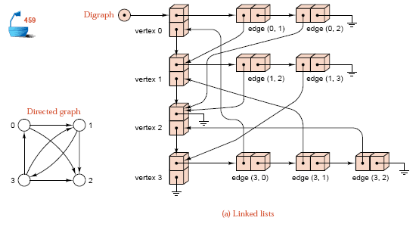
Graph Representation
What about this representation?

Slide 18
Graph Representation
When we have to choose how to represent a graph, we should take into account the following aspects:
The number of vertices.
The graph density (dense / sparse).
The modification frequency.
The algorithm to be implemented.

Slide 19
Graph ADT Operations
InitiGraph: creates a new, empty graph.
addVertex: adds an instance of Vertex to the graph.
addEdge: Adds a new, directed edge to the graph that connects two vertices.
getAdacantList: finds all vertices in the graph those are adjacent to specific vertex.
getVertices: returns the list of all vertices in the graph.
vertixIn: check if a given vertex is in the graph or not.
edgeIn: check if a given edge is in the graph or not.

Slide 20
Graph Search
  Systematically follow the edges of a graph
  to visit the vertices of the graph. Two searching strategies that are usually considered:
Breadth First Search (BFS).
Depth First Search (DFS).

Slide 21
Breadth-first Search
Input: Graph G = (V, E), and source vertex s ∈ V.
Output:
  d[v] = distance from s to v, for all v ∈ V. d[v] = ∞ if v is not reachable from s.
  pre[v] = v’s predecessor.
  Builds breadth-first tree with root s that contains all reachable vertices.

Slide 22
Breadth-first Search
2
3
3
1
S
2
1
2
1
3
2
S
S
2
2
3
3
Finished
Discovered
Undiscovered

Slide 23
Breadth-first Search
  A vertex is “discovered” the first time it is encountered during the search.
  A vertex is “finished” if all vertices adjacent to it have been discovered.
Colors the vertices to keep track of progress.
  White – Undiscovered.
  Gray – Discovered but not finished.
  Black – Finished.
    Colors are required only to reason about the algorithm. Can be implemented without colors.

Slide 24
BFS(G,s)
1. for each vertex u in V[G] – {s}
2 do color[u] ← white
3 d[u] ← ∝
4 pre[u] ← nil
5 color[s] ← gray
6 d[s] ← 0
7 pre[s] ← nil
8 Initilize (Q)
9 enqueue(Q,s)
10 while NOT Empty(Q)
11 do u ← dequeue(Q)
12 for each v in Adj[u]
13 do if color[v] = white
14 then color[v] ← gray
15 d[v] ← d[u] + 1
16 pre[v] ← u
17 enqueue(Q,v)
18 color[u] ← black
Q: a queue of discovered vertices
color[v]: color of v
d[v]: distance from s to v
pre[u]: predecessor of v

Slide 25
Example (BFS)
s
r
s
t
u
∞
0
∞
∞
pre:
s nil
  r
  t
  u
  v
  w
  x
  y
∞
∞
∞
∞
v
w
x
y
Q: s
0

Slide 26
Example (BFS)
r
s
w
r
s
t
u
1
0
∞
∞
pre:
s nil
  r s
  t
  u
  v
  w s
  x
  y
∞
1
∞
∞
v
w
x
y
Q: w r
1 1

Slide 27
Example (BFS)
r
s
t
x
w
r
s
t
u
1
0
2
∞
pre:
s nil
  r s
  t w
  u
  v
  w s
  x w
  y
∞
1
2
∞
v
w
x
y
Q: r t x
1 2 2

Slide 28
Example (BFS)
r
v
s
t
x
w
r
s
t
u
1
0
2
∞
pre:
s nil
  r s
  t w
  u
  v r
  w s
  x w
  y
2
1
2
∞
v
w
x
y
Q: t x v
2 2 2

Slide 29
Example (BFS)
r
u
v
s
t
x
w
r
s
t
u
1
0
2
3
pre:
s nil
  r s
  t w
  u t
  v r
  w s
  x w
  y
2
1
2
∞
v
w
x
y
Q: x v u
2 2 3

Slide 30
Example (BFS)
r
u
v
s
t
y
x
w
r
s
t
u
1
0
2
3
pre:
s nil
  r s
  t w
  u t
  v r
  w s
  x w
  y x
2
1
2
3
v
w
x
y
Q: v u y
2 3 3

Slide 31
Example (BFS)
r
u
v
s
t
y
x
w
r
s
t
u
1
0
2
3
pre:
s nil
  r s
  t w
  u t
  v r
  w s
  x w
  y x
2
1
2
3
v
w
x
y
Q: EMPTY

Slide 32
Breadth-first Tree
r
u
v
s
t
y
x
w
r
s
t
u
1
0
2
3
pre:
s nil
  r s
  t w
  u t
  v r
  w s
  x w
  y x
2
1
2
3
v
w
x
y
Breadth First Tree

Slide 33
Breadth-first Tree
For a graph G = (V, E) with source s, the predecessor subgraph of G is G_{pre} = (V_{pre} , E_{pre}) where
  V_{pre} ={v∈V : pre[v] ≠ NIL}{s}
  E_{pre} ={(pre[v],v)∈E : v ∈ V_{pre} - {s}}
The predecessor subgraph G_{pre} is a breadth-first tree

Slide 34
Depth-first Search (DFS)
Explore edges out of the most recently discovered vertex v.
When all edges of v have been explored, backtrack to explore other edges leaving the vertex from which v was discovered (its predecessor). “Search as deep as possible first.”
Continue until all vertices reachable from the original source are discovered.
If any undiscovered vertices remain, then one of them is chosen as a new source and search is repeated from that source.

Slide 35
Depth-first Search
Input: G = (V, E), directed or undirected. No source vertex given!
Output:
  2 timestamps on each vertex.
    d[v] = discovery time (v turns from white to gray)
    f [v] = finishing time (v turns from gray to black)
  pre[v] : predecessor of v.
Uses the same coloring scheme for vertices as BFS.

Slide 36
Depth-first Search
DFS-Visit(u)
color[u] ← GRAY
time ← time + 1
d[u] ← time
for each v adjacent to u
do if color[v] = WHITE
then pre[v] ← u
DFS-Visit(v)
color[u] ← BLACK
time ← time + 1
f[u] ← time
DFS(G)
1. for each vertex u ∈ V[G]
2. do color[u] ← white
3. pre[u] ← nil
4. time ← 0
5. for each vertex u ∈ V[G]
6. do if color[u] = white
7. then DFS-Visit(u)

Slide 37
Example (DFS)
u
v
w
pre:
  u nil
  v
  w
  x
  y
  z
U
1/
x
y
z

Slide 38
Example (DFS)
u
v
w
pre:
  u nil
  v u
  w
  x
  y
  z
v
u
1/
2/
x
y
z

Slide 39
Example (DFS)
u
v
w
pre:
  u nil
  v u
  w
  x
  y v
  z
y
v
u
1/
2/
3/
x
y
z

Slide 40
Example (DFS)
u
v
w
pre:
  u nil
  v u
  w
  x y
  y v
  z
X
y
v
u
1/
2/
4/
3/
x
y
z

Slide 41
Example (DFS)
u
v
w
pre:
  u nil
  v u
  w
  x y
  y v
  z
X
y
v
u
1/
2/
4/
3/
x
y
z

Slide 42
Example (DFS)
u
v
w
pre:
  u nil
  v u
  w
  x y
  y v
  z
y
v
u
1/
2/
4/5
3/
x
y
z

Slide 43
Example (DFS)
u
v
w
pre:
  u nil
  v u
  w
  x y
  y v
  z
v
u
1/
2/
4/5
3/6
x
y
z

Slide 44
Example (DFS)
u
v
w
pre:
  u nil
  v u
  w
  x y
  y v
  z
u
1/
2/7
4/5
3/6
x
y
z

Slide 45
Example (DFS)
u
v
w
pre:
  u nil
  v u
  w
  x y
  y v
  z
u
1/
2/7
4/5
3/6
x
y
z

Slide 46
Example (DFS)
u
v
w
pre:
  u nil
  v u
  w
  x y
  y v
  z
1/8
2/7
4/5
3/6
x
y
z

Slide 47
Example (DFS)
u
v
w
pre:
  u nil
  v u
  w nil
  x y
  y v
  z
w
1/8
2/7
9/
4/5
3/6
x
y
z

Slide 48
Example (DFS)
u
v
w
pre:
  u nil
  v u
  w nil
  x y
  y v
  z w
z
w
1/8
2/7
9/
4/5
3/6
10/
x
y
z

Slide 49
Example (DFS)
u
v
w
pre:
  u nil
  v u
  w nil
  x y
  y v
  z w
z
w
1/8
2/7
9/
4/5
3/6
10/
x
y
z

Slide 50
Example (DFS)
u
v
w
pre:
  u nil
  v u
  w nil
  x y
  y v
  z w
w
1/8
2/7
9/
4/5
3/6
10/
11
x
y
z

Slide 51
Example (DFS)
u
v
w
pre:
  u nil
  v u
  w nil
  x y
  y v
  z w
w
1/8
2/7
9/
4/5
3/6
10/
11
x
y
z

Slide 52
Example (DFS)
u
v
w
pre:
  u nil
  v u
  w nil
  x y
  y v
  z w
2/7
9/
12
1/8
4/5
3/6
10/
11
x
y
z

Slide 53
Depth First Forst
u
v
w
pre:
  u nil
  v u
  w nil
  x y
  y v
  z w
x
y
z

Slide 54
Finally
To my dear students
I am really would like to
THANK YOU
Hoping for all of you to be usually
THE BEST

