Slide 1
PXE and DHCP Implementation By
Ahmed Sayed Mohamed Mazen Adel Abbas
Yaseen Mohamed Elsedawy
Under Supervision of
Eng. Mohamed ELgamasy

Slide 2
Dynamic Host Configuration Protocol (DHCP) It is a service that gives the client an IP address , Subnet Mask , IP of the gateway, lease time and the IP of DNS.

Slide 3
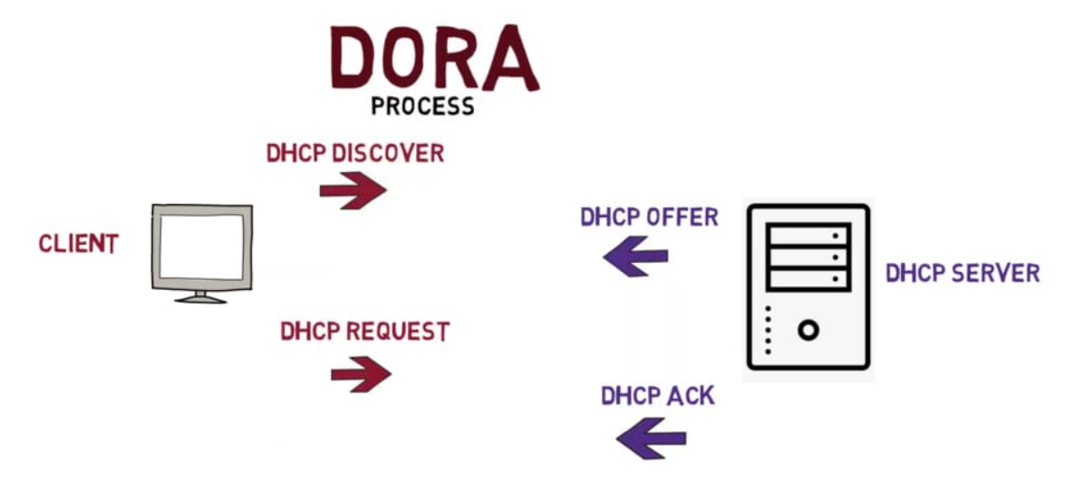
How Does a client gets an IP From DHCP server?

Slide 4
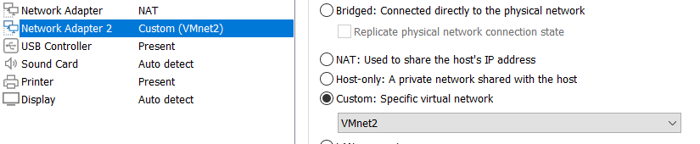
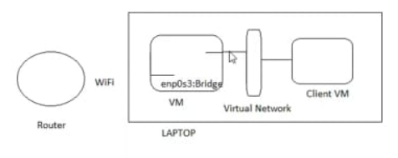

Network Settings On VMs to Simulate A Real Work Environment. Server
Client

Slide 5
Implementation Of DHCP On Linux

Slide 6
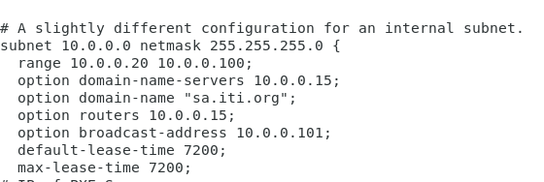
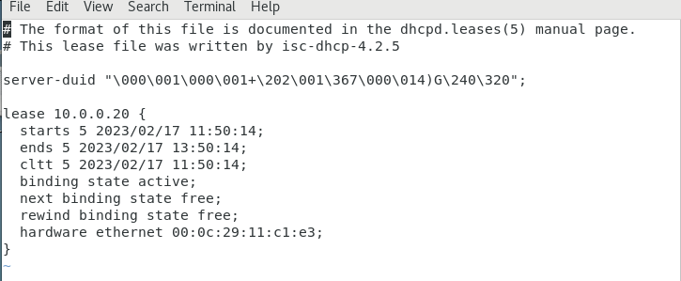
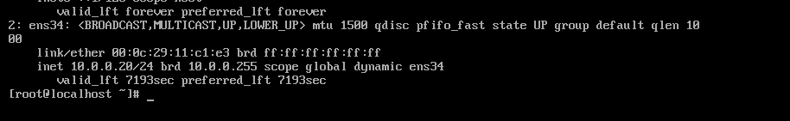
DHCP Configuration file DHCP Lease File Client gets the IP from the specified range

Slide 7
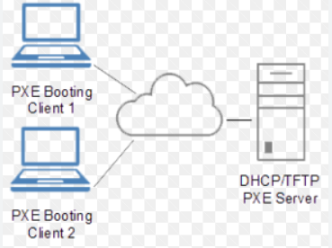
Pre-boot Execution Environment (PXE)
PXE allows computers to boot up remotely through a network interface Without the need for a local media like USB, CD , Floppy disk.

Slide 8
PXE VS IPXE
PXE only supports TFTP
IPXE supports additional protocols, including HTTP, iSCSI, ATA over Ethernet (AoE), and Fibre Channel over Ethernet (FCoE).

Slide 9
Implementation Of PXE On Linux

Slide 10
Packages Needed
tftp , tftp-server : for file sharing
syslinux : a set of boot loaders capable of booting from over the network via PXE
dhcp
xinetd : to configure tftp service

Slide 11
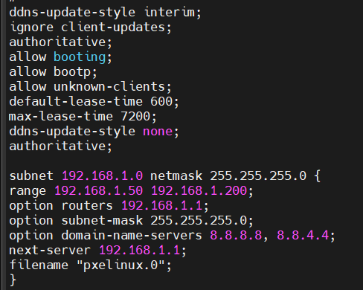
DHCP Configuration

Slide 12
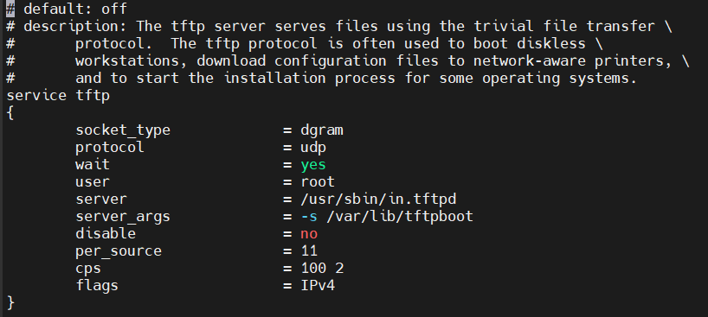
TFTP configuration using Xinetd

Slide 13
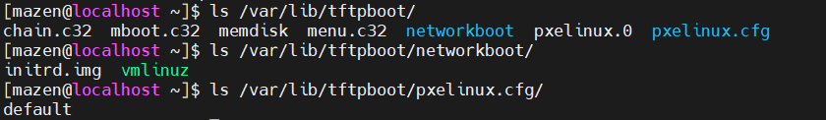
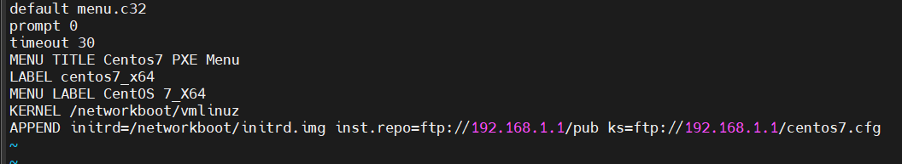
TFTP Data /var/lib/tftpboot/pxelinux.cfg/default File

Slide 14
/var/ftp Files

Slide 15
KickStart File
Kickstart file(centos7.cfg) is configuration information which the system reads at boot time and carries out the installation process without any further input.

Slide 16
Problems & Issues Faced
Problem | Solution
DORA process not completed (Client wasn’t making a request after the offer) | We made a new connection profile
Server denied you to change to given directory and couldn’t fetch files | setsebool -P allow_ftpd_full_access OR permissive/disable selinux
Access denied and couldn’t fetch files | Permissions should be 755 on /var/ftp , 777 doesn’t work…why??
Network unreachable after taking IP from DHCP server | Turned the connection down then up again…why??

Slide 17
Thank You!

