Slide 1





Manufacturing Downtime
Graduation project of DEPI
(Digital Egypt Pioneers Initiative)
Data Analytics - Data Analyst Specialist
Presented by
Ahmed Taher Abdelhamed Youssef
Abdelrhman Mohammed Mohammed Fekry
Michael Emil Abdou Habib
Aya Ramadan Mahmoud Rashed
Supervised by
Eng. Ahmed Samir Ahmed

Slide 2



Presented by
Supervised by
Manufacturing Downtime
Data Analyst Specialist
CAI3-DAT1-G2
Eng. Ahmed Samir Ahmed

Slide 3



Manufacturing Downtime
Data Analyst Specialist
CAI3-DAT1-G2
Presented by
Supervised by

Slide 4

Manufacturing Downtime
Data Analyst Specialist
CAI3-DAT1-G2
Presented by
Supervised by
Ahmed Taher
Aya Ramadan
Michael Emil
Abdelrahman Mohammed
Eng. Ahmed Samir Ahmed

Slide 5
Manufacturing Downtime
Data Analyst Specialist
CAI3-DAT1-G2
Presented by
Supervised by
Ahmed Taher
Aya Ramadan
Michael Emil
Eng. Ahmed Samir Ahmed
Abdelrahman Mohammed

Slide 7



Slide 8
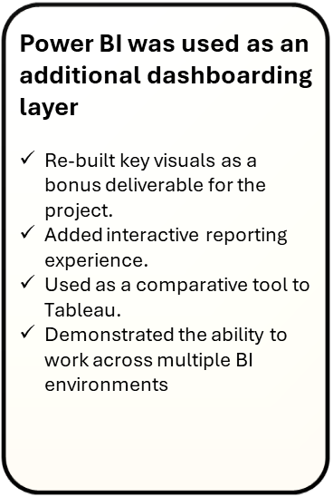

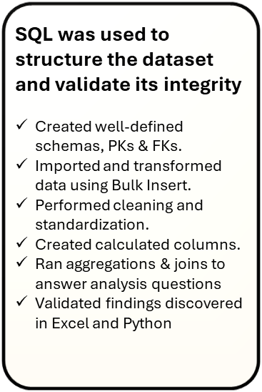

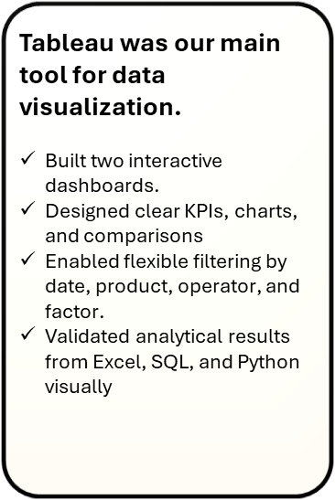

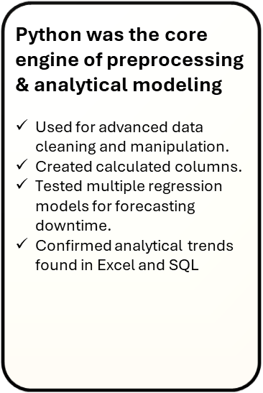

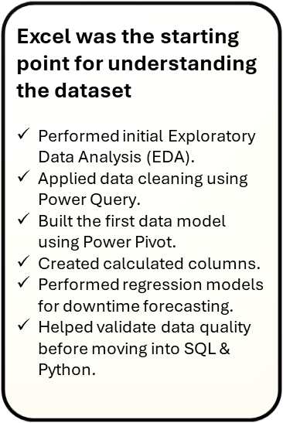



INTRODUCTION
USED TOOLS OF THIS PROJECT

Slide 9
USED TOOLS OF THIS PROJECT

Slide 10







CLEANING AND ANALYSIS
VISUALS
USED TOOLS OF THIS PROJECT

Slide 11
CLEANING AND ANALYSIS
VISUALS
USED TOOLS OF THIS PROJECT

Slide 18

Dataset Introduction
Project Objective
Analyze downtime data to understand:
Occurrences of downtime
Downtime impact
Most effective downtime factor
Why?
Understanding its causes is essential for reducing unnecessary expenses and improving efficiency.

Slide 19
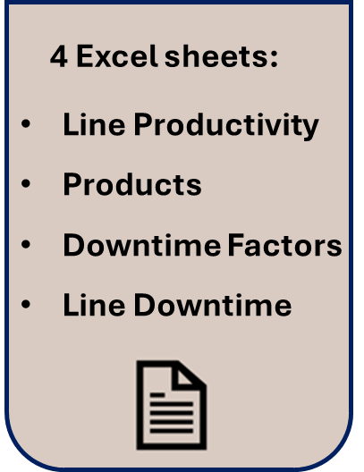
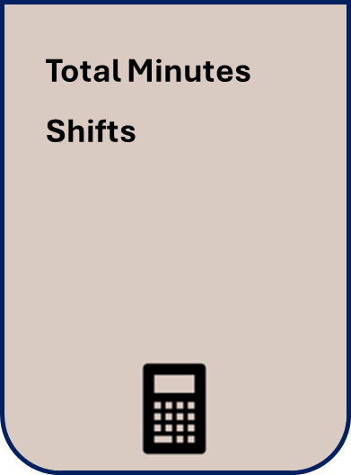

Dataset Summary
Dataset Introduction
Project Objective
Analyze downtime data to understand:
Occurrences of downtime
Downtime impact
Most effective downtime factor
Why?
Understanding its causes is essential for reducing unnecessary expenses and improving efficiency.
Sheets
Calculated Columns

Slide 20
Dataset Summary
Sheets
Calculated Columns

Slide 21

Dataset Model
Dataset Summary
Sheets
Calculated Columns

Slide 22
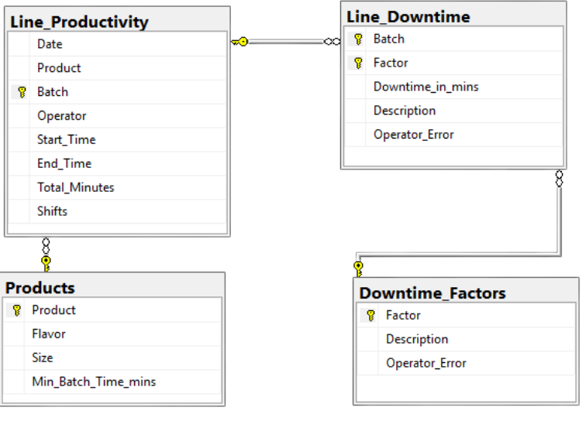
Dataset Model
Dataset Summary
Sheets
Calculated Columns

Slide 23


Slide 24


Data cleaning and modeling

Slide 25
Data cleaning and modeling
Why?
Data modeling and preprocessing are essential steps in any analytical workflow. Raw datasets often contain inconsistencies, mixed formats, and structural issues that must be resolved before reliable insights can be generated.

Slide 26
Data cleaning and modeling
Why?
Data modeling and preprocessing are essential steps in any analytical workflow. Raw datasets often contain inconsistencies, mixed formats, and structural issues that must be resolved before reliable insights can be generated.

Slide 27
Data cleaning and modeling
Why?
Data modeling and preprocessing are essential steps in any analytical workflow. Raw datasets often contain inconsistencies, mixed formats, and structural issues that must be resolved before reliable insights can be generated.
Unpivoting Columns

Slide 28




What Was Done?
Converted Time Formats
Standardized the Start Time and End Time columns to proper Time datatype for accurate duration calculations.
Unified Product Variants
Corrected inconsistent product labels, separating Cola (600 ml) and Cola (2L) into distinct product entries.
Standardized Units
Converted all size values to a consistent numeric format → 2 L → 2000 ml → 600 ml → 600 ml
Renamed Columns for Clarity
Size → Size_ml
Min Batch Time → Min batch time (mins)
STEP
02
STEP
04
Removing Duplicates
Data Transformation
Handling Missing Values
Unpivoting Columns
STEP
01
STEP
03

Slide 29





What Was Done?
Converted Time Formats
Standardized the Start Time and End Time columns to proper Time datatype for accurate duration calculations.
Unified Product Variants
Corrected inconsistent product labels, separating Cola (600 ml) and Cola (2L) into distinct product entries.
Standardized Units
Converted all size values to a consistent numeric format → 2 L → 2000 ml → 600 ml → 600 ml
Renamed Columns for Clarity
Size → Size_ml
Min Batch Time → Min batch time (mins)
STEP 01
STEP 02
Data Transformation
Handling Missing Values
Data transformation makes raw data usable. It fixes inconsistent formats, units, and column names, ensuring the dataset is clean, structured, and ready for accurate analysis.
Missing values can create gaps in analysis and lead to unreliable insights. Identifying and addressing them ensures the dataset remains complete, and accurate.

Slide 30
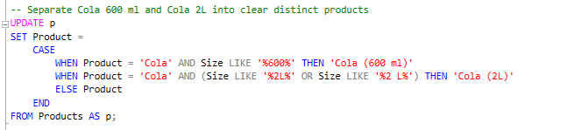
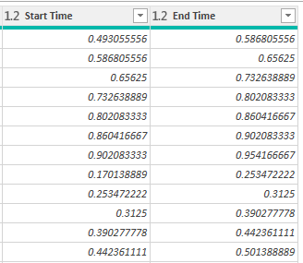
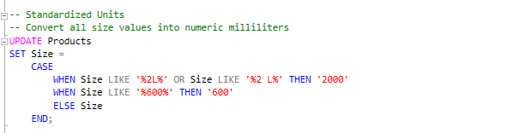
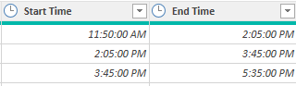
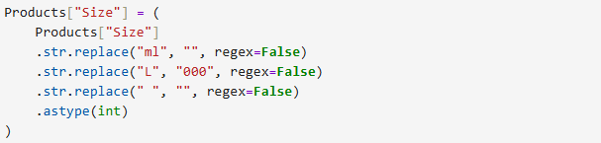
STEP 01
STEP 02
Why?
Null values and duplicate records can lead to incorrect calculations, inflated totals, and misleading KPIs. Checking for them ensures the dataset is complete, consistent, and trustworthy before analysis. By verifying that no missing or repeated entries exist across the tables, we guarantee that every metric such as downtime, duration, and batch counts, reflects the true operational performance without distortions.
Data Transformation
Handling Missing Values
Data transformation makes raw data usable. It fixes inconsistent formats, units, and column names, ensuring the dataset is clean, structured, and ready for accurate analysis.
Missing values can create gaps in analysis and lead to unreliable insights. Identifying and addressing them ensures the dataset remains complete, and accurate.

Slide 31
USING POWER QUERY (EXCEL)

Slide 34
Why?
Unpivoting transforms the downtime data from a wide format into a long, factor-level structure. This step takes multiple downtime-factor columns and converts them into individual rows—each representing a single factor and its corresponding delay. By doing this, the dataset becomes fully analysis-ready, allowing accurate aggregation, clearer comparisons across factors, and more meaningful visualizations such as Pareto charts and cause-based breakdowns.
STEP 01
Why?
Missing values can break calculations, disrupt time-based metrics, and create misleading insights. Addressing them ensures the dataset is complete, consistent, and analytically sound. By verifying that no fields are left blank, especially in critical columns such as durations, factors, and timestamps, wecan then guarantee that every KPI and summary truly represents real production performance, without gaps that could distort trends or hide important issues.
STEP 02
Data Transformation
Handling Missing Values
Data transformation makes raw data usable. It fixes inconsistent formats, units, and column names, ensuring the dataset is clean, structured, and ready for accurate analysis.
Missing values can create gaps in analysis and lead to unreliable insights. Identifying and addressing them ensures the dataset remains complete, and accurate.

Slide 35

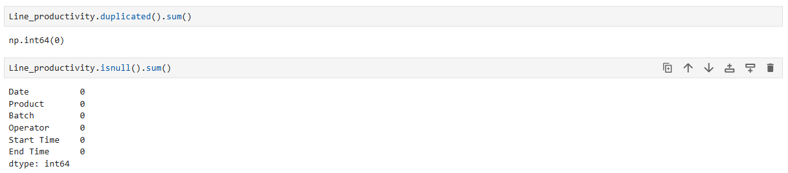

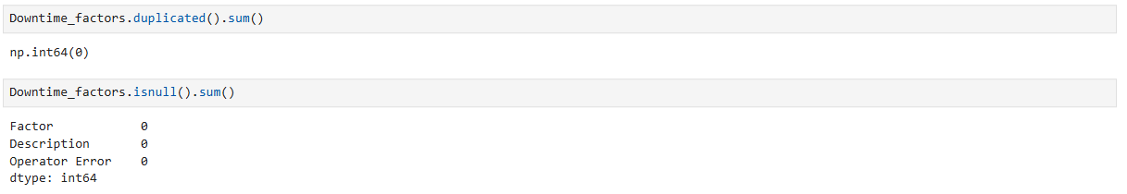
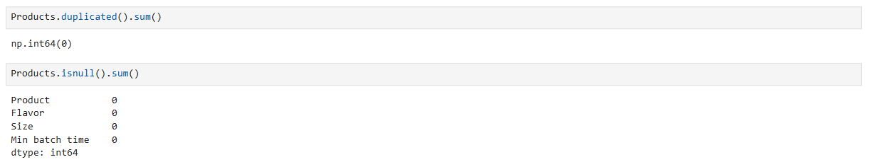

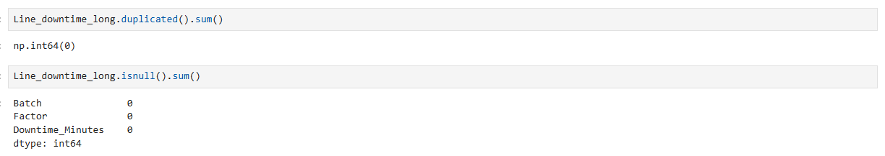
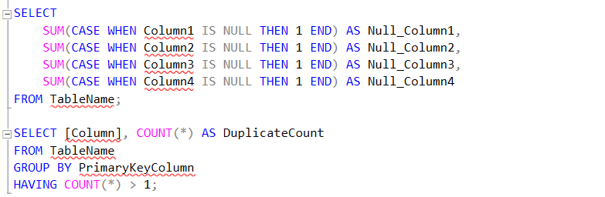

STEP 02
Handling Missing Values
Missing values can create gaps in analysis and lead to unreliable insights. Identifying and addressing them ensures the dataset remains complete, and accurate.
STEP 03
Removing Duplicates
Duplicate records inflate counts, distort totals, and lead to inaccurate conclusions. Identifying and removing them ensures the dataset reflects real production activity.

Slide 36
USING POWER QUERY (EXCEL)

Slide 37
Change table’s and column’s names respectively

Slide 39
STEP 03
Why?
Duplicate entries can inflate totals, misrepresent downtime, and produce misleading KPIs. Removing them ensures the dataset is accurate, consistent, and reflects true production activity. By confirming that no repeated rows exist, especially for batches, downtime factors, or timestamps, we can then guarantee that all calculations such as total downtime, number of events, and performance metrics remain reliable and free from artificial distortions.
Removing Duplicates
Duplicate records inflate counts, distort totals, and lead to inaccurate conclusions. Identifying and removing them ensures the dataset reflects real production activity.

Slide 40




STEP 03
Why?
Duplicate entries can inflate totals, misrepresent downtime, and produce misleading KPIs. Removing them ensures the dataset is accurate, consistent, and reflects true production activity. By confirming that no repeated rows exist, especially for batches, downtime factors, or timestamps, we can then guarantee that all calculations such as total downtime, number of events, and performance metrics remain reliable and free from artificial distortions.
Removing Duplicates
Duplicate records inflate counts, distort totals, and lead to inaccurate conclusions. Identifying and removing them ensures the dataset reflects real production activity.
STEP 04
Unpivoting Columns
Unpivoting converts wide downtime columns into factor-level rows, enabling detailed analysis of each downtime cause, proper aggregations, and more meaningful visualizations

Slide 41
Why?
Duplicate entries can inflate totals, misrepresent downtime, and produce misleading KPIs. Removing them ensures the dataset is accurate, consistent, and reflects true production activity. By confirming that no repeated rows exist, especially for batches, downtime factors, or timestamps, we can then guarantee that all calculations such as total downtime, number of events, and performance metrics remain reliable and free from artificial distortions.
USING POWER QUERY (EXCEL)

Slide 42
Why?
Duplicate entries can inflate totals, misrepresent downtime, and produce misleading KPIs. Removing them ensures the dataset is accurate, consistent, and reflects true production activity. By confirming that no repeated rows exist, especially for batches, downtime factors, or timestamps, we can then guarantee that all calculations such as total downtime, number of events, and performance metrics remain reliable and free from artificial distortions.

Slide 43
Why?
Duplicate entries can inflate totals, misrepresent downtime, and produce misleading KPIs. Removing them ensures the dataset is accurate, consistent, and reflects true production activity. By confirming that no repeated rows exist, especially for batches, downtime factors, or timestamps, we can then guarantee that all calculations such as total downtime, number of events, and performance metrics remain reliable and free from artificial distortions.

Slide 44
STEP 04
Why?
Unpivoting transforms the downtime data from a wide format into a long, factor-level structure. This step takes multiple downtime-factor columns and converts them into individual rows, each representing a single factor and its corresponding delay. By doing this, the dataset becomes fully analysis-ready, allowing accurate aggregation, clearer comparisons across factors, and more meaningful visualizations such as Pareto charts and cause-based breakdowns.
Unpivoting Columns
Unpivoting converts wide downtime columns into factor-level rows, enabling detailed analysis of each downtime cause, proper aggregations, and more meaningful visualizations

Slide 45
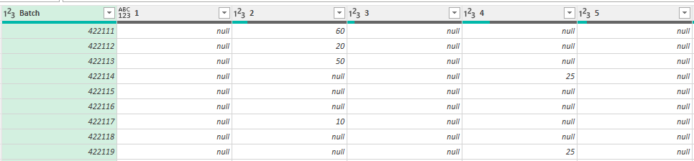
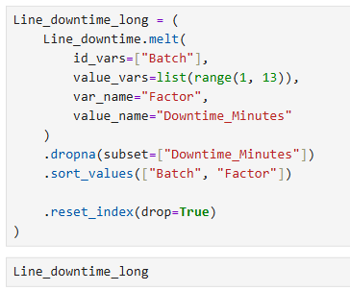
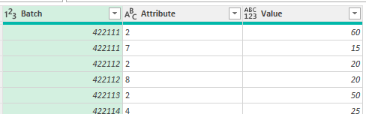
Why?
Unpivoting transforms the downtime data from a wide format into a long, factor-level structure. This step takes multiple downtime-factor columns and converts them into individual rows, each representing a single factor and its corresponding delay. By doing this, the dataset becomes fully analysis-ready, allowing accurate aggregation, clearer comparisons across factors, and more meaningful visualizations such as Pareto charts and cause-based breakdowns.
STEP 04
Unpivoting Columns
Unpivoting converts wide downtime columns into factor-level rows, enabling detailed analysis of each downtime cause, proper aggregations, and more meaningful visualizations

Slide 46
Why?
Unpivoting transforms the downtime data from a wide format into a long, factor-level structure. This step takes multiple downtime-factor columns and converts them into individual rows, each representing a single factor and its corresponding delay. By doing this, the dataset becomes fully analysis-ready, allowing accurate aggregation, clearer comparisons across factors, and more meaningful visualizations such as Pareto charts and cause-based breakdowns.
USING POWER QUERY (EXCEL)

Slide 47
Why?
Unpivoting transforms the downtime data from a wide format into a long, factor-level structure. This step takes multiple downtime-factor columns and converts them into individual rows, each representing a single factor and its corresponding delay. By doing this, the dataset becomes fully analysis-ready, allowing accurate aggregation, clearer comparisons across factors, and more meaningful visualizations such as Pareto charts and cause-based breakdowns.

Slide 49


Analysis Questions EDA

Slide 50
Analysis Questions EDA
Why?
After cleaning the dataset, the next step was to explore it through a structured set of SMART analysis questions, allowing us to uncover patterns across the whole dataset. Questions were organized into five areas that cover every aspect of analysis.

Slide 51
Analysis Questions EDA
Why?
After cleaning the dataset, the next step was to explore it through a structured set of SMART analysis questions, allowing us to uncover patterns across the whole dataset. Questions were organized into five areas that cover every aspect of analysis.
PRODUCTION LINE PERFORMANCE
DOWNTIME FACTORS
SMART QUESTIONS
PRODUCTS
OPERATOR
OVERVIEW

Slide 52
Analysis Questions EDA
Why?
After cleaning the dataset, the next step was to explore it through a structured set of SMART analysis questions, allowing us to uncover patterns across the whole dataset. Questions were organized into five areas that cover every aspect of analysis.
PRODUCTION LINE PERFORMANCE
DOWNTIME FACTORS
SMART QUESTIONS
PRODUCTS
OPERATOR
OVERVIEW

Slide 53
SMART QUESTIONS
PRODUCTION LINE PERFORMANCE
OVERVIEW
DOWNTIME FACTORS
PRODUCTS
OPERATOR

Slide 54
SMART QUESTIONS
OVERVIEW
PRODUCTION LINE PERFORMANCE
OVERVIEW
PRODUCTION LINE PERFORMANCE
DOWNTIME FACTORS
DOWNTIME FACTORS
PRODUCTS
OPERATOR
OPERATOR
PRODUCTS
What is the total downtime?
01
Calculate the total downtime minutes across the entire dataset
02
02
What is the total number of batches?
Count all batches produced during the analysis period
What % of total downtime is from operators vs. non-operators?
03
Compare the percentage of downtime caused by operators versus system/machine issues.

Slide 55
OVERVIEW
What is the total downtime?
01
Calculate the total downtime minutes across the entire dataset
PRODUCTION LINE PERFORMANCE
02
What is the total number of batches?
DOWNTIME FACTORS
Count all batches produced during the analysis period
OPERATOR
What % of total downtime is from operators vs. non-operators?
03
PRODUCTS
Compare the percentage of downtime caused by operators versus system/machine issues.
How does total downtime affect daily production output?
01
Analyze the relationship between downtime and production volume to quantify loss in productivity.
02
What is the average downtime per batch during the analysis period?
Calculate the average downtime minutes for each batch.
Which downtime factors account for at least 80% of total downtime?
03
Identify the top downtime factors that cause roughly 80% of total downtime.

Slide 56
OVERVIEW
How does total downtime affect daily production output?
01
What is the total downtime?
01
PRODUCTION LINE PERFORMANCE
Analyze the relationship between downtime and production volume to quantify loss in productivity.
Calculate the total downtime minutes across the entire dataset
02
What is the average downtime per batch during the analysis period?
02
What is the total number of batches?
DOWNTIME FACTORS
Calculate the average downtime minutes for each batch.
Count all batches produced during the analysis period
OPERATOR
Which downtime factors account for at least 80% of total downtime?
03
What % of total downtime is from operators vs. non-operators?
03
PRODUCTS
Identify the top downtime factors that cause roughly 80% of total downtime.
Compare the percentage of downtime caused by operators versus system/machine issues.
What is the most occurred downtime factor?
01
Identify which downtime factor happens the most frequently by counting all recorded occurrences across the dataset.
02
Which downtime factor occurs most frequently?
Assess the count of each downtime factor to find which issue happens most often.
How many downtime incidents occur per day?
03
Analyze how many downtime incidents happen each day.

Slide 57
OVERVIEW
What is the most occurred downtime factor?
01
How does total downtime affect daily production output?
01
PRODUCTION LINE PERFORMANCE
Identify which downtime factor happens the most frequently by counting all recorded occurrences across the dataset.
Analyze the relationship between downtime and production volume to quantify loss in productivity.
DOWNTIME FACTORS
02
What is the average downtime per batch during the analysis period?
02
Which downtime factor occurs most frequently?
Assess the count of each downtime factor to find which issue happens most often.
Calculate the average downtime minutes for each batch.
OPERATOR
How many downtime incidents occur per day?
03
Which downtime factors account for at least 80% of total downtime?
03
PRODUCTS
Analyze how many downtime incidents happen each day.
Identify the top downtime factors that cause roughly 80% of total downtime.
What is each operator’s efficiency score based on batches and downtime?
01
Evaluate operator efficiency by comparing batches handled, and downtime involvement.
02
What is the most recurring downtime factor for each operator?
Identify the downtime factor most frequently associated with each operator.
How much downtime does each operator have for each downtime factor?
03
Analyze patterns linking operators to specific downtime factors to understand root causes and behavioral trends.

Slide 58
OVERVIEW
What is each operator’s efficiency score based on batches and downtime?
01
What is the most occurred downtime factor?
01
PRODUCTION LINE PERFORMANCE
Evaluate operator efficiency by comparing batches handled, and downtime involvement.
Identify which downtime factor happens the most frequently by counting all recorded occurrences across the dataset.
DOWNTIME FACTORS
02
What is the most recurring downtime factor for each operator?
02
Which downtime factor occurs most frequently?
OPERATOR
Identify the downtime factor most frequently associated with each operator.
Assess the count of each downtime factor to find which issue happens most often.
How much downtime does each operator have for each downtime factor?
03
How many downtime incidents occur per day?
03
PRODUCTS
Analyze patterns linking operators to specific downtime factors to understand root causes and behavioral trends.
Analyze how many downtime incidents happen each day.
Which factors cause the most downtime for each product?
01
Identify the downtime factors that contribute the most downtime minutes for each product.
02
What percentage of production time is lost to downtime for each product?
Calculate how much of each product’s available production time is consumed by downtime.
Which downtime factors affect each product the most?
03
Analyze each product and determine which downtime factors contribute the most to its total downtime.

Slide 59
SAMPLE OF ANALYSIS QUESTIONS
OVERVIEW
Which factors cause the most downtime for each product?
01
What is each operator’s efficiency score based on batches and downtime?
01
PRODUCTION LINE PERFORMANCE
Identify the downtime factors that contribute the most downtime minutes for each product.
Evaluate operator efficiency by comparing batches handled, and downtime involvement.
DOWNTIME FACTORS
02
What percentage of production time is lost to downtime for each product?
02
What is the most recurring downtime factor for each operator?
OPERATOR
Calculate how much of each product’s available production time is consumed by downtime.
Identify the downtime factor most frequently associated with each operator.
PRODUCTS
Which downtime factors affect each product the most?
03
How much downtime does each operator have for each downtime factor?
03
Analyze each product and determine which downtime factors contribute the most to its total downtime.
Analyze patterns linking operators to specific downtime factors to understand root causes and behavioral trends.

Slide 60

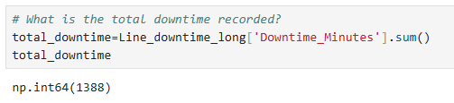

OVERVIEW
SAMPLE OF ANALYSIS QUESTIONS
Which factors cause the most downtime for each product?
01
PRODUCTION LINE PERFORMANCE
What is the total downtime?
Identify the downtime factors that contribute the most downtime minutes for each product.
DOWNTIME FACTORS
02
What percentage of production time is lost to downtime for each product?
OPERATOR
Calculate how much of each product’s available production time is consumed by downtime.
PRODUCTS
Insight
Which downtime factors affect each product the most?
03
The line accumulated 1,388 minutes of downtime, equivalent to nearly an entire production day, showing the importance of mitigating recurring downtime causes.
Analyze each product and determine which downtime factors contribute the most to its total downtime.

Slide 61
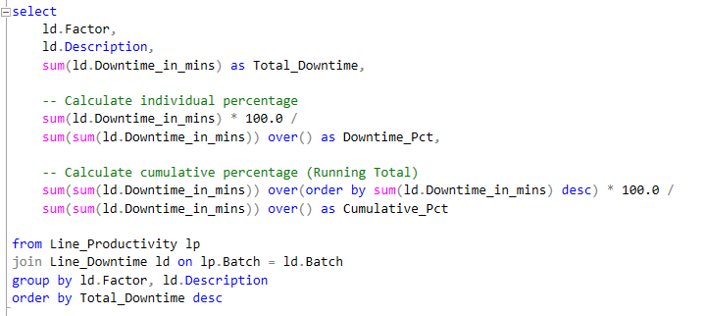
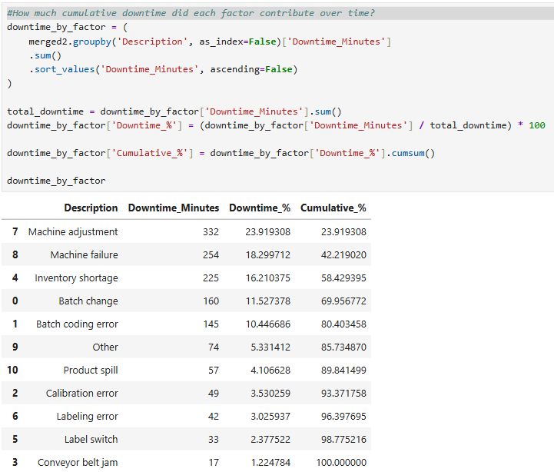
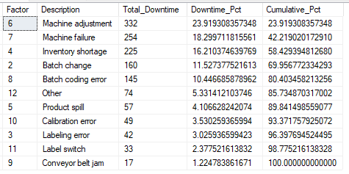
SAMPLE OF ANALYSIS QUESTIONS
Which downtime factors account for at least 80% of total downtime?
Insight
Five of eleven downtime factors account for 1,038 minutes, representing roughly 75% of total downtime. These dominant causes require immediate prioritization for corrective action.

Slide 62
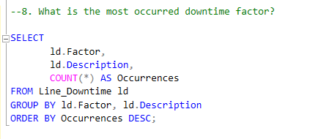
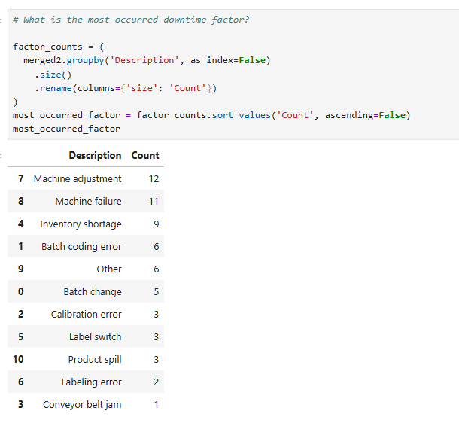
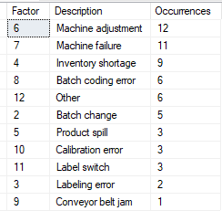
SAMPLE OF ANALYSIS QUESTIONS
What is the most occurred downtime factor?
Insight
Machine adjustment leads all downtime causes with 12 incidents, followed by machine failure (11) and inventory shortage (9). Their high recurrence suggests persistent issues driving frequent disruptions.

Slide 63
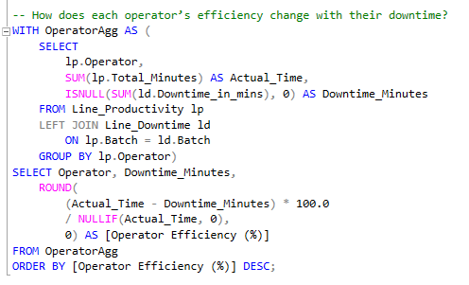
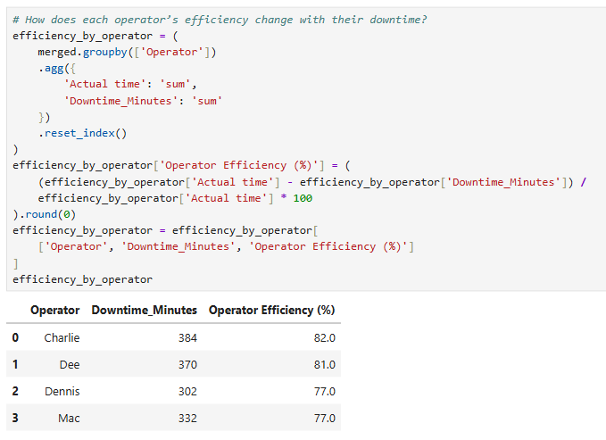
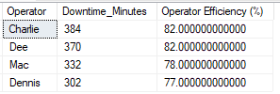
SAMPLE OF ANALYSIS QUESTIONS
What is each operator’s efficiency score based on batches and downtime?
Insight
Operator efficiency is relatively consistent across the team, ranging from 77% to 82%, indicating stable performance with minor improvement opportunities.

Slide 64
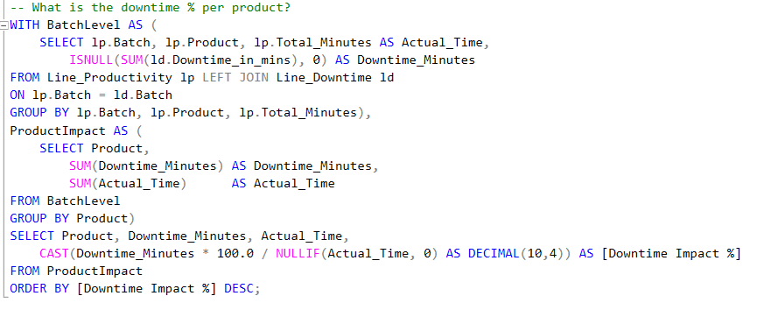
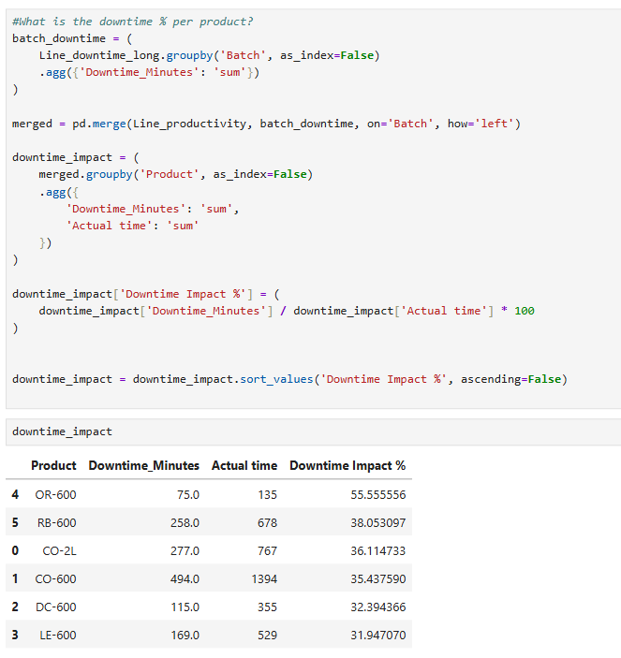
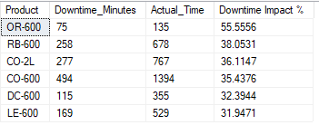
SAMPLE OF ANALYSIS QUESTIONS
What percentage of production time is lost to downtime for each product?
Insight
OR-600 has the highest downtime impact (55.6%), while other products range between 31% and 38%.

Slide 66

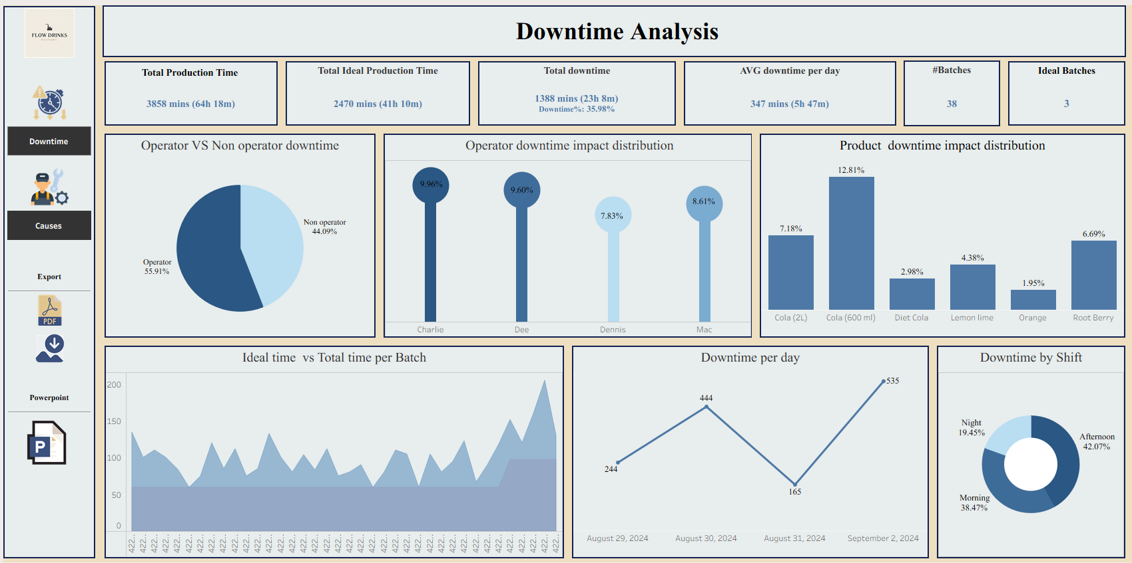

Slide 67
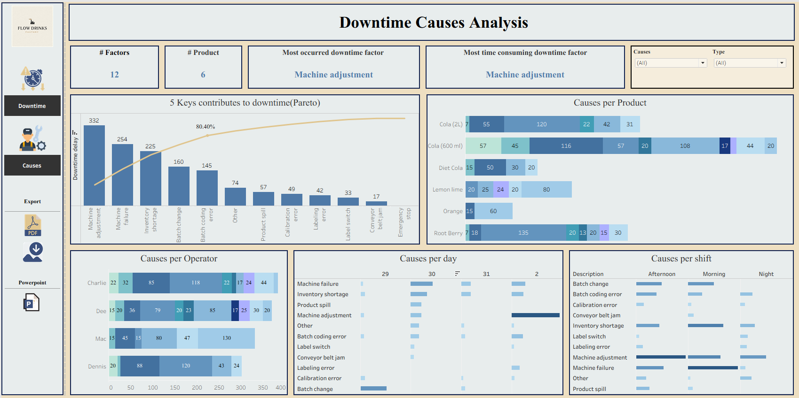

Slide 71

RECOMMENDATIONS

Slide 72
RECOMMENDATIONS

Slide 73
RECOMMENDATIONS
SHORT TERM
LONG TERM

Slide 74

RECOMMENDATIONS
SHORT TERM
LONG TERM
PRE-OPERATION

Slide 75

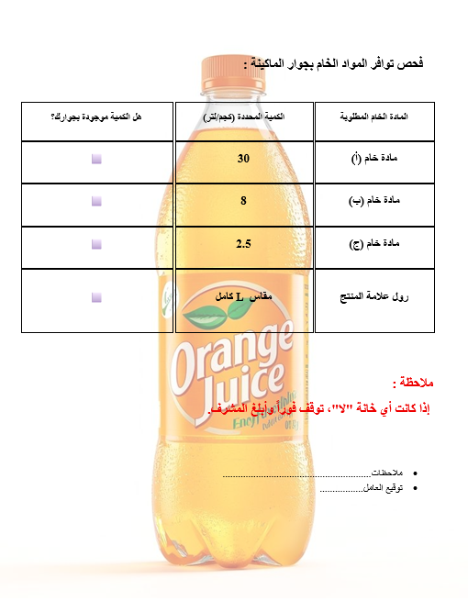
RECOMMENDATIONS
SHORT TERM
LONG TERM
PRE-OPERATION

Slide 76
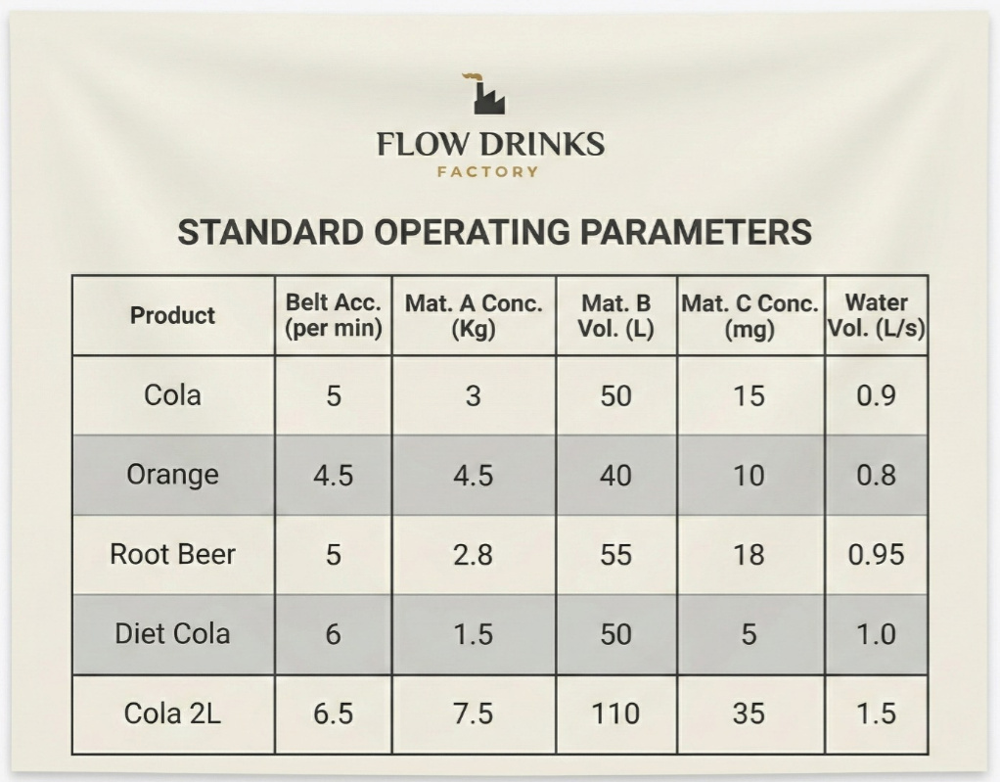

RECOMMENDATIONS
SHORT TERM
LONG TERM
PRE-OPERATION
MID-OPERATION

Slide 77
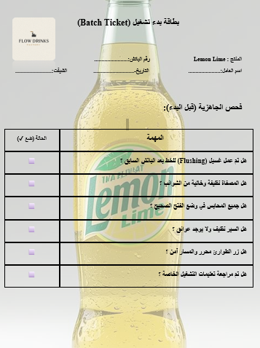
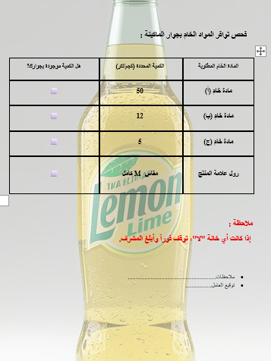
RECOMMENDATIONS
SHORT TERM
LONG TERM
PRE-OPERATION

Slide 78
RECOMMENDATIONS
SHORT TERM
LONG TERM

Slide 79
Deliverables

