Slide 1
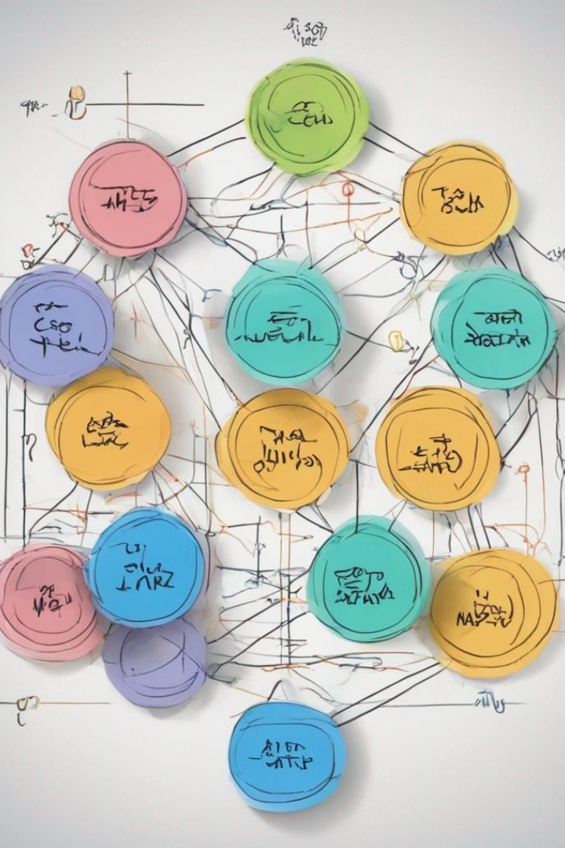
2-3 Trees

Slide 2
Definition and Importance
1
What are 2-3 Trees?
2
Why Balanced Search Trees Matter
2-3 trees are balanced search trees that store multiple keys in each node, providing efficient search operations.
2-3 trees maintain balance through their structure, ensuring guaranteed height and optimal performance in searches.

Slide 3
Transform and Conquer
1
What is Transform and Conquer
strategy?
2
How can we apply Transform and Conquer strategy using 2-3 Trees?
Is a problem-solving approach that involves transforming the original problem into a different form that is easier to solve.
The original problem is maintaining a balanced search structure, and I will use the Transform and conquer strategy by transforming the tree structure to achieve a balanced tree using 2-3 Trees

Slide 4

Construction and Insertion

Slide 5
9
Insert (9)

Slide 6
9
Root
Insert (9)

Slide 7
9 5
Insert (5)

Slide 8
5 9
Sort
Insert (5)

Slide 9
5 8 9
Split
Insert (8)

Slide 10
8
5 9
Insert (8)

Slide 11
8
5
9
Insert (8)

Slide 12
8
3 5
9
Insert (3)

Slide 13
8
Split
2 3 5
9
Insert (2)

Slide 14
3 8
2 5
9
Insert (2)

Slide 15
3 8
2
5
9
Insert (2)

Slide 16
3 8
2
4 5
9
Insert (4)

Slide 17
3 8
2
4 5 7
9
Insert (7)

Slide 18
3 5 8
2
4 7
9
Insert (7)

Slide 19
3 5 8
2
4
7
9
Insert (7)

Slide 20
5
3 8
Insert (7)
2
4
7
9

Slide 21
5
3
8
2
4
7
9

Slide 22

Time Complexity
Insertion
In the worst case, the insertion process involves traversing the tree from the root to a leaf, and possibly performing splits along the way.
The tree has a maximum height of log₂(n), where n is the number of keys.
Therefore, the overall time complexity for insertion is O(log n).

Slide 23

Thank You

