Slide 1

VAL-UNI
{
< Ahmed Raslan, Hussein Heggi, Youssef Elmahdy, Ahmed ElBarbary , Nour Abdalla ,Sarah Elsamanody
& Ahmed Jaheen >
}
...

Slide 2
Table of contents
01
02
03
Section
Overview
Section
Requirement Specification
Section
Design Specification

Slide 3

Overview
Description | What is VAL-UNI? Key Objectives
Usage | Searching Rating Evaluating
Motivation | The story behind VAL-UNI Future Plans

Slide 4
{
Description
What Is VAL-UNI?
VAL-UNI is a platform where students can share their experiences and exchange knowledge and feedback regarding professors and courses.
}
*

Slide 5
{
Description
Key Objectives for our platform
Safe Environment
Motivate students to say their opinion
Enhance the overall learning experience
}
*

Slide 6
{
Usage
Search
Search for Professors
Search for Courses
}
*

Slide 7
{
Usage
Rate (Different Criteria)
Rate Professors
Rate Courses
}
*

Slide 8
{
Usage
Evaluations
Course Evaluations for each semester
}
*

Slide 9
{
Motivation
The Story Behind VAL-UNI
RateAUC Professors
Our Experience
Serve the student body
}
*

Slide 10
{
Motivation
Future Plans
Implement in other Universities
Introduce Ads to help finance the website
}
*

Slide 11
Risk Factors
{
Community | Development
Defamation | Unliked by the target audience
Bias | Security
Increased Reliance on feedback | High cost
}

Slide 12
Requirement Specification
*

Slide 13
Requirement Specification
Product Backlog | Functional Requirements Non-functional Requirements
Use Case Diagram | Actors Cases The whole system

Slide 14
Functional Requirements
Non-Functional
Requirements

Slide 15
Functional Requirements
User Authentication
Rating Courses
Writing Out a Review Rating
Parameterized Rating
Filtered Search on Parameters
Reporting Reviews
Moderates Remove Reviews
Editing Reviews
Admin (university) Access to Review Data
Search for Courses
Search for Professors
Non-Functional Requirements

Slide 16
Non-Functional Requirements
Fluid, Simple UI
Secure
Auto removing profanity on reviews
Prevent Review Bombing
Anonymity
Customer Service ( for universities )
Performance
Scalability
Functional Requirements

Slide 17
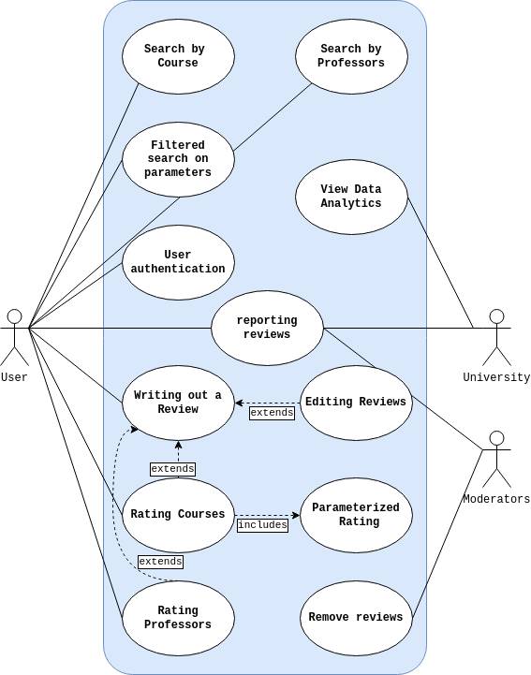
Use Case Diagram
...
{
}

Slide 18
Design Specification
*

Slide 19
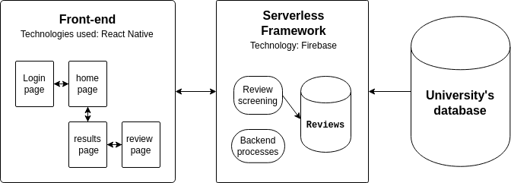
{
High level Architecture​
}

Slide 20
Thank you!
{
< Any questions?>
}

