Slide 1
DATA MINING & MACHINE LEARNING
Heart Disease Prediction with Explainable AI
Data Mining & Machine Learning Project M.Sc. in Artificial Intelligence and Data Engineering — Academic Year 2026–2027
Mohammed Ragab Elsinousi Abdalhady — ID: 722876 | Ahmed Zarrad — ID: 722204
26/07/2026

Slide 2
OVERVIEW
Presentation Outline
01
Problem & Dataset
Task definition · features · EDA
02
Pipeline & Experiments
PART 1
Preprocessing · model selection · hyperparameter optimization
03
Evaluation & Results
Metrics · cross-validation · final model performance
04
Explainability
PART 2
Global & local techniques · consistency with domain knowledge
05
Critical Discussion
Error analysis · limitations · future directions

Slide 3
PART 1 — TECHNICAL
Problem, Pipeline & Results
Problem definition · feature engineering · model selection
hyperparameter optimization · evaluation · test-set results

Slide 4
PROBLEM
Problem Definition & Dataset
The Problem
Dataset at a Glance
Early detection of heart disease from routine clinical and demographic patient data.
Task: supervised binary classification — disease present (1) vs absent (0).
Cardiovascular disease is a leading global cause of death; early screening speeds up triage and treatment.
Challenge: clinicians need predictions that are both accurate and interpretable — a black box is not enough.
Task
Binary classification
Dataset
Kaggle Heart Failure Prediction — 918 samples, 11 features
Target
HeartDisease: presence (1) / absence (0)
Features
6 numerical, 5 categorical
Missing values
Cholesterol 18.7% (29.9% in class 1); RestingBP 0.1%
Class balance
55.3% / 44.7% — close to balanced
Split
80% train (5-fold CV) / 20% test
Metric(s)
ROC-AUC + accuracy, precision, recall, F1

Slide 5
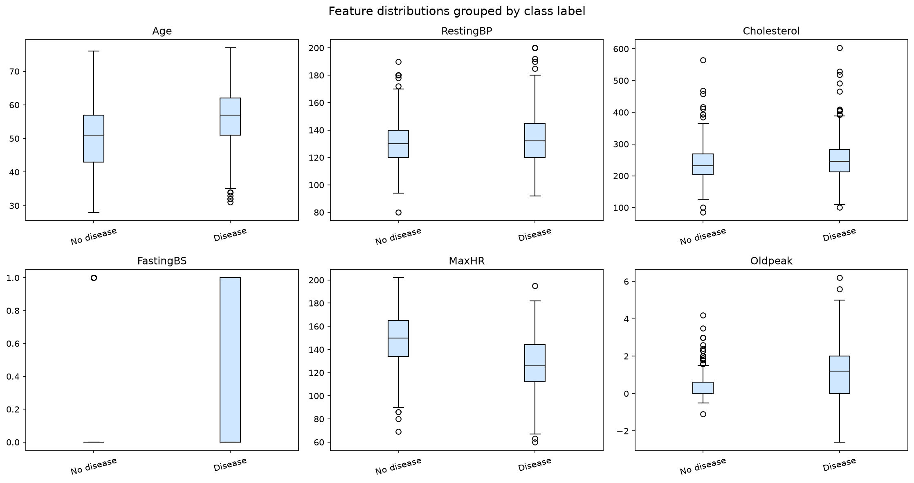
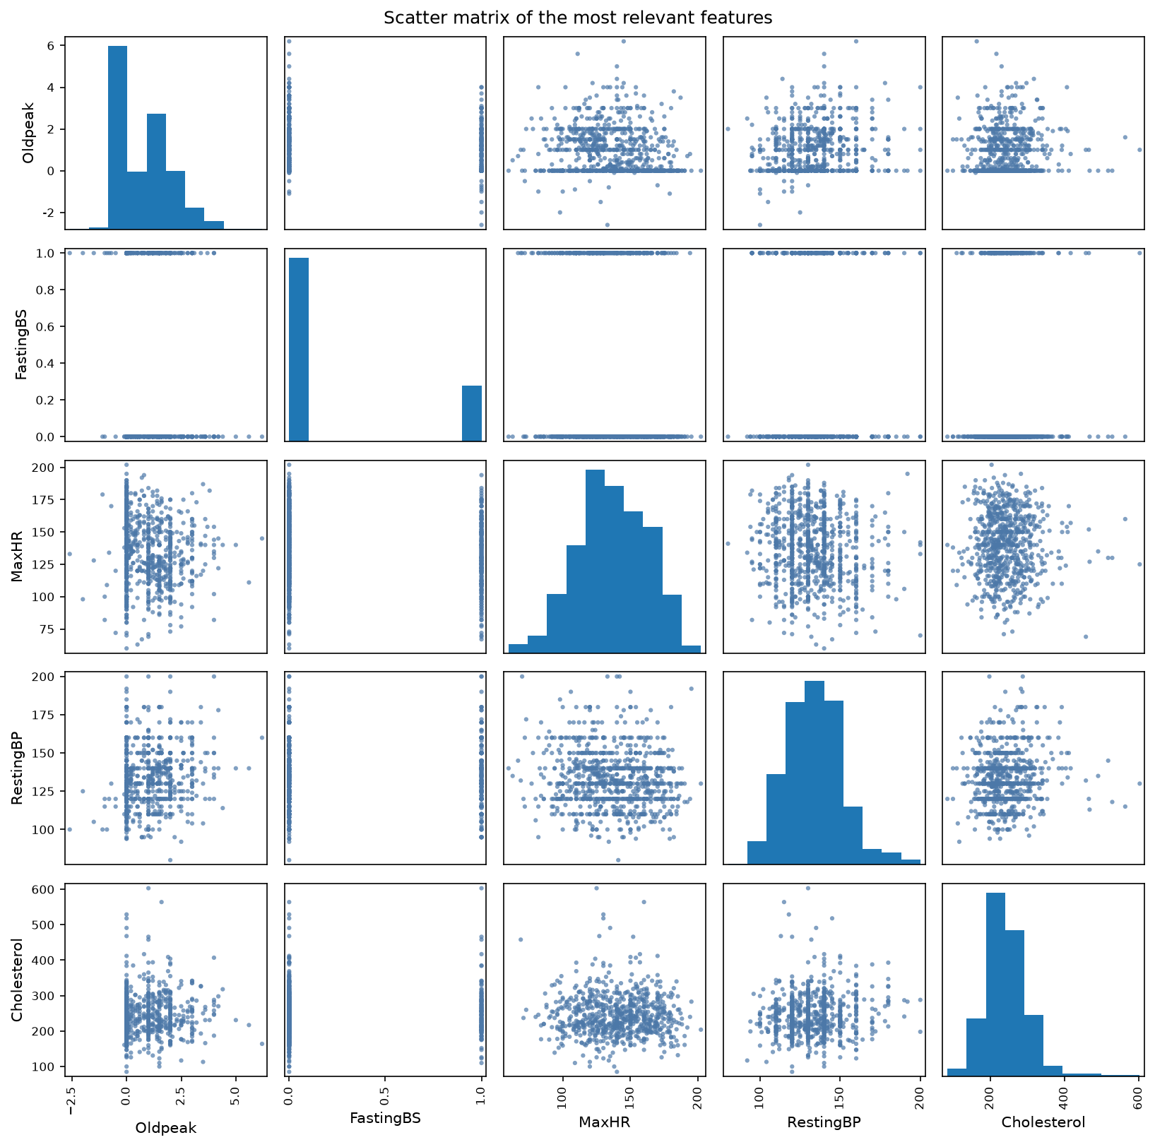
PROBLEM
Exploratory Data Analysis
Feature distributions by class — Age, MaxHR and Oldpeak separate best
Scatter matrix of the most relevant numeric features
Key findings from EDA:
Disease class: older patients, higher Oldpeak, lower MaxHR · Cholesterol zero-coded missing in 18.7% of records (29.9% class 1 vs 4.9% class 0) · Classes near-balanced (55.3% / 44.7%) → stratified splits suffice

Slide 6
PIPELINE
Feature Engineering & Selection
Engineering
Selection Method
Why These Features?
No new features — the 11 original clinical variables are used directly
Standard scaling for the 6 numeric features (incl. FastingBS)
One-hot encoding for the 5 categorical variables (handle_unknown='ignore')
Median / most-frequent imputation; zero-coded RestingBP & Cholesterol treated as missing
No feature elimination — all 11 variables retained deliberately
Permutation importance computed for interpretation, not removal
Importance assessed on the full CV-validated pipeline
Final count: 11 features (6 numeric + 5 categorical)
Each variable has direct clinical meaning: stress test, symptoms, vitals
Low-ranked features kept — medical variables act through interactions
Global importance ranking shown in the Explainability part

Slide 7
PIPELINE
ML Pipeline: Avoiding Data Leakage & Bias
Raw
Data
Preprocessing
Feature
Selection
Model
Training
Validation
(held-out fold)
Final
Evaluation
▶
▶
▶
▶
▶
Data Leakage Prevention
Class Imbalance Handling
Metric Justification
All preprocessing fitted only on training folds
One sklearn Pipeline: ColumnTransformer (impute + scale + encode) ending in the classifier
Test split created before any fitting; no val/test information reaches training
None needed — mild 55/45 imbalance; stratification only
Stratified 5-fold CV keeps the class ratio in every fold
Threshold-free ROC-AUC + per-class precision / recall
ROC-AUC: ranking quality, threshold-independent, robust to mild imbalance
FN (missed disease) ≫ FP (extra test) → favor recall
Accuracy, precision, recall and F1 also reported

Slide 8
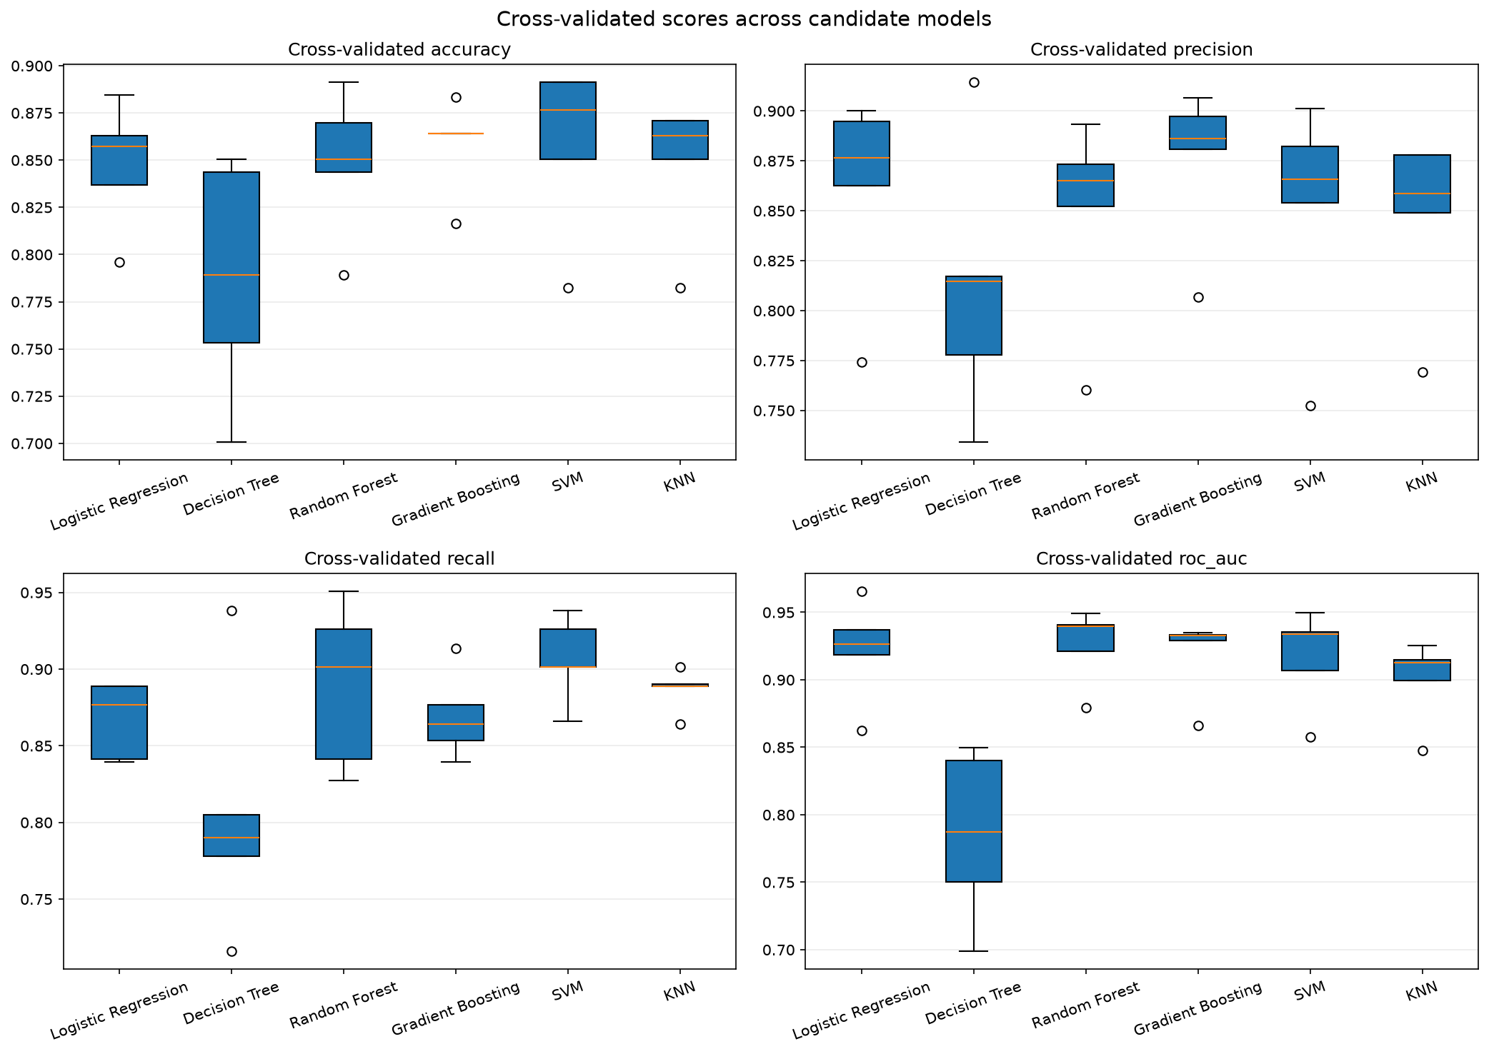
PIPELINE
Model Selection & Hyperparameter Optimization
Key Decisions
Candidate models
LR, DT, RF, GB, SVM, KNN (+ XGBoost) — linear, tree, margin, instance-based
CV strategy
Stratified 5-fold cross-validation
Selection criterion
Mean ROC-AUC + fold stability
Chosen model
Random Forest — 0.9261 ± 0.0251 CV ROC-AUC
Box plots of cross-validated scores across candidate models
(accuracy, precision, recall, ROC-AUC per fold)
Search strategy
Grid Search (GridSearchCV)
Search space
n_estimators {100–300}, max_depth {None, 5, 10}, min_samples_split {2, 5}
Best config
n_estimators = 100, max_depth = 5, min_samples_split = 5
Statistical test
Paired t & Wilcoxon vs runners-up: n.s. at α = 0.05

Slide 9
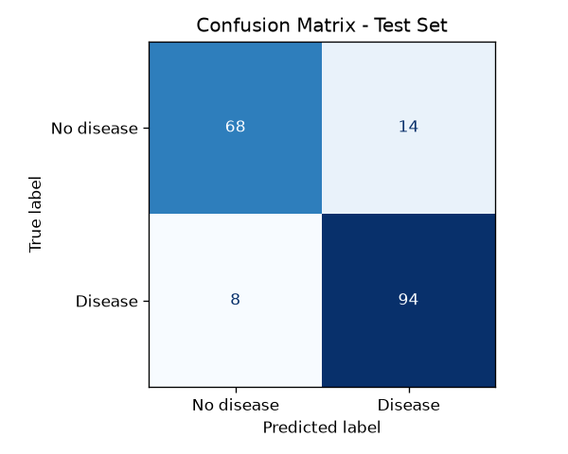
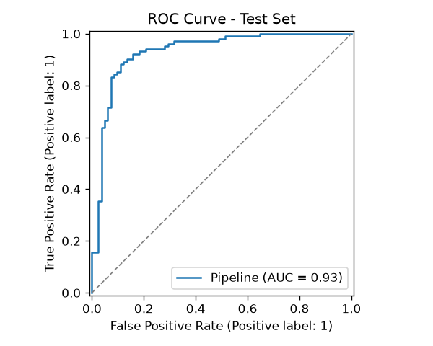
RESULTS
Test-Set Results
Confusion matrix on the hold-out test set (n = 184)
ROC curve on the test set — AUC = 0.93
Key Metrics (Test Set)
0.8804
0.9216
0.9324
0.9220
Accuracy (test)
Recall (test)
ROC-AUC (test)
Baseline LR (CV ROC-AUC)

Slide 10
PART 2 — CRITICAL ANALYSIS
Explainability &
Critical Discussion
How does the model work? · What did it get wrong and why?
Limitations · future directions · domain impact

Slide 11
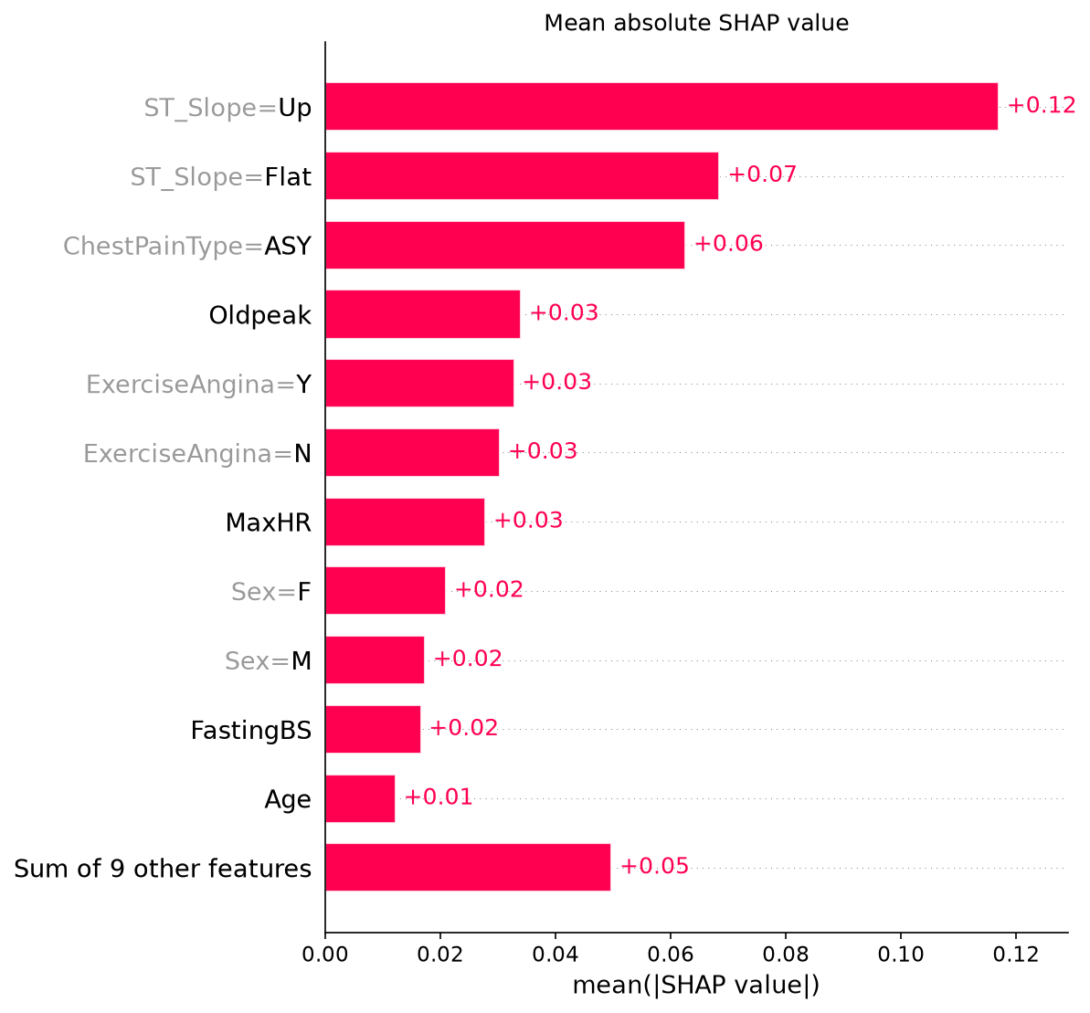
EXPLAINABILITY
Global Explainability: What Drives the Model Overall?
Interpretation
Mean |SHAP|: consistent additive attributions on the full pipeline (complements permutation importance)
Top drivers — ST_Slope, ChestPainType, Oldpeak, ExerciseAngina — match clinical expectations
Surprising: Age ranks low — its signal is absorbed by the stress-test variables
Supports the results: strong cardiac indicators, not weak proxies, drive predictions
Mean |SHAP| value per feature — global importance ranking

Slide 12
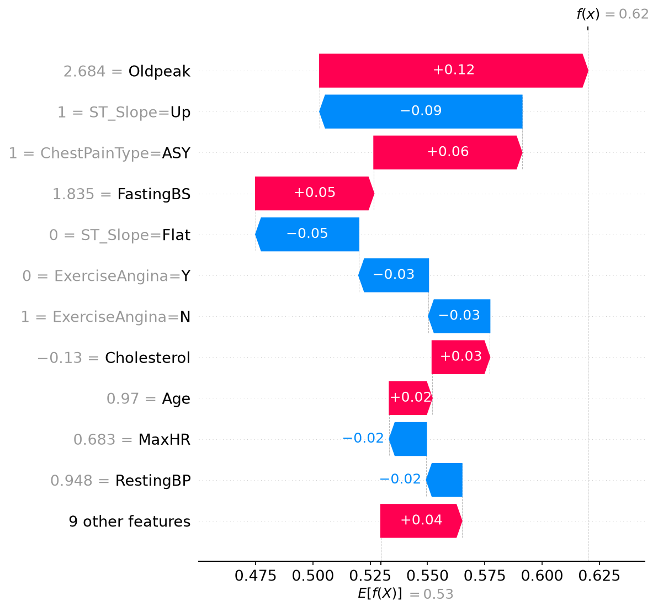
EXPLAINABILITY
Local Explainability: Why This Specific Prediction?
Case Analysis
Patient predicted positive: risk f(x) = 0.62 vs baseline E[f(X)] = 0.53
Toward disease: high Oldpeak (+0.12), ASY chest pain (+0.06), high FastingBS (+0.05)
Against disease: upward ST_Slope (−0.09), no exercise angina — same features as the global ranking
Clinically coherent: ischemia markers raise risk, a normal exercise response lowers it
Misclassified cases show the same pattern with mixed evidence — scores land near the 0.5 threshold
SHAP waterfall for one representative patient

Slide 13
CRITICAL DISCUSSION
Error Analysis: What Did the Model Get Wrong and Why?
Reverse-Engineering Errors
8 false negatives: mild profiles — high MaxHR, low Oldpeak, ST_Slope = Up, no angina
14 false positives: ASY/ATA chest pain, flat or down ST_Slope, moderate Oldpeak & MaxHR
SHAP on errors: conflicting contributions, final score near the decision threshold
Yes — borderline stress-test patterns are genuinely ambiguous, even clinically
Systematic mode: under-scores mild positives, over-scores symptomatic negatives
Confusion matrix view: 8 FN and 14 FP on the test set
Comparison with Prior Work (if applicable)
Published results on this dataset typically reach 80–90% accuracy; our 88.0% accuracy / 0.932 ROC-AUC is competitive. Many public pipelines fit preprocessing outside CV (leakage); ours fits everything per fold, so our estimate is more conservative — and more credible.

Slide 14
CRITICAL DISCUSSION
Domain Impact, Limitations & Future Directions
Domain Impact
Limitations
Future Directions
Screening support in routine check-ups: flags patients for cardiology referral
Streamlit app gives per-patient prediction + SHAP explanation
FN = missed disease (dangerous) ≫ FP = one extra test (acceptable)
Decision support only — the final judgement stays with the clinician
918 samples from a single public source — limited generalization
No lifestyle or history features (smoking, family history, medication)
Cholesterol 18.7% imputed — missingness correlates with the label
Single hold-out split; no external or prospective validation
Validate on external clinical cohorts
Probability calibration + cost-sensitive thresholds for screening
Richer features: lab history, lifestyle, ECG time series
Prospective evaluation in a real clinical workflow

Slide 15
Thank You
Conclusions:
Early heart-disease screening framed as binary classification on 918 patient records
Tuned Random Forest via stratified 5-fold CV: 0.8804 accuracy, 0.9324 ROC-AUC on the hold-out test set
SHAP shows the model reasons like a clinician: stress-test variables dominate, errors sit on borderline profiles
Small single-source dataset — next steps: external validation and probability calibration
Mohammed Ragab Elsinousi Abdalhady & Ahmed Zarrad · ahmedxzarrad@gmail.com

