Slide 1
Cs316: Algorithms Lecture 1: Introduction
Prepared by: Assoc. Prof. Ensaf Hussein
Presented by:
Assoc. Prof. Wessam El-Behaidy
Dr. Mohammed El-Said

Slide 2
Grading policy
Mid-term Exam 20%
Quizzes & tasks 20%
Sheets 10%
Final-Exam 50%

Slide 3
resources
Textbook:
Thomas Cormen, Charles Leiserson, Ronald Rivest, and Clifford Stein. Introduction to Algorithms. 3rd ed. MIT Press, 2009.
Anany Levitin, Introduction to the design and analysis of algorithms 3rd Edition, 2012.
Handouts******

Slide 4
Course Syllabus
Algorithms Design and Analysis
Asymptotic Notations
Compute Complexity for :
Non-recursive algorithms
Recursive Algorithms
Substitution Method
Iteration Tree
Master Method
Divide and Conquer Algorithms ( Merge Sort- Quick Sort)
Linear time Sorting (count – bucket – radix)
Graph
BFS - DFS
MST – Prim - Kruskal
Shortest path – Dijkstra – Bellman Ford
Dynamic Programming – Matrix Chain Multiplication - Longest Common Subsequence
Greedy Approach – Knapsack [0-1 / Fractional]

Slide 5
Course Objectives
Design algorithms using Pseudocode.
Demonstrate and study asymptotic notations in best, worst and average case.
Define and analyze the complexity of recursive and non-recursive algorithms.
Understand, analyze and apply standard algorithms involving searching, sorting, tree, graph, greedy, backtracking and dynamic programming algorithms.

Slide 6
Why Studying Algorithms?
The study of algorithms is the cornerstone of computer science.
You have to know a standard set of important algorithms from different areas of computing; in addition, you should be able to design new algorithms and analyze their efficiency.
Algorithms can be seen as special kinds of solutions to problems— not just answers but precisely defined procedures for getting answers

Slide 7

Algorithms
ABU JA‘FAR MOHAMMED IBN MUSA
AL-KHOWARIZMI (C. 780 – C. 850)
Al-Khowarizmi, an astronomer and mathematician, was a member of the House of Wisdom, an academy of scientists in Baghdad. The name al-Khowarizmi means “from Kowarzizm,” which was then part of Persia, but is now called Khiwa and is part of Uzbekistan.
Al-Khowarizmi wrote books on mathematics, astronomy, and geography.
Western Europeans first learned about algebra from his works. The word algebra comes from al-jabr, part of the title of his book Kitab al-jabr w’al muquabala. This book was translated into Latin and was a widely used textbook. His book on the use of Hindu numerals describes procedures for arithmetic operations using these numerals. European authors used a Latin corruption of his name, which later evolved to the word algorithm, to describe the subject of arithmetic with Hindu numerals.

Slide 8
What is Algorithms ?!

Slide 9
Algorithms
Program = algorithms + data structures
Data structures: Methods of organizing data
You have to design your algorithm before coding
Problem
Algorithm
Input
Computer
Output

Slide 10
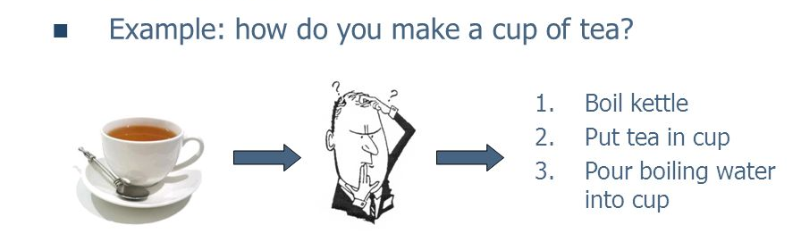
Algorithms
An algorithm: sequence of unambiguous instructions for solving a problem.
Obtaining a required output for any allowable input in a finite amount of time.

Slide 11
Understand
the problem
Problem Solving Cycle
Decide on: computational means, exact vs. approximate solving, algorithm design technique
Design algorithm
Prove correctness
Analyze the algorithm
infinite
Code the algorithm
finite

Slide 12
Example:
The greatest common divisor of two nonnegative, not-both-zero integers m and n, denoted gcd(m, n), is defined as the largest integer that divides both m and n.
Ex: gcd ( 60,24 ) ??
60 = 2 X 2 X 3 X 5
24 = 2 X 2 X 2 X 3
gcd ( 60,24 ) = 2 X 2 X 3 = 12
60
5 X
2 X 2 X 3
X 2
24

Slide 13
A solution for gcd(m,n):
Middle-school procedure
Step 1 Find the prime factorization of m
Step 2 Find the prime factorization of n
Step 3 Find all the common prime factors
Step 4 Compute the product of all the common prime factors and return it as gcd(m,n)
Is this an algorithm???
The algorithm should has no ambiguous instructions
What is the prime factors?
How to find common values?

Slide 14
Another solution for gcd(m,n)
Consecutive integer checking algorithm
Step 1 Assign the value of min {m,n } to t
Step 2 Divide m by t. If the remainder is 0, go to Step 3 otherwise, go to Step 4
Step 3 Divide n by t. If the remainder is 0, return t and stop; otherwise, go to Step 4
Step 4 Decrease t by 1 and go to Step 2
Is this an algorithm???
It is so important to specify the set of an algorithm’s inputs explicitly and carefully.
How it will work when one of its input numbers is zero?

Slide 15
Euclid’s solution for gcd
Euclid’s algorithm is based on:
Repeated application of equality
gcd( m, n ) = gcd( n , m mod n ),
until the second number becomes 0
Ex: gcd( 60, 24 )
= gcd( 24, 60 mod 24)
= gcd ( 24, 12)
= gcd ( 12, 24 mod 12)
= gcd ( 12, 0)
= 12
Notes:
Euclid’s algorithm is good for introducing the notion of an algorithm because it
makes a clear separation from a program that implements the algorithm.
It is also one that is familiar to most students.
Al Khowarizmi (many spellings possible...) – “algorism” (originally) and then
later “algorithm” come from his name.

Slide 16
Euclid’s method
Step 1 If n = 0, return m and stop; otherwise go to Step 2
Step 2 Divide m by n and assign the value of the remainder to r
Step 3 Assign the value of n to m and the value of r to n. Go to Step 1.
English like Algorithm
Could be writen as:
while n ≠ 0 do
r ← m mod n
m← n
n ← r
return m
Pseudo-code like Algorithm

Slide 17
Algorithm Design

Slide 18
Algorithm design:
Algorithm can be described in three ways:
1- Natural language like English:
When this way is chosen care should be taken, we should ensure that each & every statement is definite.
2- Graphic representation called flowchart:
This method will work well when the algorithm is small& simple.
3- Pseudo-code Method:
In this method, we should typically describe algorithms as program, which resembles language like Pascal & algol.

Slide 19
Pseudo-Code Conventions:
1- Comments begin with // and continue until the end of line.
2- Blocks are indicated with matching braces {and}.
3- An identifier begins with a letter. The data types of variables are not explicitly declared.
4- Assignment of values to variables is done using the assignment statement.
<Variable>:= <expression>; Or <Variable> ← <expression>;
5- There are two Boolean values TRUE and FALSE.
Logical Operators AND, OR, NOT
Relational Operators <, <=,>,>=, =, !=

Slide 20
6- The following looping statements are employed.
For, while and repeat-until
While Loop:
While < condition > do
{
<statement-1>
<statement-n>
}

Slide 21
For Loop:
For variable: = value-1 to value-2 step vlaue-3 do
{
<statement-1>
<statement-n>
}
repeat-until:
repeat
<statement-1>
<statement-n>
until<condition>

Slide 22
7- A conditional statement has the following forms.
If <condition> then <statement>
If <condition> then <statement-1>
Else <statement-1>
Case statement:
select case(expression)
{
case 1 : <statement-1>
case n : <statement-n>
default : <statement-n+1>
}

Slide 23
8- Input and output are done using the instructions read & write.
9- There is only one type of procedure:
Algorithm, the heading takes the form,
Algorithm Name (Parameter lists)
As an example, the following algorithm finds & returns the maximum of ‘n’ given numbers:

Slide 24
Example
algorithm Max( A, n)
// A is an array of size n
{
Result := A[1]
for I ← 2 to n do
if A[I] > Result then
Result ← A[I]
return Result
}
This algorithm:
named Max
A & n are procedure parameters.
Result & I are Local variables.

Slide 25
Analysis of Algorithms

Slide 26
Analysis of Algorithms
Term “analysis of algorithms” means an investigation of an algorithm’s efficiency
The main goal is to determine the cost of running an algorithm and how to reduce that cost.
Cost is expressed as Complexity
Time Complexity our target
Space Complexity
Always there is a tradeoff between time and space complexity

Slide 27
SPACE & TIME COMPLEXITIES
It may be useful to time how long an algorithm takes to run. But, Running time depends on CPU speed, operating system (e.g. memory management, etc..)
Time Complexity
Depends on:
Size of Data (e.g. size of array 10 or 1000)
Number of Operations needed (within loop or once)
Organization of data (e.g. find item in first location, or last location in a big array)
Space Complexity Depends on:
Size of Data
Size of Program
27

Slide 28
Time Complexity
It may be useful to time how long an algorithm takes to run
In some cases it may be essential to know how long an algorithm takes on some system
e.g. air traffic control systems
But, is this a good general comparison method?
Running time is affected by a number of factors other than algorithm efficiency

Slide 29
Running Time is Affected By
CPU speed
Amount of main memory
Specialized hardware (e.g. graphics card)
Operating system
System configuration (e.g. virtual memory)
Programming language
Algorithm implementation
Other programs
System tasks (e.g. memory management)
…

Slide 30
Time Complexity
Instead of timing an algorithm, count the number of instructions that it performs
The number of instructions performed may vary based on
The size of the input– ex, multiply two matrixes, though not always – ex, find binary representation of a decimal number. Almost all algorithms run longer on larger inputs.
The organization of the input – ex, consider searching a large array, If the target is the first item in the array the search will be very quick
The number of instructions can be written as a cost function on the input, expressed as T(n).

Slide 31
TIME COMPLEXITY
The number of operations can be written as a cost function, expressed as T(n)
T(n) => number of operations required.
n => the Problem Size
it could be the number of specific operations, or the size of data (e.g. an array) or both.
28

Slide 32
Number of Operations
We measure T(n) of an algorithm by counting the number of operations.
Each "simple" operation (+, -, =, <, >=) is one operation.
Loops and function calls are not simple operations, but depend upon the size of the data and the contents of a function. We do not want ”sort'' to be a single step operation.
Each memory access is one operation.

Slide 33
Example
Algorithm factorial (n)
{
f = 1;
if ( n > 0 )
for (i = 1 to n)
f = f * i ;
return f ;
}
Then, T(n) =
1
1
n+1
n
1
-------
2n+4

Slide 34
Time Complexity
It can be difficult to determine the exact number of operations performed by an algorithm, Though it is often still useful to do so
An alternative to counting all instructions is to focus on an algorithm's basic operation
The basic operation is the instruction that is executed the most number of times in an algorithm
The number of times that the basic operation is executed is usually proportional to its running time

Slide 35
Example
Algorithm factorial (n)
{
f = 1;
if ( n > 0 )
for (i = 1 to n)
f = f * i ;
return f ;
}
Then, approximately T(n) =
n
-------
n
The basic operation

Slide 36
Complexity of the Factorial Algorithm
T(n) = n
T(n)
n
n

Slide 37
Best-case, average-case, worst-case
The efficiencies of some algorithms may differ significantly for inputs of the same size.
For such algorithms, we need to distinguish between the worst-case, average-case, and best-case efficiencies.
Some algorithms are same for all three cases – ex, find the maximum value in an unsorted array.

Slide 38
Example (2):
Algorithm linearSearch (a, key, n)
{
for (i = 0 to n-1)
if (a[i ]== key) return i;
return -1;
}
T(n) = number of array element comparisons.
Best case: T(n) = 1
Worst case: T(n) = n

Slide 39
Complexity of the Linear Search Algorithm
T(n) = 1 in the best case.
T(n) = n in the worst case
T(n)
(n)
(1)
n

Slide 40
Best-case, average-case, worst-case
Average case not easy to be computed
NOT the average of worst and best case
Expected number of basic operations considered as a random variable under some assumption about the probability distribution of all possible inputs of size n
There are many important algorithms for which the average case efficiency is much better than the worst-case efficiency

Slide 41
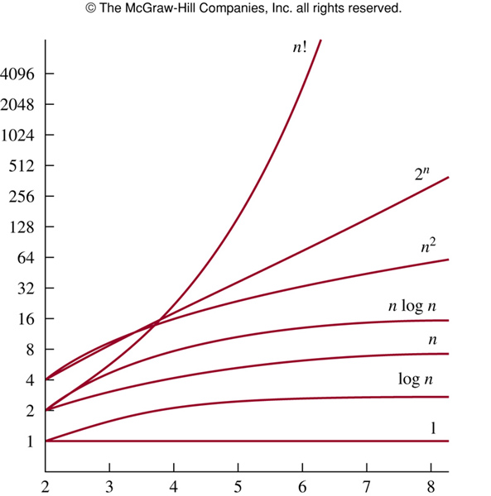
Eight Growth Functions
Eight functions O(n) that occur frequently in the analysis of algorithms (in order of increasing rate of growth relative to n):
Constant ≈ 1
Logarithmic ≈ log n
Linear ≈ n
Log Linear ≈ n log n
Quadratic ≈ n²
Cubic ≈ n³
Exponential ≈ 2^{n}
Factorial≈ n!

Slide 42
Growth Rates Compared
 | n=1 | n=2 | n=4 | n=8 | n=16 | n=32
1 | 1 | 1 | 1 | 1 | 1 | 1
log n | 0 | 1 | 2 | 3 | 4 | 5
n | 1 | 2 | 4 | 8 | 16 | 32
nlogn | 0 | 2 | 8 | 24 | 64 | 160
n² | 1 | 4 | 16 | 64 | 256 | 1024
n³ | 1 | 8 | 64 | 512 | 4096 | 32768
2^{n} | 2 | 4 | 16 | 256 | 65536 | 4294967296
n! | 1 | 2 | 24 | 40320 | 20.9T | Don’t ask!

Slide 43
References
Anany Levitin, Introduction to the design and analysis of algorithms, 2nd Edition.
Chapter 1, sections 1.1, 1.2
Chapter 2, Sections 2.1,2.2

