Slide 1
Cs316: Algorithms Lecture 2 Analysis of Algorithms
Prepared by: Assoc. Prof. Ensaf Hussein
Presented by:
Assoc. Prof. Wessam El-Behaidy
Dr. Mohammed El-Said

Slide 2
Asymptotic notations and Basic efficiency classes

Slide 3
Bounds (Asymptotic Notations)
Critical factor for problem size n:
IS NOT the exact number of basic operations executed for given n
IS how number of basic operations grows as n increases
Consequently:
Focus on how performance grows as n → ∞
Ignore constant factors
Call this: Asymptotic Order of Growth

Slide 4
Bounds (Asymptotic Notations)
Bounds describe the limiting behavior of algorithm complexity at large (n). They are:
Worst Case: Upper Bound (Big O complexity)
Best Case: Lower Bound (Big Ω complexity)
Exact (Big Θ complexity)
Approach: classify functions (i.e. of algorithms performance) based on their growth rates and divide into sets
Notes:
Upper bound: basic operations doesn’t exceed this run time
lower bound: minimum run-time and not less

Slide 5
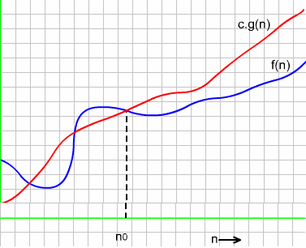
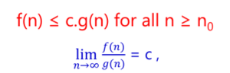
O-Notation: Definition
f(n) of the algorithm
g(n) is one of growth functions
Worst Case Upper Bound (Big O)
class of functions (algorithms) f(n) that grow no faster than g(n)
order of growth of f(n) ≤ order of growth of g(n) (within constant multiple).

Slide 6
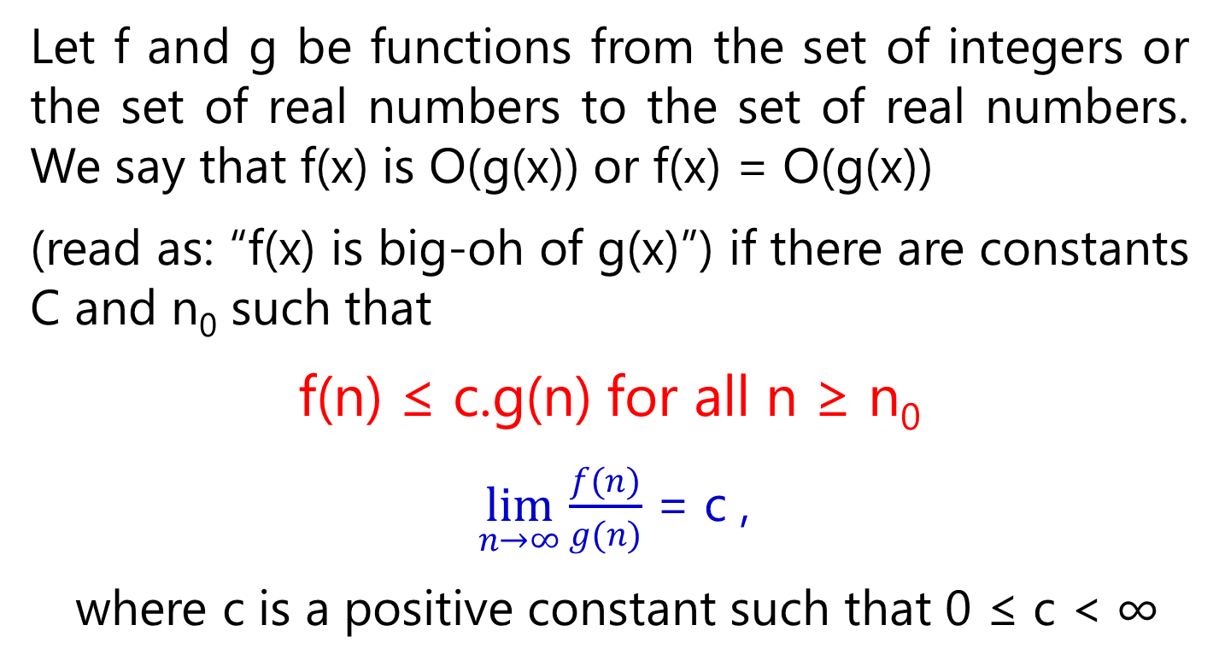
O-Notation :Definition 1
Notes:
Lim f(n)/infinity= 0

Slide 7
O-Notation :
f (n) ∈ O (g (n)) means: there are positive constants c and n₀ such that f(n) ≤ c g(n) for all values n ≥ n₀.
Then:
x ∈ O (x²)?
Yes, c = 1, n₀=1 works fine.
10x ∈ O (x)?
Yes, c = 11, n₀=1 works fine.
x² ∈ O (x)?
No, no matter what c and n₀
we pick, cx² > x for big enough x

Slide 8
O-Notation :
O(n³)
f(n) = 12n² + n
O(n²)
f(n) = n^{2.5}
f(n) = n^{3.1} – n²
Hence, only the fastest-growing term in f matters

Slide 9
O-Notation : Examples
Example : Using basic definition, we show that
3n² + 10n ϵ O(n²)
Consider, 10 ≤ n for n ≥ 10 ( obvious !)
10n ≤ n² for n ≥ 10 ( Multiplying both sides with n )
3n²+10n ≤ 3n² + n² for n ≥ 10 ( Adding 3n² to both sides )
=4n² (Simplifying )
3n² + 10 n ≤ c.n² for n ≥ n₀ where c =4 and n₀= 10 (Solution)
Therefore, it follows from the basic definition that
3n² +10n = O(n²)
The choice of constant c is not unique. However, for each different c there is a corresponding value of n₀ which satisfies the basic relation .This behavior is illustrated by the next example

Slide 10
Example : In the preceding example it was shown that
3n² + 10n ≤ c.n² for c=4, n₀=10.
We now show that the relation holds true for a different value of c and corresponding n₀.
Consider n ≤ n² for n ≥ 1 ( Obvious)
10n ≤ 10n² for n≥ 1 (Multiplying both sides with 10 )
3n² +10 n ≤ 3n² + 10n² for n≥ 1 ( Adding 3n² on both sides)
3n² +10n ≤ 13n² for n ≥ 1 ( Simplifying )
Or,
3n² +10n ≤ c.n², for n ≥ n₀ where c=13, n0=1 ( Solution )
Therefore, by basic definition,
3n² + 10n = O(n²)

Slide 11
O-Notation Example Comparison of Growth Rates
The results of analysis in the preceding examples are plotted in the next diagram.
It can be seen that the function cg(n) =4n² ( c= 4) overshoots the function f(n)= 3n² + 10n for n₀=10.
Also, the function cg(n) =13n² ( c =13 ) grows faster than f(n) = 3n² + 10n for n₀=1

Slide 12
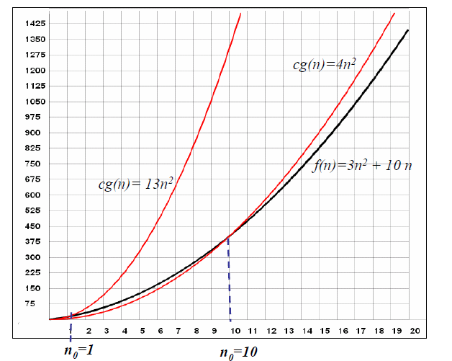
Tight upper
bound
Growth of functions 13n² and 4n² versus the function 3n² + 10 n

Slide 13
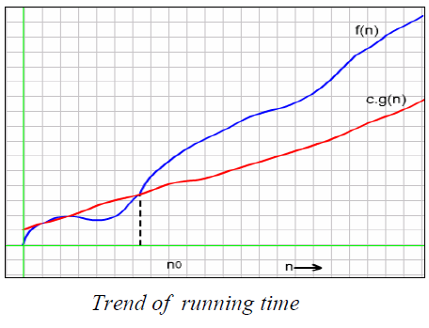
Ω-Notation: DEFINITION
Best Case: Lower Bound (Big Ω)
class of functions f(n) that grow at least as fast as g(n)
If order of growth of f(n) ≥ order of growth of g(n) (within constant multiple).
f(n) ≥ c.g(n) for all n ≥ n₀

Slide 14
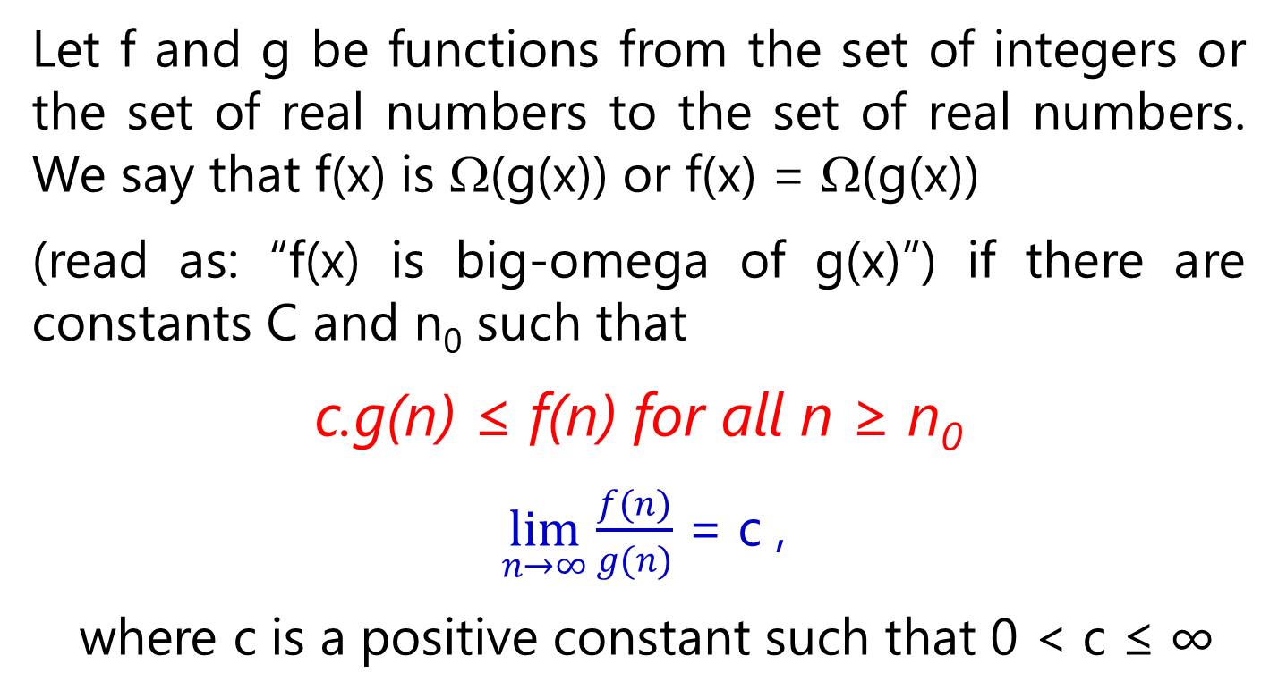
Ω-Notation: Definition
Let f and g be functions from the set of integers or the set of real numbers to the set of real numbers. We say that f(x) is Ω(g(x)) or f(x) = Ω(g(x))
(read as: “f(x) is big-omega of g(x)”) if there are constants C and n₀ such that
c.g(n) ≤ f(n) for all n ≥ n₀
$\lim_{n→∞}{\frac{f(n)}{g(n)}}$ = c ,
where c is a positive constant such that 0 < c ≤ ∞
Notes:
Lim infinity/g(n)=infinity

Slide 15
Ω-Notation Basic Method
Example: Using basic definition, we show that
n³ ϵ Ω(n²).
For, n³ ≥ n² for n ≥ 0
i.e. we can select c=1 and n₀= 0

Slide 16
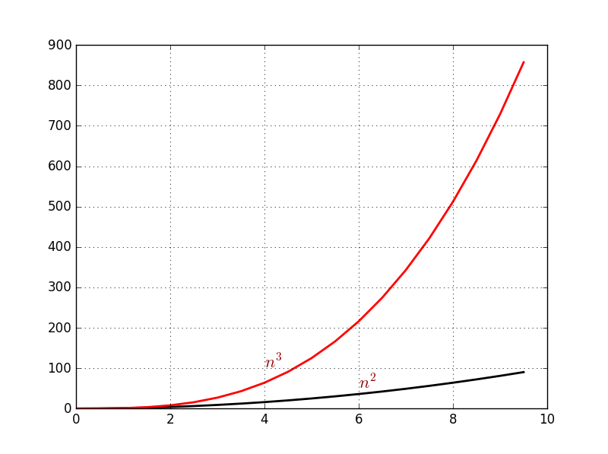

Slide 17
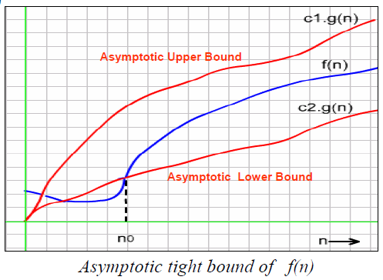
θ-Notation: Definition
Exact (Big Θ complexity)
Class of functions f(n) that grow at same rate as g(n)
Order of growth of f(n) = order of growth of g(n) (within constant multiples).
c2.g(n) ≤ f(n) ≤ c1.g(n)
for all n ≥ n0

Slide 18
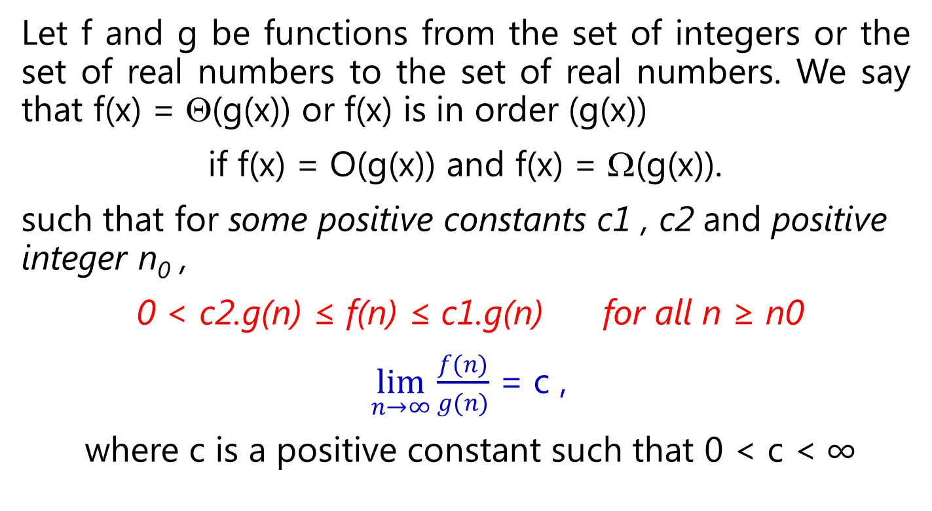
θ-Notation: Definition
Let f and g be functions from the set of integers or the set of real numbers to the set of real numbers. We say that f(x) = Θ(g(x)) or f(x) is in order (g(x))
if f(x) = O(g(x)) and f(x) = Ω(g(x)).
such that for some positive constants c1 , c2 and positive integer n₀ ,
0 < c2.g(n) ≤ f(n) ≤ c1.g(n) for all n ≥ n0
$\lim_{n→∞}{\frac{f(n)}{g(n)}}$ = c ,
where c is a positive constant such that 0 < c < ∞

Slide 19
Example: We show that ½ n (n-1) ϵ θ(n²).
We need to prove that
c₂ g(n) ≤ F(n) ≤ c₁ g(n) for all n ≥ n_{o}
first, consider the upper bound,
F(n) ≤ c₁ g(n)
½ n² – ½ n ≤ ½ n² for all n ≥ 0.
Second, consider the lower bound,
F(n) ≥ c₂ g(n)
½ n² – ½ n ≥ ½ n² – ½ n ½ n for all n ≥ 2.
= ¼ n².
Hence we can select c₂ = ¼ , c₁= ½ , and n₀ = 2.
½ n(n-1) = ½ n² – ½ n

Slide 20
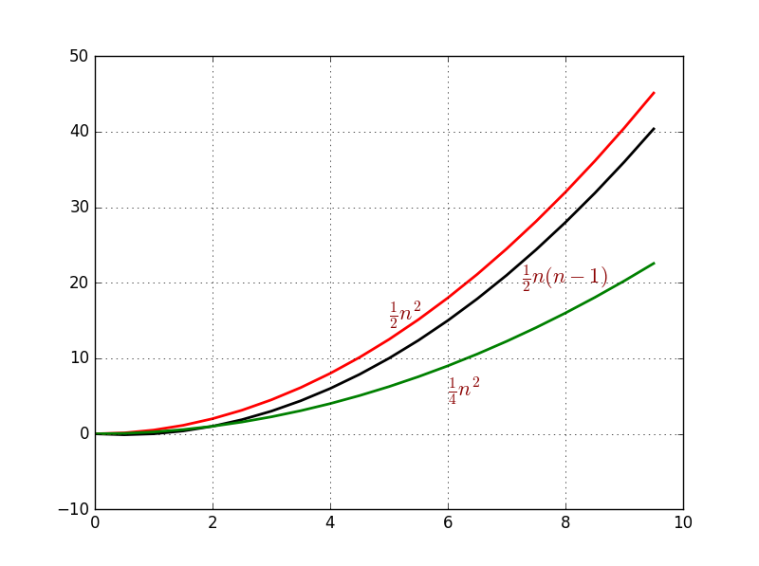
Comparison of Growth Rates

Slide 21
Bounds (Asymptotic Notations)
f(n) ≤ c × g(n)
for all n ≥ n₀
c2×g(n) ≤ f(n) ≤ c1×g(n)
for all n ≥ n₀
f(n) ≥ c × g(n)
for all n ≥ n₀
c × g(n)
c₁ × g(n)
f(n)
f(n)
f(n)
c × g(n)
c₂ × g(n)
n₀
n
n₀
n
n₀
n
f(n) є Θ(g(n))
f(n) є Ω(g(n))
f(n) є O(g(n))

Slide 22
Theorem :
Suppose f₁(x) = O(g₁(x)) and f₂(x) = O(g₂(x)) then
(f₁+f₂)(x) = O (max(g₁(x),g₂(x))
Example 1: Theorem 1
If our problem contains sorting inputs, then search within.
Consider sorting algorithm= O(n²) comparisons and then binary search = O(log₂n) comparisons, then:
efficiency is O(max{n², log₂n}) = O(n²)

Slide 23
Example 2: Theorem 1
Consider the summation f(n) consisting of basic functions :
f(n) = n +√n + n^{1.5}+ lg n + n lg n + n²
We have seen that
lg n < √n < n <n lg n <n^{1.5} < n²
which means that the function n² grows faster than all other functions in the expression
Thus,
f(n) = n + √n + n^{1.5}+ lg n + n lg n + n²
= O( max (n , √n , n^{1.5}, lg n , n lg n , n² ) )
= O(n²)

Slide 24
Theorem :
(2) Suppose f₁(x) = O(g₁(x)) and f₂(x) = O(g₂(x)) then
(f₁f₂)(x) = O (g₁(x).g₂(x))
Example : Theorem 2
If we have two nested loops,
inner loop = O(n) and outer loop = O(n), so:
The efficiency is O(n . n) = O(n²)

Slide 25
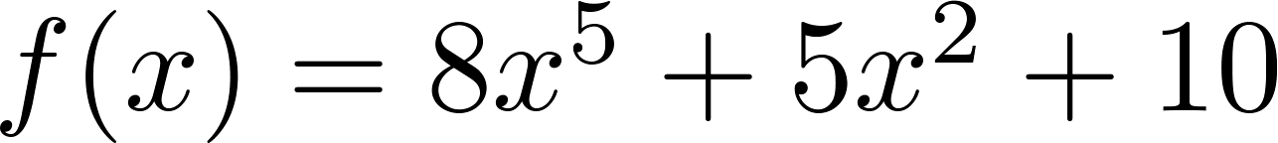
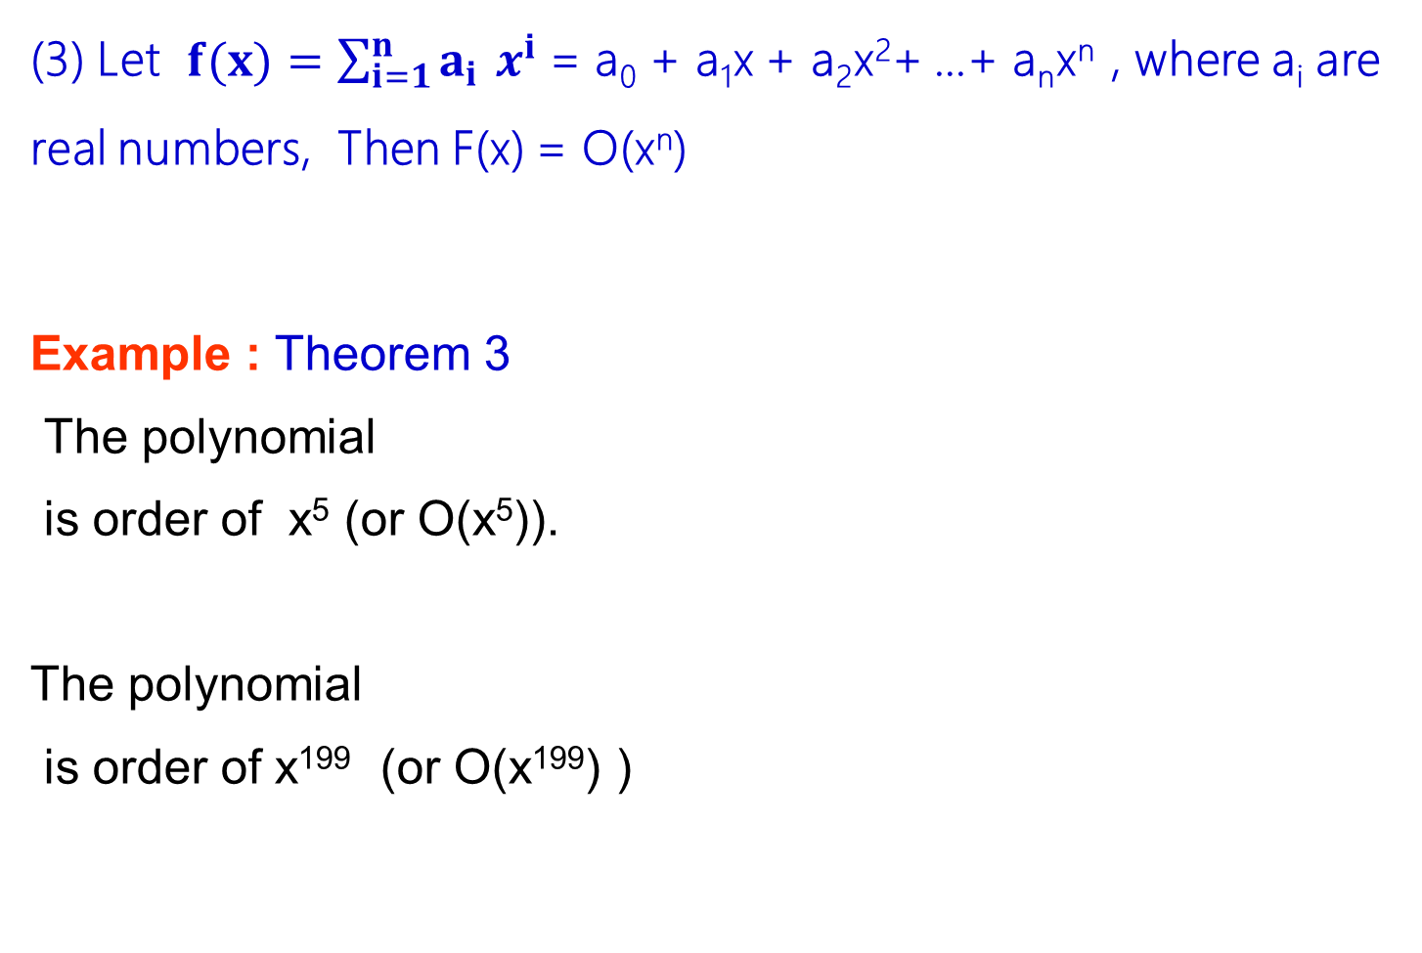
Theorem : Polynomial
(3) Let $f(x)=\sum_{i=1}^{n}{a_{i }x^{i}}$ = a₀ + a₁x + a₂x²+ …+ a_{n}x^{n} , where a_{i} are real numbers, Then F(x) = O(x^{n})
Example : Theorem 3
The polynomial
is order of x⁵ (or O(x⁵)).
The polynomial
is order of x¹⁹⁹ (or O(x¹⁹⁹) )

Slide 26
Theorem : Transitivity
(4) If f(x) = O(g (x)) and h(x) ˃ g(x) for sufficiently large x₀, it follows that f (x) = O(h (x))
Example : Theorem 4
x²+2x+1 = O(x²); and x³ > x²
➔ x²+2x+1 = O(x³)

Slide 27
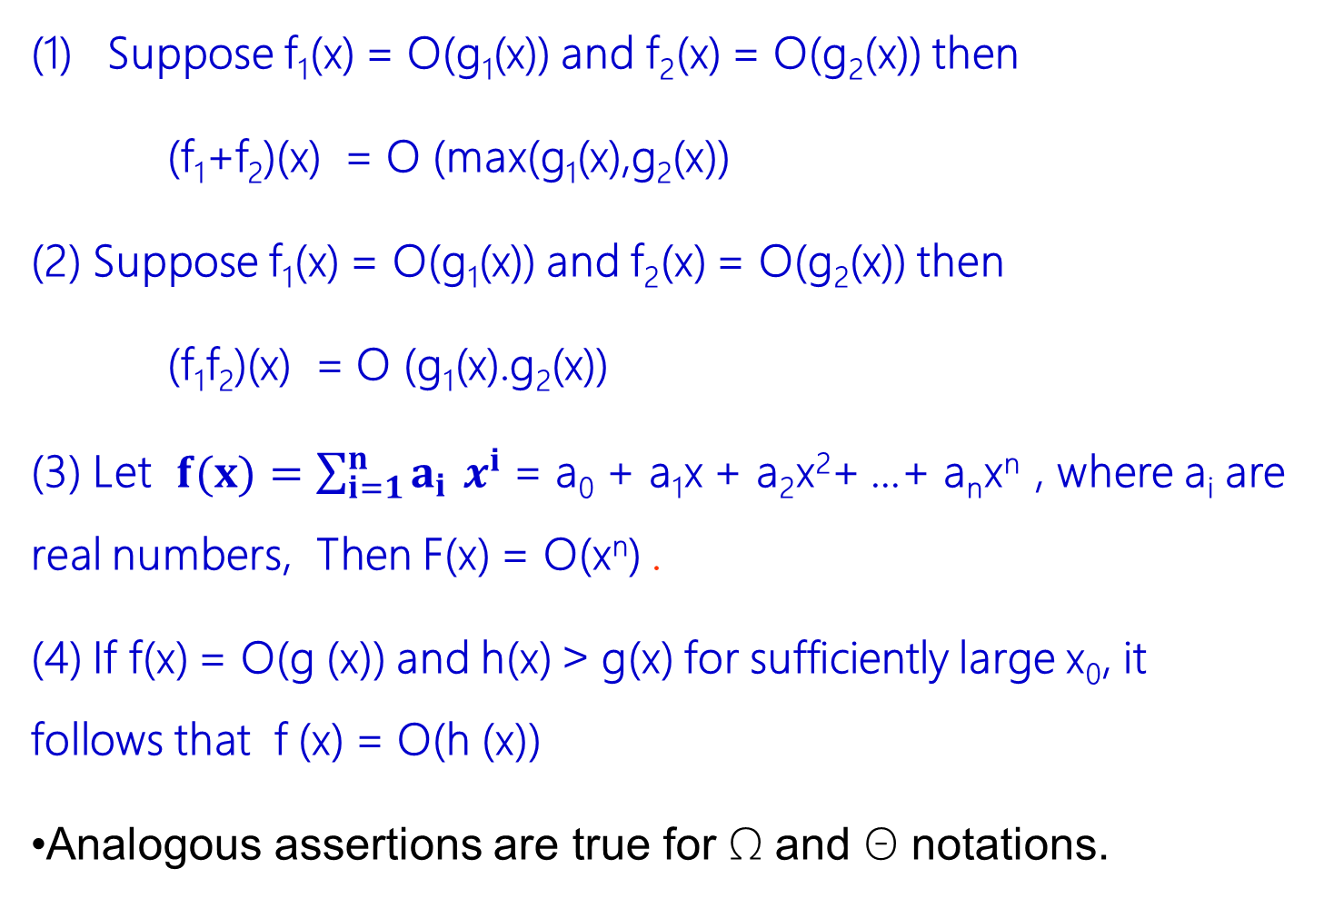
Theorem :
Suppose f₁(x) = O(g₁(x)) and f₂(x) = O(g₂(x)) then
(f₁+f₂)(x) = O (max(g₁(x),g₂(x))
(2) Suppose f₁(x) = O(g₁(x)) and f₂(x) = O(g₂(x)) then
(f₁f₂)(x) = O (g₁(x).g₂(x))
(3) Let $f(x)=\sum_{i=1}^{n}{a_{i }x^{i}}$ = a₀ + a₁x + a₂x²+ …+ a_{n}x^{n} , where a_{i} are real numbers, Then F(x) = O(x^{n}) .
(4) If f(x) = O(g (x)) and h(x) ˃ g(x) for sufficiently large x₀, it follows that f (x) = O(h (x))
Analogous assertions are true for Ω and Θ notations.

Slide 28
Note:
All logarithmic functions log_{a} n belong to the same class order of (log n) no matter what the logarithm’s base a > 1 is
Exponential functions a^{n} have different orders of growth for different a’s
order log n < order n^{α} (α>0) < order a^{n} < order n! < order n^{n}
Notes:
N power alpha➔polynomial

Slide 29
Question…
Cost Function: t_{A}(n) = n² + 200n + 10000
Which term in the function is most important (dominates)?
It depends on the size of n
n = 20, t_{A}(n) = 400 + 4000 + 10000
The constant, is the dominating term
n = 100, t_{A}(n) = 10000 + 20000 + 10000
200n is the dominating term
n = 1000, t_{A}(n) = 1000000 + 200000 + 10000
n² is the dominant term

Slide 30
References
Anany Levitin, Introduction to the design and analysis of algorithms, 2nd Edition.
Chapter 1, sections 1.1, 1.2
Chapter 2, Sections 2.1,2.2
Kenneth H. Rosen, Discrete Mathematics and its applications, 7th Edition .
Chapter 3 Algorithms

