Slide 1
Cs316: Algorithms Lecture 3 Analysis of Non-recursive Algorithms
Prepared by: Assoc. Prof. Ensaf Hussein
Presented by:
Assoc. Prof. Wessam El-Behaidy
Dr. Mohammed El-Said

Slide 2
1
2
Insertion Sort.
3
Appendix : useful formulas for Analysis of Algorithms.
Analyzing Non-recursive Algorithms.
Merge Sort
4

Slide 3
Analyzing Non-recursive Algorithms

Slide 4
Analysis Algorithm control structures
Sequencing
If-then-else
For loop
While loop
Recursion

Slide 5
sequencing
EX:
If t_{A} = θ(n) , t_{B}= θ(n²)
➔ t_{A}+t_{B} = max(t_{A} , t_{B})
= θ(n²)
PA
t_{A}
PB
t_{B}
t_{A}+t_{B} = max(t_{A},t_{B})

Slide 6
if-then-else
t_{A}/t_{B} = max(t_{A},t_{B})
Condition
PA
PB
t_{B}
t_{A}

Slide 7
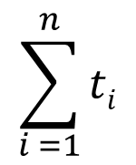

For loop
for i←1 to n
{
P(i)
}
for i←1 to n
{
for j←1 to n
{
P(ij)
}
}
$$\sum_{i =1}^{n}{\sum_{j =1}^{n}{ti}j}$$

Slide 8
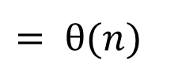
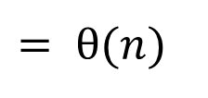
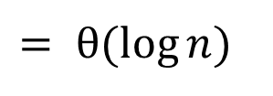
While loop
While (n>0)
{
----------
----------
Set n←n-1
}
While (n>0)
{
----------
----------
Set n ← n/2
}
Set x← 0
Set y← n
While (x<y)
{
----------
----------
Set x ←x+1
Set y ← y-1
}
$$= θ(n)$$
$$= θ(\log{n})$$
$$= θ(n)$$
Notes:
N=n-1 same as n=n+1, n=n+2 or 3 or 5 whatever value positive or negative
N=n/2 or n=n*2 O(logn) for base 2 based on what number you divide or multiply into

Slide 9
Theoretical analysis of time efficiency
Time efficiency is analyzed by determining the number of repetitions of the basic operation as a function of input size
Basic operation: the operation that contributes most towards the running time of the algorithm
T(n) ≈ c_{op}C(n)
input size
Number of times basic operation is executed
running time
execution time
for basic operation
Notes:
Cop is assumed as constant because we still in design phase

Slide 10
General Plan
How to find T(n) ≈ c_{op}C(n)??
Decide on a parameter indicating an input’s size
Does C(n) depends only on n or does it also depend on type of input?
Identify the basic operation
Set up sum expressing the # of times basic operation is executed.
Find closed form for the sum or at least establish its order of growth

Slide 11
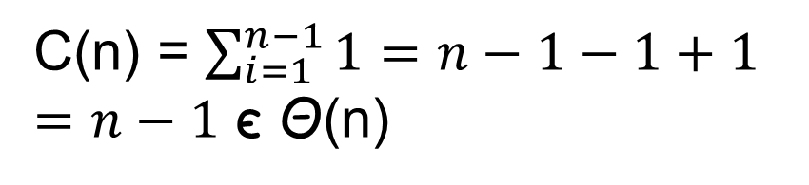
Analysis of Non-recursive Examples
ALGORITHM MaxElement( A [0..n-1] )
//Determines largest element
maxval <- A[0]
for i <- 1 to n-1 do
if A[i] > maxval
maxval <- A[i]
return maxval
Then:
Times of execution
Input size: n
Basic operation: > or <-

Slide 12


Analysis of Nonrecursive (contd.)
Times of execution
ALGORITHM UniqueElements(A [0..n-1] )
//Determines whether all elements are distinct
for i <- 0 to n-2 do
for j <- i+1 to n-1 do
if A[i] = A[j]
return false
return true
$$\sum_{i=0}^{n−2}{}$$
$$\sum_{j=i+1}^{n−1}{}$$
Input size: n
Basic operation: A[i] = A[j]

Slide 13
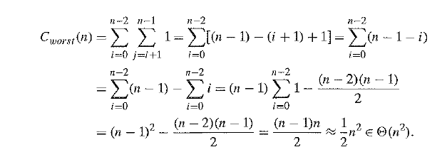
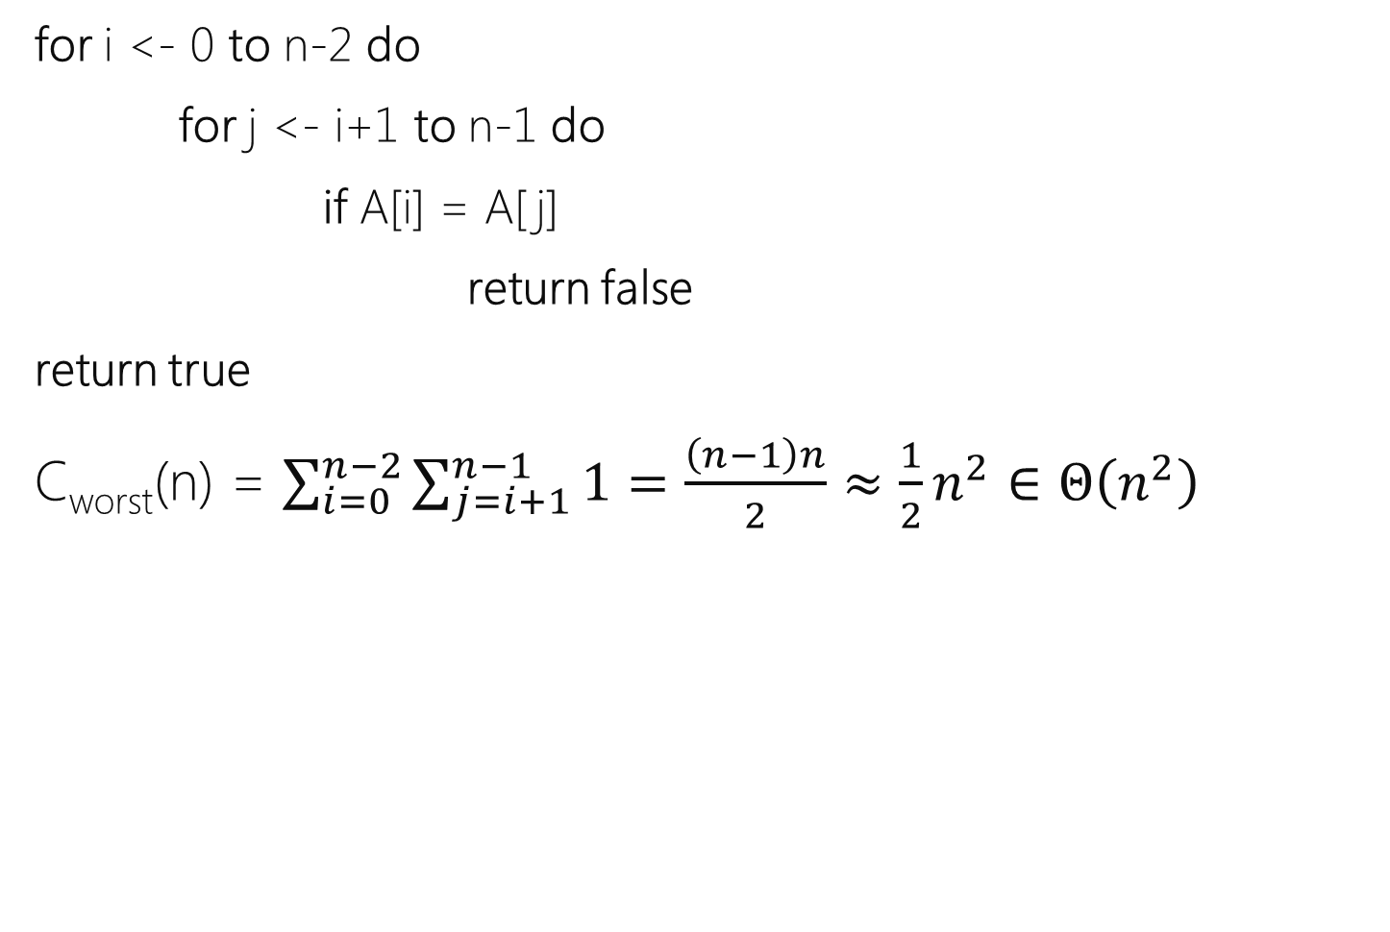
Analysis of Nonrecursive (contd.)

Slide 14

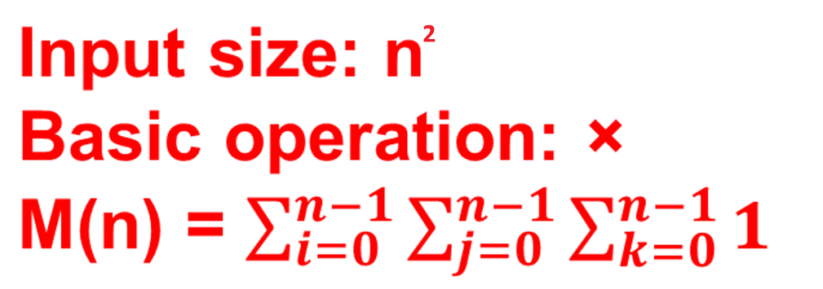
Analysis of Nonrecursive (contd.)
ALGORITHM MatrixMultiplication(A[ 0..n-1 , 0..n-1],
B[ 0..n-1 , 0..n-1])
for i <- 0 to n-1 do
for j <- 0 to n-1 do
C[i, j] = 0.0
for k <- 0 to n-1 do
C[i, j] = C[i, j] + A[i, k]×B[k, j]
return C

Slide 15

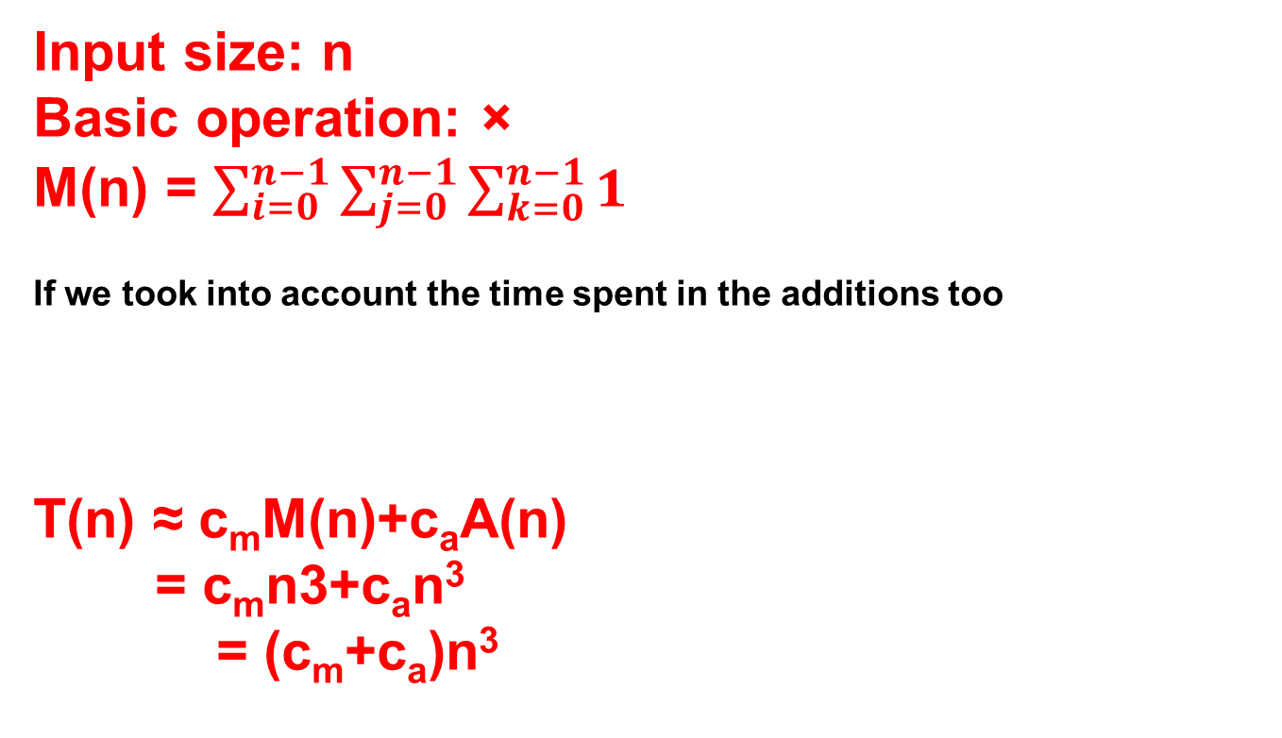
Analysis of Nonrecursive (contd.)
Input size: n
Basic operation: ×
M(n) = $\sum_{i=0}^{n−1}{\sum_{j=0}^{n−1}{\sum_{k=0}^{n−1}{1}}}$
If we took into account the time spent in the additions too
T(n) ≈ c_{m}M(n)+c_{a}A(n)
= c_{m}n3+c_{a}n³
= (c_{m}+c_{a})n³

Slide 16
Analysis of Nonrecursive (contd.)
Algorithm linearSearch (A [0..n-1] , key)
for (i = 0 to n-1)
if ( A[i ]== key )
return i;
return -1;
Best case: C(n) = 1 Then C(n) є Ω(1)
Worst case: C(n) = = n
Then C(n) є O(n)
Input size: n
Basic operation: ==
When i = 0 ➔ A[i] == Key
Key not found
$$\sum_{i=0}^{n−1}{1}$$

Slide 17
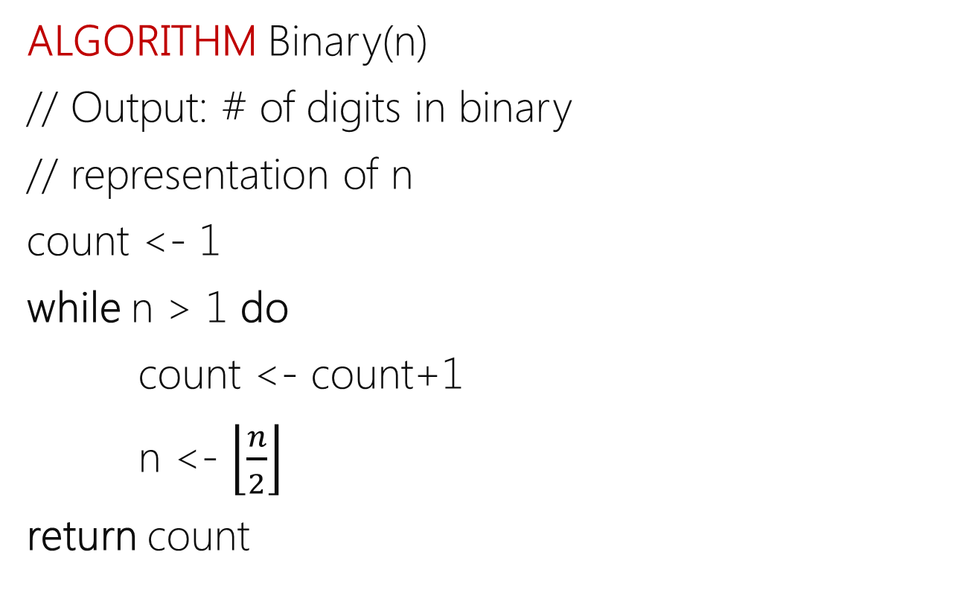
Analysis of Nonrecursive (contd.)
The loop variable takes on only a few values between its lower and upper limits.
Each iteration n is divided by 2
Therefore, we have to use an alternative way of computing the number of times the loop is executed.
Assume, there are an integer value m so
2^{m} <= n <= 2^{m+1}
As, n is divided by 2 each iteration
After how many iteration n will be equal to 1??
➔After m iteration
➔After m iteration
2^{m} <= n <= 2^{m+1}
By taking log₂
m <= lg n <= m+1
Then:
C(n) ∈ Θ(lg n)

Slide 18
Algorithms techniques
Brute force (ex. Sequential search)
Decrease and Conquer (ex. Insertion Sort)
Divide and Conquer (ex. Merge – Quick Sort)
Transform and Conquer (ex. Heap Sort)
Dynamic Programming
Greedy Technique.
Notes:
Decrease and conquer is a technique used to solve problems by reducing the size of the input data at each step of the solution process. This technique is similar to divide-and-conquer, in that it breaks down a problem into smaller subproblems, but the difference is that in decrease-and-conquer, the size of the input data is reduced at each step.

Slide 19
Decrease and Conquer
Decrease or reduce problem instance to smaller instance of the same problem and extend solution.
Conquer the problem by solving smaller instance of the problem.

Slide 20
Insertion Sort

Slide 21
Insertion Sort
Idea: like sorting a hand of playing cards
Start with an empty left hand and the cards facing down on the table.
Remove one card at a time from the table, and insert it into the correct position in the left hand
compare it with each of the cards already in the hand, from right to left
The cards held in the left hand are sorted
these cards were originally the top cards of the pile on the table

Slide 22
Insertion Sort
To insert 12, we need to make room for it by moving first 36 and then 24.
6
10
24
36
12

Slide 23
Insertion Sort
6
10
24
36
12

Slide 24
Insertion Sort
6
10
24
36
12

Slide 25
Insertion Sort
input array
5 2 4 6 1 3
at each iteration, the array is divided in two sub-arrays:
left sub-array
right sub-array
sorted
unsorted

Slide 26
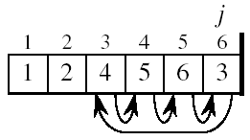
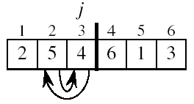
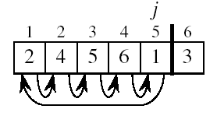
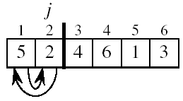
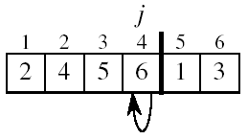
Insertion Sort

Slide 27
INSERTION-SORT
1
2
3
4
5
6
7
8
a₁
a₂
a₃
a₄
a₅
a₆
a₇
a₈
INSERTION-SORT(A)
for j ← 2 to n
key ← A[ j ]
//Insert A[ j ] into the sorted sequence A[1 . . j-1]
i ← j - 1
while i > 0 and A[i] > key
A[i + 1] ← A[i]
i ← i – 1
A[i + 1] ← key
key
Notes:
J→ right array
i→ left array

Slide 28
Analysis of Insertion Sort
INSERTION-SORT(A)
for j ← 2 to n do
key ← A[ j ]
i ← j - 1
while i > 0 and A[i] > key
do A[i + 1] ← A[i]
i ← i – 1
A[i + 1] ← key
The for loop main operation
Assume t_{j} is # of times the while statement is executed at iteration j
Notes:
₇

Slide 29
Best Case Analysis
The array is already sorted
A[i] ≤ key upon the first
time the while loop test is run
t_{j} = 1
Then:
Best case of T(n) ∈ Θ(n)
while i > 0 and A[i] > key
A[i + 1] ← A[i]
i ← i – 1

Slide 30
Worst Case Analysis
while i > 0 and A[i] > key
A[i + 1] ← A[i]
i ← i – 1
The array is reversed
Always A[i] > key
Have to compare key with all elements to the left of the j-th position ⇒ compare with j-1 elements
⇒ t_{j} = j
Then:

Slide 31
Worst Case Analysis
Worst case of T(n) ∈ Θ(n²)
Using
T (n) =

Slide 32
Insertion Sort - Summary
Advantages
Good running time for “almost sorted” arrays Θ(n)
Disadvantages
Θ(n²) running time in worst and average case

Slide 33
Divide and conquer algorithm design strategy

Slide 34
Divide and Conquer
Three steps are involved:
Divide the problem into several subproblems, perhaps of equal size
Subproblems are solved, typically recursively
The solutions to the subproblems are combined to get a solution to the original problem

Slide 35
Divide and Conquer (contd.)
Problem of size n
Sub-problem 1
Sub-problem 2
Solution to sub-problem 1
Solution to sub-problem 2
Don’t assume
always breaks up
into 2, could be > 2
Sub-problems
Solution to the original problem

Slide 36
Divide and Conquer (contd.)
Example 1: Divide array into two halves, recursively sort left and right halves, then merge two halves → Merge sort
Example 2: Partition array into items that are “small” and items that are “large”, then recursively sort the two sets → Quicksort
Example 3: Partition array into two halves from ‘mid’, search into the left half if the search key is smaller than ‘mid’ or search into the right half otherwise → Binary search

Slide 37
Merge Sort

Slide 38
Merge sort
8
2
9
4
5
3
1
6
Sorting Problem: Sort a sequence of n elements into non-decreasing order.
Divide: Divide the n-element sequence to be sorted into two subsequences of n/2 elements each
Conquer: Sort the two subsequences recursively using merge sort.
Combine: Merge the two sorted subsequences to produce the sorted answer.

Slide 39
Merge sort (contd.)
Divide:
8 | 3 | 2 | 9 | 7 | 1 | 5 | 4
Merge:
q
8 | 3 | 2 | 9
7 | 1 | 5 | 4
q
2 | 9
7 | 1
q
5 | 4
8 | 3
8
3
2
9
7
1
5
4
3 | 8
2 | 9
1 | 7
4 | 5
2 | 3 | 8 | 9
1 | 4 | 5 | 7
1 | 2 | 3 | 4 | 5 | 7 | 8 | 9

Slide 40
Merge sort(contd.)
Algorithm Merge-Sort(A, p, r):
if p < r then
q← ⎣(p+r)/2⎦
Merge-Sort(A, p, q)
Merge-Sort(A, q+1, r)
Merge(A, p, q, r)
A:
2
3
8
9
1
4
5
7
P
q
r

Slide 41
Merging Idea
p
q
r
1
2
3
4
5
6
7
8
2
4
5
7
1
2
3
6
Copy each of the two sorted sub-sets into two temp sets
Choose the smaller of the two top elements of the two temp sets
Remove it and place it in the output set
Repeat the process until one set is empty
Take the remaining and place them onto the output set
A1← A[p, q]
A[p, r]
A2← A[q+1, r]

Slide 42
Pseudocode of the MERGE procedure
p
q
r
MERGE (A, p, q, r )
//Compute n₁ and n₂
1. n₁ ← q − p + 1 2. n₂ ← r − q 3. Create arrays L[1 . . n₁ + 1] and R[1 . . n₂ + 1] 4. FOR i ← 1 TO n₁ 5. DO L[i] ← A[p + i − 1] 6. FOR j ← 1 TO n₂ 7. DO R[j] ← A[q + j ] 8. L[n₁ + 1] ← ∞ 9. R[n₂ + 1] ← ∞ . . .
1
2
3
4
5
6
7
8
2
4
5
7
1
2
3
6
n₁
n₂
L
2
4
5
7
∞
R
1
2
3
6
∞

Slide 43
Pseudocode of the MERGE procedure
p
q
r
MERGE (A, p, q, r )
. . .
10. i ← 1 11. j ← 1 12. FOR k ← p TO r 13. DO IF L[i ] ≤ R[ j] 14. THEN A[k] ← L[i] 15. i ← i + 1 16. ELSE A[k] ← R[j] 17. j ← j + 1
1
2
3
4
5
6
7
8
2
4
5
7
1
2
3
6
k
n₁
n₂
i
L
2
4
5
7
∞
r
R
1
2
3
6
∞
j

Slide 44
Analysis of Merge Sort
ALGORITHM Mergesort(A, p, r )
IF p < r THEN q = FLOOR[(p + r)/2]
MERGE_Sort (A, p, q) T(n/2)
MERGE_Sort (A, q + 1, r) T(n/2)
MERGE (A, p, q, r) θ(n)
T(n) = 2T(n/2) + θ(n)
recurrence relation

Slide 45
Binary Search

Slide 46
Binary search
low → low index in range
high → high index in range
middle= ∟(low+ high)/2⅃
Initially:
low=0,
high=size-1
low
middle
high
low
0 | 1 | 2 | 3 | 4 | 5 | 6 | 7 | 8 | 9
5 | 17 | 35 | 59 | 77 | 79 | 83 | 90 | 92 | 120
Key
79
key > a [middle]
low= middle+1
low
Middle
high
high
5 | 6 | 7 | 8 | 9
79 | 83 | 90 | 92 | 120
Low
high
Key < a [middle]
high= middle-1
Middle
5 | 6
79 | 83
Key == a [middle]
Return Middle
In our example, it returns the index 5 after only 3 comparisons

Slide 47
BINARY-SEARCH: Recurrence
For an ordered array A, finds if x is in the array A[lo…hi]
BINARY-SEARCH (A, lo, hi, x)
if (lo > hi)
return FALSE
mid ← ⎣(lo+hi)/2⎦
if x = A[mid]
return TRUE
if ( x < A[mid] )
BINARY-SEARCH (A, lo, mid-1, x)
if ( x > A[mid] )
BINARY-SEARCH (A, mid+1, hi, x)
1
2
3
4
5
6
7
8
2
3
5
7
9
10
11
12
lo
mid
hi

Slide 48
BINARY-SEARCH: Recurrence
BINARY-SEARCH (A, lo, hi, x)
if (lo > hi)
return FALSE
mid ← ⎣(lo+hi)/2⎦
if x = A[mid]
return TRUE
if ( x < A[mid] )
BINARY-SEARCH (A, lo, mid-1, x)
if ( x > A[mid] )
BINARY-SEARCH (A, mid+1, hi, x)
T(n) = c + T( n / 2 )
Because of the IF condition only one of the two calls will be executed
constant time: c₁
constant time: c₂
constant time: c₃
same problem of size n/2
same problem of size n/2

Slide 49
Appendix: useful mathematical formulas for the analysis of algorithms

Slide 50
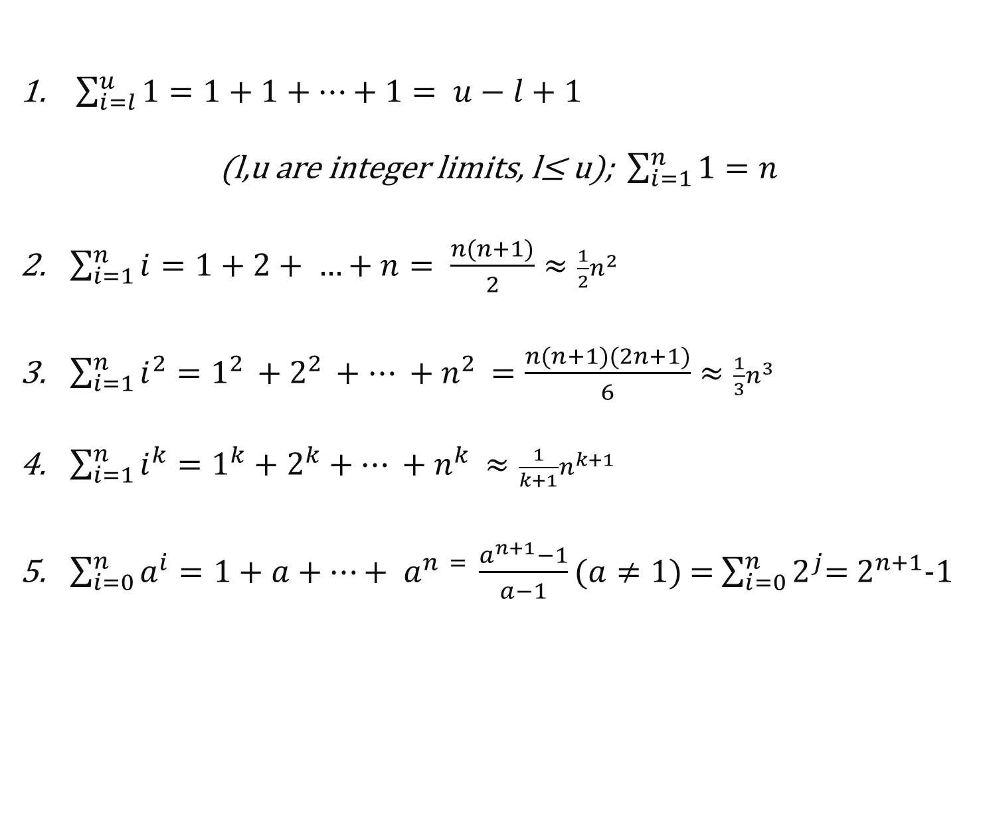
Appendix: Important Summation Formulas
$\sum_{i=l}^{u}{1}=1+1+…+1= u−l+1$
(l,u are integer limits, l≤ u); $\sum_{i=1}^{n}{1=n}$
$\sum_{i=1}^{n}{i}=1+2+ …+n= \frac{n(n+1)}{2}≈\frac{1}{2}n^{2}$
$\sum_{i=1}^{n}{i^{2}}=1^{2 }+2^{2 }+… +n^{2 }=\frac{n(n+1)(2n+1)}{6}≈\frac{1}{3}n^{3}$
$\sum_{i=1}^{n}{i^{k}}=1^{k}+2^{k}+… +n^{k }≈\frac{1}{k+1}n^{k+1}$
$\sum_{i=0}^{n}{a^{i}}=1+a+…+ a^{n = }\frac{a^{n+1}−1}{a−1}(a≠1)$ = $\sum_{i=0}^{n}{2^{j}}$= $2^{n+1}$-1

Slide 51
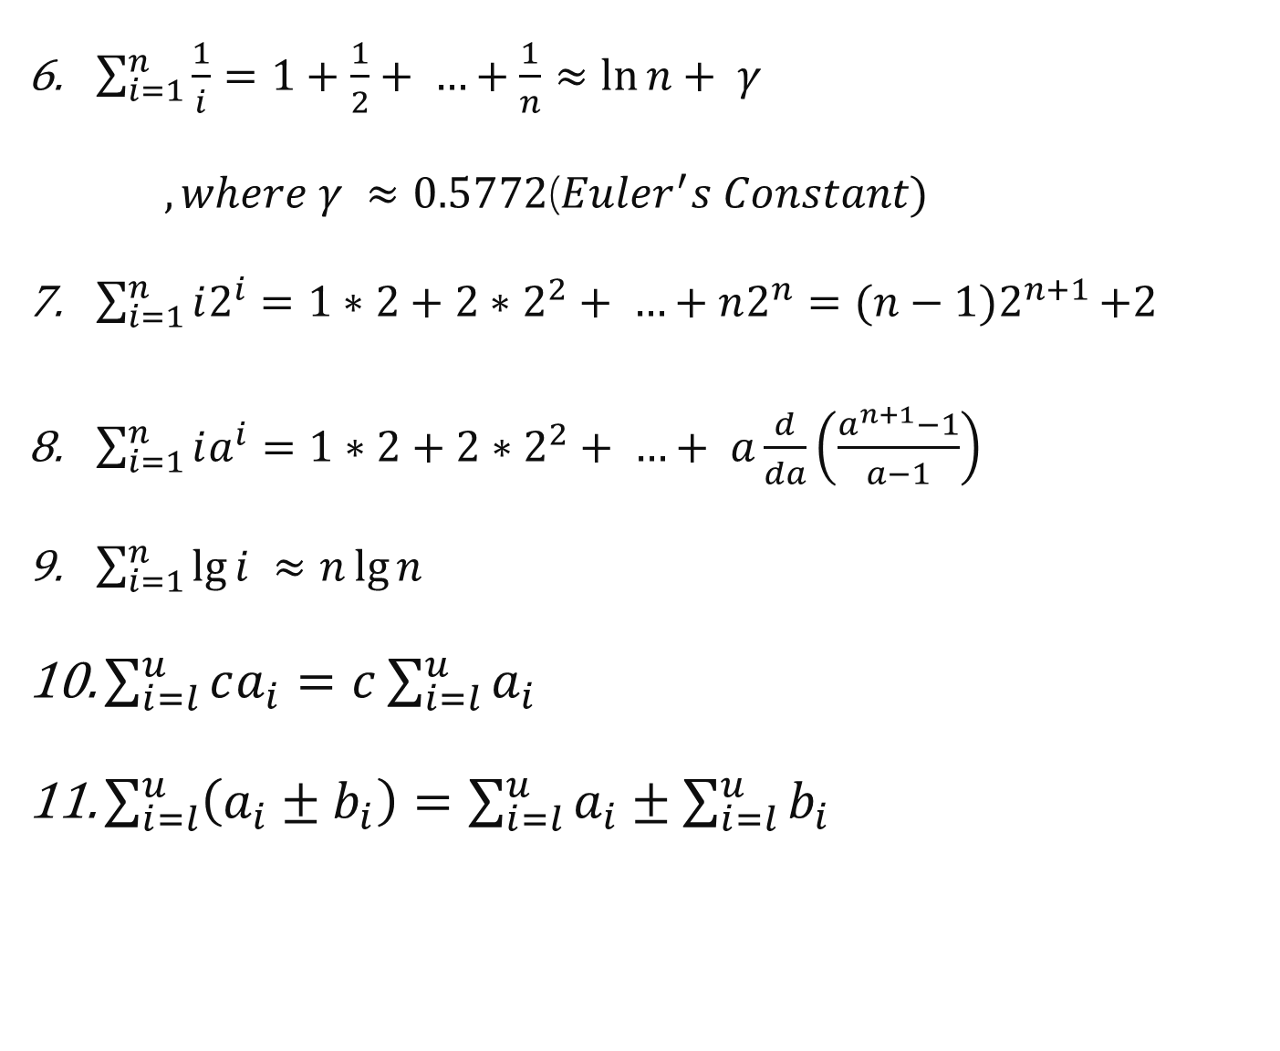
Appendix: Important Summation Formulas
$\sum_{i=1}^{n}{\frac{1}{i}}=1+\frac{1}{2}+ …+\frac{1}{n}≈\ln{n+ γ }$
$, where γ ≈0.5772$($Euler^{′}s Constant)$
$\sum_{i=1}^{n}{i2^{i}}=1∗2+2∗2^{2}+ …+n2^{n}=(n−1)2^{n+1 }$+2
$\sum_{i=1}^{n}{ia^{i}}=1∗2+2∗2^{2}+ …+ a\frac{d}{da}\left(\frac{a^{n+1}−1}{a−1}\right)$
$\sum_{i=1}^{n}{\lg{i ≈n\lg{n}}}$
$\sum_{i=l}^{u}{ca_{i}}=c\sum_{i=l}^{u}{a_{i}}$
$\sum_{i=l}^{u}{\left(a_{i}±b_{i}\right)=\sum_{i=l}^{u}{a_{i}}±\sum_{i=l}^{u}{b_{i}}}$

Slide 52

Appendix: Properties of logarithms
log_{a} 1 = 0
log_{a} a = 1
log_{b}(m^{n}) = n · log_{b}(m)
log_{b}(mn) = log_{b}(m) + log_{b}(n)
log_{b}(^{m}/_{n}) = log_{b}(m) – log_{b}(n)
a ^{log}b ^{m} = m ^{log}b ª
log_{a} m = $\frac{\text{log}\text{b} \text{m}}{\text{log}\text{b} \text{a}}$ = log_{a} b log_{b} m

