Slide 1
Cs 316: Algorithms Lecture 4 Analysis Of Recursive Algorithms
Prepared by: Assoc. Prof. Ensaf Hussein
Presented by:
Assoc. Prof. Wessam El-Behaidy
Dr. Mohammed El-Said

Slide 2
Outline
Analysis of recursive algorithms
Substitution
Iteration Method – Iteration Tree
Master Method
Recursive Algorithms
Factorial
Fibonacci Sequence
Tower of Hanoi

Slide 3
Analysis of Merge Sort
ALGORITHM Mergesort(A, p, r )
IF p < r THEN q = FLOOR[(p + r)/2]
MERGE_Sort (A, p, q) T(n/2)
MERGE_Sort (A, q + 1, r) T(n/2)
MERGE (A, p, q, r) θ(n)
T(n) = 2T(n/2) + θ(n)
Time of Division
Time of Conquer
Θ(nlgn)
recurrence relation

Slide 4
BINARY-SEARCH: Recurrence
BINARY-SEARCH (A, lo, hi, x)
if (lo > hi)
return FALSE
mid ← ⎣(lo+hi)/2⎦
if x = A[mid]
return TRUE
if ( x < A[mid] )
BINARY-SEARCH (A, lo, mid-1, x)
if ( x > A[mid] )
BINARY-SEARCH (A, mid+1, hi, x)
T(n) = c + T( n / 2 )
constant time: c₁
constant time: c₂
constant time: c₃
same problem of size n/2
same problem of size n/2
Θ(lgn)

Slide 5
Recurrences
An equation that describes a function in terms of its value on smaller inputs.
T(n) = T(n-1) + n
Recurrences arise when an algorithm contains recursive calls to itself

Slide 6
Compute Complexity for Recursive algorithms

Slide 7
General Plan for Analysis of recursive algorithms
Decide on a parameter indicating an input’s size
Identify the basic operation
Check whether the number of times the basic operation is executed may vary on different inputs of the same size. (If it may, the worst, average, and best cases must be investigated separately.)
Set up a recurrence relation with an appropriate initial condition expressing the number of times the basic operation is executed.
Solve the recurrence (or, at the very least, establish its solution’s order of growth).

Slide 8
Methods for Solving Recurrences
Iteration method
Recursion tree method
Master method

Slide 9
1. Iteration Method
The basic idea is to:
expand the recurrence and
express it as a summation of terms dependent only on n and the initial conditions.

Slide 10
Example(1): Binary search recurrence
Consider T(n) = c + T(n/2), and T(1) = θ(1).
T(n) = c + T(n/2)
= c + c + T(n/4)
= c + c + c + T(n/8) = 3c + T(n/2³)
. . .
T(n) = k c + T(n/2^{k})
= c log₂n + T(1)
T(n)= Θ(lgn)
T(n/2) = c + T(n/4)
T(n/4) = c + T(n/8)
When T(n/2^{k})=T(1) ? when n = 2^{k}
➔k = log₂n
log₂n lgn

Slide 11
Example(2):
Consider the recurrence
T(n) = T(n-1) +1 , and T(1) = θ(1).
Solution:
Expanding the above terms
T(n) = T(n-1) +1 T(n-1) = T(n-2) + 1 thus,
T(n) = (T(n-2)+1) +1 =T(n-2) + 2
T(n-2) = T(n-3) + 1. thus,

Slide 12
Example(2):
T(n) = (T(n-3) +1) + 2 = T(n-3) + 3.
T(n-3) = T(n-4) + 1. thus,
T(n) = T(n-4) +4 .
. . .
T(n) = T(n-k) + k.
➔ T(n-k)= T(1)= θ(1), when k =n-1
Thus, T(n)=θ(1)+(n-1)=θ(n)
Hence, T(n)=θ(n)

Slide 13
Example(3)
T(n/4) = n/4 +3T(n/16)
T(n/16) = n/16 +3T(n/64)

Slide 14


Example(3)
n+3n/4+3²n/4²+3³n/4³+3⁴T(n/4⁴)
n+3n/4+3²n/4²+3³n/4³+……+3^{k}T(n/4^{k})
T(n/4^{k}) will be T(1) By taking n = 4^{k}
k = log₄n
log_{a} a^{n} = n
a ^{log}b ^{m} = m ^{log}b ª
$\text{log}\text{4} \text{3}$ =0.79 <1
$$\sum_{i=0}^{∞}{{ar}^{i}}=\frac{a}{1−r}(r<1)$$
Notes:
use the infinite geometric series instead of finite, a=1, r = ¾ ➔ 1/1-r

Slide 15
2. The Recursion-tree Method
Is a pictorial representation of an iteration method which is in the form of a tree, where at each level nodes are expanded.
Idea:
Each node represents the cost of a single sub-problem.
Sum up the costs with each level to get level cost.
Sum up all the level costs to get total cost.
Particularly suitable for divide-and-conquer recurrence.
Best used to generate a good guess.

Slide 16
Recursion Tree for T(n)=3T(n /3)+Θ(n)
T(n)
cn
T(n) = 3T(n/3) + cn
T(n/3) = 3T(n/9)+c(n/3)
T(n/9) =3T(n/27)+c(n/9)
T(n/3)
T(n/3)
T(n/3)
T(n)
cn
c(n/3)
c(n/3)
c(n/3)
T(n/9)
T(n/9)
T(n/9)
T(n/9)
T(n/9)
T(n/9)
T(n/9)
T(n/9)
T(n/9)

Slide 17
Cost per level
Level # node 0 1 3
2 3²
i 3^{i} h 3^{h}
T(n) = 3^{h}T(1) +
cn
cn
c(n/3)
c(n/3)
3cn/3
c(n/3)
3²cn/9
c(n/9)
c(n/9)
c(n/9)
c(n/9)
c(n/9)
c(n/9)
c(n/9)
c(n/9)
c(n/9)
3^{i}cn/3^{i}
17
T(1)
T(1)
T(1)
T(1)
T(1)
T(1)
3^{h} T(1)
Total T(n)
Note: T(1)= T(n/3^{h})

Slide 18

Size of problem at leaves :
n/3^{h} = 1 → 3^{h} = n → h = log₃n
T(n) = 3^{h} * T(1) + $\sum_{i=0}^{h−1}{cn}$
T(n⁾ = 3^{log}3^{n} * T(1) + $\sum_{i=0}^{h−1}{cn}$
T(n) = n T(1) + cn. h
T(n) = n T(1) + cn . log₃ n
T(n) = θ(n log n)
T(1)= T(n/3^{h})

Slide 19
Recursion Tree for T(n)=4T(n /2)+Θ(n)
T(n)
cn
T(n) = 4T(n/2) + cn
T(n/2) = 4T(n/4)+c(n/2)
T(n/4) =4T(n/8)+c(n/4)
T(n/2)
T(n/2)
T(n/2)
T(n/2)
cn
c(n/2)
c(n/2)
c(n/2)
c(n/2)
T(n/4)
T(n/4)
T(n/4)
T(n/4)
T(n/4)
T(n/4)
T(n/4)
T(n/4)
T(n/4)
T(n/4)
T(n/4)
T(n/4)
T(n/4)
T(n/4)
T(n/4)
T(n/4)

Slide 20
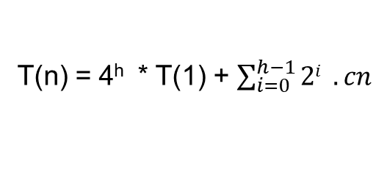
cn
Level # node 0 1 4
2 4²
i 4^{i} h 4^{h}
cn
c(n/2)
c(n/2)
c(n/2)
c(n/2)
4cn/2
C(n/4)
C(n/4)
C(n/4)
C(n/4)
C(n/4)
C(n/4)
C(n/4)
C(n/4)
C(n/4)
C(n/4)
C(n/4)
C(n/4)
C(n/4)
C(n/4)
C(n/4)
C(n/4)
4²cn/4
4^{i}cn/2^{i} = 2^{i}cn
T(1)
T(1)
T(1)
T(1)
T(1)
T(1)
4^{h} T(1)
T(1)= T(n/2^{h})
T(n) = 4^{h} * T(1) + $\sum_{i=0}^{h−1}{2i} . cn$

Slide 21
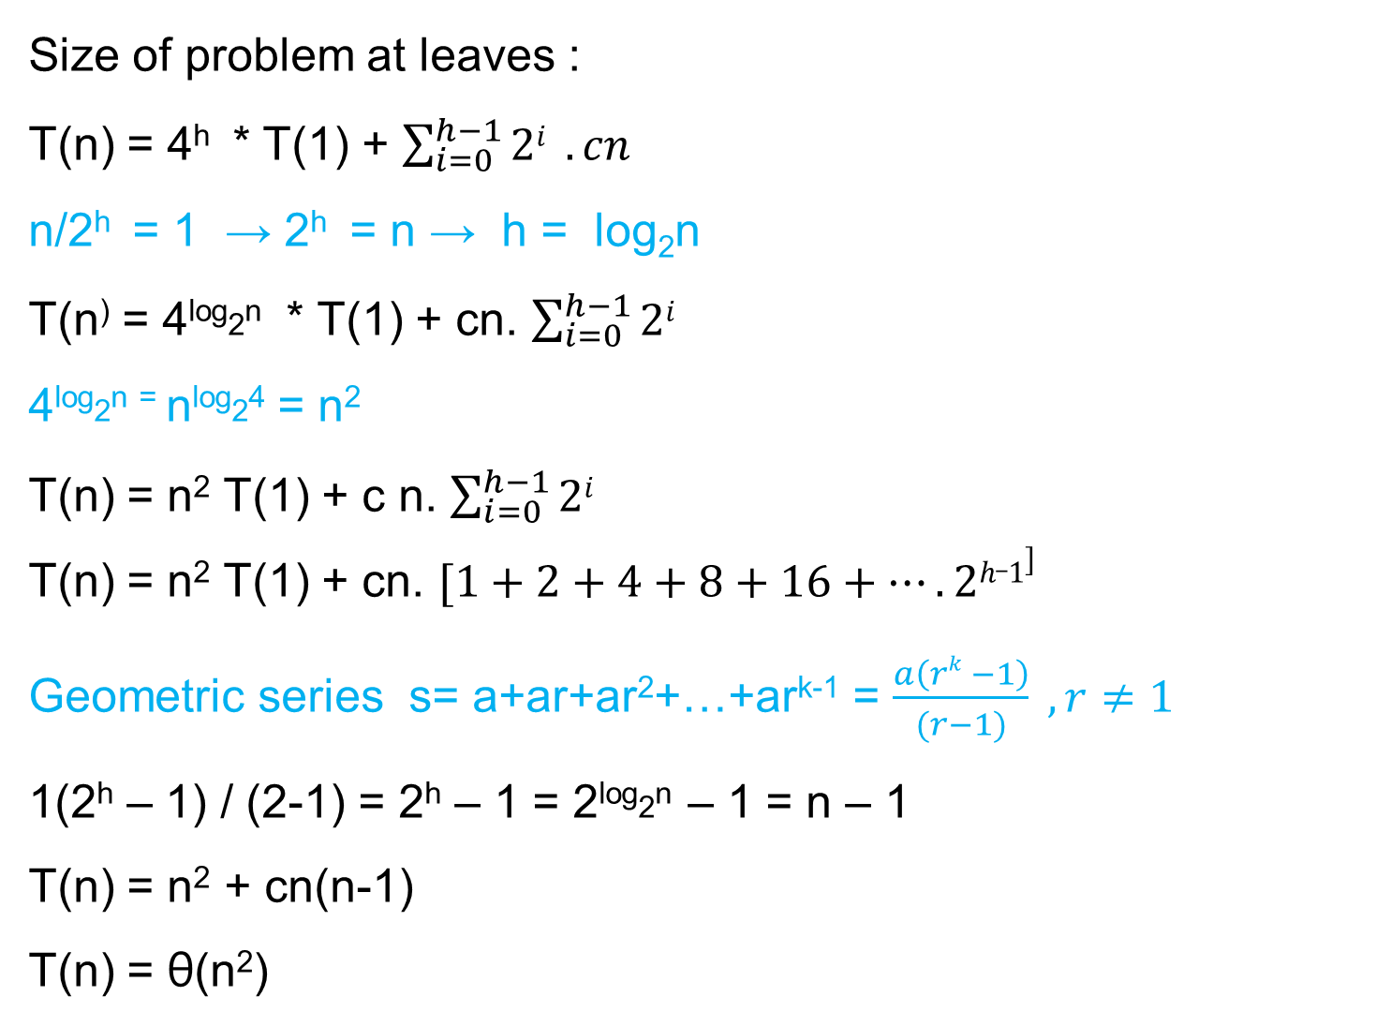
Size of problem at leaves :
T(n) = 4^{h} * T(1) + $\sum_{i=0}^{h−1}{2i} . cn$
n/2^{h} = 1 → 2^{h} = n → h = log₂n
T(n⁾ = 4^{log}2^{n} * T(1) + cn. $\sum_{i=0}^{h−1}{2i}$
4^{log}2^{n =} n^{log}2⁴ = n²
T(n) = n² T(1) + c n. $\sum_{i=0}^{h−1}{2i}$
T(n) = n² T(1) + cn. $[1+2+4+8+16+…. 2h_1]$
Geometric series s= a+ar+ar²+…+ar^{k-1} = $\frac{a\left(rk −1\right)}{(r−1)} , r≠1$
1(2^{h} – 1) / (2-1) = 2^{h} – 1 = 2^{log}2^{n} – 1 = n – 1
T(n) = n² + cn(n-1)
T(n) = θ(n²)
a=1, r = 2

Slide 22
References
Introduction to Algorithms, Second Edition by Thomas H. Cormen, Charles E. Leiserson, Ronald L. Rivest and Clifford Stein, The MIT Press © 2001
Chapter 4.3

