Slide 1
Cs 316: Algorithms Lecture 5 Analysis Of Recursive Algorithms
Prepared by: Assoc. Prof. Ensaf Hussein
Presented by:
Assoc. Prof. Wessam El-Behaidy
Dr. Mohammed El-Said

Slide 2
Outline
Analysis of recursive algorithms
Substitution
Iteration Method – Iteration Tree
Master Method
Recursive Algorithms
Factorial
Fibonacci Sequence
Tower of Hanoi

Slide 3
3. Master Method
The idea is to solve a class of recurrences that have the form
a >= 1 and b > 1, and f is asymptotically positive!
a’s subproblems of size n/b are solved recursively, each in time T(n/b)
f(n) is the cost of dividing the problem and combining the results.
Ex: In merge-sort
a = 2
b = 2
f(n) = n

Slide 4
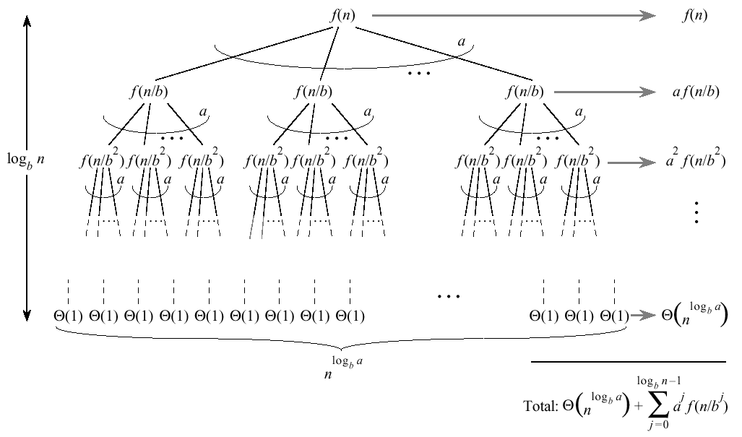
Master Method
Split problem into a parts at log_{b}n levels.
There are leaves

Slide 5
Master Method Intuition
Three common cases:
Running time dominated by cost at leaves
Running time evenly distributed throughout the tree
Running time dominated by cost at root
Consequently, to solve the recurrence, we need only to characterize the dominant term
In each case compare with
Case 1:
Case 2:
Case 3:

Slide 6
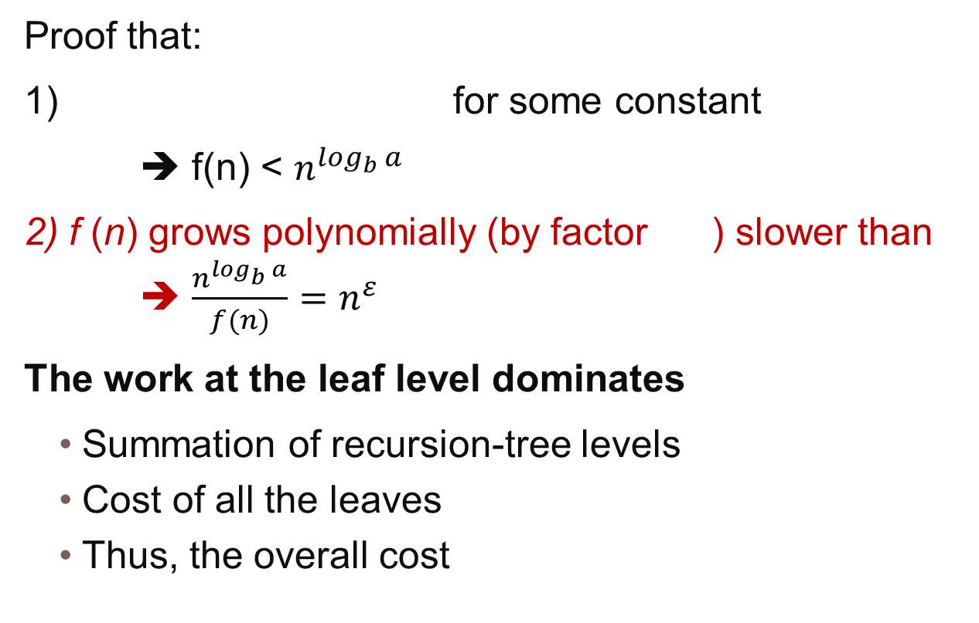
Master Method Case 1
Proof that:
1) for some constant
➔ f(n) < $n^{\log_{b} a}$
2) f (n) grows polynomially (by factor ) slower than ➔ $\frac{n^{\log_{b} a}}{f(n)}=n^{ε}$
The work at the leaf level dominates
Summation of recursion-tree levels
Cost of all the leaves
Thus, the overall cost

Slide 7
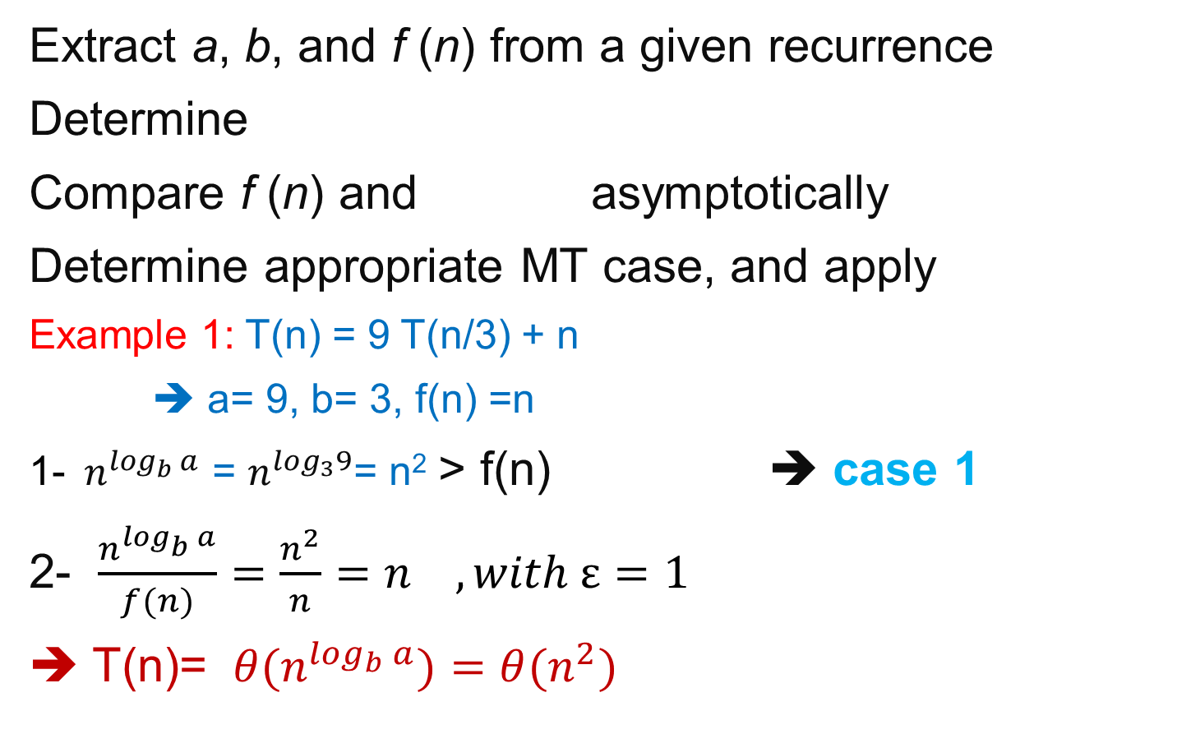
Strategy
Extract a, b, and f (n) from a given recurrence
Determine
Compare f (n) and asymptotically
Determine appropriate MT case, and apply
Example 1: T(n) = 9 T(n/3) + n
➔ a= 9, b= 3, f(n) =n
1-${ n}^{\log_{b} a}$ = $n^{\log_{3}9}$= n² > f(n) ➔ case 1
2- $\frac{n^{\log_{b} a}}{f(n)}=\frac{n^{2}}{n}=n , with ε=1$
➔ T(n)= ${ θ(n}^{\log_{b} a})=θ(n^{2})$

Slide 8
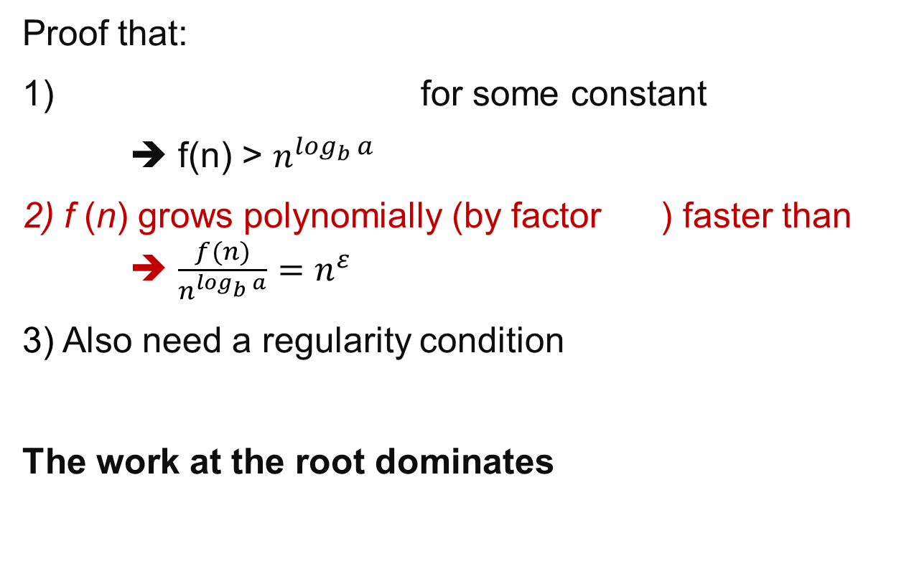
Master Method Case 3
Proof that:
1) for some constant
➔ f(n) > $n^{\log_{b} a}$
2) f (n) grows polynomially (by factor ) faster than ➔ $\frac{f(n)}{n^{\log_{b} a}}=n^{ε}$
3) Also need a regularity condition
The work at the root dominates

Slide 9
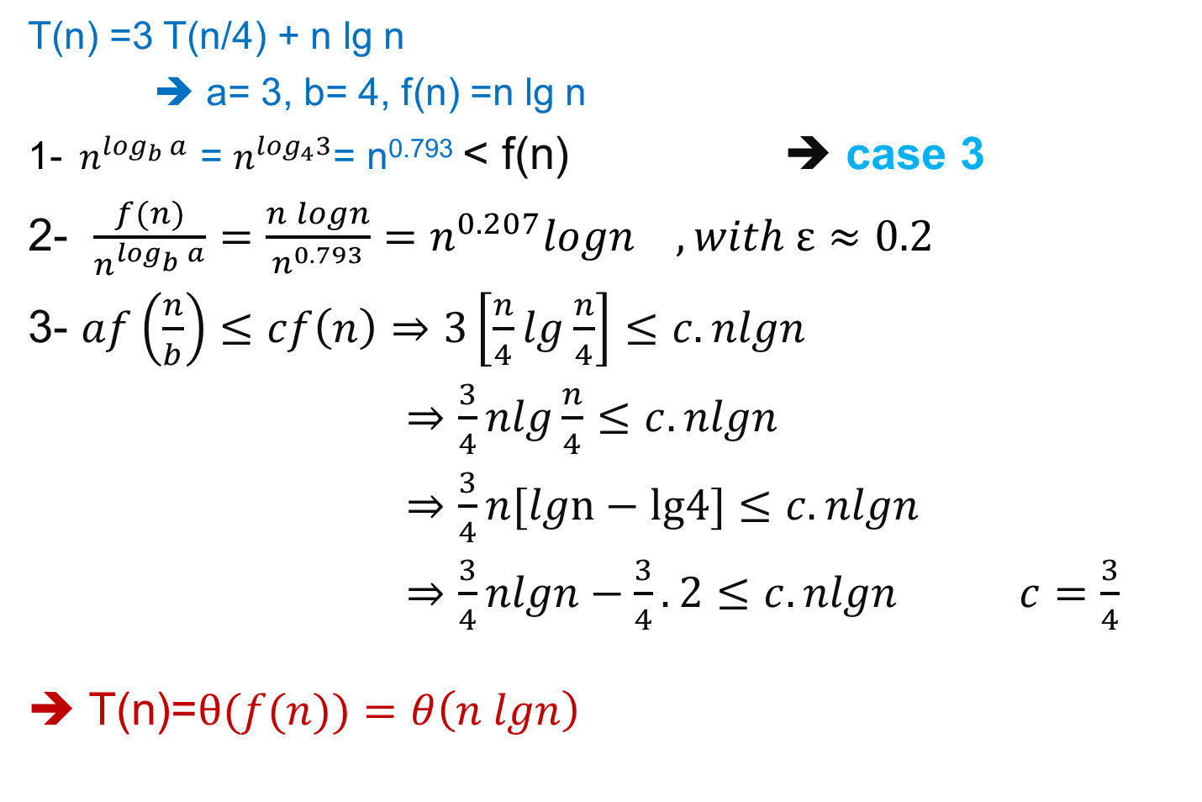
Example 2
T(n) =3 T(n/4) + n lg n
➔ a= 3, b= 4, f(n) =n lg n
1-${ n}^{\log_{b} a}$ = $n^{\log_{4}3}$= n^{0.793} < f(n) ➔ case 3
2- $\frac{f(n)}{n^{\log_{b} a}}=\frac{n logn}{n^{0.793}}=n^{0.207}logn , with ε≈0.2$
3- $af\left(\frac{n}{b}\right)≤cf\left(n\right)⇒3\left[\frac{n}{4}lg\frac{n}{4}\right]≤c. nlgn$
$⇒\frac{3}{4}nlg\frac{n}{4}$ $≤c. nlgn$
$⇒\frac{3}{4}n[lgn−lg4]$ $≤c. nlgn$
$⇒\frac{3}{4}nlgn−\frac{3}{4}.2$ $≤c. nlgn c=\frac{3}{4}$
➔ T(n)=$θ(f(n))=θ\left(n lgn\right)$

Slide 10
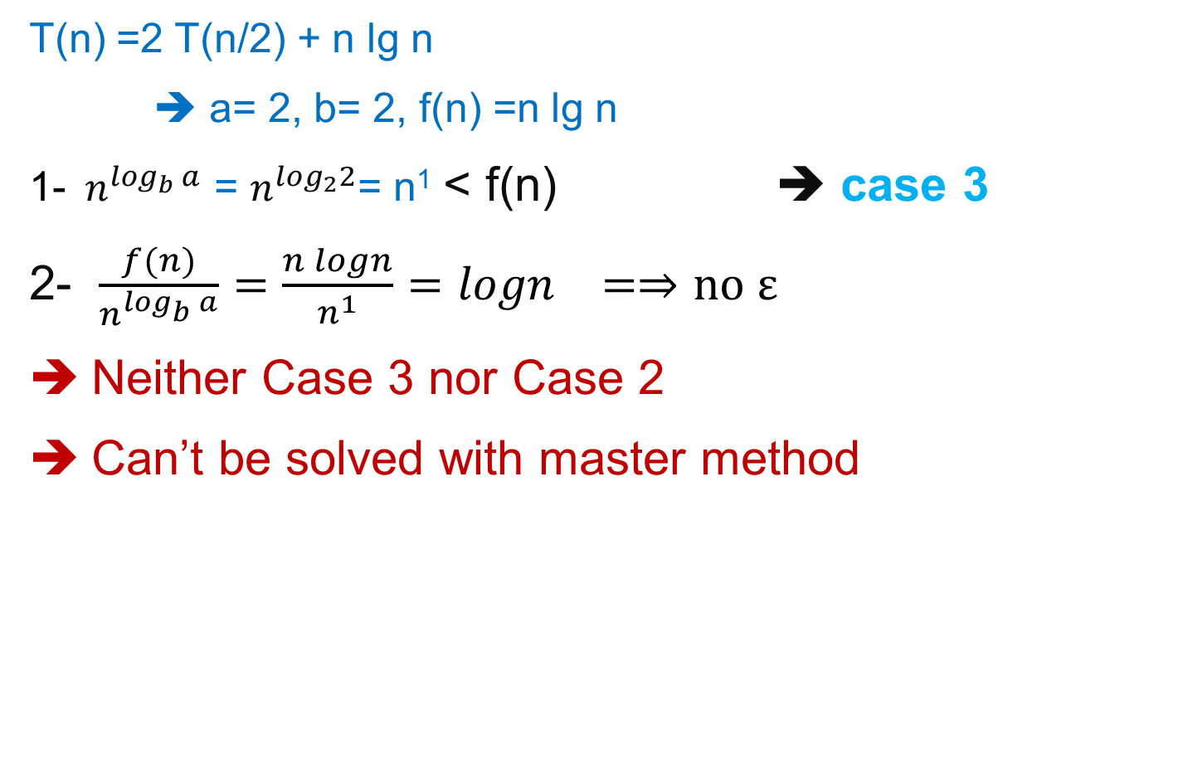
Example 3
T(n) =2 T(n/2) + n lg n
➔ a= 2, b= 2, f(n) =n lg n
1-${ n}^{\log_{b} a}$ = $n^{\log_{2}2}$= n¹ < f(n) ➔ case 3
2- $\frac{f(n)}{n^{\log_{b} a}}=\frac{n logn}{n^{1}}=logn =⇒no ε$
Neither Case 3 nor Case 2
Can’t be solved with master method

Slide 11
Master Method Case 2
and are asymptotically the same
The work is distributed equally throughout the tree
(level cost) * (number of levels)

Slide 12
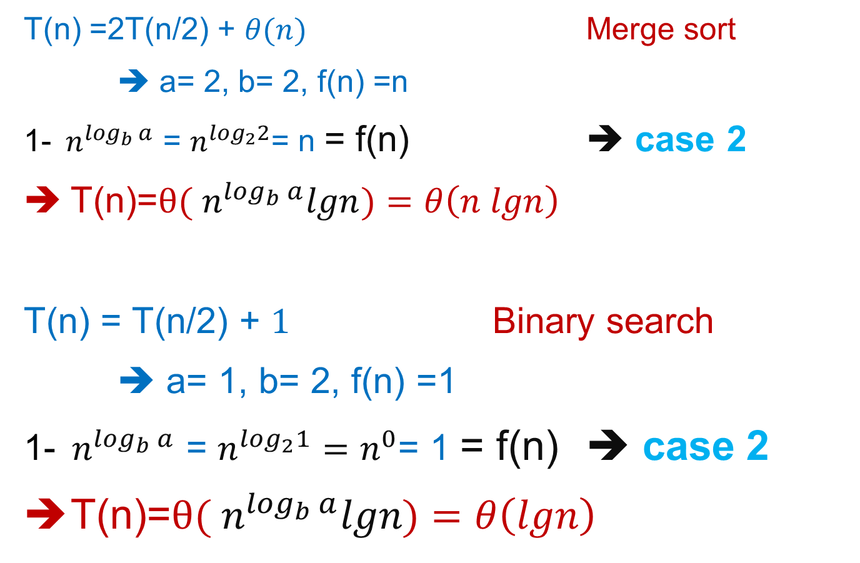
Example 4-5:
T(n) =2T(n/2) + $θ(n)$ Merge sort
➔ a= 2, b= 2, f(n) =n
1-${ n}^{\log_{b} a}$ = $n^{\log_{2}2}$= n = f(n) ➔ case 2
T(n)=$θ({ n}^{\log_{b} a}lgn)=θ\left(n lgn\right)$
T(n) = T(n/2) + $1$ Binary search
➔ a= 1, b= 2, f(n) =1
1-${ n}^{\log_{b} a}$ = $n^{\log_{2}1}=n^{0}$= 1 = f(n) ➔ case 2
T(n)=$θ({ n}^{\log_{b} a}lgn)=θ\left(lgn\right)$

Slide 13
Master Theorem Summarized
Given a recurrence of the form
The master method cannot solve every recurrence of this form; there is a gap between cases 1 and 2, as well as cases 2 and 3

Slide 14
Example Recurrences
T(n) = T(n-1) + n Θ(n²)
Recursive algorithm that loops through the input to eliminate one item
T(n) = T(n/2) + c Θ(lgn)
Recursive algorithm that halves the input in one step
T(n) = T(n/2) + n Θ(n)
Recursive algorithm that halves the input but must examine every item in the input
T(n) = 2T(n/2) + 1 Θ(n)
Recursive algorithm that splits the input into 2 halves and does a constant amount of other work

Slide 15
recursive algorithms
Factorial
Fibonacci Sequence
Tower of Hanoi

Slide 16
Analysis of Recursive Algorithms Factorial
ALGORITHM F(n)
// Output: n!
if n = 0
return 1
else
return n×F(n-1)
Input size: n
Basic operation: ×
M(n) = M(n-1) + 1 for n > 0
to compute
F(n-1)
to multiply
n and F(n-1)

Slide 17
Analysis Of Recursive Factorial
T(0) = 1 (1)
T(n) = c + T(n - 1) (2)
= c + c + T(n - 2) by subtituting T(n – 1) in (2)
= c +c +c + T(n - 3) by substituting T(n – 2) in (2)
…
= kc + T(n - k)
The base case is reached when n – k = 0 → k = n, we then have:
T(n) = nc + T(n - n)
= cn + T(0)
= cn + 1
Therefore the method factorial is O(n)

Slide 18

Analysis of Recursive (contd.): Tower of Hanoi
$$(2^{\#of disks}−1) movements$$

Slide 19
Tower of Hanoi (contd.)
M(n-1)
M(n) = M(n-1) + 1 + M(n-1)
M(1) = 1
1
M(n-1)

Slide 20
Tower of Hanoi (contd.)

Slide 21
Tower of Hanoi (contd.)
ALGORITHM ToH(n, s, m, d)
if n = 1
print “move from s to d”
else
ToH(n-1, s, d, m)
print “move from s to d”
ToH(n-1, m, s, d)
M(1) = 1
M(n-1)
M(1)
M(n-1)

Slide 22
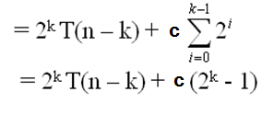
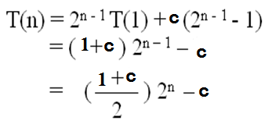
Expanding:
T(1) = 1 (1)
T(n) = 2T(n – 1) + c if n > 1 (2)
= 2[2T(n – 2) + c] + c = 2² T(n – 2) + 2c + c by substituting T(n – 1) in (2)
= 2² [2T(n – 3) + c] + 2c + c = 2³ T(n – 3) + 2²c + 2c + c by substituting T(n-2) in (2)
= 2³ [2T(n – 4) + c] + 2² c+ 2c + c = 2⁴ T(n – 4) + 2³ c + 2²c + 2¹c + 2⁰c
by substituting T(n – 3) in (2)
= ……
= 2^{k} T(n – k) + c[2^{k- 1} + 2^{k– 2} + . . . 2¹ + 2⁰]
The base case is reached when n – k = 1 → k = n – 1, we then have:
Therefore, The method hanoi is O(2^{n})

Slide 23
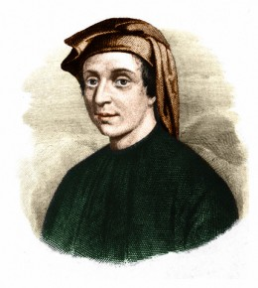
Fibonacci Sequence
Leonardo Fibonacci, the Italian mathematician
of the middle ages, first used the sequence
1, 1, 2, 3, 5, 8, 13, 21, 34, 55, ......
in his example of Breeding Rabbits.
Fibonacci used the sequence to explain the breeding pattern of rabbits under ideal circumstances. The set up for the problem is as follows:
Rabbits mate when they are one month old and at the end of the second month, the female can reproduce exactly one pair of rabbits, one male and one female.
One pair of newly born rabbits (one male and one female) is observed initially for the study.
It is assumed that the newborns of rabbits never die.

Slide 24
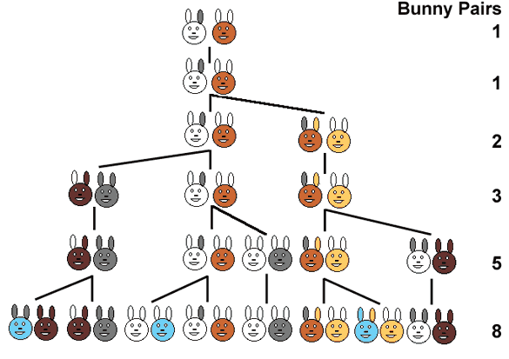
Fibonacci Sequence
newborn
adult
newborn
newborn
adult
adult

Slide 25
Analysis Of Recursive Fibonacci
fibonacci (n) { // Recursively calculates Fibonacci number
if( n == 1 || n == 2)
return 1;
else
return fibonacci(n – 1) + fibonacci(n – 2);
}
T(n) = c if n = 1 or n = 2 (1)
T(n) = T(n – 1) + T(n – 2) + b if n > 2 (2)
We determine a lower bound on T(n):
Expanding: T(n) = T(n - 1) + T(n - 2) + b
≥ T(n - 2) + T(n-2) + b

Slide 26
= 2T(n - 2) + b
= 2[T(n - 3) + T(n - 4) + b] + b by substituting T(n - 2) in (2)
≥ 2[T(n - 4) + T(n - 4) + b] + b
= 2²T(n - 4) + 2b + b
= 2²[T(n - 5) + T(n - 6) + b] + 2b + b
by substituting T(n - 4) in (2)
≥ 2³T(n – 6) + (2² + 2¹ + 2⁰)b
. . .
≥ 2^{k}T(n – 2k) + (2^{k-1} + 2^{k-2} + . . . + 2¹ + 2⁰)b
= 2^{k}T(n – 2k) + (2^{k} – 1)b
The base case is reached when n – 2k = 2 → k = (n - 2) / 2
Hence T(n) ≥ 2 ^{(n – 2) / 2} T(2) + [2 ^{(n - 2) / 2} – 1]b
= (b + c)2 ^{(n – 2) / 2} – b
= [(b + c) / 2]*(2)^{n/2} – b → Recursive Fibonacci is exponential

Slide 27
References
Introduction to Algorithms, Second Edition by Thomas H. Cormen, Charles E. Leiserson, Ronald L. Rivest and Clifford Stein, The MIT Press © 2001
Chapter 4.3

