Slide 1
Cs 316: Algorithms Lecture 6: Heap Sort
Prepared by: Assoc. Prof. Ensaf Hussein
Presented by:
Assoc. Prof. Wessam El-Behaidy
Dr. Mohammed El-Said

Slide 2
Heapsort
Combines the better attributes of merge sort and insertion sort.
Like merge sort, but unlike insertion sort, running time is O(n lg n).
Like insertion sort, but unlike merge sort, sorts in place.
Heap sort is implemented using binary heap data structure.

Slide 3
Binary Heap
Data Structure

Slide 4
Binary Heap
The binary heap has 2 properties:
Shape property
Heap property

Slide 5
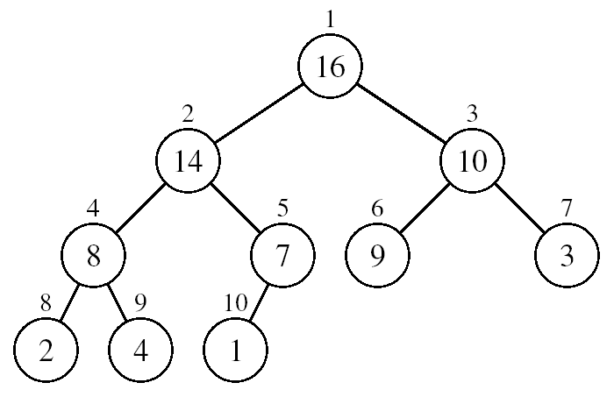
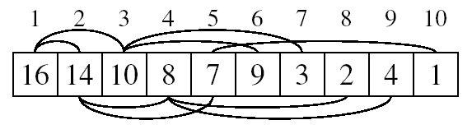
Data Structure Binary Heap: Shape property
1) Array viewed as a complete binary tree.
➔ Meaning that all levels of the tree are fully filled except possibly the last level, which is filled from left to right.

Slide 6
Data Structure Binary Heap: Shape property
1) Array viewed as a complete binary tree.
Physically – linear array.
Logically – binary tree, filled on all levels (except lowest.)

Slide 7
Data Structure Binary Heap: Shape property
1) Array viewed as a complete binary tree.
Physically – linear array.
Logically – binary tree, filled on all levels (except lowest.)
2) Parent-Child Relationship: Map from array elements to tree nodes and vice versa
Root – A[1]
Left[i ] – A[2i]
Right[i ] – A[2i+1]
Parent[i] – A[⎣i/2⎦]
length[A] –number of elements in array A.
heap-size[A] – number of elements in
heap stored in A.
heap-size[A] ≤ length[A]
Notes:
Heap size -> unsorted numbers

Slide 8
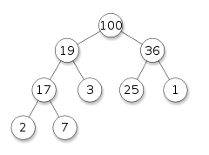
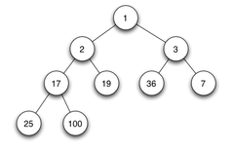
Data Structure Binary Heap: Heap property
Max Heap
For every node excluding the root, value is greater than or equal to each of its children
A [ parent [ i ] ] ≥ A [ i ]
Largest element is stored at the root.
In any subtree, no values are larger than the value stored at subtree root.
Min Heap
For every node excluding the root, value is less than or equal to each of its children
A [ parent [ i ] ] ≤ A [ i ]
Smallest element is stored at the root.
In any subtree, no values are smaller than the value stored at subtree root.
Max Heap
Min Heap

Slide 9
Heaps – Example
26
24
20
18
17
19
13
12
14
11
Max-heap as an
array.
1 2 3 4 5 6 7 8 9 10
Max-heap as a binary
tree.
26
It satisfies:
Complete binary tree
Parent-Child Relation
Max heap property
24
20
18
17
19
13
Level Order Traversal.
filled from left to right.
12
14
11

Slide 10
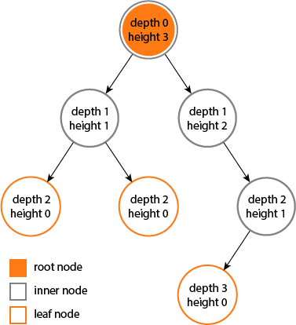
Tree Characteristics
The depth of a node is the number of edges from the node to the tree's root node.
A root node will have a depth of 0.
The height of a node is the number of edges on the longest path from the node to a leaf.
A leaf node will have a height of 0.
Height of a tree: the height of the root

Slide 11
Example
4
Height of root = 3
1
3
Height of (2)= 1
2
16
9
10
depth of (10)= 2
14
8

Slide 12
Other Heap Characteristics
Heaps have some other characteristics as a binary tree:
At i^{th} level (depth), there are at most 2^{i} nodes.
Ex: At level 3, there are at most 2³ =8 nodes
2) A binary tree at depth d has at most 2 ^{d+1} -1 nodes.
Ex: At depth 3, there are at most 2⁴ -1 =15 nodes

Slide 13
Other Heap Characteristics
Heaps have some other characteristics as a binary tree:
3) A binary tree with n nodes has depth at least ⎣lg n⎦
4) Height of tree = ⎣lg n⎦ ➔Height of a heap = ⎣lg n⎦
5) No. of leaves = ⎡n/2⎤
6) No. of nodes of height h ≤ ⎡n/2^{h+1}⎤

Slide 14
Heap SORT

Slide 15
Example 1: Heap Sort
Input Array:
24
21
23
22
36
29
30
34
28
27
1 2 3 4 5 6 7 8 9 10
Initial Heap:
(not max-heap)
24
21
23
22
36
29
30
34
28
27

Slide 16
Example 1: BuildMaxHeap ()
1- Build Max Heap
Call MaxHeapify(⎣10/2⎦ = 5)
24
21
23
22
36
29
30
34
28
27
MaxHeapify(4)
1 2 3 4 5 6 7 8 9 10
24
36
24
MaxHeapify(3)
MaxHeapify(2)
21
30
34
24
21
23
36
23
MaxHeapify(1)
36
36
27
21
29
36
21
30
28
23
34
22
24
22
34
22
28
24
27
21
Max Heap Array:
36
34
30
28
27
29
23
22
24
21
1 2 3 4 5 6 7 8 9 10

Slide 17
Example 2: MaxHeapify(A,1)
2- Heap Sort
Exchange A[1]->A[i]
MaxHeapify(A, 1)
36
21
34
36
21
34
21
21
28
34
30
21
27
29
24
28
28
23
X
22
36
24
21
21
24
21
34
30
28
27
29
23
22
24
36
Array:
34
28
30
24
27
29
23
22
24
36
1 2 3 4 5 6 7 8 9 10
1 2 3 4 5 6 7 8 9 10

Slide 18
Maintaining the heap property
Suppose two subtrees are max-heaps, but the root violates the max-heap property.
Fix the offending node by exchanging the value at the node with the larger of the values at its children.
May lead to the subtree at the child not being a heap.
Recursively fix the children until all of them satisfy the max-heap property.

Slide 19
EXAMPLE2:
A=[4, 7, 3, 1, 2]
1- Build Max Heap
- Start from node number i=n/2 up to 1
- Call MaxHeapify(A,i)
i=n/2 = |_5/2 _| =2 A[i] >= his children? Yes
i=1 A[i] > = his children? No ➔ swap with largest
➔Increment i , and check if max heap property remains in the rest of subtree
4
4
i=1
7
i=2
4
3
i=2
7
3
7
3
1
2
1
2
1
2
The Max heap is built ➔ A=[7, 4, 3, 1, 2]
10

Slide 20
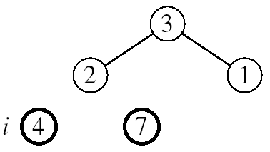
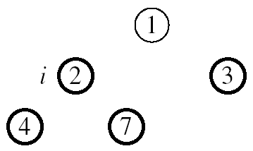
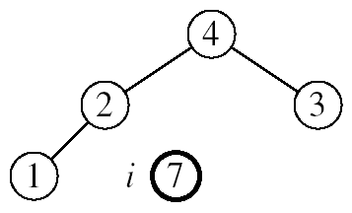
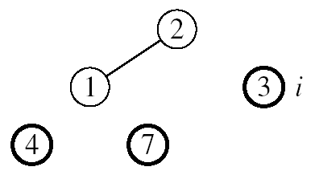
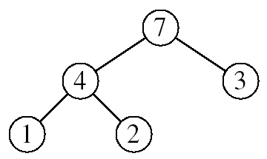

Example2: A=[7, 4, 3, 1, 2]
2- Heap Sort
Note: Max heap property is applied on each step (Call MaxHeapify)
Heap-size=5
Heap-size=4
Heap-size=3
Heap-size=2

Slide 21
HeapSort
Use max-heap for sorting. Sort by maintaining the as yet unsorted elements as a max-heap.
Start by building a max-heap on all elements in A.
Maximum element is in the root, A[1].
Move the maximum element to its correct final position.
Exchange A[1] with A[n].
Discard A[n] – it is now sorted.
Decrement heap-size[A].
Restore the max-heap property on A[1..n–1].
Call MaxHeapify, that maintains the array as a max-heap .
Repeat until heap-size[A] is reduced to 2.

Slide 22
Heapsort Algorithm
Algorithm HeapSort (A)
1. Build-Max-Heap(A)
2. for i ← length [A] downto 2
3. do exchange A[1] ↔ A[i ]
4. heap-size[A] ← heap-size[A] – 1
5. MaxHeapify (A, 1)

Slide 23
Building a heap
Use MaxHeapify to convert an array A into a max-heap.
Call MaxHeapify on each element in a bottom-up manner.
BuildMaxHeap(A)
1. heap-size[A] ← length[A]
2. for i ← ⎣length[A]/2⎦ downto 1
3. do MaxHeapify(A, i )

Slide 24
Procedure MaxHeapify
MaxHeapify(A, i )
1. l ← left(i )
2. r ← right(i )
3. if l ≤ heap-size[A] and A[l ] > A[i ]
4. then largest ← l
5. else largest ← i
6. if r ≤ heap-size[A] and A[r ] > A[largest]
7. then largest ← r
8. if largest ≠ i
9. then exchange A[i ] ↔ A[largest]
10. MaxHeapify(A, largest)
Assumption:
Left(i) and Right(i) are max-heaps.
Notes:
L and r are indices
Recursively call until largest=i or it reaches the leaves.

Slide 25
Running Time for MaxHeapify
MaxHeapify(A, i )
1. l ← left(i )
2. r ← right(i )
3. if l ≤ heap-size[A] and A[l ] > A[i ]
4. then largest ← l
5. else largest ← i
6. if r ≤ heap-size[A] and A[r ] > A[largest]
7. then largest ← r
8. if largest ≠ i
9. then exchange A[i ] ↔ A[largest]
10. MaxHeapify(A, largest)
Time to fix node i and its children = Θ(1)
+
Time to fix the subtree rooted at one of i’s children = T(size of subree at largest)

Slide 26
Running Time for MaxHeapify(A, n)
T(n) = T(largest) + Θ(1)
largest ≤ 2n/3 (worst case occurs when the last row of tree is exactly half full)
T(n) ≤ T(2n/3) + Θ(1) ⇒ T(n) = O(lg n)
Alternately, MaxHeapify takes O(h) where h is the height of the node where MaxHeapify is applied
Notes:
Master method :
T(n)=aT(n/b) + f(n)
T(n) ≤ T(2n/3) + Θ(1) , a=1, b=3/2 and f(n)=Θ(1)
$n^{\log_{b}^{a}}=n^{\log_{3/2}^{1}}=n^{0}$=1
f(n)=Θ ($n^{\log_{b}^{a}}$)
Case 2: T(n)= Θ($n^{\log_{b}^{a}}$logn)=Θ (logn)
Height=lg n

Slide 27
Running Time of BuildMaxHeap
Loose upper bound:
Cost of a MaxHeapify call × No. of calls to MaxHeapify
O(lg n) × O(n) = O(nlg n)
Tighter bound:
Build-Max-Heap takes O(n)
BuildMaxHeap(A)
1. heap-size[A] ← length[A]
2. for i ← ⎣length[A]/2⎦ downto 1
3. do MaxHeapify(A, i )

Slide 28
Algorithm Analysis
In-place
Not Stable
Build-Max-Heap takes O(n) and each of the n-1 calls to Max-Heapify takes time O(lg n).
Therefore, T(n) = O(n lg n)
HeapSort(A)
1. Build-Max-Heap(A)
2. for i ← length[A] downto 2
3. do exchange A[1] ↔ A[i]
4. heap-size[A] ← heap-size[A] – 1
5. MaxHeapify(A, 1)

Slide 29
Heap Procedures for Sorting
MaxHeapify O(lg n)
BuildMaxHeap O(n)
HeapSort O(n lg n)

Slide 30
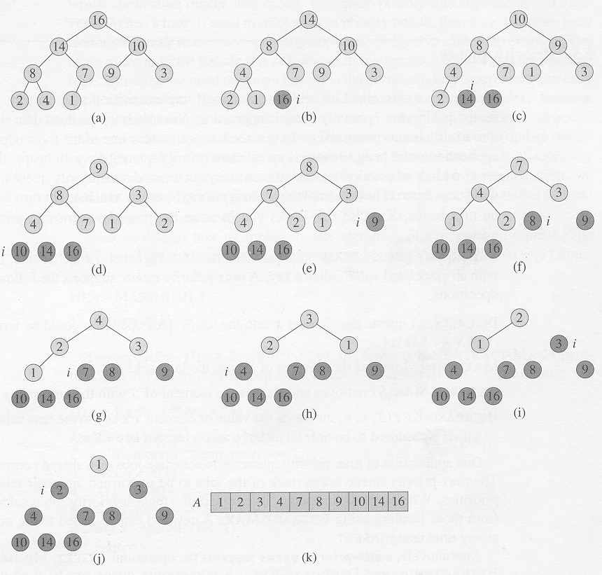
Copyright © The McGraw-Hill Companies, Inc. Permission required for reproduction or display.

Slide 31
References
Introduction to Algorithms, Second Edition by Thomas H. Cormen, Charles E. Leiserson, Ronald L. Rivest and Clifford Stein, The MIT Press © 2001
Chapter 6.1, 6.2, 6.3, 6.4

