Slide 1
Cs 316: Algorithms Lecture 7: Graph Representation and Search
Prepared by: Assoc. Prof. Ensaf Hussein
Presented by:
Assoc. Prof. Wessam El-Behaidy
Dr. Mohammed El-Said

Slide 2




Linear data structures
Array
Linked List
Stack
Queue

Slide 3
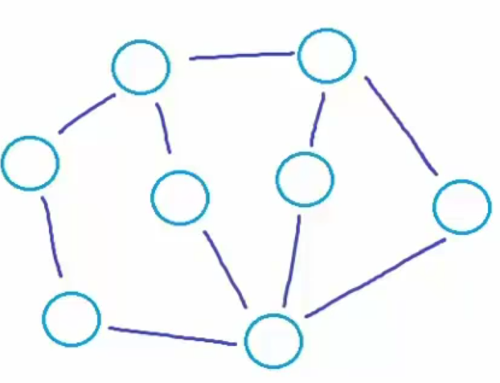
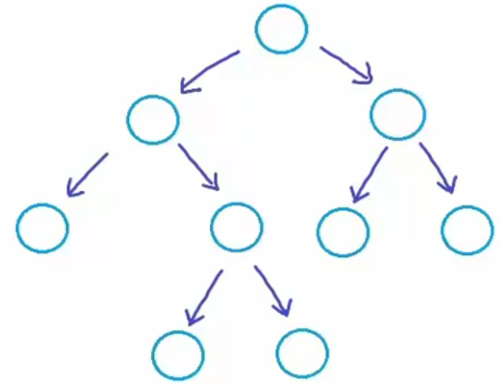
Non-linear data structures
Tree
Graph

Slide 4
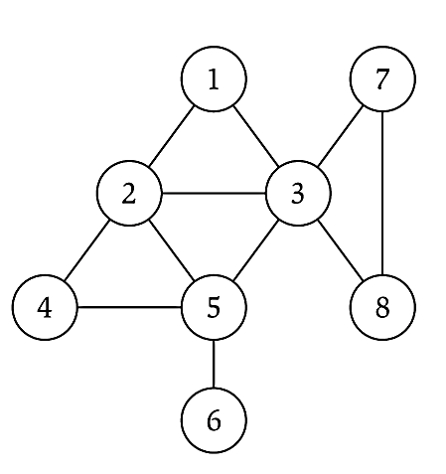
Graph – Definitions
Graph – mathematical object consisting of a set of:
Denoted by
V = nodes (vertices, points).
E = edges (links, arcs) between pairs of nodes, where each edge is a pair (v,w) s.t. v,w ∈ V
G = (V, E)

Slide 5
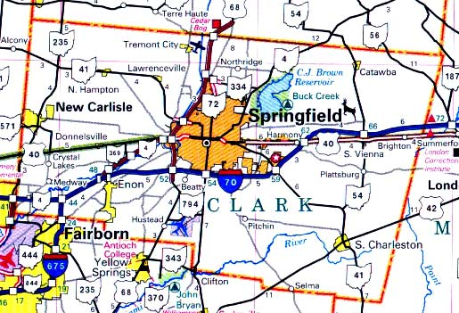
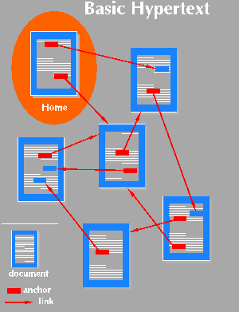

Applications
Applications that involve not only a set of items, but also the connections between them
Maps
Schedules
Computer networks
Hypertext
Circuits

Slide 6
Definitions

Slide 7
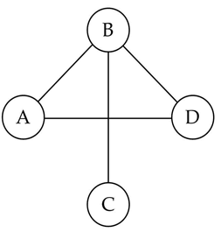
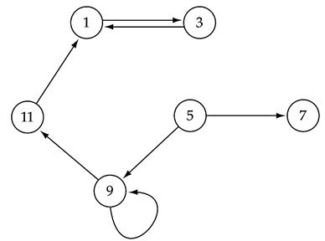
Graphs - definitions
If the edge pair is ordered then the graph is called a directed graph (also called digraphs) .
Undirected graph, which is not a directed graph, also called a normal graph or just a graph.
Undirected graph
Directed graph
Directed edge
V = { A,B,C,D }
E = {(A,B), (B,A), (A,D), (D,A) (B,D), (D,B), (B,C), (C,B)}
V = { 1, 3,5,7,9,11}
E = {(1,3) (3,1) (11,1) (9,11) (9,9) (5,9) (5,7) }

Slide 8
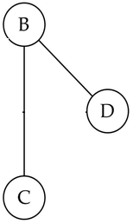
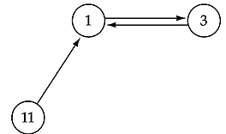
Graph – Definitions
Two vertices of a graph are adjacent if they are joined by an edge.
Vertex w is adjacent to v iff edge (v,w) ∈ E.
Undirected graph
Directed graph
- An edge is enough
- iff there is a direct edge from v to w
w is successor of v
v is predecessor of w
Ex:
With Edge (B,D)
. B is adjacent to D
. D is adjacent to B.
With Edge (B,C)
. B is adjacent to C
. C is adjacent to B.
Ex:
3 is adjacent to 1 ➔ (1,3)
1 is adjacent to 3 ➔ (3,1)
1 is adjacent to 11➔(11,1)

Slide 9
Graph – Definitions
A (directed) path between two vertices is a sequence of edges that begins at one vertex and ends at another vertex.
A simple path passes through a vertex only once.
Example:
w1, w2, …, w_{N} is a path if (w_{i}, w_{i+1}) ∈ E for 1 ≤ i ≤. N-1
1
2
A graph G (undirected)
3
4
5
The graph G= (V,E) has 5 vertices and 12 edges:
V = {1,2,3,4,5}
E = { (1,2),(1,3),(1,4),(2,5),(3,4),(4,5), (2,1),(3,1),(4,1),(5,2),(4,3),(5,4) }
Path:
1,2,5 ( a simple path), 1,3,4,1,2,5 (a path but not a simple path)

Slide 10
Graph – Definitions
A cycle is a path that begins and ends at the same vertex.
For undirected graphs, the edges must be distinct➔ No Self loops
In a directed graph is a path of length at least 1 such that w₁ = w_{N}. ➔ Self loops
A directed acyclic graph (DAG) is a type of directed graph having no cycles.
A simple cycle is a cycle that does not pass through other vertices more than once.

Slide 11
Graph – An Example
1
2
A graph G (undirected)
3
4
5
The graph G= (V,E) has 5 vertices and 12 edges:
V = {1,2,3,4,5}
E = { (1,2),(1,3),(1,4),(2,5),(3,4),(4,5), (2,1),(3,1),(4,1),(5,2),(4,3),(5,4) }
Adjacent:
1 and 2 are adjacent -- 1 is adjacent to 2 and 2 is adjacent to 1
Cycle:
2,5,4,1,2 (a simple cycle), 1,3,4,1,4,1 (a cycle, but not simple cycle)

Slide 12
Directed Graph – An Example
1
2
3
4
5
The graph G= (V,E) has 5 vertices and 7 edges:
V = {1,2,3,4,5}
E = { (1,2),(1,4),(2,5),(4,5),(3,1),(4,3),(5,5) }
Adjacent:
2 is adjacent to 1, but 1 is NOT adjacent to 2
Path:
1,2,5 ( a directed path),
Cycle:
1,4,3,1 (a directed cycle), 5,5 (a Self loop)

Slide 13
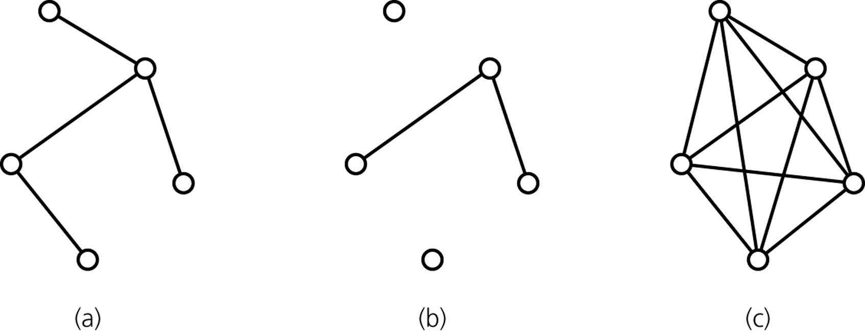
Graph -- Definitions
A connected graph has a path between each pair of distinct vertices.
A complete graph has an edge between each pair of distinct vertices.
A complete graph is also a connected graph. But a connected graph may not be a complete graph.
connected
disconnected
complete

Slide 14
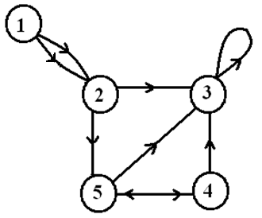
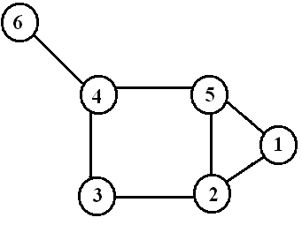
Graph – Definitions
In graph, degree is the number of edges incident on a node
In digraph, Degree = in-degree + out-degree
In-degree: Number of edges entering
Out-degree: Number of edges leaving
outdeg(1)=2
indeg(1)=0
outdeg(2)=2
indeg(2)=2
outdeg(3)=1
indeg(3)=4
deg(1) = 2
deg(2) = 3
deg(5) = 3

Slide 15
Weighted Graph
We can label the edges of a graph with numeric values, the graph is called a weighted graph.
1
8
2
Weighted (Undirected) Graph
10
3
6
3
5
4
7
5
1
8
2
Weighted Directed Graph
10
3
6
3
5
4
7
5

Slide 16
Types of graphs
Undirected: edge (u, v) = (v, u); for all v, (v, v) ∉ E (No self loops.)
Directed: (u, v) is edge from u to v, denoted as u → v. Self loops are allowed.
Weighted: each edge has an associated weight, given by a weight function w : E → R.
Dense: |E| ≈ |V|².
Sparse: |E| << |V|².
Adjacency relationship is:
Symmetric if G is undirected.
Not necessarily symmetric if G is directed.
If G is connected:
There is a path between every pair of vertices.
|E| ≥ |V| – 1.
Furthermore, if |E| = |V| – 1, then G is a tree.

Slide 17
Graph Representations
How to represent a graph, in memory?

Slide 18
Representation of Graphs
Two standard ways.
Adjacency Lists.
Adjacency Matrix.
a
b
a
b
d
c
b
a
c
c
d
c
d
a
b
d
a
c
1
2
1 2 3 4
1 0 1 1 1
2 1 0 1 0
3 1 1 0 1
4 1 0 1 0
a
b
c
d
3
4

Slide 19
Adjacency Lists
Consists of an array Adj of |V| lists. One list per vertex.
For u ∈ V, Adj[u] consists of all vertices adjacent to u.
Adj
a
b
a
b
d
c
b
c
If weighted, store weights also in adjacency lists.
c
d
c
d
d
a
b
a
b
d
c
b
a
c
c
d
c
d
a
b
d
a
c

Slide 20
Storage Requirement
For directed graphs:
Sum of lengths of all adj. lists is
∑out-degree(v) = |E|
^{v∈V}
Total storage: Θ(V+E)
For undirected graphs:
Sum of lengths of all adj. lists is
∑degree(v) = 2|E|
^{v∈V}
Total storage: Θ(V+E)
No. of edges leaving v
No. of edges incident on v. Edge (u,v) is incident on vertices u and v.

Slide 21
Pros and Cons: adj list
Pros
Space-efficient, when a graph is sparse.
Can be modified to support many graph variants.
Cons
Determining if an edge (u,v) ∈G is not efficient.
Have to search in u’s adjacency list. Θ(degree(u)) time.
Θ(V) in the worst case.
a
b
d
c
b
a
c
c
d
a
b
d
a
c

Slide 22
Adjacency Matrix
|V| × |V| matrix A.
Number vertices from 1 to |V| in some arbitrary manner.
A is then given by:
1
2
1 2 3 4
1 0 1 1 1
2 0 0 1 0
3 0 0 0 1
4 0 0 0 0
a
b
c
d
4
3
1
2
1 2 3 4
1 0 1 1 1
2 1 0 1 0
3 1 1 0 1
4 1 0 1 0
a
b
A = A^{T} for undirected graphs.
c
d
3
4
For weighted graph:
Weights are stored instead of 1 and 0

Slide 23
Space and Time
Space: Θ(V²).
Not memory efficient for large graphs.
Time: to list all vertices adjacent to u: Θ(V).
Time: to determine if (u, v) ∈ E: Θ(1).
1 2 3 4
1 0 1 1 1
2 0 0 1 0
3 0 0 0 1
4 0 0 0 0

Slide 24
Searching a graph

Slide 25
Graph-searching Algorithms
Searching a graph:
Systematically follow the edges of a graph to visit the vertices of the graph.
Used to discover the structure of a graph.
Standard graph-searching algorithms.
Breadth-first Search (BFS).
Depth-first Search (DFS).

Slide 26
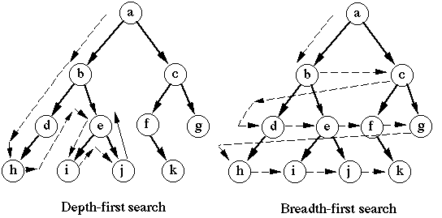
Graph-searching Algorithms

Slide 27
Breadth-first Search
Input: Graph G = (V, E), either directed or undirected, and source vertex s ∈ V.
Output:
d [v] = distance (smallest # of edges, or shortest path) from s to v, for all v ∈ V. d [v] = ∞ if v is not reachable from s.
π[v] = u such that (u, v) is last edge on shortest path s v.
u is v’s predecessor.
Builds breadth-first tree with root s that contains all reachable vertices.

Slide 28
Breadth-first Search
Expands the frontier between discovered and undiscovered vertices uniformly across the breadth of the frontier.
A vertex is “discovered” the first time it is encountered during the search.
A vertex is “finished” if all vertices adjacent to it have been discovered.
Colors the vertices to keep track of progress.
White – Undiscovered.
Gray – Discovered but not finished.
Black – Finished.
Colors are required only to reason about the algorithm. Can be implemented without colors.

Slide 29
BFS(G,s)
for each vertex u in V[G] – {s}
do color[u] ← white
d[u] ← ∝
π[u] ← nil
color[s] ← gray
d[s] ← 0
π[s] ← nil
Q ← Φ
enqueue(Q,s)
while Q ≠ Φ
do u ← dequeue(Q)
for each v in Adj[u]
do if color[v] = white
then color[v] ← gray
d[v] ← d[u] + 1
π[v] ← u
enqueue(Q,v)
color[u] ← black
white: undiscovered
gray: discovered
black: finished
Q: a queue of discovered vertices
color[v]: color of v
d[v]: distance from s to v
π[u]: predecessor of v

Slide 30
BFS(G,s)
for each vertex u in V[G] – {s}
do color[u] ← white
d[u] ← ∝
π[u] ← nil
color[s] ← gray
d[s] ← 0
π[s] ← nil
Q ← Φ
enqueue(Q,s)
π :
s nil
r nil
t nil
u nil
v nil
w nil
x nil
y nil
r
s
t
u
Example:
∞
0
∞
∞
Q: s
d: 0
∞
∞
∞
∞
v
w
x
y

Slide 31
BFS(G,s)
for each vertex u in V[G] – {s}
do color[u] ← white
d[u] ← ∝
π[u] ← nil
color[s] ← gray
d[s] ← 0
π[s] ← nil
Q ← Φ
enqueue(Q,s)
while Q ≠ Φ
do u ← dequeue(Q)
for each v in Adj[u]
do if color[v] = white
then color[v] ← gray
d[v] ← d[u] + 1
π[v] ← u
enqueue(Q,v)
color[u] ← black
white: undiscovered
gray: discovered
black: finished
Q: a queue of discovered vertices
color[v]: color of v
d[v]: distance from s to v
π[u]: predecessor of v

Slide 32
BFS(G,s)
while Q ≠ Φ
do u ← dequeue(Q)
for each v in Adj[u]
do if color[v] = white
then color[v] ← gray
d[v] ← d[u] + 1
π[v] ← u
enqueue(Q,v)
color[u] ← black
π :
s nil
r nil
t nil
u nil
v nil
w nil
x nil
y nil
r
s
t
u
Example:
∞
0
∞
∞
Q: s
d: 0
∞
∞
∞
∞
v
w
x
y

Slide 33
BFS(G,s)
while Q ≠ Φ
do u ← dequeue(Q)
for each v in Adj[u]
do if color[v] = white
then color[v] ← gray
d[v] ← d[u] + 1
π[v] ← u
enqueue(Q,v)
color[u] ← black
π :
s nil
r s
t
u
v
w s
x
y
r
s
t
u
Example:
1
0
∞
∞
Q: w r
d: 1 1
∞
1
∞
∞
v
w
x
y

Slide 34
Example (BFS)
π :
s nil
r s
t w
u
v
w s
x w
y
r
s
t
u
1
0
2
∞
∞
1
2
∞
v
w
x
y
Q: r t x
d: 1 2 2

Slide 35
Example (BFS)
π :
s nil
r s
t w
u
v r
w s
x w
y
r
s
t
u
1
0
2
∞
2
1
2
∞
v
w
x
y
Q: t x v
d: 2 2 2

Slide 36
Example (BFS)
π :
s nil
r s
t w
u t
v r
w s
x w
y
r
s
t
u
1
0
2
3
2
1
2
∞
v
w
x
y
Q: x v u
d: 2 2 3

Slide 37
Example (BFS)
π :
s nil
r s
t w
u t
v r
w s
x w
y x
r
s
t
u
1
0
2
3
2
1
2
3
v
w
x
y
Q: v u y
d: 2 3 3

Slide 38
Example (BFS)
π :
s nil
r s
t w
u t
v r
w s
x w
y x
r
s
t
u
1
0
2
3
2
1
2
3
v
w
x
y
Q: EMPTY

Slide 39
Breadth-first Tree
π :
s nil
r s
t w
u t
v r
w s
x w
y x
r
s
t
u
1
0
2
3
2
1
2
3
v
w
x
y
Breadth First Tree

Slide 40
Breadth-first Tree
For a graph G = (V, E) with source s, the predecessor subgraph of G is G_{π} = (V_{π} , E_{π}) where
V_{π} ={v∈V : π[v] ≠ NIL}{s}
E_{π} ={(π[v],v)∈E : v ∈ V_{π} - {s}}
The predecessor subgraph G_{π} is a breadth-first tree if:
V_{π} consists of the vertices reachable from s and
for all v∈V_{π} , there is a unique simple path from s to v in G_{π} that is also a shortest path from s to v in G.
The edges in E_{π} are called tree edges. |E_{π} | = |V_{π} | - 1.

Slide 41
Analysis of BFS
BFS(G,s)
for each vertex u in V[G] – {s}
do color[u] ← white
d[u] ← ∝
π[u] ← nil
color[s] ← gray
d[s] ← 0
π[s] ← nil
Q ← Φ
enqueue(Q,s)
while Q ≠ Φ
do u ← dequeue(Q)
for each v in Adj[u]
do if color[v] = white
then color[v] ← gray
d[v] ← d[u] + 1
π[v] ← u
enqueue(Q,v)
color[u] ← black
O(V)
Each vertex is enqueued and dequeued at most once.
So, total time for queuing is O(V).
Adjacency list of each vertex is scanned at most once. The sum of lengths of all adjacency lists is Θ(E).

Slide 42
Analysis of BFS
Total running time of BFS is O(V+E),
linear in the size of the adjacency list representation of graph.

Slide 43
Depth-first Search (DFS)
Explore edges out of the most recently discovered vertex v.
When all edges of v have been explored, backtrack to explore other edges leaving the vertex from which v was discovered (its predecessor).
“Search as deep as possible first.”
Continue until all vertices reachable from the original source are discovered.
If any undiscovered vertices remain, then one of them is chosen as a new source and search is repeated from that source.

Slide 44
Depth-first Search
Input: G = (V, E), directed or undirected. No source vertex given!
Output:
2 timestamps on each vertex. Integers between 1 and 2|V|.
d [v] = discovery time (v turns from white to gray)
f [v] = finishing time (v turns from gray to black)
π[v] : predecessor of v = u, such that v was discovered during the scan of u’s adjacency list.
Uses the same coloring scheme for vertices as BFS.

Slide 45
Pseudo-code
DFS(G)
1. for each vertex u ∈ V[G]
2. do color[u] ← white
3. π[u] ← NIL
4. time ← 0
5. for each vertex u ∈ V[G]
6. do if color[u] = white
7. then DFS-Visit(u)
DFS-Visit(u)
color[u] ← GRAY // White vertex u has been discovered
time ← time + 1
d[u] ← time
for each v ∈ Adj[u]
do if color[v] = WHITE
then π[v] ← u
DFS-Visit(v)
color[u] ← BLACK
// Blacken u; it is finished.
f[u] ← time ← time + 1
Uses a global timestamp time.

Slide 46
Example (DFS)
DFS-Visit(u)
color[u] ← GRAY
time ← time + 1
d[u] ← time
for each v ∈ Adj[u]
do if color[v] = WHITE
then π[v] ← u
DFS-Visit(v)
color[u] ← BLACK
f[u] ← time ← time + 1
u
v
w
π :
u nil
v
w
x
y
z
U
1/
x
y
z

Slide 47
Example (DFS)
DFS-Visit(u)
color[u] ← GRAY
time ← time + 1
d[u] ← time
for each v ∈ Adj[u]
do if color[v] = WHITE
then π[v] ← u
DFS-Visit(v)
color[u] ← BLACK
f[u] ← time ← time + 1
u
v
w
π :
u nil
v u
w
x
y
z
v
u
1/
2/
x
y
z
Notes:
Recursive call as I push in a stack

Slide 48
Example (DFS)
DFS-Visit(u)
color[u] ← GRAY
time ← time + 1
d[u] ← time
for each v ∈ Adj[u]
do if color[v] = WHITE
then π[v] ← u
DFS-Visit(v)
color[u] ← BLACK
f[u] ← time ← time + 1
u
v
w
π :
u nil
v u
w
x
y v
z
y
v
u
1/
2/
3/
x
y
z

Slide 49
Example (DFS)
DFS-Visit(u)
color[u] ← GRAY
time ← time + 1
d[u] ← time
for each v ∈ Adj[u]
do if color[v] = WHITE
then π[v] ← u
DFS-Visit(v)
color[u] ← BLACK
f[u] ← time ← time + 1
u
v
w
π :
u nil
v u
w
x y
y v
z
X
y
v
u
1/
2/
4/
3/
x
y
z

Slide 50
Example (DFS)
DFS-Visit(u)
color[u] ← GRAY
time ← time + 1
d[u] ← time
for each v ∈ Adj[u]
do if color[v] = WHITE
then π[v] ← u
DFS-Visit(v)
color[u] ← BLACK
f[u] ← time ← time + 1
u
v
w
π :
u nil
v u
w
x y
y v
z
X
y
v
u
1/
2/
B
4/
3/
x
y
z

Slide 51
Example (DFS)
DFS-Visit(u)
color[u] ← GRAY
time ← time + 1
d[u] ← time
for each v ∈ Adj[u]
do if color[v] = WHITE
then π[v] ← u
DFS-Visit(v)
color[u] ← BLACK
f[u] ← time ← time + 1
Leaf node
u
v
w
π :
u nil
v u
w
x y
y v
z
y
v
u
1/
2/
B
4/5
3/
x
y
z
Notes:
Leaf node: difference between discover time and finish time is 1

Slide 52
Example (DFS)
DFS-Visit(u)
color[u] ← GRAY
time ← time + 1
d[u] ← time
for each v ∈ Adj[u]
do if color[v] = WHITE
then π[v] ← u
DFS-Visit(v)
color[u] ← BLACK
f[u] ← time ← time + 1
u
v
w
π :
u nil
v u
w
x y
y v
z
v
u
1/
2/
B
4/5
3/6
x
y
z

Slide 53
Example (DFS)
u
v
w
π :
u nil
v u
w
x y
y v
z
u
1/
2/7
B
4/5
3/6
x
y
z

Slide 54
Example (DFS)
u
v
w
π :
u nil
v u
w
x y
y v
z
u
1/
2/7
F
B
4/5
3/6
x
y
z

Slide 55
Example (DFS)
DFS(G)
1. for each vertex u ∈ V[G]
2. do color[u] ← white
3. π[u] ← NIL
4. time ← 0
5. for each vertex u ∈ V[G]
6. do if color[u] = white
7. then DFS-Visit(u)
DFS-Visit(u)
color[u] ← GRAY
time ← time + 1
d[u] ← time
for each v ∈ Adj[u]
do if color[v] = WHITE
then π[v] ← u
DFS-Visit(v)
color[u] ← BLACK
f[u] ← time ← time + 1
u
v
w
π :
u nil
v u
w
x y
y v
z
1/8
2/7
F
B
4/5
3/6
x
y
z

Slide 56
Example (DFS)
u
v
w
π :
u nil
v u
w nil
x y
y v
z
w
1/8
2/7
9/
F
B
4/5
3/6
x
y
z

Slide 57
Example (DFS)
u
v
w
π :
u nil
v u
w nil
x y
y v
z
w
1/8
2/7
9/
F
B
C
4/5
3/6
x
y
z

Slide 58
Example (DFS)
u
v
w
π :
u nil
v u
w nil
x y
y v
z w
z
w
1/8
2/7
9/
F
B
C
4/5
3/6
10/
x
y
z

Slide 59
Example (DFS)
u
v
w
π :
u nil
v u
w nil
x y
y v
z w
z
w
1/8
2/7
9/
F
B
C
4/5
3/6
10/
B
x
y
z

Slide 60
Example (DFS)
u
v
w
π :
u nil
v u
w nil
x y
y v
z w
w
1/8
2/7
9/
F
B
C
4/5
3/6
10/11
B
x
y
z

Slide 61
Example (DFS)
u
v
w
π :
u nil
v u
w nil
x y
y v
z w
1/8
2/7
9/12
F
B
C
4/5
3/6
10/11
B
x
y
z

Slide 62
Depth First Forest
u
v
w
π :
u nil
v u
w nil
x y
y v
z w
x
y
z

Slide 63
Analysis of DFS
DFS(G)
1. for each vertex u ∈ V[G]
2. do color[u] ← white
3. π[u] ← NIL
4. time ← 0
5. for each vertex u ∈ V[G]
6. do if color[u] = white
7. then DFS-Visit(u)
DFS-Visit(u)
color[u] ← GRAY ∇ White vertex u has been discovered
time ← time + 1
d[u] ← time
for each v ∈ Adj[u]
do if color[v] = WHITE
then π[v] ← u
DFS-Visit(v)
color[u] ← BLACK ∇ Blacken u; it is finished.
f[u] ← time ← time + 1
Θ(V)
Θ(V)
Θ(E)

Slide 64
Analysis of DFS
Loops on lines 1-3 & 5-7 take Θ(V) time, excluding time to execute DFS-Visit.
DFS-Visit is called once for each white vertex v∈V when it’s painted gray the first time. Lines 4-7 of DFS-Visit is executed |Adj[v]| times. The total cost of executing DFS-Visit is ∑_{v∈V}|Adj[v]| = Θ(E)
Total running time of DFS is Θ(V+E).

Slide 65
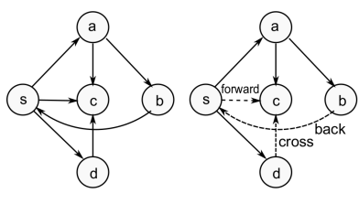
DFS: Kinds of edges
DFS introduces an important distinction among edges in the original graph:
Tree edge: encounter new (white) vertex
Back edge: from descendent to ancestor
Forward edge: from ancestor to descendent, but not a tree edge.
Cross edge: between a tree or subtrees
Note: tree & back edges are important; most algorithms don’t distinguish forward & cross
Theorem:
In DFS of an undirected graph, we get only tree and back edges. No forward or cross edges.

Slide 66
References
Introduction to Algorithms, Second Edition by Thomas H. Cormen, Charles E. Leiserson, Ronald L. Rivest and Clifford Stein, The MIT Press © 2001
Chapter 22.1, 22.2, 22.3

