Slide 1
Cs 316: Algorithms Lecture 8: Minimum Spanning Tree (MST)
Prepared by: Assoc. Prof. Ensaf Hussein
Presented by:
Assoc. Prof. Wessam El-Behaidy
Dr. Mohammed El-Said

Slide 2
Problem: Laying Telephone Wire
Central office

Slide 3
Wiring: Naïve Approach
Central office
Expensive!

Slide 4
Wiring: Better Approach
Central office
Minimize the total length of wire connecting the customers

Slide 5
Problem
8
7
b
c
d
4
9
2
a
i
14
e
11
4
8
7
6
10
h
g
f
1
2
A town has a set of houses and a set of roads
A road connects 2 and only 2 houses
A road connecting houses u and v has a repair cost w(u, v)

Slide 6
Problem
8
7
b
c
d
4
9
2
a
i
14
e
11
4
8
7
6
10
h
g
f
1
2
Goal: Repair enough (and no more) roads such that:
Everyone stays connected
i.e., can reach every house from all other houses
2. Total repair cost is minimum

Slide 7
Minimum Spanning Trees
A connected, undirected graph:
Vertices = houses, Edges = roads
A weight w(u, v) on each edge (u, v) ∈ E
b
8
c
7
d
b
8
c
7
d
4
9
4
9
2
2
a
11
i
4
14
e
a
11
i
4
14
e
7
6
7
6
8
10
8
10
h
g
f
g
g
f
1
2
1
2
Find T ⊆ E such that:
T connects all vertices
w(T) = Σ_{(u,v)∈T} w(u, v) is minimized

Slide 8
Minimum Spanning Trees
Spanning Tree
A tree (i.e., connected, acyclic graph) which contains all the vertices of the graph
Minimum Spanning Tree
Spanning tree with the minimum sum of weights
Spanning forest
If a graph is not connected, then there is a spanning tree for each connected component of the graph
b
8
c
7
d
4
9
2
a
11
i
4
14
e
8
7
6
10
g
g
f
1
2

Slide 9
Minimum spanning tree (MST)
Let’s think about simple MSTs on this graph:
a
1
b
5
2
4
c
d
3

Slide 10
Minimum spanning tree (MST)
Black edges and nodes are in T
Is T a minimum cost spanning tree?
Not spanning ➔ d is not in T.
a
1
b
5
2
4
c
d
3

Slide 11
Minimum spanning tree (MST)
Black edges and nodes are in T
Is T a minimum cost spanning tree?
Not a tree ➔ has a cycle.
a
1
b
5
2
4
c
d
3

Slide 12
Minimum spanning tree (MST)
Black edges and nodes are in T
Is T a minimum cost spanning tree?
Not minimum cost ➔ can swap edges 4 and 2.
a
1
b
5
2
4
c
d
3

Slide 13
Minimum spanning tree (MST)
Which edges form a MST?
Minimum spanning tree is not unique
Number of edges in a MST: |V| - 1
a
1
b
a
1
b
3
3
4
2
4
2
c
d
c
d
3
3

Slide 14
Applications of MST
Any time you want to visit all vertices in a graph at minimum cost
In the design of electronic circuitry, it is often necessary to make a set of pins electrically equivalent by wiring them together
Find the least expensive way to connect a set of cities, terminals, computers, etc.
Provides a heuristic for traveling salesman problems. The optimum traveling salesman tour is at most twice the length of the minimum spanning tree (why??)

Slide 15
Growing a MST(Generic Algorithm)
GENERIC_MST(G, w)
1 A:={ } -- A is a subset of MST
2 while A does not form a spanning tree do
3 find an edge (u,v) that is safe for A
4 A:=A∪{(u,v)}
5 return A
Notes:
Safe= don’t perform a cycle, and minimum weight

Slide 16
How to find a safe edge
7
b
c
d
9
4
2
S↑
a
11
i
e
↑ S
4
7
6
8
10
V-S↓
h
g
f
↓ V-S
1
2
We need some definitions and a theorem:
A cut (S,V-S) of an undirected graph G=(V,E) is a partition of V.

Slide 17
How to find a safe edge
7
b
c
d
9
4
2
S↑
a
11
i
e
↑ S
4
7
6
8
10
V-S↓
h
g
f
↓ V-S
1
2
We need some definitions and a theorem:
An edge crosses the cut (S,V-S) if one of its endpoints is in S and the other is in V-S.
An edge is a light edge crossing a cut if its weight is the minimum of any edge crossing the cut.
The edge (d,c) is the light edge crossing the cut.
Notes:
This figure shows a cut (S,V-S) of the graph.

Slide 18
The algorithms of MST
Kruskal and Prim algorithms are elaborations of the generic algorithm.
Each of them uses a specific rule to determine a safe edge of GENERIC_MST.

Slide 19
Prim Algorithm
➔ starts with one node.
➔ one by one, adds a node
➔ each time selecting the node whose connecting edge is safe edge

Slide 20
Prim’s Algorithm
The edges in set A always form a single tree
Starts from an arbitrary “root”: V_{A} = {a}
At each step:
Find a light edge crossing (V_{A}, V - V_{A})
Add this edge to A
Repeat until the tree spans all vertices
b
8
c
7
d
4
9
2
a
11
i
4
14
e
8
7
6
10
h
g
f
1
2

Slide 21
How to Find Light Edges Quickly?
Use a priority queue Q contains vertices not yet included in the tree, i.e., (V – VA)
EX: V_{A} = {a, b}, Q = {c, d, e, f, g, h, i}
We associate a key with each vertex v:
key[v] = minimum weight of any edge (u, v) connecting v to V_{A}
8
7
b
c
d
4
9
2
a
i
4
14
e
11
7
6
8
10
Key[h]=min(8, 11)
h
g
f
1
2

Slide 22
How to Find Light Edges Quickly?
Initially ➔ Key of v is ∞ if v is not adjacent to any vertices in V_{A}
After adding a new node to V_{A} ➔ We update the weights of all the nodes adjacent to it
EX: after adding a to the tree, k[b]=4 and k[h]=8
8
7
b
c
d
4
9
2
a
i
4
14
e
11
7
6
8
10
h
g
f
1
2

Slide 23
Example
∞
∞
∞
b
8
c
7
d
0 ∞ ∞ ∞ ∞ ∞ ∞ ∞ ∞ ∞
Q = {a, b, c, d, e, f, g, h, i}
V_{A} = ∅
Extract-MIN(Q) ⇒ a
4
9
∞
2
∞
a
11
i
4
14
e
8
7
6
10
h
g
f
1
2
∞
∞
∞
4
key [b] = 4 π [b] = a
key [h] = 8 π [h] = a
4 ∞ ∞ ∞ ∞ ∞ 8 ∞
Q = {b, c, d, e, f, g, h, i} V_{A} = {a}
π = {a, #, #, #, #,#, a,#}
Extract-MIN(Q) ⇒ b
∞
∞
∞
b
8
c
7
d
4
9
∞
2
∞
a
11
i
4
14
e
8
7
6
10
h
g
f
1
2
∞
∞
∞
8

Slide 24
Example
8
key [c] = 8 π [c] = b
key [h] = 8 π [h] = a ➔ unchanged
8 ∞ ∞ ∞ ∞ 8 ∞
Q = {c, d, e, f, g, h, i} V_{A} = {a, b}
π = {b, #, #, #,#, a,#}
Extract-MIN(Q) ⇒ c
4
∞
∞
b
8
c
7
d
4
9
∞
2
∞
a
11
i
4
14
e
8
7
6
10
h
g
f
1
2
∞
8
∞
8
7
4
∞
8
7
key [d] = 7 π [d] = c
key [f] = 4 π [f] = c
key [i] = 2 π [i] = c
7 ∞ 4 ∞ 8 2
Q = {d, e, f, g, h, i} V_{A} = {a, b, c}
π = { c, #, c ,#, a, c}
Extract-MIN(Q) ⇒ i
b
c
d
4
2
9
∞
2
∞
a
11
i
4
14
e
8
7
6
10
h
g
f
1
2
8
∞
∞
4

Slide 25
Example
key [h] = 7 π [h] = i
key [g] = 6 π [g] = i
7 ∞ 4 6 8
Q = {d, e, f, g, h} V_{A} = {a, b, c, i}
π = { c, #, c ,i, i}
Extract-MIN(Q) ⇒ f
4
8
7
b
8
c
7
d
4
9
2
2
∞
a
11
i
4
14
e
8
7
6
10
h
g
f
1
2
8
∞
4
7
6
key [g] = 2 π [g] = f
key [d] = 7 π [d] = c unchanged
key [e] = 10 π [e] = f
7 10 2 8
Q = {d, e, g, h} V_{A} = {a, b, c, i, f}
π = { c, f ,f, i}
Extract-MIN(Q) ⇒ g
4
8
7
b
8
c
7
d
4
9
10
2
2
∞
a
11
i
4
14
e
8
7
6
10
h
g
f
1
2
7
6
4
2

Slide 26
Example
4
8
7
key [h] = 1 π [h] = g
7 10 1
Q = {d, e, h} V_{A} = {a, b, c, i, f, g}
π = { c, f ,g}
Extract-MIN(Q) ⇒ h
b
8
c
7
d
4
9
10
2
2
a
11
i
4
14
e
8
7
6
10
h
g
f
1
2
7
2
4
1
4
8
7
7 10
Q = {d, e} V_{A} = {a, b, c, i, f, g, h}
π = { c, f}
Extract-MIN(Q) ⇒ d
b
8
c
7
d
4
9
10
2
2
a
11
i
4
14
e
8
7
6
10
h
g
f
1
2
1
2
4

Slide 27
Example
b
8
c
7
d
4
9
2
a
11
i
4
14
e
8
7
6
10
4
8
7
h
g
f
1
2
b
8
c
7
d
4
9
9
2
2
10
key [e] = 9 π [e] = d
9
Q = {e} V_{A} = {a, b, c, i, f, g, h, d}
π = { d}
Extract-MIN(Q) ⇒ e
Q = ∅ V_{A} = {a, b, c, i, f, g, h, d, e}
a
11
i
4
14
e
8
7
6
10
h
g
f
1
2
1
2
4

Slide 28
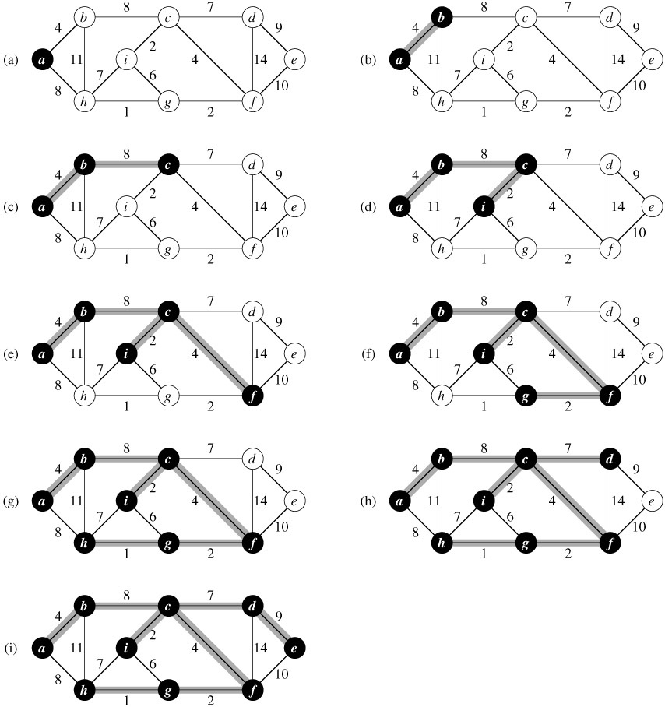

Slide 29
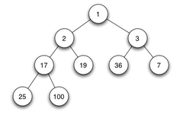
PRIM(V, E, w, r)
For the graph
Preferred to be implemented as a binary heap
Q ← ∅
for each u ∈ V
do key[u] ← ∞
π[u] ← NIL
INSERT(Q, u)
key[r] ← 0 ► DECREASE-KEY(Q, r, 0)
while Q ≠ ∅
do u ← EXTRACT-MIN(Q)
for each v ∈ Adj[u]
do if v ∈ Q and w(u, v)<key[v]
then π[v] ← u
DECREASE-KEY(Q, v, w(u, v))
A binary heap is a complete binary tree which satisfies the heap ordering property.
The min-heap property: the value of each node is greater than or equal to the value of its parent. Root node hold the smallest key element.
A heap with N nodes always has O(log N) height.
In Q change the key of r to be 0

Slide 30
Running Time Analysis
Depending on the heap implementation, running time is :
 | Extract_Min | Decrease_Key
Binary heap | O(lg V) | O(lg V)

Slide 31
PRIM(V, E, w, r)
Q ← ∅
for each u ∈ V
do key[u] ← ∞
π[u] ← NIL
INSERT(Q, u)
key[r] ← 0 ► DECREASE-KEY(Q, r, 0)
while Q ≠ ∅
do u ← EXTRACT-MIN(Q)
for each v ∈ Adj[u]
do if v ∈ Q and w(u, v)<key[v]
then π[v] ← u
DECREASE-KEY(Q, v, w(u, v))
Total time: O(VlgV + ElgV) = O(ElgV)
O(V) if Q is implemented as a min-heap
O(lgV)
Min-heap operations:
O(VlgV)
Executed |V| times
Takes O(lgV)
Executed O(E) times total
Constant
O(ElgV)
Takes O(lgV)

Slide 32
Prim’s Algorithm
Prim’s algorithm is a “greedy” algorithm
Greedy algorithms find solutions based on a sequence of choices which are “locally” optimal at each step.
Nevertheless, Prim’s greedy strategy produces a globally optimum solution!

Slide 33
Kruskal’s Algorithm
Creates a forest of trees. Initially the forest consists of n single node trees (and no edges).
At each step, we add one safe edge (the cheapest one) so that it joins two trees together.

Slide 34
Kruskal’s Algorithm
How is it different from Prim’s algorithm?
Prim’s algorithm grows one
tree all the time
Kruskal’s algorithm grows
multiple trees (i.e., a forest)
at the same time.
Trees are merged together
using safe edges
Since an MST has exactly |V| - 1
edges, after |V| - 1 merges,
we would have only one component
tree1
u
v
tree2

Slide 35
Example
Initially we have 9 set of vertices:
{a}, {b}, {c}, {d}, {e}, {f}, {g}, {h}, {i}
Edges arranged in decreasing order according to their weights:
1: (h, g) 2: (c, i), (g, f)
4: (a, b), (c, f) 6: (i, g)
7: (c, d), (i, h) 8: (a, h), (b, c)
9: (d, e) 10: (e, f)
11: (b, h) 14: (d, f)
b
8
c
7
d
4
9
2
a
11
i
4
14
e
7
6
8
10
h
g
f
1
2
1: (h, g)
2: (c, i), (g, f)
4: (a, b), (c, f)
6: (i, g)
7: (c, d), (i, h)
8: (a, h), (b, c)
9: (d, e)
10: (e, f)
11: (b, h)
14: (d, f)
{a}, {b}, {c}, {d}, {e}, {f}, {g}, {h}, {i}

Slide 36
Example
Add (h, g)
Add (c, i)
Add (g, f)
Add (a, b)
Add (c, f)
Ignore (i, g)
Add (c, d)
Ignore (i, h)
Add (a, h)
Ignore (b, c)
Add (d, e)
Ignore (e, f)
Ignore (b, h)
Ignore (d, f)
b
8
c
7
d
4
9
2
a
11
i
4
14
e
7
6
8
10
h
g
f
1
2
1: (h, g)
2: (c, i), (g, f)
4: (a, b), (c, f)
6: (i, g)
7: (c, d), (i, h)
8: (a, h), (b, c)
9: (d, e)
10: (e, f)
11: (b, h)
14: (d, f)
{a}, {b}, {c}, {d}, {e}, {f}, {g}, {h}, {i}
{a}, {b}, {c}, {d}, {e}, {f}, {g, h}, {i}
{a}, {b}, {c, i}, {d}, {e}, {f, g, h}
{a, b}, {c, i, f, g, h, d}, {e}
{a, b, c, i, f, g, h, d, e}
{a, b}, {c, i, f, g, h}, {d}, {e}
{a, b, c, i, f, g, h, d}, {e}

Slide 37
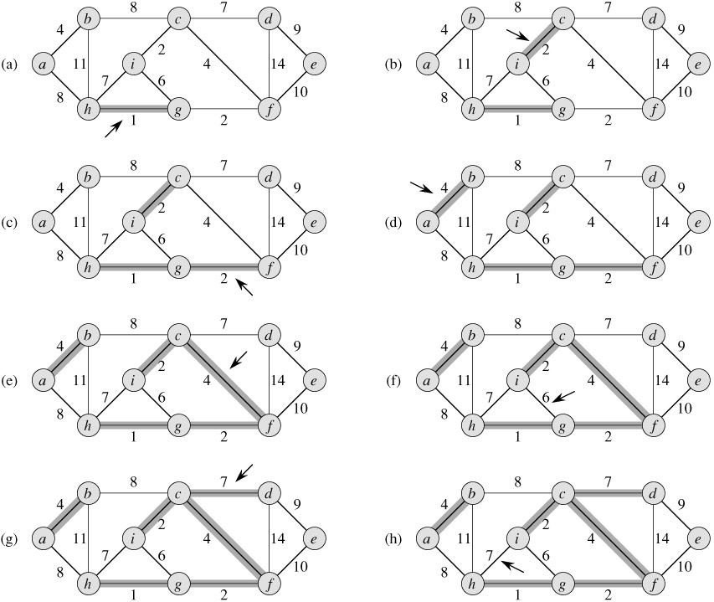

Slide 38
Implementation of Kruskal’s Algorithm
Uses a disjoint-set data structure to determine whether an edge connects vertices in different components.
Disjoint-set: is a data structure that tracks a set of elements partitioned into a number of disjoint (non-overlapping) subsets.
A disjoint-set forest consists of a number of elements each of which stores a parent pointer.

Slide 39
Implementation of Kruskal’s Algorithm
If an element's parent pointer points to no other element, then the element is the root of a tree and is the representative member of its set.
Each element in the set that has a particular property representative member.

Slide 40
Operations on Disjoint Data Sets
MAKE-SET(u) – creates a new set whose only member is u
FIND-SET(u) – returns a representative element from the set that contains u
E.g.: S_{u} = {r, s, t, u}
FIND-SET(u) = r FIND-SET(s) = r
FIND-SET has to return the same value for the elements of the same set

Slide 41
Operations on Disjoint Data Sets
UNION(u, v) – unites the dynamic sets that contain u and v, say S_{u} and S_{v}
E.g.: S_{u} = {r, s, t, u}, S_{v} = {v, x, y}
UNION (u, v) = {r, s, t, u, v, x, y}
Running time for FIND-SET and UNION depends on implementation. Can be O(lg n).

Slide 42
KRUSKAL(V, E, w)
A ← ∅
for each vertex v ∈ V
do MAKE-SET(v)
sort E into non-decreasing order by w
for each (u, v) taken from the sorted list
do if FIND-SET(u) ≠ FIND-SET(v)
then A ← A ∪ {(u, v)}
UNION(u, v)
return A
Notes:
FIND-SET(u) ≠ FIND-SET(v) ➔ to not perform a cycle

Slide 43
KRUSKAL(V, E, w)
A ← ∅
for each vertex v ∈ V
do MAKE-SET(v)
sort E into non-decreasing order by w
for each (u, v) taken from the sorted list
do if FIND-SET(u) ≠ FIND-SET(v)
then A ← A ∪ {(u, v)}
UNION(u, v)
return A
Running time: O(V+ElgE+ElgV)
O(V)
O(ElgE)
O(E)
O(ElgV)
O(lgV)

Slide 44
Running Time
Running time: O(V+ElgE+ElgV)
Since E= O(V²),
we have lgE=O(2lgV)=O(lgV)
The total time for Kruskal's algorithm is O(E lg V), which is asymptotically the same as of Prim's algorithm.

Slide 45
Kruskal’s Algorithm
Kruskal’s algorithm is a “greedy” algorithm
Kruskal’s greedy strategy produces a globally optimum solution
S
x
u
y
v
V - S

Slide 46
References
Introduction to Algorithms, Second Edition by Thomas H. Cormen, Charles E. Leiserson, Ronald L. Rivest and Clifford Stein, The MIT Press © 2001
Chapter 23.2

