Slide 1

SOCIAL MEDIA app
NETWORK PRESENTATION

Slide 2

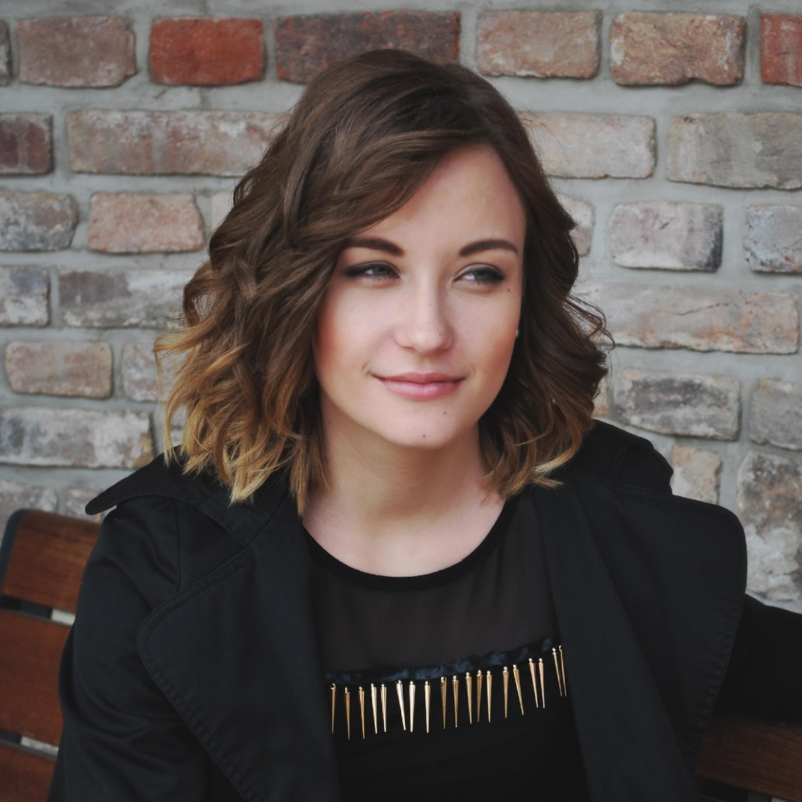
Bonjour!
Je suis ahmed aoulad amar
You can contact me at @Ahmed.dev on shareme

Slide 3

so way
en quoi est-il différent des autres ???

Slide 4
donc SHAREME a été trouvé pour résoudre trois problèmes de base
A: Le contenu n'est jamais supprimé
B :Copyright
C : DESTRUCTION

Slide 5
NOWADYS
SOCIAL MEDIA NETWORKS
…
Facebook
Twitter

Slide 6
VA ÊTRE PRIVÉ
Headquarters

Slide 7
5,000,000,000
USE MEDIA

Slide 8
MODIFICATIONS QUE NOUS VOULONS AJOUTER DANS LE FUTUR
STARSE
COMMANTS
NOTIFACATIONS
Itself is what the end-user derives value from also can refer to the information
Itself is what the end-user derives value from also can refer to the information
Itself is what the end-user derives value from also can refer to the information
PRIVET CHAT
COUINTROL
SUPORT
Itself is what the end-user derives value from also can refer to the information
Itself is what the end-user derives value from also can refer to the information
Itself is what the end-user derives value from also can refer to the information

Slide 9
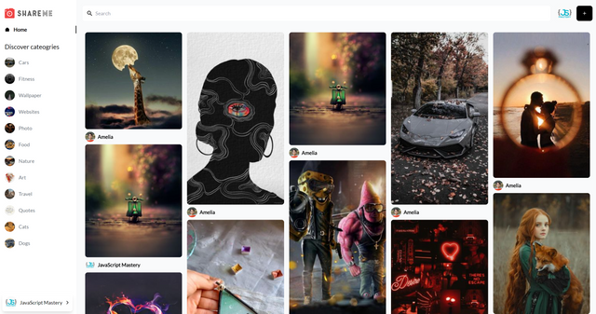
WEBET IU
Itself is what the end-user derives value from also can refer to the information

Slide 10
REACT
SANTY( EXPERSS , NODEJS, MONGODB)

