Slide 1
Healthcare Provider Fraud Detection
Machine Learning Project
By: Ahmed Hisham 13007014
Course: Machine Learning

Slide 2
Why Fraud Detection?
• Healthcare fraud costs billions yearly.
• Fraudulent providers inflate claims and bill unnecessary services.
• Goal: Identify suspicious (“PotentialFraud”) providers.
• Dataset: CMS Fraud Detection Challenge

Slide 3
Datasets Used
      Rows inpatient: 40,474
      Rows outpatient: 517,737
      Beneficiaries: 138,556
We used 4 datasets:
• Beneficiary information
• Inpatient claims
• Outpatient claims
• Provider fraud labels
Key facts:
• Total providers: 5,410
• Fraudulent: 506
• Non-fraudulent: 4,904
• Highly imbalanced dataset

Slide 4
Feature Engineering
Aggregated features per provider:
• LOS (mean, max, min)
• Inpatient reimbursement totals
• Outpatient reimbursement totals
• Inpatient claim count
• Outpatient claim count
Final dataset: 9 numerical features + label

Slide 5
Models Trained
Two models:
• Logistic Regression (baseline)
• Random Forest (best)
Why Random Forest?
• Works well with imbalanced datasets
• Captures non-linear fraud patterns

Slide 6
Model Metrics — Random Forest
Accuracy: 94%
Precision (Fraud): 68%
Recall (Fraud): 67%
F1 Score: 68%
Interpretation: Detects ~2/3 fraudulent providers.

Slide 7
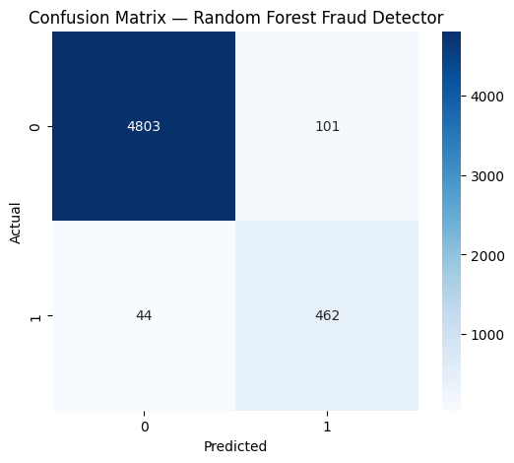
Confusion Matrix

Slide 8
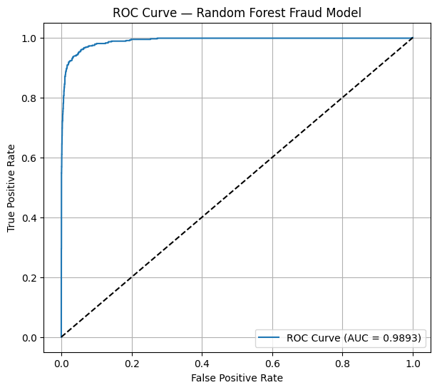
ROC Curve & AUC
Shows excellent class separation.

Slide 9
Key Fraud Indicators
Top predictors:
• INP_LOS_max
• Total inpatient reimbursement
• Outpatient claim count
• Outpatient reimbursement totals

Slide 10
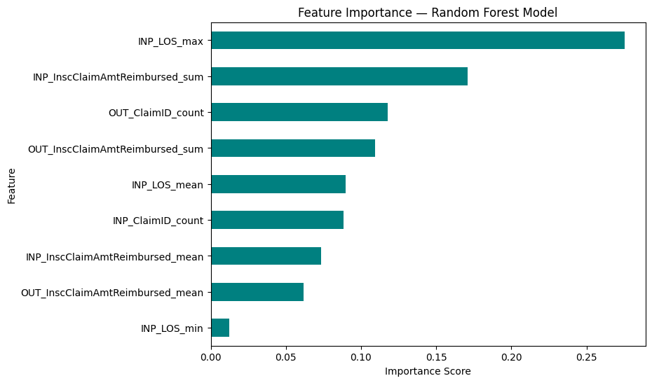

Slide 11
Conclusion & Future Work
Model has strong predictive ability.
Identifies most fraudulent providers.
Supports healthcare auditing.
Future improvements:
• XGBoost / LightGBM
• SMOTE balancing
• Diagnosis code embeddings
• Real-time API deployment

