Slide 1
Optimizing Convolutional Neural Networks: A Comparative Study of Scheduling Algorithms And Regularization Techniques

Slide 2
Introduction
Convolutional Neural Networks (CNNs) have transformed the field of deep learning, especially in tasks like image and video recognition [1]. Despite their success, optimizing CNNs remains a complex challenge due to various factors influencing their performance and generalization. This project seeks to investigate how different scheduling algorithms and regularization methods can address these issues.

Slide 3
Aim of the study
The main goal is to improve CNN performance while minimizing overfitting by conducting a comparative analysis of diverse optimization techniques. The study aims to offer valuable insights into practical strategies for enhancing the effectiveness of CNNs in real-world applications.

Slide 4
Problem formulation
Let L(λ) be the loss function of a CNN, where λ represents the model parameters. The optimization problem can be formulated as:
Min L(λ)
s.t. regularization constraints,
where regularization techniques such as dropout and weight decay can be included in the optimization framework.

Slide 5
Methodology
evaluate the performance of different optimization techniques.
Simulations will be conducted using standard datasets (e.g., CIFAR-10, MNIST).
metrics recorded for analysis are: 1. accuracy
2. validation loss.
Key aspects include: 1. Scheduling Algorithms: Implementation of learning rate schedulers.
2. Regularization Techniques: Comparison of dropout and batch normalization.

Slide 6
implementation
We have implemented a model 3 times to train the CIFAR10 dataset, each time with an enhanced version of the model.
Model 1's architecture included three convolutional blocks with LeakyReLU activation, BatchNormalization, MaxPooling2D, and Dropout layers, followed by a classification head.
Model 2 introduced modifications such as reduced kernel regularization (l2 to 1e-4), adjusted Dropout rates, and a one-cycle learning rate scheduler.
Model 3 further enhanced the architecture by increasing the number of filters, adding a fourth convolutional block, using a cosine annealing learning rate scheduler, and employing data augmentation through ImageDataGenerator.

Slide 7
Results for CIFAr10 dataset:

Slide 8
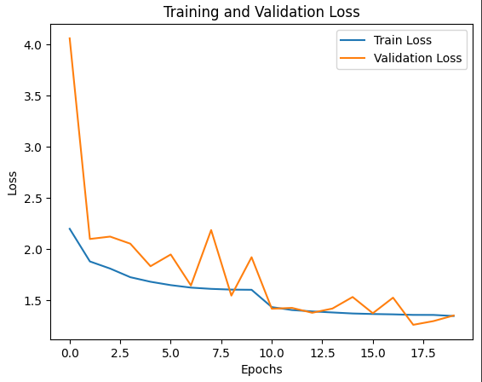
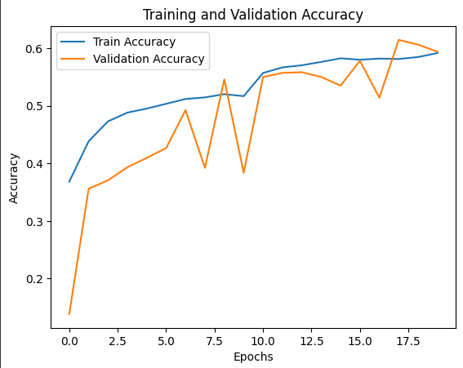
Result(Model1)
This model achieved a training and validation accuracy of 59.67%.

Slide 9
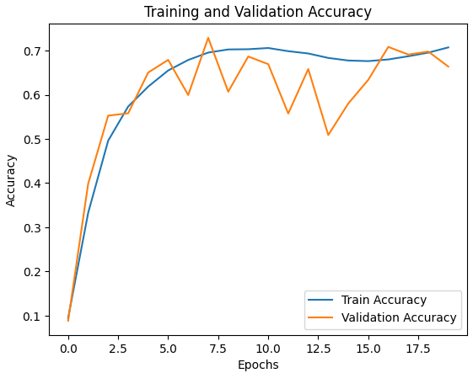
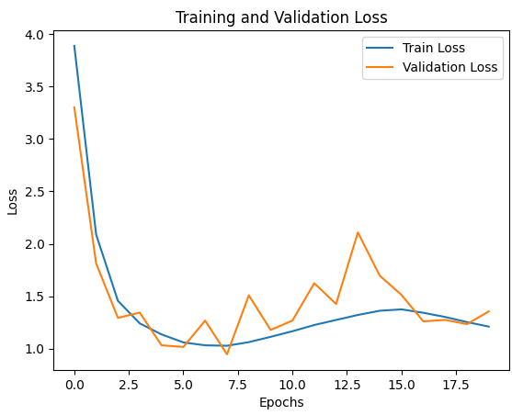
Result(model2)
These changes improved the training accuracy to 70% and validation accuracy to 66%, showing better performance and reduced overfitting compared to Model 1

Slide 10
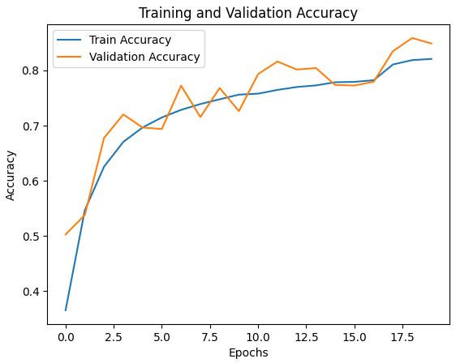
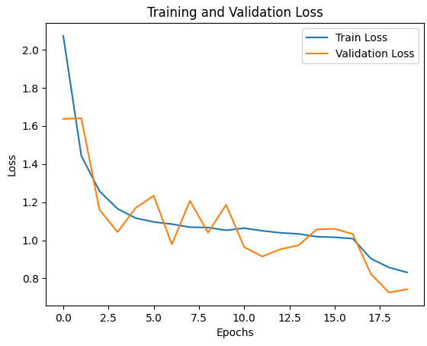
Result(model3)
These enhancements resulted in a significant improvement, with training accuracy at 82% and validation accuracy at 84%. This model demonstrated the best performance, effectively reducing overfitting and achieving higher accuracy

Slide 11
Implementing the model on Mnist dataset:

Slide 12
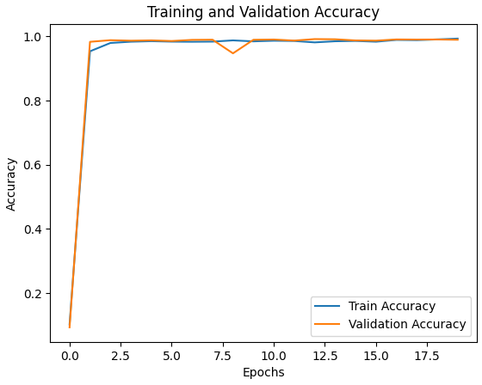
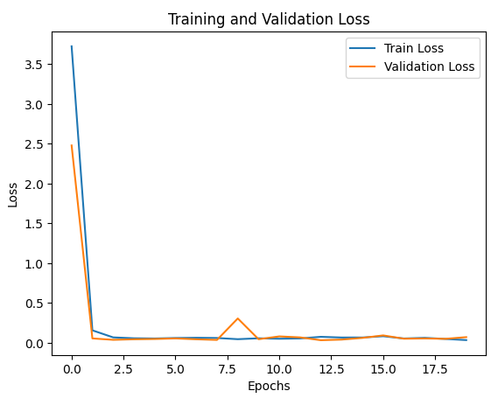
Results
The model achieves both training and test accuracy at 99%, with the learning rate gets adapted with each epoch.

