Slide 1


Spyware-Detector
Faculty of Computers and Information,
Fayoum University,
Major of: Computer Science

Slide 2
Team Members
Mahmoud Soliman Ahmed
AbdulRahman Mahmoud Ahmed
Ahmed Nasser Abdeltawab
Ahmed Medhat Saad
Ahmed Moamer Mohammed
Ahmed Nasser Nabil
Supervisors
Dr. Ahmed Sadek

Slide 3
Agenda
01. Introduction
02. Problem Definition
Why exactly this project?
The problem that we developed this project to solve.
03. Our Objectives
04. Motivation
05. Related Works
06. System Actors
What are we looking forward to solving this problem.
What inspires us to develop this project?
Past works, and what is the difference between them and us.
Who will use our app?

Slide 4
Agenda
07. System Functions
08. SW/HW Tools
Function and Non-Function Requirements.
Software and hardware tools used to develop this project.
09. Expected outcome?
10. System Analysis
11. Time Plan
12. References
Mobile, web or desktop application?
10.1 user Requirement.
10.2 System Requirement.
Gantt chart

Slide 5
01. Introduction
Intelligent spyware detector capable of scanning files and classifying them as spyware or not

Slide 6
02. The Problem Definition
Malwares is rapidly becoming a major security issue, specifically spywares.
what is your feeling if you wake up with a warning message that tell you all your credit-cards, banking accounts, email passwords had been stolen !!?
Most of the Current anti-spyware tools operate in a way similar to traditional antivirus tools, where signatures associated with known spy-ware programs are checked against newly-installed applications. Unfortunately, these techniques are very easy to evade by using simple obfuscation transformations.

Slide 7
03. Our Objectives
Extract features from the file [APIs, URLs, IPs, …].
Construct well-balanced dataset from these features of spyware and good-wares.
Train machine learning model on our dataset

Slide 8
04. Motivation
Spywares are rapidly becoming a major security issue.
Apply our study of security and Machine Learning to solve real problems like this.
Providing an open source project that can be updated later by others.

Slide 9
05. Related Works
result
PE Header
URL&IP
Good-wares
Preprocessing
Data
Dataset
Model
ML Algorithms
Strings
Spywares
entropy & APIs
Features extraction
Features extraction
program
Notes:
i am here

Slide 10
05. Related Works
While searching, we find most of the free dataset has a lack of features representation that causes low accuracy to the ML Model, and the paid dataset was very expensive.
SO, we decided to build our dataset by themselves with more features and choose the suitable ML algorithm to it.
Notes:
i am here

Slide 11
06. System actors
Anyone wants to ensure that a program is a spyware or Not.

Slide 12
07. Functional and Non-Functional requirements
Functional requirements
Non-Functional requirements
Upload a file from the user
Take a link of the file.
Return a file is a spyware or not with percentage.
The site should only scan on file in every attempt.

Slide 13
08. Software / Hardware Tools
Software Tools
Hardware Tools
VMware Workstation
Anaconda environment
Python libraries
NumPy
pandas
matplotlib
sklearn
pefile
supports 64-bit host operating systems.

Slide 14
09. Expected Outcome
Web Application.

Slide 15
10. System Analysis (User Requirements)
Upload the untrusted file on the website.

Slide 16
10. System Analysis (System Requirements)
Get the uploaded File from the user
Extracting features from the file [APIs, URLs, IPs, …]
Pass These features to ML Model
Return the result to the user

Slide 17
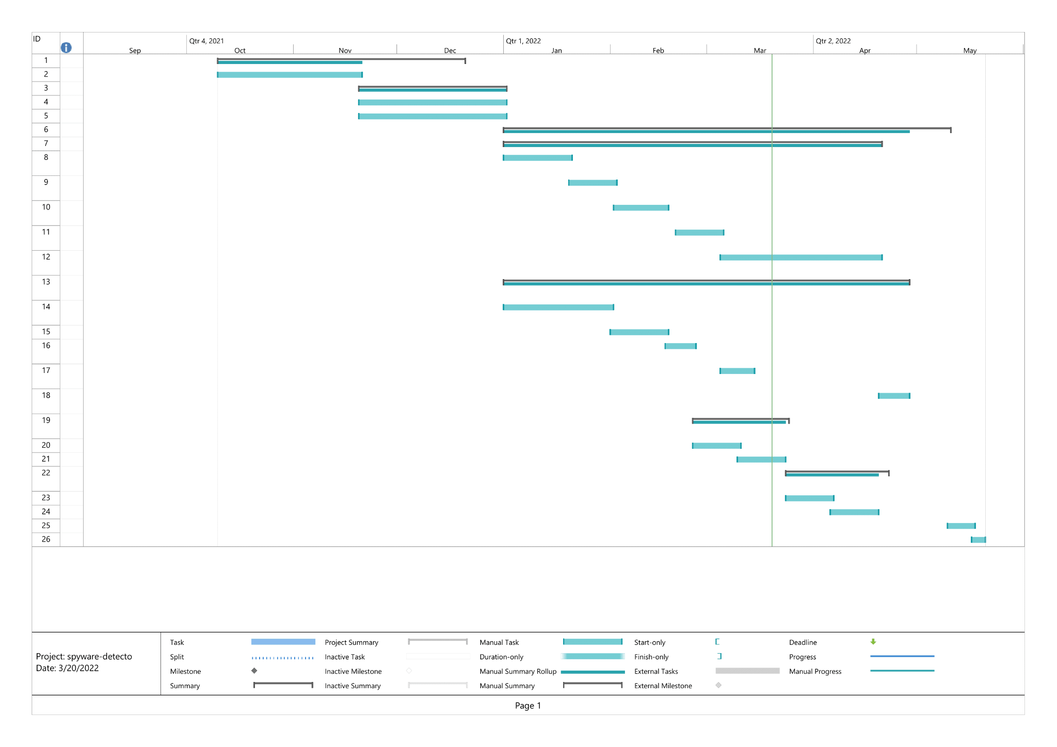
11. Time Plan

Slide 18
12. References
https://youtube.com/playlist?list=PL6-3IRz2XF5UM-FWfQeF1_YhMMa12Eg3s
https://docs.microsoft.com/learn/paths/create-machine-learn-models/
https://www.udacity.com/course/intro-to-machine-learning--ud120
https://classroom.udacity.com/courses/ud977
https://www.youtube.com/playlist?list=PL74sw1ohGx7FE-DI18bOfi2X61zRE-wMd
https://maharatech.gov.eg/enrol/index.php?id=1404
https://reverseengineering.stackexchange.com/questions/25466/best-way-to-find-the-entropy-of-an-exe-file
https://github.com/arielf/scripts/blob/master/byte-entropy
Malware Data Science: Attack Detection and Attribution By Joshua Saxe, Hillary Sanders,
Practical Malware Analysis: The Hands-On Guide to Dissecting Malicious Software by Andrew Honig and Michael Sikorski.

Slide 19
Timeline

